Slide 1
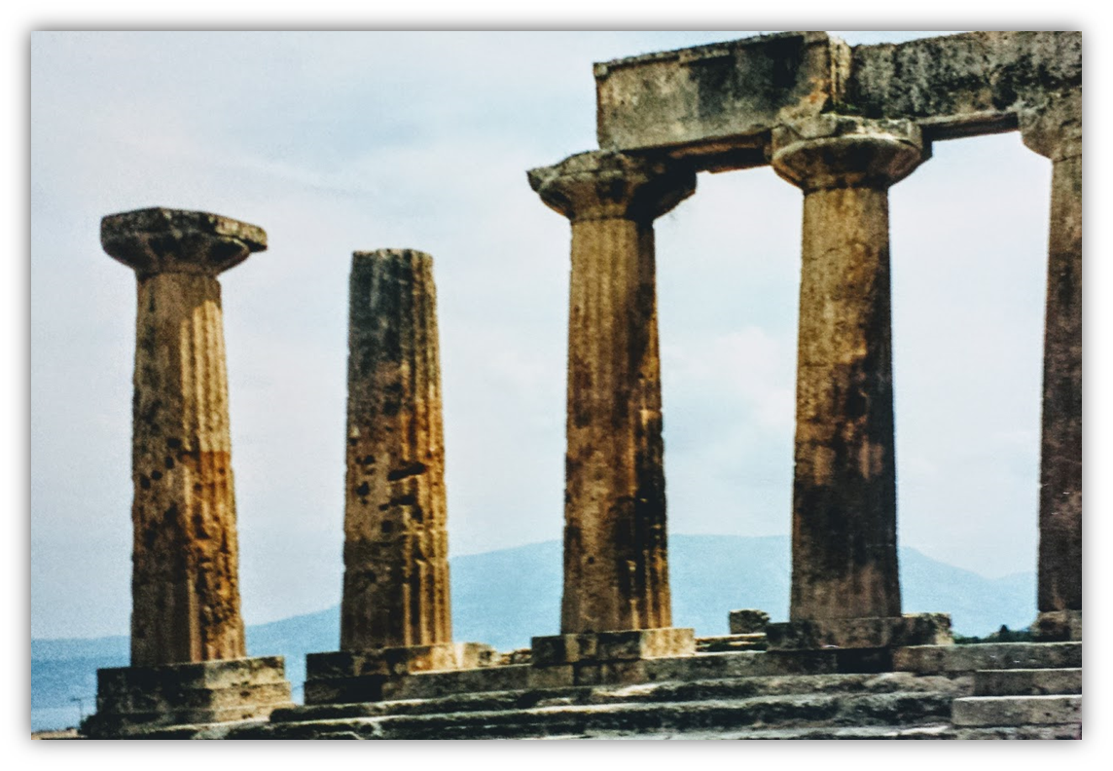
The Epistle of Second Corinthians

Slide 2
Outline of 2nd Corinthians
Explanation of Paul’s Apostolic Ministry (1:1—6:10)
Greetings from “an apostle…by the will of God” (1:1-2)
Past events in Paul’s ministry
Trouble in Asia, but comfort from God (1:3-11)
Plans for visiting Corinth (1:12-24)
Writing out of love produces sorrow, yields forgiveness (2:1-11)
Nature of the word Paul ministered
Dual aroma of the gospel (2:12-17)
The word is ministered thru the Corinthians’ changed lives (3:1-5)
A ministry of the Spirit (3:6-18)
God’s treasure in earthen vessels (4:1-7)
Motivation for ministering
An eternal perspective (4:8-18)
A future expectation (5:1-11)
The love of Christ (5:12-16)
Reconciling men to God (5:17-21)
Proof that Paul is a minister of God (6:1-10)

Slide 3
Outline of 2nd Corinthians
Exhortations to the Corinthians (6:11—9:15)
Concerning fellowshipping darkness
The Corinthians must open their hearts and separate from the world (6:11—7:3)
Comfort and confidence in the Corinthians’ obedience (7:4-16)
Concerning the collection for the saints. The Corinthians are to do the following:
Follow the examples of Christ and the Macedonian churches (8:1-9)
Complete what had been planned and purposed (8:10-15)
Prove themselves (8:16—9:5)
Sow that they might reap, in order to have more to sow (9:6-15)

Slide 4
Outline of 2nd Corinthians
Exoneration of Paul’s Apostleship (10:1—13:10)
Paul’s ministry cannot be measured “according to the flesh” (10:1-18)
Paul must boast:
His selflessness excludes others from being regarded as apostles (11:1-15)
His willingness to suffer (11:16-33)
His exaltation due to his revelations is tempered by infirmity (12:1-10)
His miracles (12:11-13)
He spent and was spent so as not to burden the Corinthians (12:14-18)
His desire for their edification (12:19—13:10)
Conclusion (13:11-14)

Slide 5
Exoneration of Paul’s Apostleship: Admonitions to Repent Before His Visit (2 Corinthians 13:1-14)
Paul’s visit will be characterized by justice and discipline (13:1-2)
This will be Paul’s third visit.
The sins and shortcomings that remain among the Corinthians will be established by two or three witnesses (Deut. 19:15; Matthew 18:16)
Paul repeats that his intention is to discipline those who need it (2 Cor. 10:6, 10-11; 1 Cor. 4:18, 21)
The power of Christ which worked in the Corinthians, and by which He was raised from the dead, will empower Paul’s actions toward the Corinthians (13:3-4; Ephesians 1:19-20)
Notes:
Deuteronomy 19:15 "One witness shall not rise against a man concerning any iniquity or any sin that he commits; by the mouth of two or three witnesses the matter shall be established.
Matthew 18:16 But if he will not hear, take with you one or two more, that 'BY THE MOUTH OF TWO OR THREE WITNESSES EVERY WORD MAY BE ESTABLISHED.’
1 Corinthians 4:18 Now some are puffed up, as though I were not coming to you.
1 Corinthians 4:21 What do you want? Shall I come to you with a rod, or in love and a spirit of gentleness?
Ephesians 1:19-20 and what is the exceeding greatness of His power toward us who believe, according to the working of His mighty power 20 which He worked in Christ when He raised Him from the dead and seated Him at His right hand in the heavenly places,

Slide 6
Exoneration of Paul’s Apostleship: Admonitions to Repent Before His Visit (2 Corinthians 13:1-14)
Paul encourages self-examination (13:5-6)
The Corinthians needed to fully vet themselves. They must test the quality of their “metal” to see if Jesus is truly in them! (Ezekiel 22:18)
Paul’s expectation is that when they test Paul they will clearly see that he passes the test!
Notes:
Prove or “test” is from δοκιμάζω to test, examine, prove, scrutinise (to see whether a thing is genuine or not), as metals
Reprobates or “disqualified” is from ἀδόκιμος 1) not standing the test, not approved 1a) properly used of metals and coins
Ezekiel 22:18 "Son of man, the house of Israel has become dross to Me; they are all bronze, tin, iron, and lead, in the midst of a furnace; they have become dross from silver.

Slide 7
Exoneration of Paul’s Apostleship: Admonitions to Repent Before His Visit (2 Corinthians 13:1-14)
Paul prays that the Corinthians would do right! (13:7-9)
His motive was not his own vindication – he would rather that the Corinthians were honorable even if it seemed that Paul did not pass the test (cf. Romans 9:3)
All of Paul’s motives and actions were “for the truth.”
Paul is glad to be weak through suffering and sacrifice if it results in the Corinthians being strong (Philippians 2:16-18)
He prays that the Corinthians may be complete.
His sharp tone is meant to preclude an unpleasant visit and enable him to use his authority for edification (13:10; 10:2, 8)
Notes:
Romans 9:3 For I could wish that I myself were accursed from Christ for my brethren, my countrymen according to the flesh,
Philippians 2:16-18 holding fast the word of life, so that I may rejoice in the day of Christ that I have not run in vain or labored in vain. 17 Yes, and if I am being poured out as a drink offering on the sacrifice and service of your faith, I am glad and rejoice with you all. 18 For the same reason you also be glad and rejoice with me.

Slide 8
Exoneration of Paul’s Apostleship: Admonitions to Repent Before His Visit (2 Corinthians 13:1-14)
Final exhortations (13:11-12)
Farewell
Become complete (7:1; 13:9)
Be of good comfort (1:3-4; 2:7)
Be of one mind, live in peace; and the God of love and peace will be with you (1 Corinthians 1:10)
Greet one another with a holy kiss*
Greetings & grace (13:13-14)
All the saints greet you.
The grace of the Lord Jesus Christ, and the love of God, and the communion of the Holy Spirit be with you all. Amen.
Notes:
1 Corinthians 1:10 Now I plead with you, brethren, by the name of our Lord Jesus Christ, that you all speak the same thing, and that there be no divisions among you, but that you be perfectly joined together in the same mind and in the same judgment.
Rom_16:16 Greet one another with a holy kiss. The churches of Christ greet you.
1Co_16:20 All the brethren greet you. Greet one another with a holy kiss.
1Th_5:26 Greet all the brethren with a holy kiss.
1 Peter 5:14 Greet one another with a kiss of love. Peace to you all who are in Christ Jesus. Amen.

Slide 9
2 Corinthians REVIEW
What truths have we learned about the character and ministry of the apostle Paul from chapters 1-6.
In chapters 7-9, Paul exhorted the Corinthians to holiness and charity. How does the condition of the heart relate to those qualities?
In chapters 10-13, what facts does Paul present to prove himself a genuine apostle, in contrast to those who were false apostles?

Slide 10
Lesson Schedule for our study of Second Corinthians Eastside Auditorium Winter Quarter 2017-18

