Slide 1
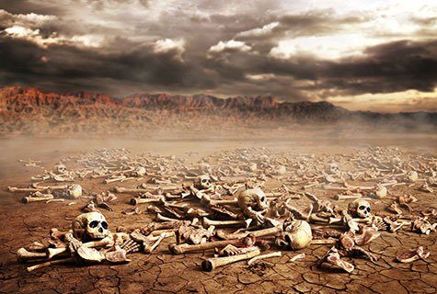
Ezekiel
“Ye Shall Know That I Am The Lord”

Slide 2

Ezekiel
Lesson 1: The Prophet of the Lord’s Glory
Ezekiel the man
His name means “God strengthens” (Ezek. 2:3-5; 3:7-11)
He was born in 622 B.C. during the reign of Josiah and grew up in Judah
He would have witnessed the first Jewish captives being taken off to Babylon in 605 B.C. by Nebuchadnezzar (Daniel 1:1-4)
He was 25 years old when he was taken into captivity (Ezek. 1:1-2)
  This was 597 B.C. when Jehoiachin and 10,000 Jews were taken captive (2 Kings 24:10-16)
Five years later (592 B.C.) he was called to be a prophet and continued in that role until at least 570 B.C. (29:17)

Slide 3
Ezekiel
Lesson 1: The Prophet of the Lord’s Glory
Ezekiel the man
Jerusalem fell 6 years after he began his work (586 B.C.)
  Afterwards, Ezekiel’s prophecies focused on assurance and hope for Israel’s future.
Ezekiel was a married man (24:15-18)
Ezekiel was a contemporary of both Jeremiah and Daniel.
  Jeremiah was 20+ years older than both Ezekiel and Daniel. He prophesied in Jerusalem from 626 to 586 B.C.
  Daniel was in the first group of captives taken to Babylon where he lived and prophesied from 605 to 536 B.C.
  Ezekiel dwelt in Tel-Abib (Hill of Corn Ears) near the river Chebar.

Slide 4
Ezekiel
Lesson 1: The Prophet of the Lord’s Glory
Background of Ezekiel (2 Kings 21-25; 2 Chronicles 33-36)
The Past:
  Israel had fallen to Samaria in 721 B.C.
  Judah survived because of the righteous direction of Hezekiah (Isaiah 37)
  Kings Manasseh and Amon promoted idolatry (697-640 B.C.)
  Josiah reigned from 640-608 B.C. and brought about great religious reforms, but the hearts of the people were unchanged (Jeremiah 3:6-10)
  Almost immediately upon Josiah’s death, the people returned to idolatry under the reigns of Jehoahaz and Jehoiakim (608-597 B.C.)

Slide 5
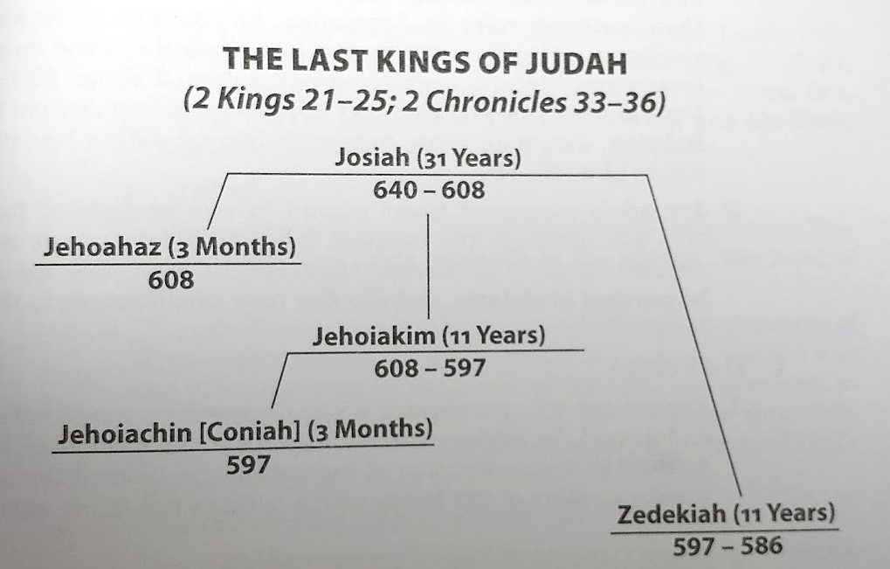
Ezekiel
Lesson 1: The Prophet of the Lord’s Glory

Slide 6
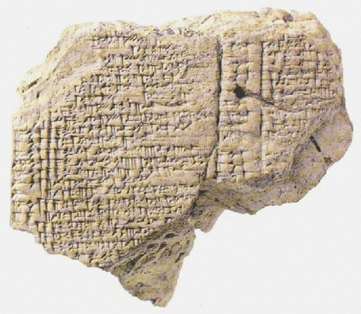
Ezekiel
Lesson 1: The Prophet of the Lord’s Glory
Background of Ezekiel (2 Kings 21-25; 2 Chronicles 33-36)
The Present:
  God raises up Nebuchadnezzar, King of Babylon, to punish His people for their disobedience (Jeremiah 25:8-11)
    Nebuchadnezzar besieges Jerusalem and takes captives in 605 B.C. including Daniel.
    In 597 B.C. Nebuchadnezzar removes Jehoiachin as King of Judah after a 3 month reign. He takes 10,000 captives to Jerusalem, including Jehoiachin and Ezekiel. He installs Zedekiah as king.
    He returns in 586 B.C. and destroys Jerusalem (2 Kings 25:1-10)
Ration tablet from Babylon which records the rations distributed to Jehoiachin (cf. 2 Kings 24:27-29)

Slide 7
Ezekiel
Lesson 1: The Prophet of the Lord’s Glory
Background of Ezekiel (2 Kings 21-25; 2 Chronicles 33-36)
The Future:
  Ezekiel not only prophesied of the doom of Judah and Jerusalem, but also of its future restoration. Although Judah would be dead for 70 years, the Lord was able to bring her back to life, like resurrecting a valley filled with dry bones. (Ezekiel 37)

Slide 8
Ezekiel
Lesson 1: The Prophet of the Lord’s Glory
Key Expressions in Ezekiel
“The word of the Lord came unto me saying…” is found 49 times. “Thus says the Lord” is found 64 times. These are God’s words! (2 Peter 1:20-21)
“Son of man” occurs 93 times in reference to Ezekiel. It suggests a contrast between God’s divinity and the mere humanity of Ezekiel to whom God was revealing His will.
“You shall know that I am the Lord” is used 63 times.
  When Judah and Jerusalem are destroyed and the people taken.
  When judgments come upon Gentile nations.
  When the remnant of Judah is restored.

Slide 9
Ezekiel
Lesson 1: The Prophet of the Lord’s Glory
Overview of Ezekiel’s Message
Jerusalem must fall (Chapters 1-24)
Gentile nations will fall also (Chapters 25-32)
There is hope for Judah’s future! The nation will be restored, and the seed of Abraham will approach God again in the temple. (Chapters 33-48)

