Slide 1
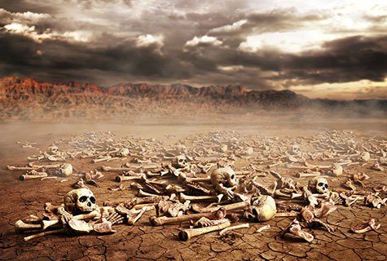
Ezekiel
“Ye Shall Know That I Am The Lord”

Slide 2
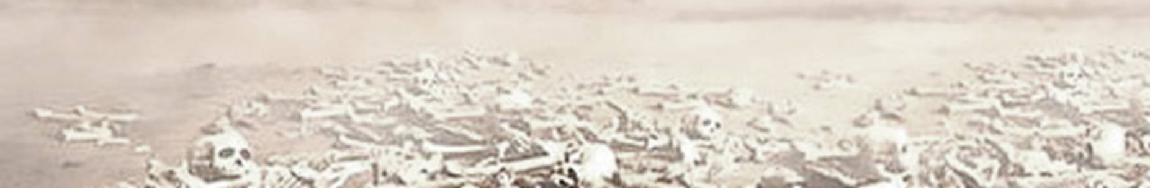
Ezekiel
Lessons 11 – Ezekiel 20-22
Israel’s History of Rebellion (Ezekiel 20:1-29)
Resistance to God in Egypt (20:1-9)
Resistance to God in the wilderness (20:10-26)
Resistance to God in Canaan (20:27-29)
God would deal severely with Israel in the present, yet still restore her in the future (20:30-44)
The Lord repeatedly spared Israel for His name’s sake among the Gentiles (20:9, 14, 22, 44)

Slide 3
Ezekiel
Lessons 11 – Ezekiel 20-22
The Sword of Judgment & Retribution (Ezekiel 21)
The Lord draws His sword to destroy Jerusalem (20:1-7)
  Ezekiel’s emotions are to convey the terrible news (21:6-7)
The polished sword is put in the hand of the “slayer” (Nebuchadnezzar) to slaughter Israel’s princes (21:8-18)
Nebuchadnezzar would destroy both Jerusalem and Ammon (21:19-32)

Slide 4
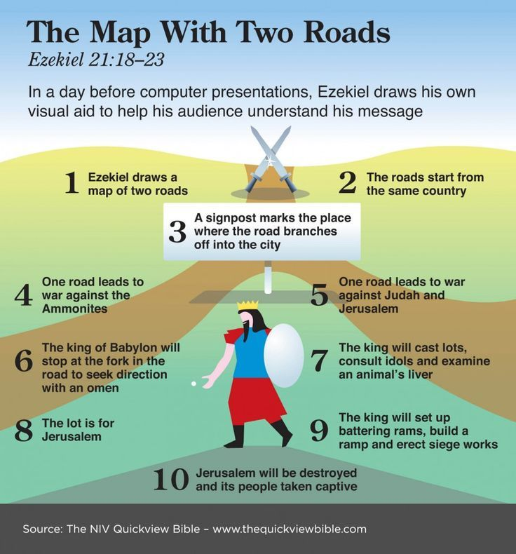

Slide 5
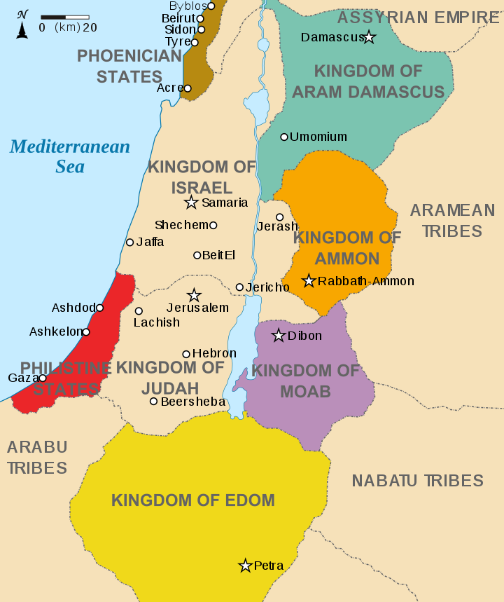

Slide 6
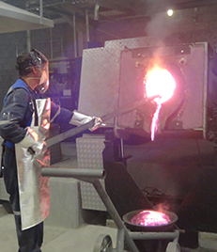
Ezekiel
Lessons 11 – Ezekiel 20-22
The Sins of Jerusalem and Israel (Ezekiel 22)
Israel is judged for shedding blood and committing vile sins (22:1-16)
Israel’s impurities will be purged in fire (22:17-22)
Corrupt spiritual & political leaders had filled the nation with iniquity – NO ONE would stand up for right to defend the land (22:23-31)

