Slide 1
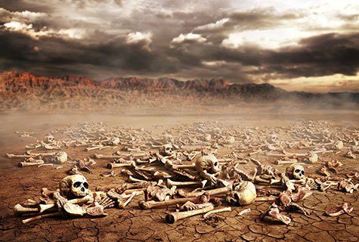
Ezekiel
“Ye Shall Know That I Am The Lord”
Lesson 8: Chapters 12, 13, 14

Slide 2
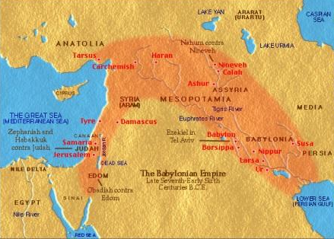

Jeremiah – Daniel – Ezekiel: Timeline (B.C.)
640
627
605
593
586
571
536
Jeremiah
Daniel
Ezekiel 592-570 BC
586 B.C.; Judah falls, Jerusalem destroyed

Slide 3

Ezekiel
Review: Chapters 1-9
Summary: Chapters 1 - 11
Chapter 1: Vision of the Glory of the Lord
Chapters 2-3: Call of Ezekiel to the office of Prophet, to be a Watchman
Chapters 4-5: Four Symbolic actions Portraying the Fall of Jerusalem
Chapters 6-7: Devastation and Desolation of the land; a remnant will be spared
Chapters 8-11: The Glory of the Lord Departs from the Temple because of Judah’s wickedness

Slide 4
Ezekiel
Lesson 8: Ezekiel 12-14
Chapters 12-14: Various Prophecies Depicting the Certainty of Judah’s Destruction
Chapter 12: Ezekiel Acts as an exile, shows it will come with terror, and will happen soon.
Chapter 13: False Prophets, Prophetesses condemned.
Chapter 14: People have idols in their hearts; The presence of Righteous people will not make God spare the nation/land.

Slide 5
Ezekiel
Lesson 8: Ezekiel 12
The Certainty of Destruction:
  Ezekiel Acts out being Exiled (12:1-16)
    Vs. 1-2: The people have eyes and ears but refuse to see, hear. (cf. Matt. 13:13-15)
    Vs. 3-4: With the people watching, God tells Ezekiel to pack his belongings for captivity in the daytime, and depart in the evening.
    Vs. 5-6: “Dig through the wall, take your things out through it, and put them on your shoulder. Cover your face” so that you can’t see the land.
    Vs. 7: Ezekiel did as he was told.
Note the number of times God calls the people “Rebellious” in Chapter 12

Slide 6
Ezekiel
Lesson 8: Ezekiel 12
The Certainty of Destruction:
  Ezekiel Acts out being Exiled (12:1-16)
    Vs. 8-9: God: Did the people ask “what are you doing?”
    Vs. 10-11: This prophecy concerned the Prince and people in Jerusalem. Ezekiel demonstrated what was going to be done to them. They will go into exile.
    Vs. 12: “The prophecy shows how the prince, King Zedekiah would flee. This was fulfilled. Jer. 39: 4, 2 Kings 25:4.

Slide 7
Ezekiel
Lesson 8: Ezekiel 12
The Certainty of Destruction:
  Ezekiel Acts out being Exiled (12:1-16)
    Vs. 13-14: God will send the Prince (Zedekiah) to Babylon, but he won’t see it, though he would die there. This was fulfilled when Zedekiah was captured, brought to Babylon, blinded and remained there until his death. Jer. 52:1-11. His army would be scattered and attacked.
    Vs. 15-16: A few people would be spared in order to declare to other nations that their sins were the cause.
Ezekiel’s prophecy can be reliably dated to around 592 BC, five to six years before Jerusalem fell and Zedekiah was captured in 586 BC. Skeptics who deny the possibility of prophecy have no choice but claim Ezekiel was written later and that he wrote history. The Jewish historian Josephus records that Zedekiah was aware of Ezekiel’s prophecy.

Slide 8
Ezekiel
Lesson 8: Ezekiel 12
The Certainty of Destruction:
  Ezekiel Eats & Drinks with quaking, trembling (12:17-20)
    This demonstrated how the inhabitants of Jerusalem would eat in anxiety, and drink with dismay.
    The land would be stripped, laid waste, on account of the violence its inhabitants.
Violence was noted in Chapter 8 among the reasons God was provoked to anger. It is cited again in Chapter 12:19. It was one of the reasons God destroyed the world with a flood (6:11). What does God think of the violence in our nation today? (murder, gun violence, rioting, abortion)

Slide 9
Ezekiel
Lesson 8: Ezekiel 12
The Certainty of Destruction:
  Though it might seem otherwise, God’s judgments would soon come (12:21-28)
    Vs. 21-25: The people mocked prophecy with a proverb: The days grow long, and every vision comes to nothing. God was going to put an end to that proverb. The days are near when the visions would be fulfilled. There would not be any false visions any more. God’s words will be performed.
    Vs. 26-28: They had also said that the visions would be fulfilled much later. God made it clear this was not the case.

Slide 10
Ezekiel
Lesson 8: Ezekiel 13
Condemnation of False Prophets and Prophetesses:
  God was against the false Prophets who falsely claimed to speak for Him (13:1-16)
    Vs. 1-7: Ezekiel told to prophesy against the false prophets. They had not built up a wall for Israel (symbolic for protection brought about from speaking truthful prophecies). God hadn’t sent them, yet they expected Him to fulfill their prophecies.
    Vs. 8-16: The false prophets would not come into the council of God’s people. Their names would be omitted from the register of the house of Israel. They would not return to the land. They had built a wall of weak mortar (or whitewash, symbolic of false prophecies) that claimed peace. That wall would fail due to the storms God would bring.

Slide 11
Ezekiel
Lesson 8: Ezekiel 13
Condemnation of False Prophets and Prophetesses:
  God was against the false prophetesses (13:17-23)
    Vs. 17-19: The false prophetesses sewed magic bands for their arms and made veils in the hunt souls. This is thought to have been associated with sorcery. They had profaned God by causing innocent people to die in exchange for small amounts of food, while protecting the guilty.
    Vs. 20-23: God would tear off their bands and veils, and free those who had been victimized. They had encouraged the wicked in his evil ways. God would deliver His people out of the control of these wicked women.
How do these passages help us to understand what God thinks of false teachers and others who by way of error and worldly influences, lead people astray in our day?

Slide 12
Ezekiel
Lesson 8: Ezekiel 14
Idols in their Hearts Made them Estranged from God:
  Some had feigned loyalty to God by consulting Him, yet they had idols in their hearts (14:1-11)
    Vs. 1-5: When certain elders of the people came to Ezekiel, God asked why He should allow them to consult Him, when they had idols in their hearts. God would answer them.
    Vs. 6-8: Repent and turn away from idols, abominations! Otherwise, God would provide a direct answer to the man that didn’t. God would set His face against him.
    Vs. 9-11: If the prophet allows himself to be deceived, the Lord will give him over to it, and God will destroy him. The false prophet and the one who inquires of a false prophet shall be equally punished.

Slide 13
Ezekiel
Lesson 8: Ezekiel 14
Idols in their Hearts Made them Estranged from God:
  The presence of some righteous people won’t spare them from Judgment (14:12-23)
    Vs. 15-20: When a land sins against God, and it reaches a point that God determines to desolate it by famine, wild beasts, sword, or pestilence, even if men like Noah, Job and Daniel were there, it wouldn’t cause it to be spared.
Chapter 14 mentions Daniel. Because of the amazing accuracy of Daniel’s prophecies (esp. those concerning the Seleucid and Ptolemaic empires in Daniel 11), skeptics (who do not believe in prophecy or divine inspiration) assert a much later date for Daniel. They claim that a fictitious author (or authors), who had a knowledge of history, wrote the book in the 2nd century BC. But this mention in Ezekiel means that Daniel was known to Jews in the 6th Century BC, substantiating the divine inspiration of his writings. Remnants of the book of Daniel were also found among the Dead Sea Scrolls, which date to nearly the time in which skeptics claim it was written.

Slide 14
Ezekiel
Lesson 8: Ezekiel 14
Idols in their Hearts Made them Estranged from God:
  The presence of some righteous people won’t spare them from Judgment (14:12-23)
    Vs. 21-23: God mentions the four acts of judgment previously mentioned. But some survivors would be left and brought as exiles to Babylon. Then those already in exile will realized God was justified in handing out this punishment.
What are our idols today? Colossians 3:5 equates Covetousness is idolatry. What do we covet? What is really more important to us that God? Do we, like the people mentioned in Ezekiel 14 pretend as though we are serving God, when other things are really more important to us?

Slide 15
. . .

