Slide 1
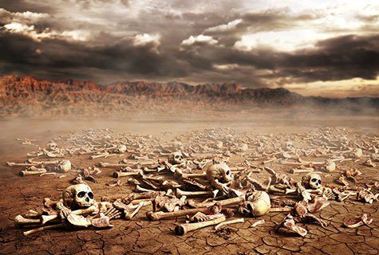
Ezekiel
“Ye Shall Know That I Am The Lord”

Slide 2

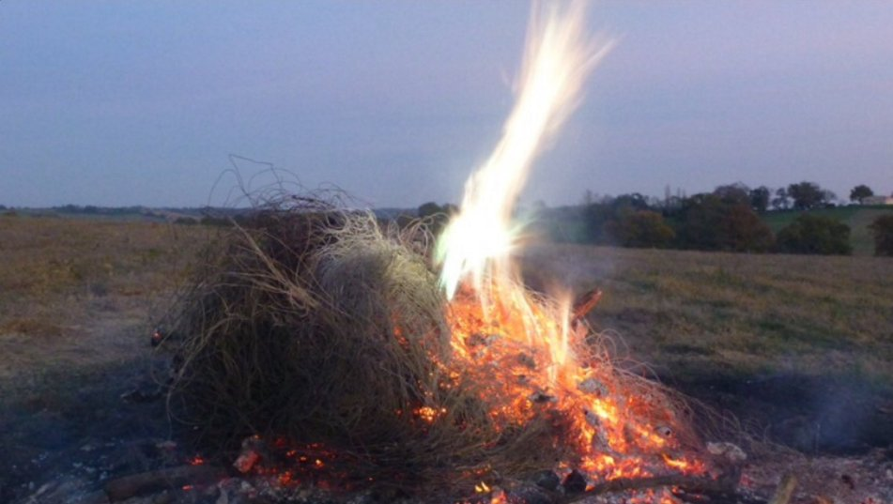
Ezekiel
Lessons 9 – Ezekiel 15-16
Israel is like a useless vine burned in the fire (Ezekiel 15)
The fruitless vine of the forest is useless; it is fit only to be burned (15:1-5)
Even so, the inhabitants of Jerusalem would surely be destroyed for their unfaithfulness (15:6-10)

Slide 3
Ezekiel
Lessons 9 – Ezekiel 15-16
Israel is like an unfaithful wife (Ezekiel 16)
Like an unwanted child of idolatrous nations, Israel was initially filthy, outcast, and destitute (16:1-5)
God’s compassion nourished her and enabled her to become His beautiful bride (16:6-14)
Yet Israel played the harlot; she used her blessings to commit idolatrous acts, including the sacrificing of her children (16:15-21)
She did not remember what God had done for her (16:22)
She committed harlotry with the nations beyond the borders of Canaan (16:23-30)

Slide 4
Ezekiel
Lessons 9 – Ezekiel 15-16
Israel is like an unfaithful wife (Chapter 16)
Like an unfaithful wife, Israel scorned payment for her harlotry (16:31-34)
Jerusalem (Judah) would be given over to the very nations with whom she consorted for punishment and destruction (16:35-43)
  Her punishment would correspond with her sin.
  “I will recompense your deeds on your own head.”
Jerusalem was even worse than her idolatrous sisters, Samaria and Sodom (16:44-58)
Yet the Lord would provide atonement for Israel and establish an everlasting covenant (16:59-63)

