Slide 1
…

Slide 2


Paul’s Epistles To The Churches & Saints In
4
Galatia
Philippi
Ephesus
Colossae

Slide 3
Paul’s Epistle To The Galatians
Lesson 1 – General Introduction
Freedom is man’s most yearned-for instinct (inalienable right)
Men have endured & suffered much to gain it…both collectively and individually
Our culture even has “symbols” attesting to the value of freedom

Slide 4
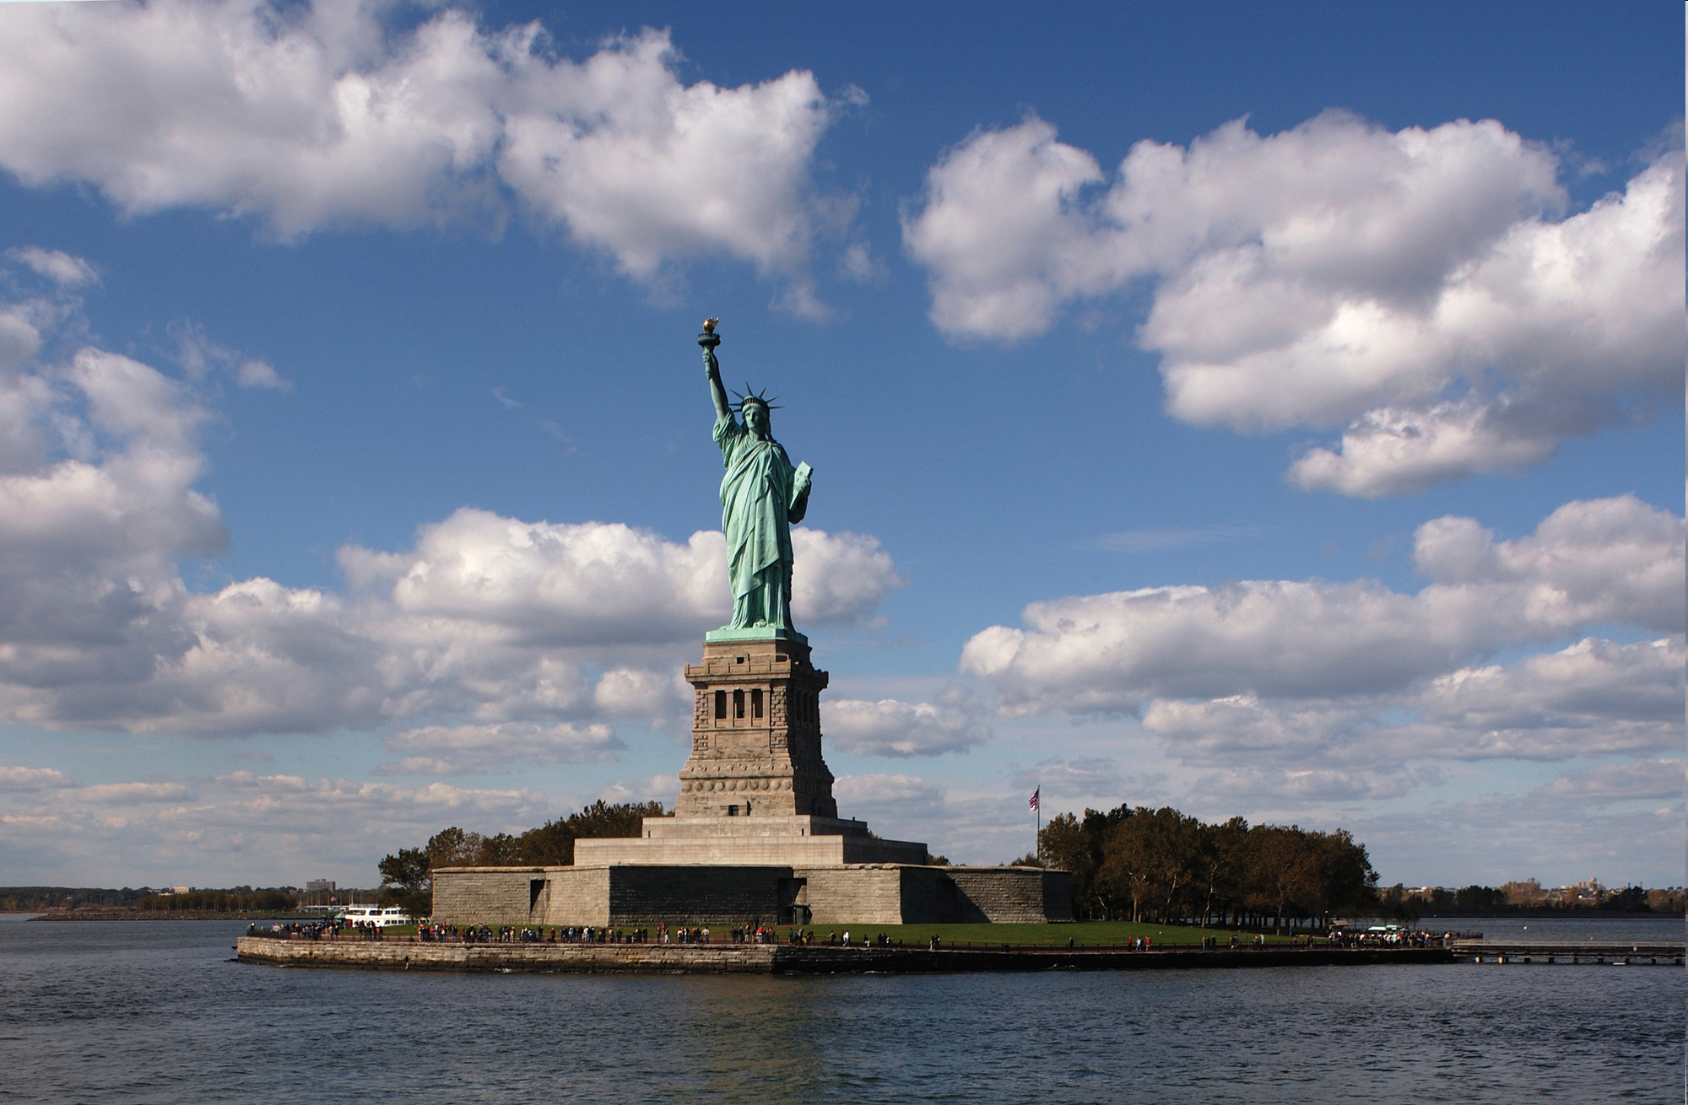
Famous quote on a plaque inside the statue…
Give me your tired, your poor, Your huddled masses yearning to breathe free, The wretched refuse of your teeming shore. Send these, the homeless, tempest-tossed to me, I lift my lamp beside the golden door!

Slide 5
Paul’s Epistle To The Galatians
Lesson 1 – General Introduction
Just as the Statue Of Liberty welcomes all who want to live free in America, the greatest freedom also calls all men with its “beacon”
The gospel (i.e. Divine truth) calls all to be free from sin and to be free in Christ
This is Paul’s theme as he writes to the Christians living and worshiping in Galatia

Slide 6
Paul’s Epistle To The Galatians
Lesson 1 – General Introduction
First century Galatia = modern-day Turkey
A Roman province in Asia Minor
Name derived from the Gauls (ancestors of the French)
Contained territories of Phrygia, Pisidia, and Lycaonia…cities of Antioch Pisidia, Lystra, Derbe, and Iconium Acts 13-18

Slide 7
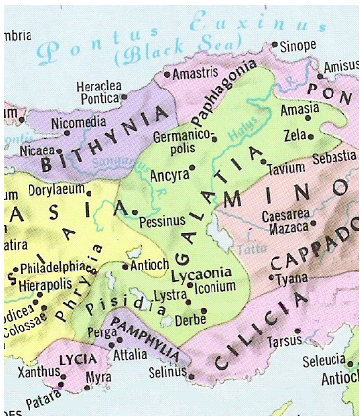

Slide 9
Paul’s Epistle To The Galatians
Lesson 1 – General Introduction
Along with Barnabas, Paul’s initial labors were in Galatia (1st Missionary Journey Acts 13-14)
False Judaizing teachers opposed Paul, wanting to enslave Galatian Gentiles to a perverted version of the Mosaic Law Gal 2:4
This harmonizes with the story in Acts 15

Slide 10
Paul’s Epistle To The Galatians
Lesson 1 – General Introduction
Paul taught FREEDOM FOR ALL (Gentile & Jew)
GENTILES
They had been freed from the vices & immoralities of paganism
Yet, they were not “free” to live without any moral restraint 5:13, 16

Slide 11
Paul’s Epistle To The Galatians
Lesson 1 – General Introduction
Paul taught FREEDOM FOR ALL (Gentile & Jew)
JEWS
They had been freed from the bondage of a law that could not save 3:2, 5, 10-14
They were exhorted to not be enslaved again with a yoke of bondage 5:1

Slide 12
Paul’s Epistle To The Galatians
Lesson 1 – General Introduction
Reason For Writing
Somehow Paul learned of the apostasy of the Galatian Christians 1:6
Notice how he begins…NO thankfulness Rom 1:8 1 Cor 1:4 Eph 1:16 Phil 1:3 Col 1:3 1 Thess 1:2 2 Thess 1:3
Also, Paul doesn’t address the false teachers…he had no sympathy for them 5:12
Paul wrote to exhort the saints to reject the error of the Judaizers and to embrace truth 3:1-3 5:2-4

Slide 13
Paul’s Epistle To The Galatians
Lesson 1 – General Introduction
Time & Place Of Writing
Of all his 13 epistles, Paul’s letter to Galatia is the most obscure – no specific information re: these details
After “Jerusalem Conference” 2:1-10
Before 3rd journey collection for saints
Basically, there are 2 scenarios:
Paul saw the Galatians’ apostasy…wrote later
Paul was informed re: the Galatians’ apostasy and sent a letter sometime later

Slide 14
Paul’s Epistle To The Galatians
Lesson 1 – General Introduction
Time & Place Of Writing
Paul saw the Galatians’ apostasy…wrote later
Paul witnessed it himself while passing through Galatia (starting point for each of his missionary journeys)
Later, he sent this letter outlining his concerns
Plausible…how likely? Acts 17:16-17

Slide 15
Paul’s Epistle To The Galatians
Lesson 1 – General Introduction
Time & Place Of Writing
Paul was informed re: the Galatians’ apostasy
For this to be correct, someone would have had to know where to find Paul
This view also necessitates (somewhat) knowing when & from where he wrote

Slide 16
Paul’s Epistle To The Galatians
Lesson 1 – General Introduction
Time & Place Of Writing
Paul was informed re: the Galatians’ apostasy
This epistle was written after Acts 15…proven by Gal 2
There were no 1st journey epistles Acts 13-14
The only 2nd journey letters were the two to Thessalonica…written from Corinth Acts 18:11
Thus, Galatians = a 3rd journey letter

Slide 17
Paul’s Epistle To The Galatians
Lesson 1 – General Introduction
Time & Place Of Writing
Paul was informed re: the Galatians’ apostasy
How would someone know where to find Paul?
Re: finding Paul, the only information we have is his 2nd journey promise to return to Ephesus…fulfilled on the 3rd journey Acts 18:19-21
In Ephesus for 3 years Acts 19:10 20:31
Length of stay gave ample opportunity for a report to come to him & for him to write

Slide 18
Paul’s Epistle To The Galatians
Lesson 1 – General Introduction
Time & Place Of Writing
Of all his 13 epistles, Paul’s letter to Galatia is the most obscure – no specific information re: these details
After “Jerusalem Conference” 2:1-10
Before 3rd journey collection for saints
Basically, there are 2 scenarios:
Paul saw the Galatians’ apostasy…wrote later
Paul was informed re: Galatians’ apostasy and sent a letter later
7
4

Slide 19
Paul’s Epistle To The Galatians
Lesson 1 – General Introduction
Outline Of The Letter (3 main divisions…2 chapters each)
Salutation & Opening Concern Gal 1:1-5
Paul defends his apostleship Gal 1:6 – 2:21
Spiritual blessings based on God’s promises, not works of law Gal 3:1 – 4:31
How one lives if he is “free in Christ” Gal 5:1 – 6:18
APPLICATION SECTION

Slide 20
Paul’s Epistle To The Galatians
Lesson 1 – General Introduction
Additional Information Re: Outlining Galatians
We must not forget it is a letter…it has a “flow of thought” that must be seen, appreciated
If we wrote someone a letter or e-mail, we would write in the same way…especially if we were addressing some serious concerns
Paul sets forth 3 main “propositions” (affirmations/statements demanding proof)

Slide 21
Paul’s Epistle To The Galatians
Lesson 1 – General Introduction
Additional Information Re: Outlining Galatians
PROPOSITION #1 Paul’s message came from God…it did not come from man 1:11-12
PROPOSITION #2 Justification comes on basis of faith, not law 2:16
PROPOSITION #3 If one claims to live in the Spirit, he must also walk by the Spirit 5:1, 16-18

Slide 22
…

