Slide 1
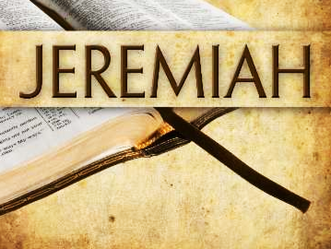
Judgment Upon Judah and the Nations
Jeremiah chapters 24-25

Slide 2

Judgment Upon Judah and the Nations (Jeremiah 24-25)
The events described in this chapter took place sometime after Jeconiah had been taken to Babylon by Nebuchadnezzar in 597 B.C. but before the destruction of the city of Jerusalem and the capture of Zedekiah in 586 B.C.
Jeremiah has a vision of two baskets of figs.
  One basket contained very good figs, and another basket had very bad figs that could not be eaten.
  Those who were taken into exile are considered the good figs, while those left behind are the bad figs. The good figs will eventually be brought back to the land (24:4-7).
  The bad figs, including Zedekiah will be swept forever from the land. (24:8-10) [Humphries, p. 37]

Slide 3
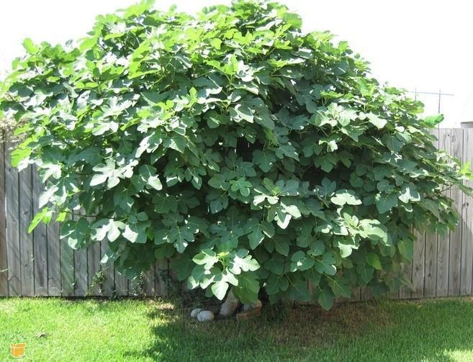
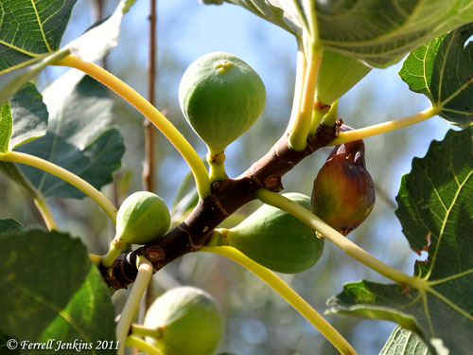
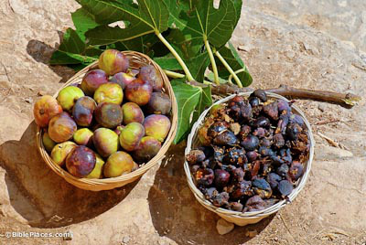
Fig Facts
Mentioned over fifty times in Scripture, the fig tree was extremely important for both nutritional and economic reasons in ancient times. When things were well in Israel and the people prosperous, the Bible describes “every man sitting under his own fig tree” (1 Kgs 4:25). The prophets on the other hand, when predicting judgment on Israel, speak of the fig trees being destroyed.
Figs, common in the Middle East today, were cultivated in Canaan before the Israelites entered the land. They were one of the seven species listed among the produce of the land God would give Israel (Deut 8:8). The spies brought back samples of this fruit before Israel entered the land (Num 13:23). Figs are both cultivated and grow wild in the region. (BiblePlaces.com)
Ripening figs at Shechem (above)
Bowls of good & bad figs (below)

Slide 4
Judgment Upon Judah and the Nations (Jeremiah 24-25)
How would captivity be good for the good figs? (24:5-7 30:11; 31:18-19; 46:28; cf. Ezekiel 11:14-21; Prov. 3:12)
  How could this knowledge help you when bad things are happening in your life and you feel that the Lord is allowing or causing these things to happen?
  Hebrews 12:6-11 “FOR WHOM THE LORD LOVES HE CHASTENS, AND SCOURGES EVERY SON WHOM HE RECEIVES.” 7 If you endure chastening, God deals with you as with sons…Now no chastening seems to be joyful for the present, but painful; nevertheless, afterward it yields the peaceable fruit of righteousness to those who have been trained by it.
Notes:
Proverbs 3:12 For whom the LORD loves He corrects, Just as a father the son in whom he delights.

Slide 5
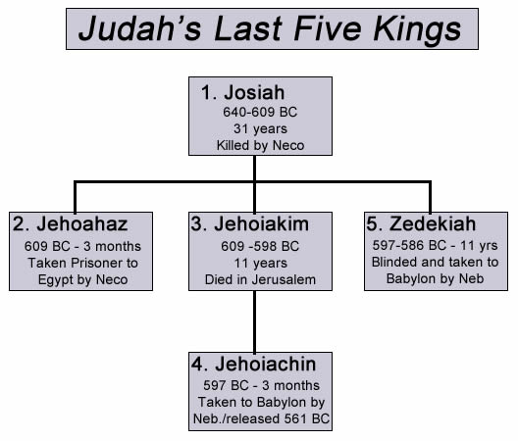
Kings who reigned in the days of Jeremiah

Slide 6
Judgment Upon Judah and the Nations (Jeremiah 24-25)
Jeremiah declares God’s judgment on Judah and the nations around them for their refusal to listen to God (25:1-14)
  This prophecy is dated in the fourth year of Jehoiakim and helps us precisely date the length of Jeremiah’s prophetic work. (25:1)
  Jeremiah reminds the people of Israel that he has been preaching to them for 23 years.
  How had Judah reacted to his preaching? (25:2-3)
  What had been Judah’s reaction to the earlier prophets? (23:4-7)
  What would be Judah’s punishment and the punishment of the surrounding nations? (25:8-11)
  What would happen to Babylon after 70 years? (25:12-14)

Slide 7
Judgment Upon Judah and the Nations (Jeremiah 24-25)
The nations would be made to drink of the cup of God’s wrath. (25:15-29)
  What would be the consequence of drinking? (25:15-16, 27)
  Which nations would be made to drink the cup of God’s wrath?
  What if they refused to drink? (25:28-29)

Slide 8
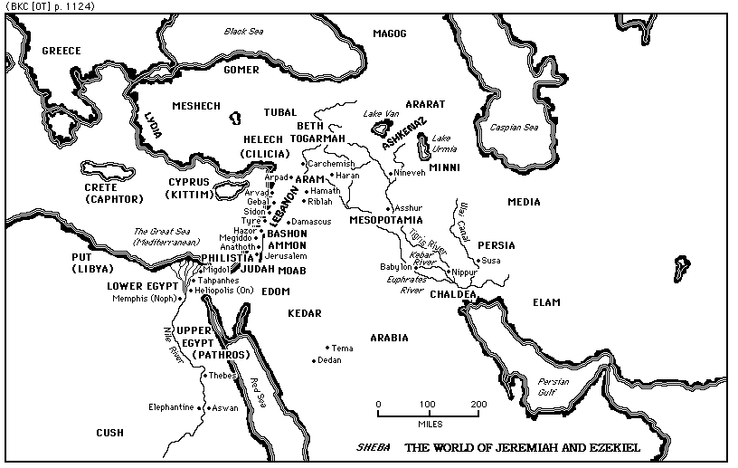

Slide 9
Judgment Upon Judah and the Nations (Jeremiah 24-25)
The nations would be made to drink of the cup of God’s wrath. (25:15-29)
  What would be the consequence of drinking? (25:15-16, 27)
  Which nations would be made to drink the cup of God’s wrath?
  What if they refused to drink? (25:28-29)
The Lord’s indignation would be felt by all the inhabitants of the earth, from nation to nation. (25:30-33)
Like a mighty lion, the Lord would rise to attack the faithless shepherds (25:34-38)

Slide 10
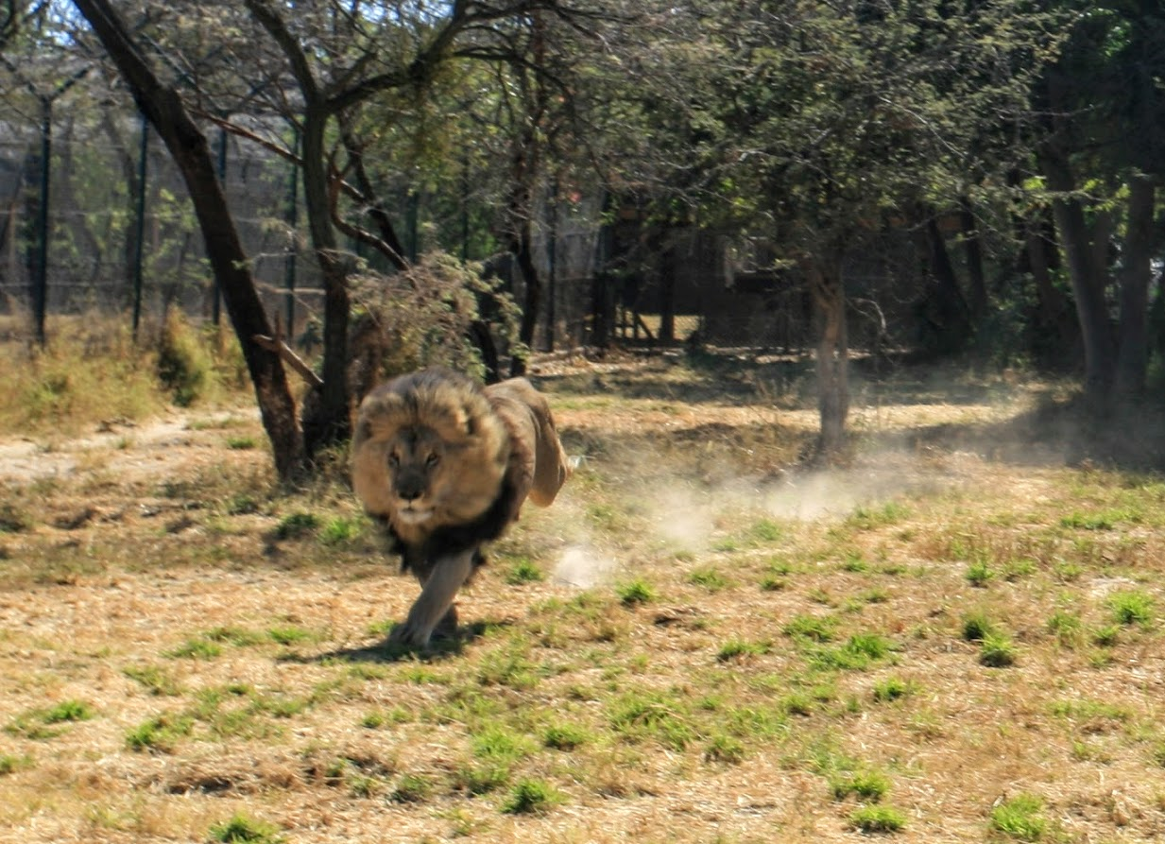
“…the peaceful dwellings are cut down because of the fierce anger of the LORD. He has left His lair like the lion” (Jer 25:37-38)
Photo by Steve Klein

