Slide 1
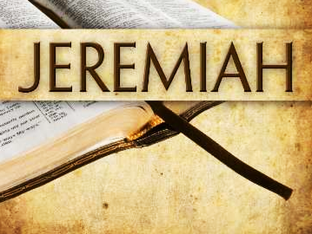
The Prophet’s Call and The Case Against Israel
Jeremiah Chapters 1 & 2

Slide 2

The Time & Circumstances of Jeremiah’s call to prophesy
Jeremiah is identified as “the son of Hilkiah, one of the priests who were in Anathoth in the land of Benjamin”
  This Hilkiah is probably not the High Priest of Jeremiah’s day who found the Book of the Law in the temple (2 Chronicles 34:13-21)
Jeremiah prophesies during the reigns of Josiah, Jehoiakim, & Zekekiah.

Slide 3
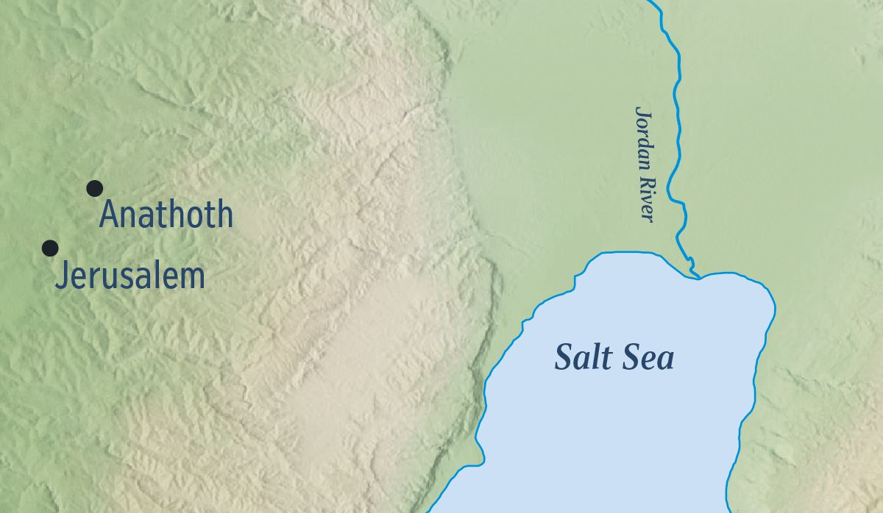
The Time & Circumstances of Jeremiah’s call to prophesy
Jeremiah was a priest from Anathoth, a village in the tribal territory of Benjamin

Slide 4
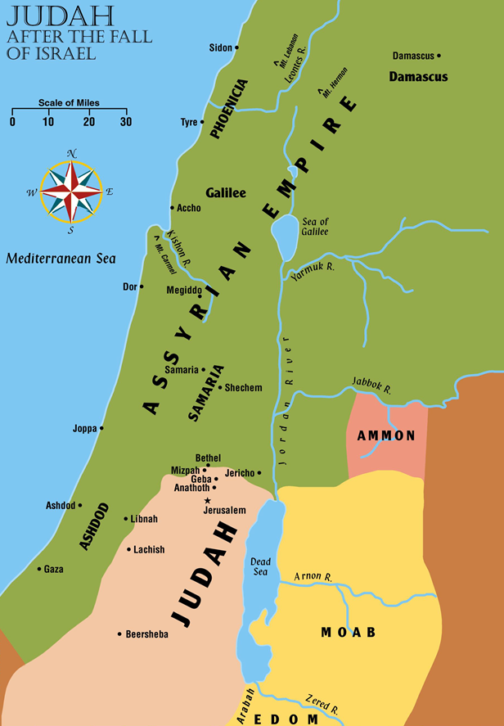
Judah after the Fall of Israel

Slide 5
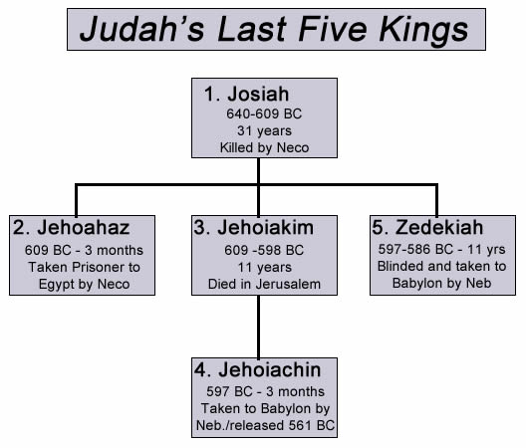
The word of the LORD came to Jeremiah “in the days of Josiah the son of Amon, king of Judah, in the thirteenth year of his reign. It came also in the days of Jehoiakim the son of Josiah, king of Judah, until the end of the eleventh year of Zedekiah the son of Josiah, king of Judah, until the carrying away of Jerusalem captive in the fifth month.” (Jeremiah 1:2-3)

Slide 6
The Word of the Lord Comes to Jeremiah
The Lord knew Jeremiah before He formed him in the womb; He sanctified and ordained Jeremiah as a prophet (1:4-5)
  God’s choice of Saul of Tarsus was similar (Gal. 1:15-16)
  Does this remove free-will from the prophet?
What excuse did Jeremiah give for being unable to speak? (1:6)
  Is this similar to Moses’ excuses in Exodus 3:11—4:17?
  What counsel did Paul give to Timothy on this same matter? (1 Timothy 4:12, 16; 2 Timothy 1:7)
What assurances did God give Jeremiah? (1:7-10)
Notes:
1 Timothy 4:12 Let no one despise your youth, but be an example to the believers in word, in conduct, in love, in spirit, in faith, in purity.
1 Timothy 4:16 Take heed to yourself and to the doctrine. Continue in them, for in doing this you will save both yourself and those who hear you.
2 Timothy 1:7 For God has not given us a spirit of fear, but of power and of love and of a sound mind.

Slide 7
The Word of the Lord Comes to Jeremiah
Two visions of assurance:
  The branch of the almond tree (1:11-12)
  The boiling pot, facing away from the north (13-16)

Slide 8
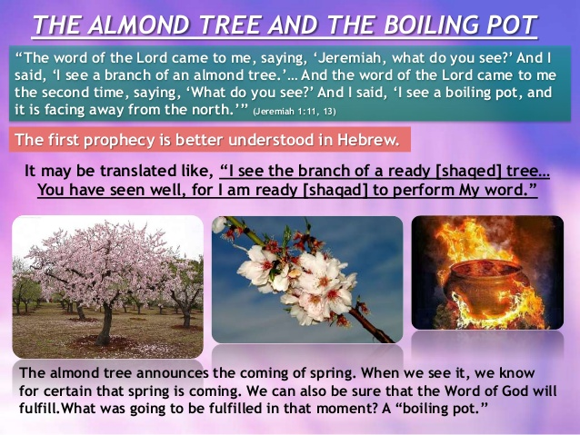

Slide 9
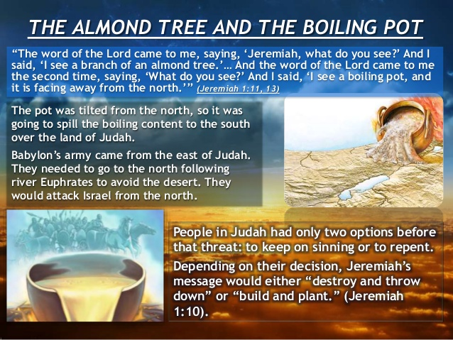
Notes:
Two visions of assurance:
The branch of the almond tree (1:11-12)
The boiling pot, facing away from the north (13-16)

Slide 10
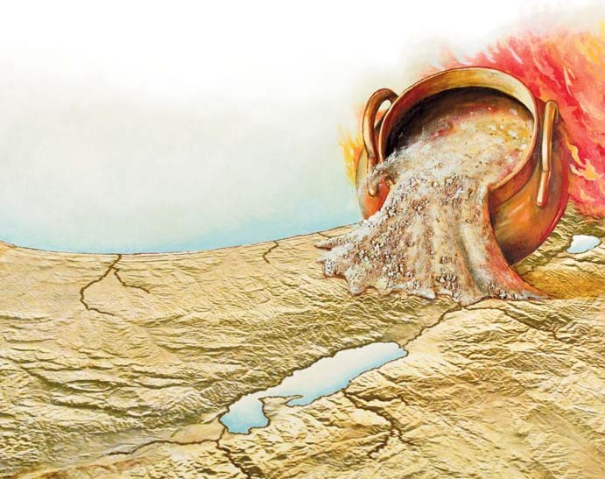

Slide 11
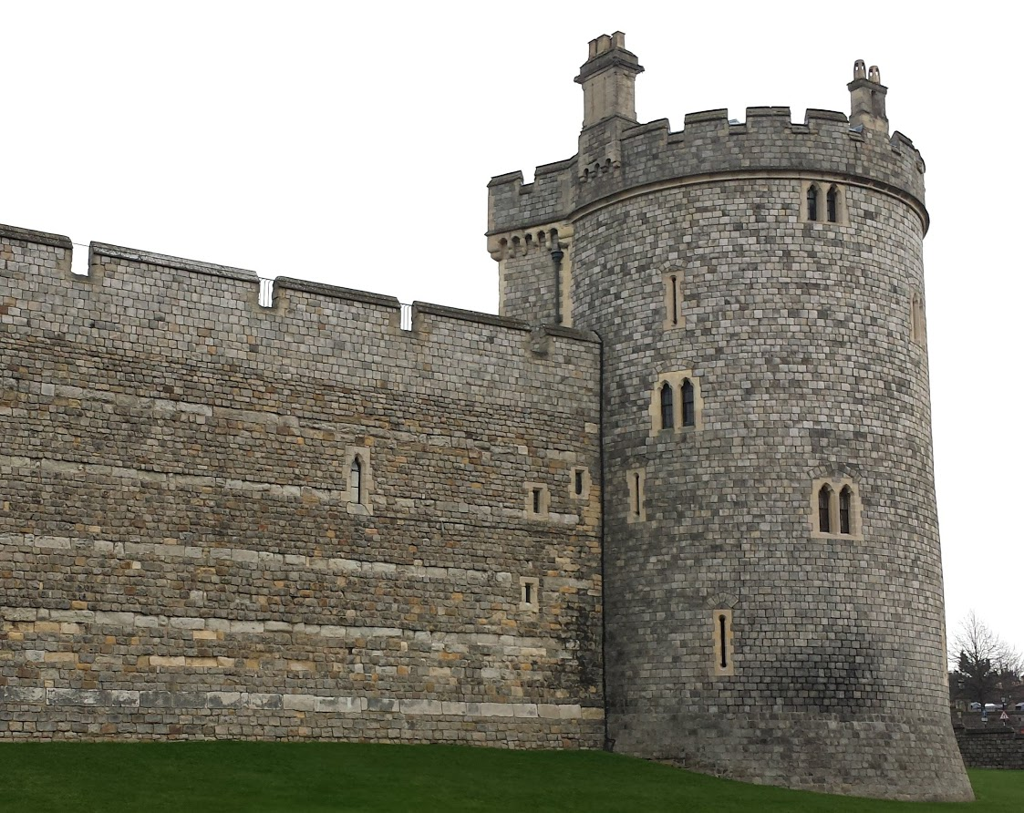
The Word of the Lord Comes to Jeremiah
God motivates Jeremiah with both warning and the promise of help (1:17-19)
  Does God give us similar motivations today to do His will and speak His word? (Hebrews 13:6; 1 John 4:4; Ephesians 6:10 ff.)
Notes:
Hebrews 13:6 So we may boldly say: "THE LORD IS MY HELPER; I WILL NOT FEAR. WHAT CAN MAN DO TO ME?“
1 John 4:4 You are of God, little children, and have overcome them, because He who is in you is greater than he who is in the world.

Slide 12
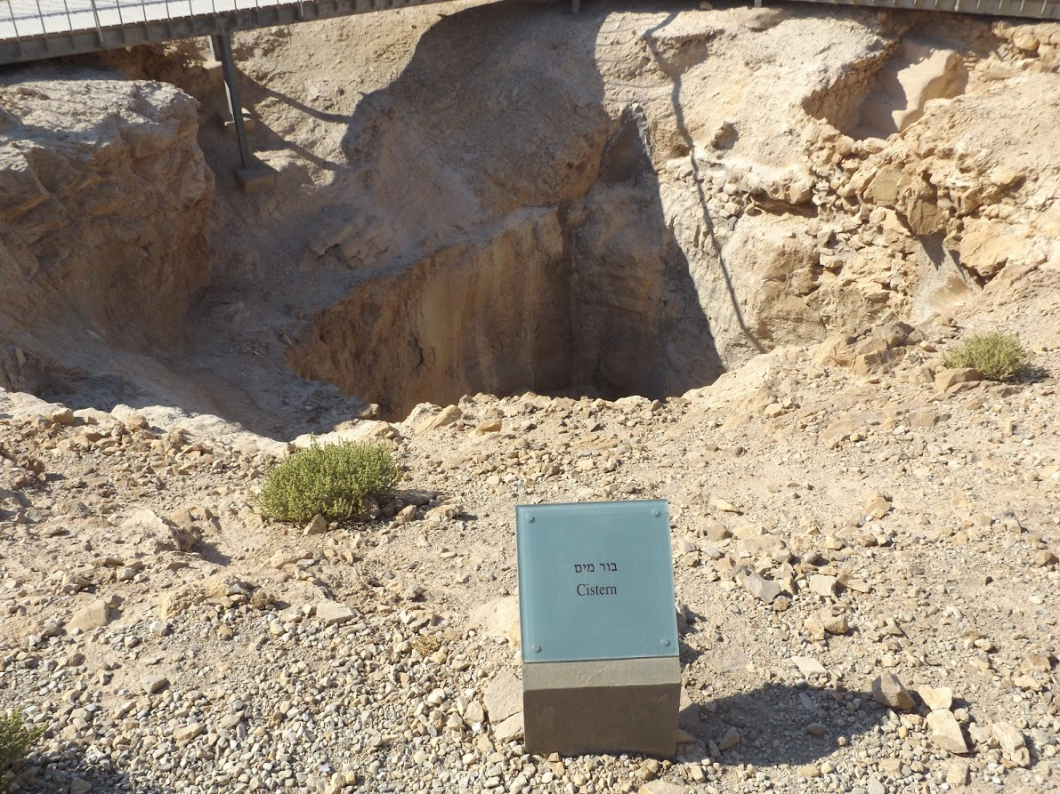
Israel has forsaken the lord
The Lord remembers the kindness, love, and holiness of Israel in her youth, & His protection of her (2:1-3)
Why then has Israel sought other God’s and defiled the bountiful land God gave them? (2:4-8)
The Lord brings charges against her (2:9-13) What other nation has changed gods? "For My people have committed two evils: they have forsaken Me, the fountain of living waters, and hewn themselves cisterns —broken cisterns that can hold no water.”

Slide 13

Israel has forsaken the Lord
The land is plundered and the king killed by foreign invaders because Israel forsook the Lord (2:14-17)
Pictures of Israel’s unfaithfulness (2:18-26)
  Taking the roads to Egypt and Syria to slake her thirst (18)
  Playing the harlot with idols (20)
  Planted as a noble vine, growing as a degenerate vine (21)
  Unable to wash off iniquity with strong soap (22)
  Unrestrained as a dromedary or a donkey in heat (23-24)
  Turning away from a loving provider to strangers (25)
  Will be shamed, as a thief caught in the act (26a)

Slide 14
Israel has forsaken the Lord
Israel’s trust in false gods and foreign nations will be her doom, not her salvation? (2:27-37)
  “Can a virgin forget her ornaments, or a bride her attire? Yet my people have forgotten me days without number” (2:32).

