Slide 1
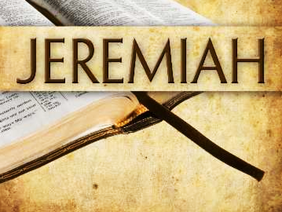
The Temple Address (1)
Jeremiah chapters 7 & 8

Slide 2
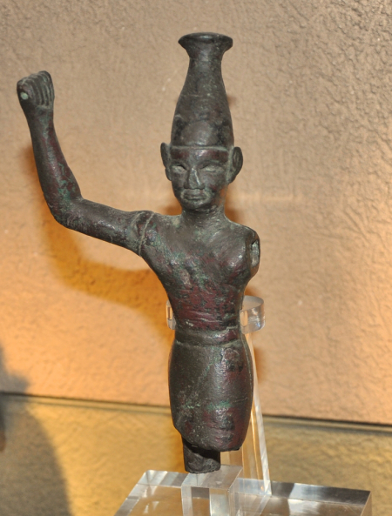
The Temple Address
Temple Worship does not Mask Their Evil
Jeremiah is to proclaim these words at the entrance to the temple (7:1-2)
Judah’s trust in the temple to protect her from God’s wrath is unfounded; she must fully repent! (7:3-11)
  What is significant about Judah repeating the phrase “the temple of the Lord” three times?
  What sins were prevalent among the people? (7:6-9)
  Would their temple worship deliver them to do all these abominations?
Canaanite “Baal”
Photo by Leon Mauldin

Slide 3
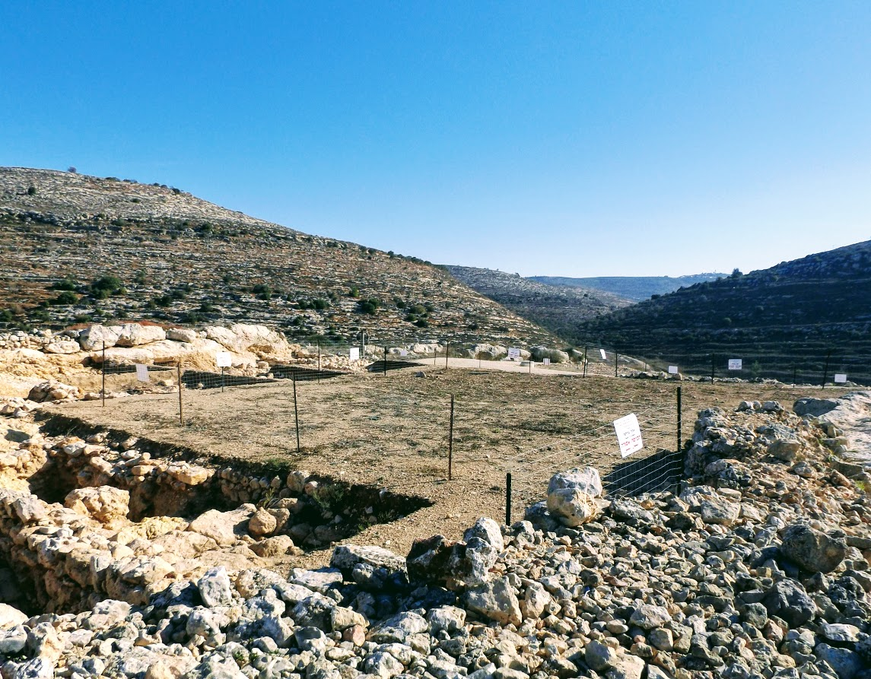
The Temple Address
Temple Worship does not Mask Their Evil
Take a lesson from Shiloh! (7:12-15)
Archaeological Excavations at Shiloh, Site of Tabernacle

Slide 4
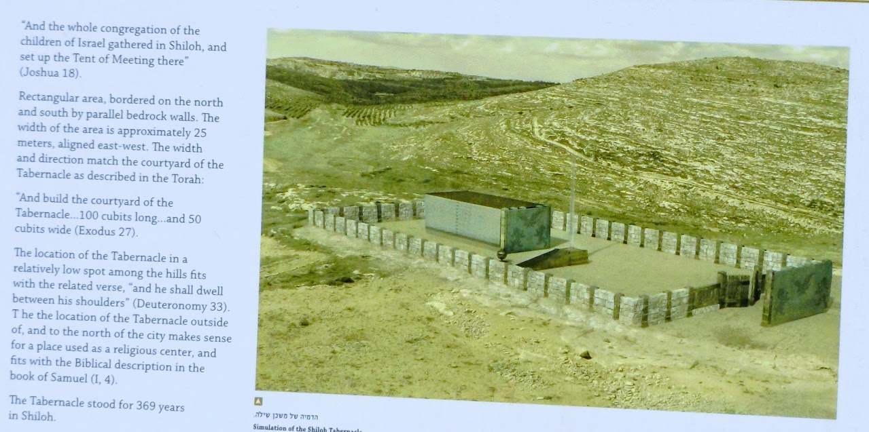
Informational plaque at Shiloh

Slide 5
The Temple Address
Temple Worship does not Mask Their Evil
Jeremiah is instructed not to “pray for this people” who have provoked the Lord by idolatry (7:16-20)
The Lord expects OBEDIENCE before SACRIFICE (7:21-29)
  How does this principle apply in your life today?
The Lord will make the land desolate because Judah has defiled His house and engaged in the abomination of sacrificing their children to idols (7:30-34)
When Judah is punished, the false god’s she has pursued will not deliver her. Her past leaders who brought her to this point would be seen as vile, and those who remain would wish for death (8:1-3)

Slide 6
The Temple Address
Unrepentant Evil Results in Certain Punishment
What are Judah’s faults according to 8:4-17?
  Unwillingness to repent (8:5-6)
  Rejection of the law by the scribes and wise men (8:8-10)
    They engaged in covetousness (8:10b)
    They gave false comfort, encouraging the status quo instead of repentance (8:11)
    They were not ashamed and did not know how to blush (8:12)
  What symbolic images are used to describe her punishment?
    How is it compared to the stork, the dove or the swallow? (8:7)
    How is it like being given gall to drink? (8:14)
    How is it compared to vipers? (8:17)

