Slide 1
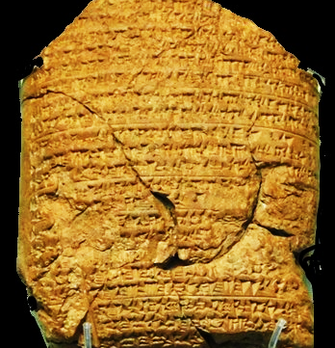
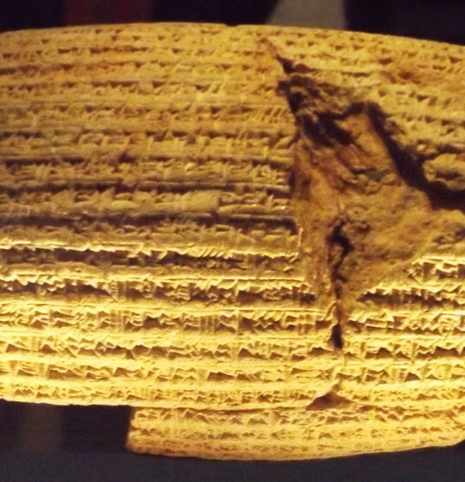
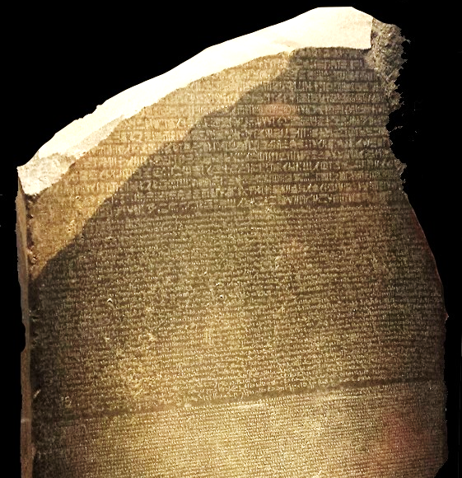
Captivity  Return  Years of Silence
Notes:
Three artifacts symbolizing the captivity, return, and years of silence.
This clay tablet from the Babylonian Chronicle (left) details major events in the Babylonian empire. Each year is separated by a line. This tablet records the exploits of Nebuchadnezzar from 605 to 594 BC, and specifically mentions taking captives and tribute from Jerusalem.
The Cyrus Cylindar (center, circa 530 B.C.) records the policy of Cyrus of Persia to allow captive nations to return to their homelands and rebuild the cities and temples. The Bible prophecies that Cyrus would do this 100 years before he was born (Isaiah 44:28).
The Rosetta Stone (right) is a granodiorite stele, found in 1799, inscribed with three versions of a decree issued at Memphis, Egypt, in 196 BC during the Ptolemaic dynasty on behalf of King Ptolemy V. The top and middle texts are in Ancient Egyptian using hieroglyphic script and demotic scripts, respectively, while the bottom is in Ancient Greek. As the decree has only minor differences between the three versions, the Rosetta Stone proved to be the key to deciphering Egyptian hieroglyphs, thereby opening a window into ancient Egyptian history.

Slide 2
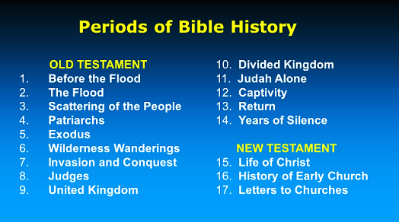

Slide 3
Jewish/Roman History
In the wake of the demise of Antiochus IV and the end of Syrian domination, the high priesthood falls to the descendants of the Maccabees → Simon → John Hyrcanus.
Meanwhile, Julius Caesar enters onto the stage of history.
He becomes a dominant Roman military figure, a rival of Pompey’s, eventually challenging and defeating Pompey in 48 BC at Pharsalus.
Pompey flees to Egypt, but Caesar follows.
Ptolemy assassinates Pompey, but Caesar becomes embroiled in a dynastic struggle between Ptolemy and Cleopatra. In danger in Egypt, Caesar is rescued by the Idumean ruler Antipater.
Notes:
Hearing of Pompey's flight to Egypt, Caesar remained in hot pursuit, first landing in Asia and reaching Alexandria on 2 October 48 BC, where he learnt of Pompey's murder and then was embroiled in a dynastic dispute between Ptolemy XIII and Cleopatra.[49]
Pompey had been a political ally of Ptolemy XII, but Ptolemy XIII, at the urging of his court eunuchs, had Pompey ambushed and killed before Caesar arrived and occupied Alexandria. Caesar then attempted to reconcile the rival Ptolemaic siblings, but Ptolemy's chief adviser, Potheinos, viewed Caesar's terms as favoring Cleopatra, so his forces besieged her and Caesar at the palace.
During Caesar's Egyptian campaign, Antipater led Jewish troops in the Battle of the Jewish Camp, which saved Caesar's trapped force

Slide 4
Jewish/Roman History
Antipater (an Idumean)
– Named Procurator of Judea by Caesar.
– Hyrcanus II re-confirmed as High Priest.
– Antipater has 2 sons
Herod (military prefect in Galilee)
Phasael (military prefect in Judea)
Antipater is poisoned in 43 B.C.
Mark Antony
Caesar is assassinated in 44 B.C. (Ides of March).
Mark Antony & Octavian (Caesar’s nephew) defeat the conspirators.
Mark Antony controls Judea.

Slide 5
Jewish/Roman History
Mark Antony
Appoints Antipater’s 2 sons (Herod & Phasael) joint rulers in Judea.
Antigonus (son of Aristobolus, the defeated brother of Hyrcanus II) began contending for office of High Priest, joining forces with the Parthians.
Hyrcanus II is removed from office and mutilated.
Phasael is captured and commits suicide in prison.
Herod escapes safely to Rome!

Slide 6
Jewish History
Herod (37-4 B.C.)
Eventually gains control of all of Palestine.
Antigonus is captured and brought to Rome.
Mark Antony beheads him at Herod’s request.
Herod takes the title of “Herod the Great.”
He is made “King” of Judea (Matthew 2:3).
He convinces Rome to allow Jews their religious freedom.
The Herodian family would play a major role in N.T. story (to both Jews & Christians).

Slide 7
Jewish/Roman History
Eventually Octavian and Mark Antony cannot co-exist
Octavian defeats Mark Antony at the Battle of Actium in 31 BC.
Octavian becomes emperor in 27 BC when the Roman Senate confers upon him title of “Caesar Augustus” (Luke 2:1).

Slide 8
Herods, Samaritans, and Jewish Sects
The political, cultural and religious landscape of Palestine in the time of Christ must be understood in view of these groups.
Their origins have already been discussed, so students should be able to follow the historical connections to the creation of each group.
Samaritans: Israel, Assyria, and later the Maccabees.
Herods: Edom, Maccabees, Rome.
Jewish Sects: Greek Seleucids, Maccabees, Rome

Slide 9
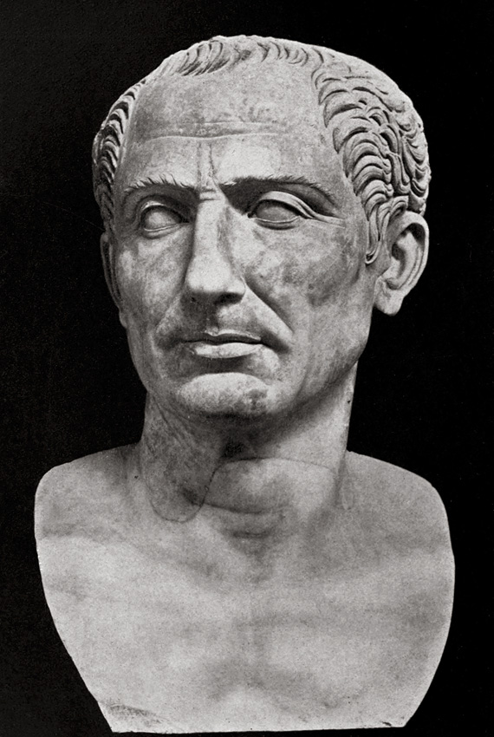
Rome’s Influence in Israel
Connection to Antipater
Antipater was an Idumean ruler.
Descendants of the Edomites, the Idumeans occupied an area south of Jerusalem in the 2nd century BC.
John Hyrcanus (135-104 BC) had compelled them to become Jews.
Antipater supported Hyrcanus II against his brother Aristobulus II.
Antipater also supported Pompey until his death, then switched allegiance to Julius Caesar who made him governor of Judea.
He appointed his son Herod as Tetrarch.
Julius Caesar

Slide 10
The Herodian Dynasty
Herod the Great
Son of Antipater, Herod reigned from 37 BC to 4 BC.
He is remembered in history as a great builder.
His Sons:
Archaelaus, Ethnarch of Judea, 4 BC to AD 6 (Matthew 2:22)
Herod Philip, Tetrarch of Iturea and Trachonitis, 4 BC to AD 34 (Luke 3:1)
Herod Antipas, Tetrarch of Galilee, 4 BC to AD 39 (Matthew 14:3-12; Mark 6:17-29; Luke 13:32; 23:7-12)
His Grandson: Herod Agrippa I, king of Judea, AD 37-44 (Acts 12)
His Great Grandchildren, born to Herod Agrippa I
Bernice, consort of her brother, Herod Agrippa II (Acts 25:13)
Herod Agrippa II, Tetrarch of Chalcis, AD 48-70
Drusilla, married Felix, governor of Judea, AD 52-59
Notes:
An ethnarch is a political leader of a homogeneous kingdom or ethnic group.
A tetrarch is the governor of one of four divisions of a country or province.
Matthew 2:22 But when he (Joseph) heard that Archelaus was reigning over Judea instead of his father Herod, he was afraid to go there. And being warned by God in a dream, he turned aside into the region of Galilee.
Luke 3:1 Now in the fifteenth year of the reign of Tiberius Caesar, Pontius Pilate being governor of Judea, Herod being tetrarch of Galilee, his brother Philip tetrarch of Iturea and the region of Trachonitis, and Lysanias tetrarch of Abilene,
Herod Antipas, Tetrarch of Galilee is the Herod that killed John the Baptist and had part in the trial of Jesus (Mark 6, Luke 23).
Herod Agrippa I Killed James, imprisoned Peter, was stuck by the Lord and eaten by worms (Acts 12).
Herod Agrippa II with his Sister/Wife Bernice give Paul an audience -- Acts 25:13 And after some days King Agrippa and Bernice came to Caesarea to greet Festus.

Slide 11
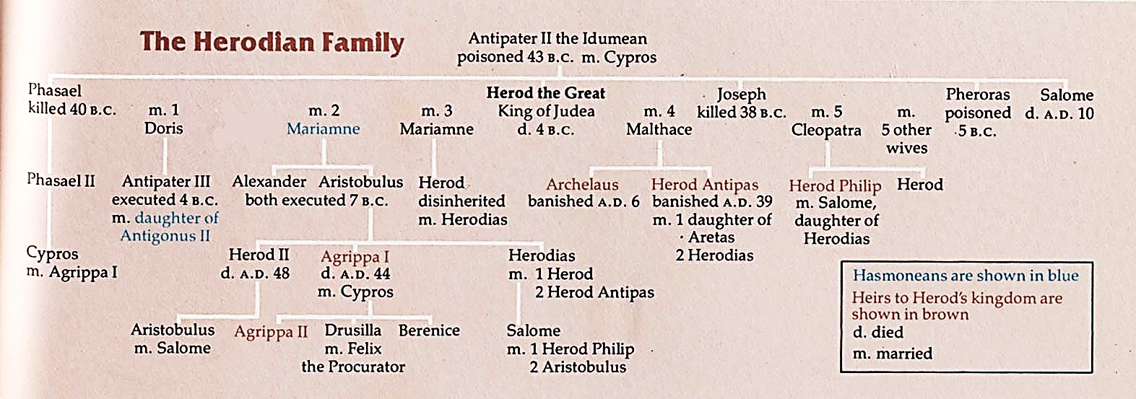

Slide 12
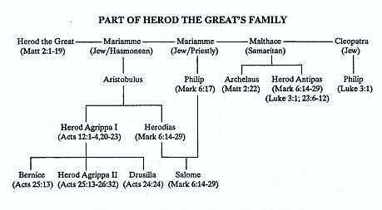

Slide 13
The Samaritans
Samaria was the capital of the northern kingdom of Israel
It was captured by the Assyrians in 722 BC, many of its inhabitants were transplanted to foreign lands, and foreigners were brought to Samaria (2 Kings 17 & 18).*
When the Jews returned from captivity (536 BC), the Samaritans offered to help, but their offer was refused by Zerubbabel and Joshua (Ezra 4:3ff).
The Samaritans may have sided with the Seleucids during Maccabean times.
John Hyrcanus destroyed the Samaritan temple on Mount Gerizim in 128 BC.
Notes:
The name “Samaritans” is used for the first time in the Bible in 2 Kings 17:29 However every nation continued to make gods of its own, and put them in the shrines on the high places which the Samaritans had made, every nation in the cities where they dwelt.

Slide 14
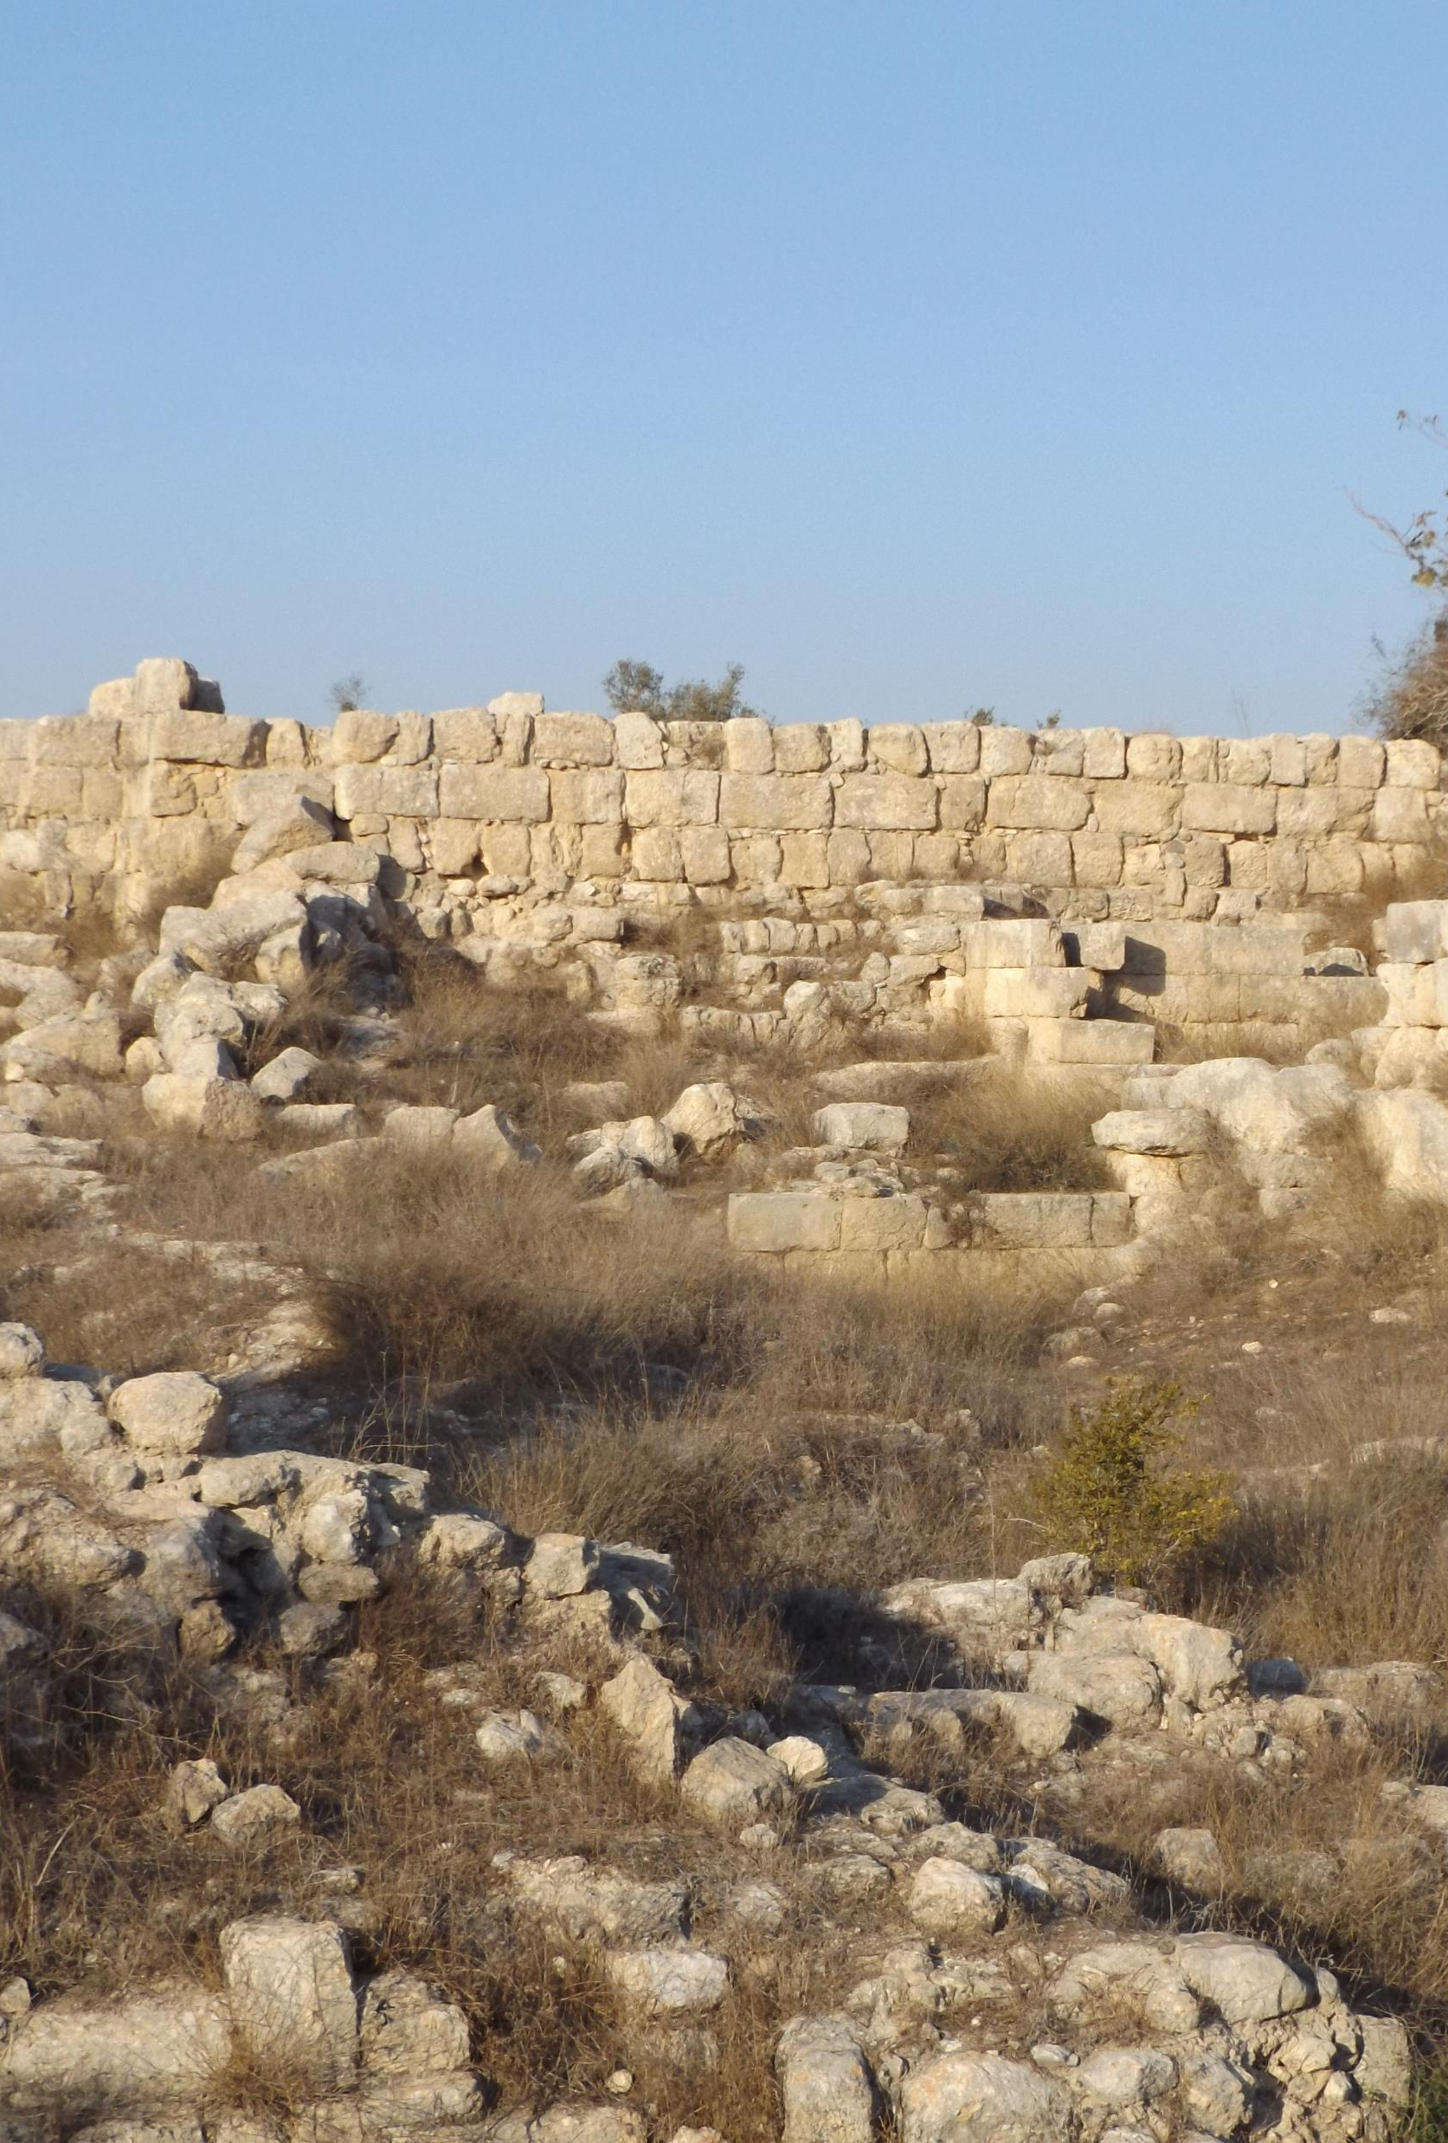
The Samaritans
Herod the Great rebuilt and beautified the city of Samaria and built a temple to Caesar Augustus there.
One of Herod’s wives was a Samaritan.
Pilate’s slaughter of Samaritans at Mount Gerizim led to his removal as procurator in AD 36.
Jews had no dealings with Samaritans, and this affected both travel and commerce in the first century AD.
But the Samaritans received both Jesus and the gospel favorably (John 4, Acts 8:1-25)

Slide 15
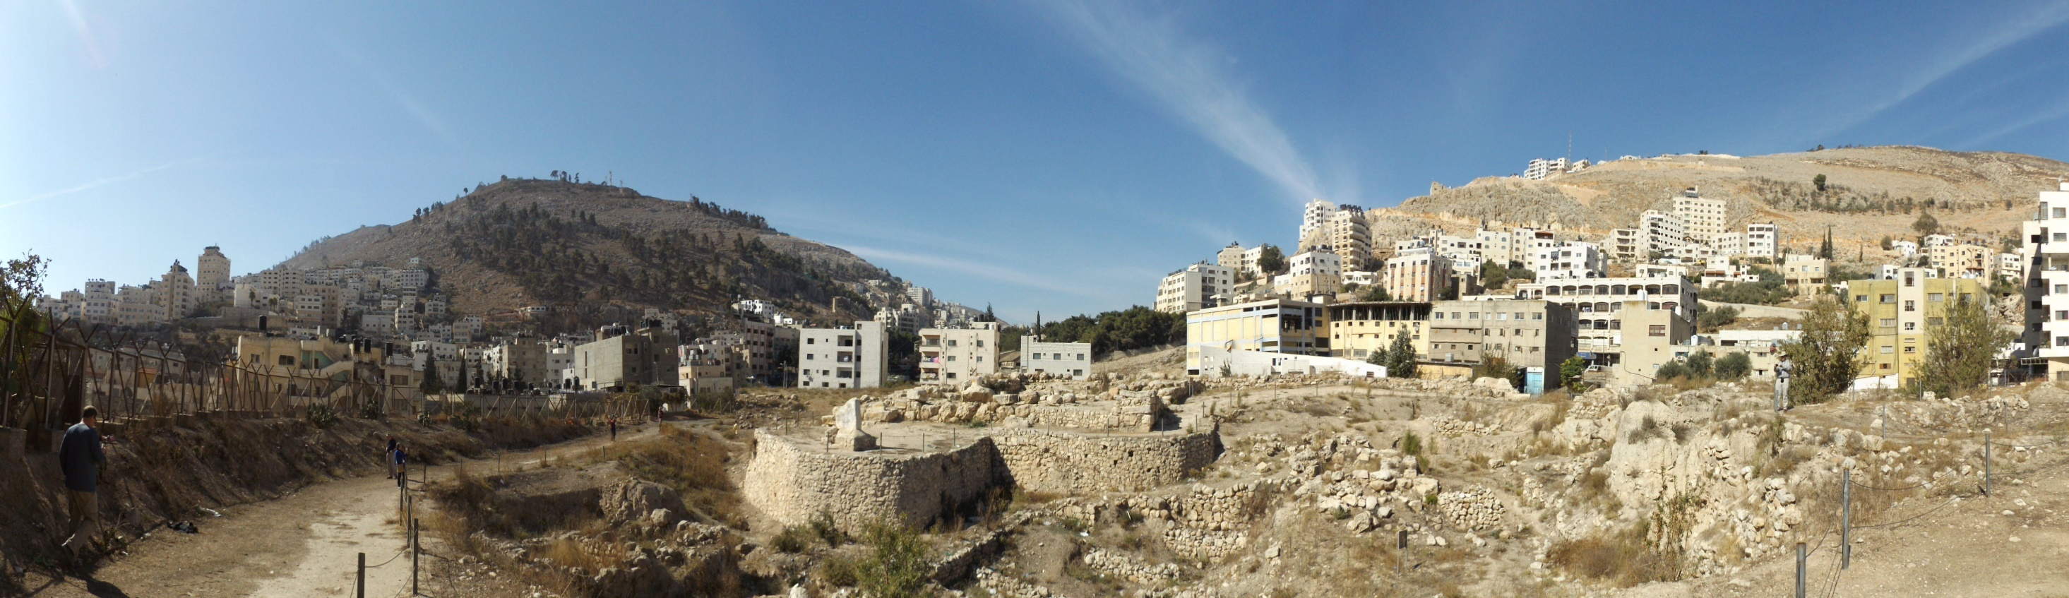
Mount Gerizim and Mount Ebal (Viewed from Sychar/Shechem – Modern Nablus)

Slide 16
Development of the Jewish Sects
Hellenism was spread by Alexander the Great and his successors.
Jews encountered it in Palestine and throughout the Greco-Roman world.
Many Jews outside of Jerusalem (in places like Alexandria) were willing to adopt a Greek lifestyle and blend it with Judaism.
Some of those in Jerusalem who did so became the Sadducees.
Other Jews resisted being Hellenized and saw it as an attack on their religion. They were known as the Hasidim or “pious ones.”
The Pharisees and Essenes came from the Hasidim.
During the time of the Maccabees the lines were drawn between the Hellenists and the Hasidim.
Due to their desire for religious purity, the Hasidim were less willing to cooperate with Greek and Roman political authorities, so the power of the High Priesthood and much of the Sanhedrin fell into the hands of Hellenists.

Slide 17
The Pharisees
Pharisee means “separated one.”
They are the spiritual descendants of the Hasidim (pious ones).
They numbered 6,000 in the time of Herod the Great.
They believed in angels, spirits, an afterlife, etc.
They accepted all of what we know as the Old Testament, but also put great emphasis on oral laws and traditions.
They kept the Sabbath strictly but added extreme traditions as law.
They devised legal loopholes to God’s law and to their own traditions.
“The Pharisees fostered the synagogue as an institution of religious worship, outside and separate from the Temple. The synagogue may thus be considered a Pharasaic institution, since the Pharisees developed it, raised it to high eminence, and gave it a central place in Jewish religious life.” (Encyclopedia Britannica, Pharisee)

Slide 18
The Sadducees
Their name is derived from the sons of Zadok, priest in David’s time.
They were a smaller group than the Pharisees, but they wielded more political power because they controlled the priesthood and were willing to adopt to the culture of their Greco-Roman overlords.
They believed that only the Torah (books of Moses) were authoritative.
They denied the existence of angels, spirits, afterlife, etc.
Their religion was bound up in the temple, which they controlled.
They craved political power.
They were elitists, aristocratic, and religiously liberal.
Jesus was a threat both to the Pharisees’ religious hold on the people and to the Sadducees political power. Ultimately, both groups were eager to have Him crucified, and that purpose united the two factions in the Sanhedrin.

Slide 19
High Priests
The High Priesthood melded with civil government and political affairs from the time of the Maccabees onward. Consideration was initially given based on Hasmonean lineage, but political considerations also played a major part.
The Hasmonean Dynasty
Jonathan Apphus, 153-143 BC
Simon Thassi, brother of Jonathan Apphus, 142-134 BC
John Hyrcanus I, son of Simeon Tassi, 134-104 BC
Aristobulus I, son of John Hyrcanus, 104-103 BC
Alexander Jannaeus, son of John Hyrcanus, 103-76 BC
John Hyrcanus II, son of Alexander Jannaeus, 76-66 BC
Aristobulus II, son of Alexander Jannaeus, 66-63 BC
Hyrcanus II (restored), 63-40 BC
Antigonus, son of Aristobulus II, 40-37 BC

Slide 20
High Priests
Eleazar ben Ananus, 16-17 AD
Simon ben Camithus, 17-18 AD
Joseph ben Caiaphas,18-36 AD (son-in-law of the high priest Ananus ben Seth)
Jonathan ben Ananus, 36-37 AD
Theophilus ben Ananus, 37-41 AD
Simon Cantatheras ben Boethus, 41-43 AD
Matthias ben Ananus, 43 AD
Elioneus ben Simon Cantatheras, 43-44 AD
Jonathan ben Ananus, 44 (restored) AD
Josephus ben Camydus, 44-46 AD
Ananias son of Nedebeus, 46-58 AD
Jonathan, 58 AD
Ishmael II ben Fabus, 58-62 AD (possible relation to priest of same name from 15-16?)
Joseph Cabi ben Simon, 62-63 AD
Ananus ben Ananus, 63 AD
Jesus son of Damneus, 63 AD
Joshua ben Gamla, 63-64 AD (his wife Martha belonged to family of Boethus)
Mattathias ben Theophilus, 65-66 AD
Phannias ben Samuel, 67-70 AD
Under Roman Rule, the High priest served at the pleasure of the ruling Herod or the Roman Governor
Ananelus, 37-36 BC
Aristobulus III, grandson of Aristobulus II & Hyrcanus II, 36 BC. He was the last of the Hasmoneans; brother of Herod's second wife Mariamne I.
Ananelus (restored), 36-30 BC
Joshua ben Fabus, 30-23 BC
Simon ben Boethus, 23-5 BC (his daughter Mariamne II was third wife of Herod the Great)
Matthias ben Theophilus, 5-4 BC
Joazar ben Boethus, 4 BC
Eleazar ben Boethus, 4-3 BC
Joshua ben Sie, 3 BC - ?
Joazar ben Boethus (restored), 6 AD
Ananus ben Seth, 6-15 AD
Ishmael ben Fabus (Phiabi), 15-16 AD

Slide 21
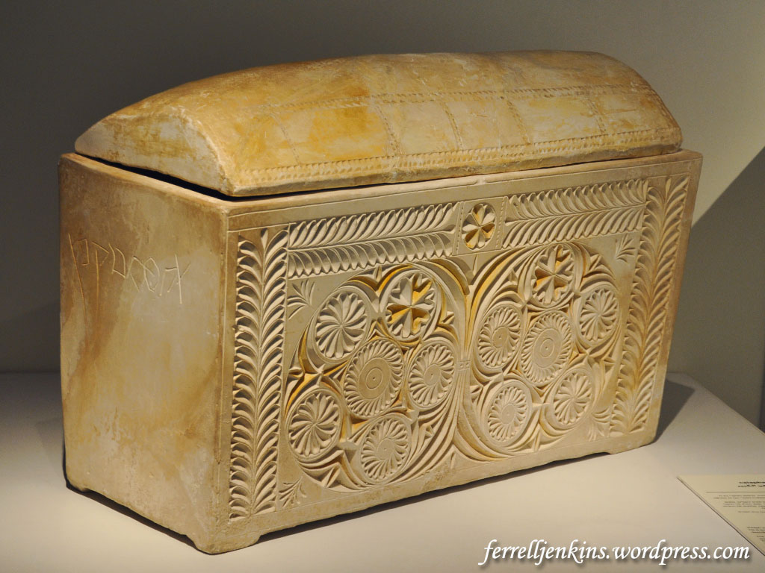
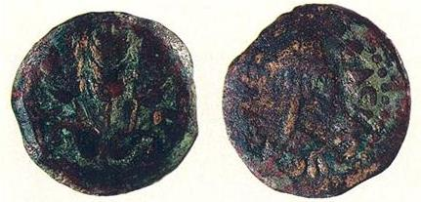
Caiaphas Ossuary and Coins
A bronze coin minted in 42/43 C.E. during the reign of Herod Agrippa I, proved to be yet another significant find in the Caiaphas burial chamber. Discovered inside the skull of an adult woman interred in an ossuary marked “Miriam, daughter of Simon,” the coin is the first known example of a pagan custom practiced at a Jewish burial in Jerusalem, although a similar case was found in a tomb near Jericho. The coin may represent payment to the Greek god Charon in exchange for safe passage for the deceased’s spirit across the River Styx—or some version of this custom. (“Discovered in Jerusalem- Burial Cave of the Caiaphas Family,” BAR Sep-Oct 1992.)
Photo by Ferrell Jenkins

Slide 22
The Essenes
Little is known about the Essenes outside of a mention by Josephus and what archaeologists have uncovered at what appears to be the site of an Essene commune at Qumran.
They lived in secluded communes sharing their possessions.
They were restrained and sober, and they rejected all oaths.
Otherwise, many of their main doctrines were similar to the Pharisees.
They are not mentioned in the gospels.
Both Philo and Josephus indicate that there were about 4,000 of them in the first century.

Slide 23
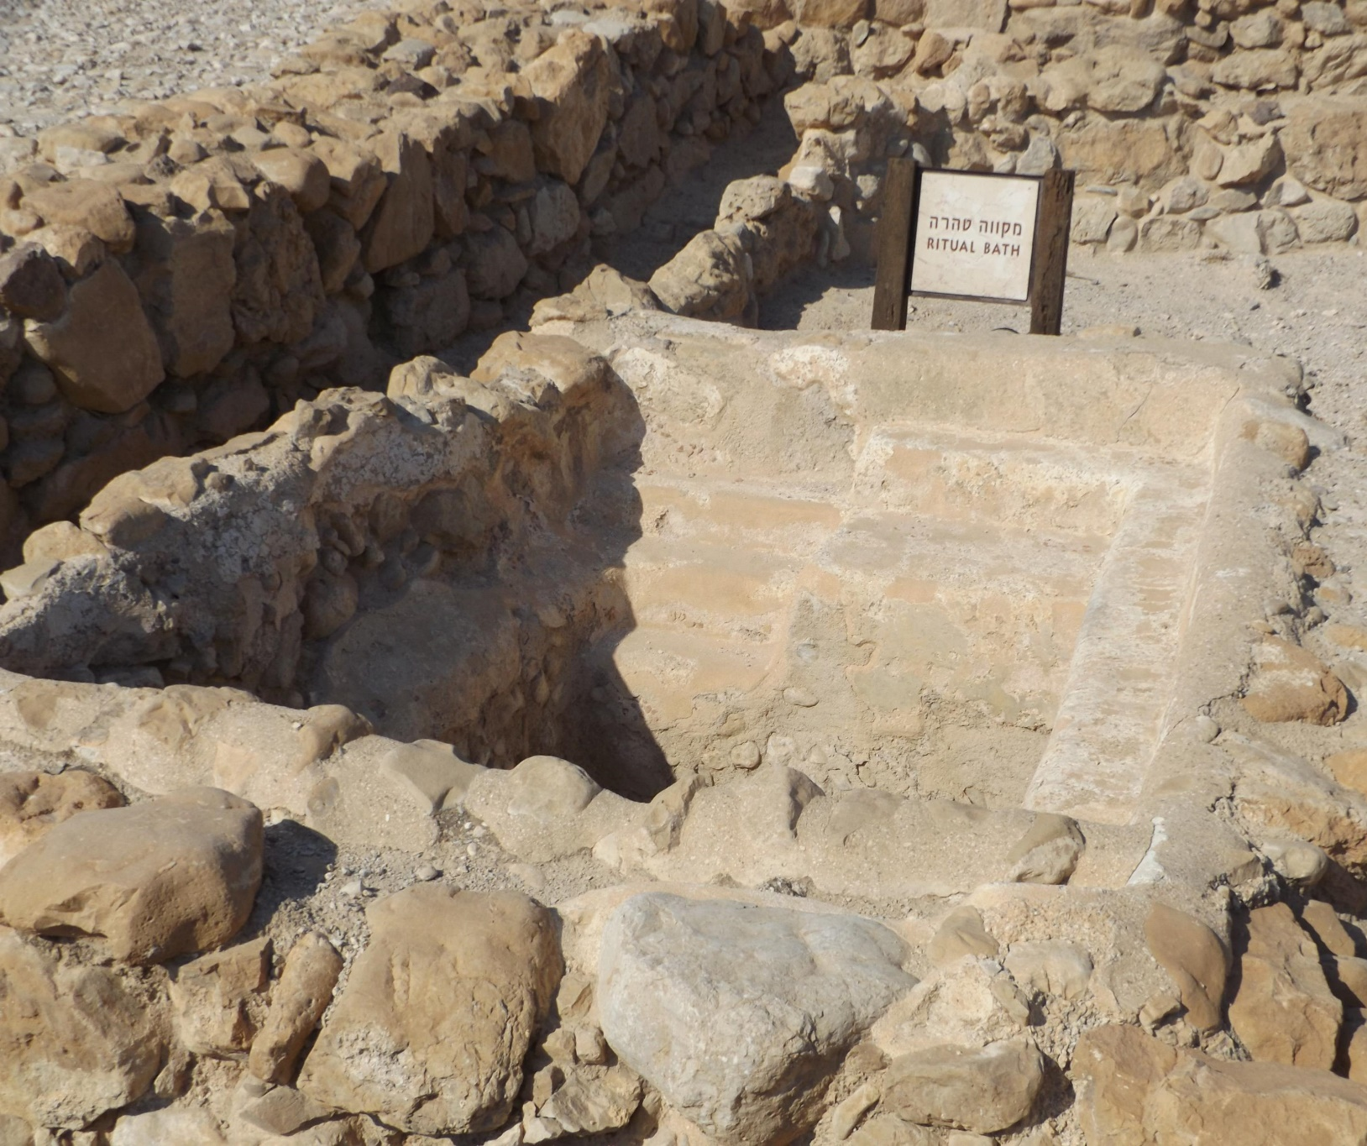
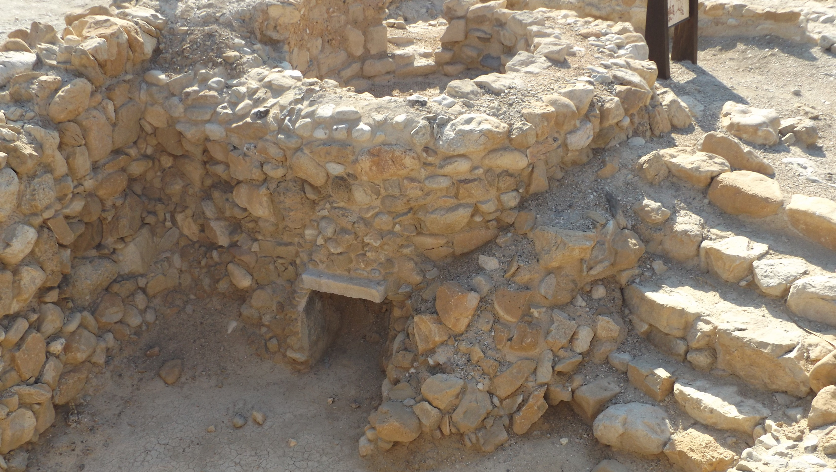
Possible Essene Ruins at Qumran
At LEFT: Ritual Bath
BELOW: Kiln

Slide 24
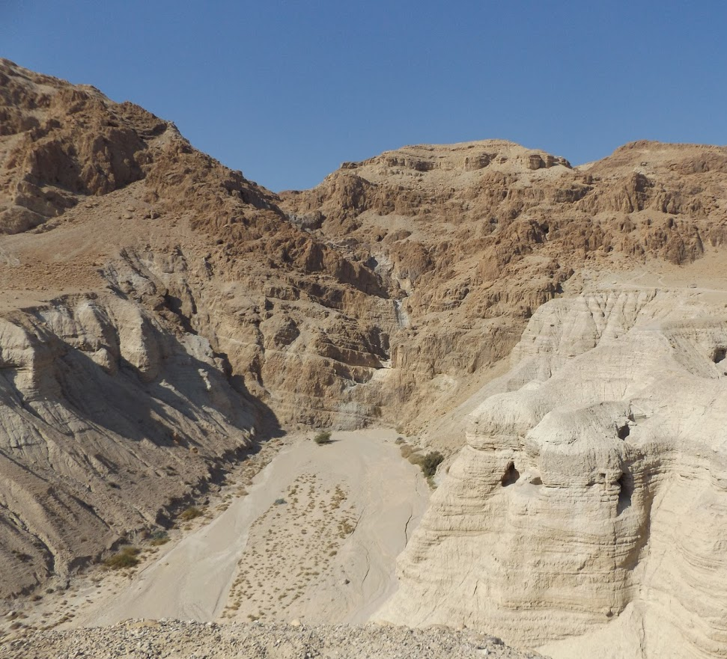
Qumran Caves & Wadi Qumran
The majority of the Dead Sea Scrolls were discovered in caves adjacent to the Qumran settlement.
The Scrolls are mainly copies of religious writings and Bible texts that date from the 3rd century B.C. to the 1st century A.D. They MAY have been produced and preserved by the Essenes.

Slide 25
The Zealots
Objected to God’s people being ruled by Gentiles, and so desired to overthrow Roman rule by force.
Began in AD 6 when Judas the Galilean and Zadduk the Pharisee rebelled against Rome.
They refused to pay taxes to Rome and regarded loyalty to Caesar as a sin.
Simon the Zealot or Canaanite (Aramaic for “zealot”) became a disciple of Christ (Luke 6:15; Acts 1:13; Mark 3:18)
Prior to doing so, he would have been a mortal enemy of Matthew the tax collector.

Slide 26
The Herodians
A small group of politically minded Jews. Connected to the Sadducees, “who supported the Herodian dynasty, and by implication, the Roman rule which had put the Herods in power” (Gundry).

