Slide 1
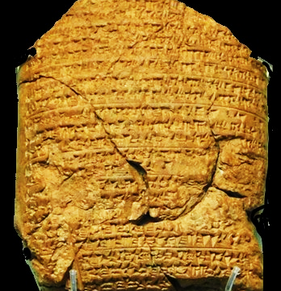
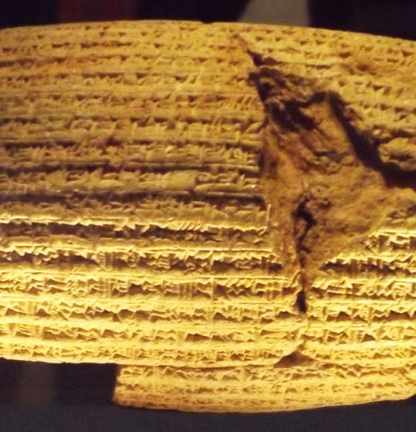
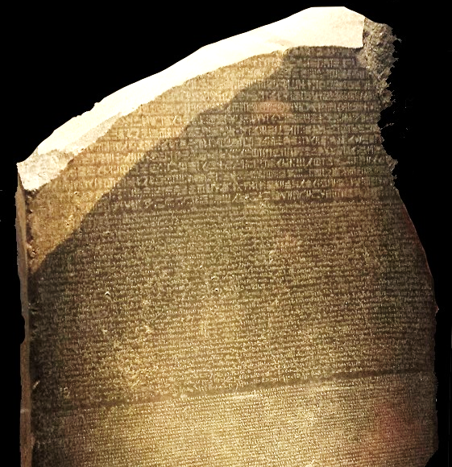
Captivity  Return  Years of Silence
Notes:
Three artifacts symbolizing the captivity, return, and years of silence.
This clay tablet from the Babylonian Chronicle (left) details major events in the Babylonian empire. Each year is separated by a line. This tablet records the exploits of Nebuchadnezzar from 605 to 594 BC, and specifically mentions taking captives and tribute from Jerusalem.
The Cyrus Cylindar (center, circa 530 B.C.) records the policy of Cyrus of Persia to allow captive nations to return to their homelands and rebuild the cities and temples. The Bible prophecies that Cyrus would do this 100 years before he was born (Isaiah 44:28).
The Rosetta Stone (right) is a granodiorite stele, found in 1799, inscribed with three versions of a decree issued at Memphis, Egypt, in 196 BC during the Ptolemaic dynasty on behalf of King Ptolemy V. The top and middle texts are in Ancient Egyptian using hieroglyphic script and demotic scripts, respectively, while the bottom is in Ancient Greek. As the decree has only minor differences between the three versions, the Rosetta Stone proved to be the key to deciphering Egyptian hieroglyphs, thereby opening a window into ancient Egyptian history.

Slide 2
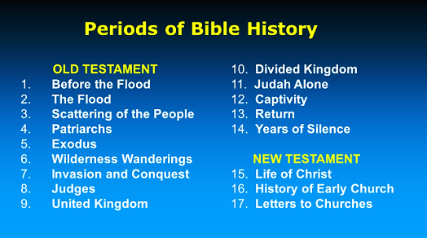

Slide 3
Development of the Jewish Sects
Hellenism was spread by Alexander the Great and his successors.
Jews encountered it in Palestine and throughout the Greco-Roman world.
Many Jews outside of Jerusalem (in places like Alexandria, Egypt) were willing to adopt a Greek lifestyle and blend it with Judaism.
Some of those in Jerusalem who did so became the Sadducees.
Other Jews resisted being Hellenized and saw it as an attack on their religion. They were known as the Hasidim or “pious ones.”
The Pharisees and Essenes came from the Hasidim.
During the time of the Maccabees, the lines were drawn between the Hellenists and the Hasidim.
Due to their desire for religious purity, the Hasidim were less willing to cooperate with Greek and Roman political authorities, so the power of the High Priesthood and much of the Sanhedrin fell into the hands of Hellenists.

Slide 4
The Pharisees
Pharisee means “separated one.”
They are the spiritual descendants of the Hasidim (pious ones).
They numbered 6,000 in the time of Herod the Great.
They believed in angels, spirits, an afterlife, etc.
They accepted all of what we know as the Old Testament but also put great emphasis on oral laws and traditions.
They kept the Sabbath strictly but added extreme traditions as law.
They devised legal loopholes to God’s law and to their own traditions.
“The Pharisees fostered the synagogue as an institution of religious worship, outside and separate from the Temple. The synagogue may thus be considered a Pharasaic institution, since the Pharisees developed it, raised it to high eminence, and gave it a central place in Jewish religious life.” (Encyclopedia Britannica, Pharisee)

Slide 5
The Sadducees
Their name is derived from the sons of Zadok, priest in David’s time.
They were a smaller group than the Pharisees, but they wielded more political power because they controlled the priesthood and were willing to compromise with their Greco-Roman overlords.
They believed that only the Torah (books of Moses) were authoritative.
They denied the existence of angels, spirits, afterlife, etc.
Their religion was bound up in the temple, which they controlled.
They craved political power.
They were elitists, aristocratic, and religiously liberal.
Jesus was a threat both to the Pharisees’ religious hold on the people and to the Sadducees political power. Both groups were eager to have Him crucified, and that purpose united the two factions in the Sanhedrin.

Slide 6
High Priests
The High Priesthood melded with civil government and political affairs from the time of the Maccabees onward. Ordination was initially based on Hasmonean lineage, but political considerations also played a major part.
The Hasmonean Dynasty
Jonathan Apphus, 153-143 BC
Simon Thassi, brother of Jonathan Apphus, 142-134 BC
John Hyrcanus I, son of Simeon Tassi, 134-104 BC
Aristobulus I, son of John Hyrcanus, 104-103 BC
Alexander Jannaeus, son of John Hyrcanus, 103-76 BC
John Hyrcanus II, son of Alexander Jannaeus, 76-66 BC
Aristobulus II, son of Alexander Jannaeus, 66-63 BC
Hyrcanus II (restored), 63-40 BC
Antigonus, son of Aristobulus II, 40-37 BC

Slide 7
High Priests
Eleazar ben Ananus, 16-17 AD
Simon ben Camithus, 17-18 AD
Joseph ben Caiaphas,18-36 AD (son-in-law of the high priest Ananus ben Seth)
Jonathan ben Ananus, 36-37 AD
Theophilus ben Ananus, 37-41 AD
Simon Cantatheras ben Boethus, 41-43 AD
Matthias ben Ananus, 43 AD
Elioneus ben Simon Cantatheras, 43-44 AD
Jonathan ben Ananus, 44 (restored) AD
Josephus ben Camydus, 44-46 AD
Ananias son of Nedebeus, 46-58 AD
Jonathan, 58 AD
Ishmael II ben Fabus, 58-62 AD (possible relation to priest of same name from 15-16?)
Joseph Cabi ben Simon, 62-63 AD
Ananus ben Ananus, 63 AD
Jesus son of Damneus, 63 AD
Joshua ben Gamla, 63-64 AD (his wife Martha belonged to family of Boethus)
Mattathias ben Theophilus, 65-66 AD
Phannias ben Samuel, 67-70 AD
Under Roman Rule, the High priest served at the pleasure of the ruling Herod or the Roman Governor
Ananelus, 37-36 BC
Aristobulus III, grandson of Aristobulus II & Hyrcanus II, 36 BC. He was the last of the Hasmoneans; brother of Herod's second wife Mariamne I.
Ananelus (restored), 36-30 BC
Joshua ben Fabus, 30-23 BC
Simon ben Boethus, 23-5 BC (his daughter Mariamne II was third wife of Herod the Great)
Matthias ben Theophilus, 5-4 BC
Joazar ben Boethus, 4 BC
Eleazar ben Boethus, 4-3 BC
Joshua ben Sie, 3 BC - ?
Joazar ben Boethus (restored), 6 AD
Ananus ben Seth, 6-15 AD
Ishmael ben Fabus (Phiabi), 15-16 AD

Slide 8
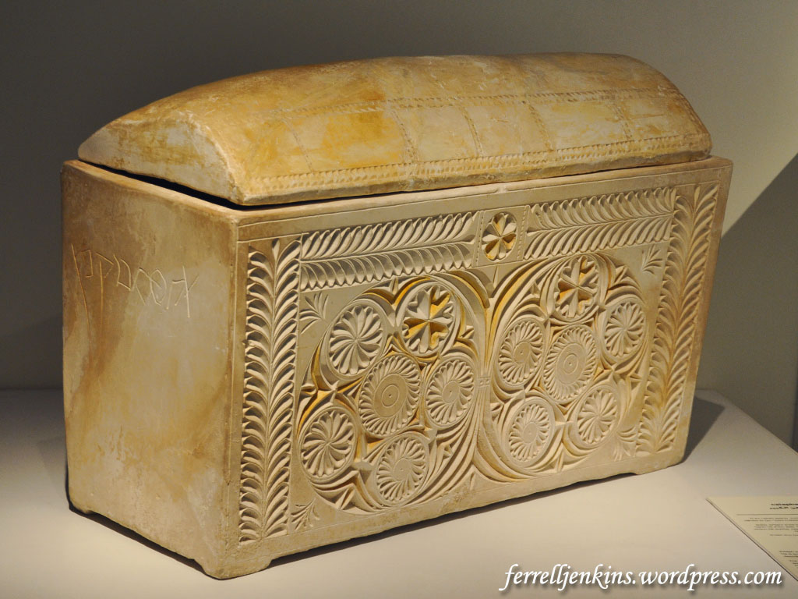
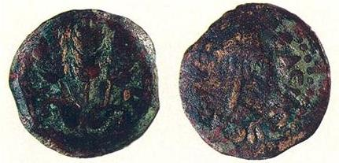
Caiaphas Ossuary and Coins
A bronze coin minted in 42/43 C.E. during the reign of Herod Agrippa I, proved to be yet another significant find in the Caiaphas burial chamber. Discovered inside the skull of an adult woman interred in an ossuary marked “Miriam, daughter of Simon,” the coin is the first known example of a pagan custom practiced at a Jewish burial in Jerusalem, although a similar case was found in a tomb near Jericho. The coin may represent payment to the Greek god Charon in exchange for safe passage for the deceased’s spirit across the River Styx—or some version of this custom. (“Discovered in Jerusalem- Burial Cave of the Caiaphas Family,” BAR Sep-Oct 1992.)
Photo by Ferrell Jenkins

Slide 9
The Essenes
Little is known about the Essenes outside of a mention by Josephus and what archaeologists have uncovered at what appears to be the site of an Essene commune at Qumran.
They lived in secluded communes sharing their possessions.
They were restrained and sober, and they rejected all oaths.
Otherwise, many of their main doctrines were similar to the Pharisees.
They are not mentioned in the gospels.
Both Philo and Josephus indicate that there were about 4,000 of them in the first century.

Slide 10
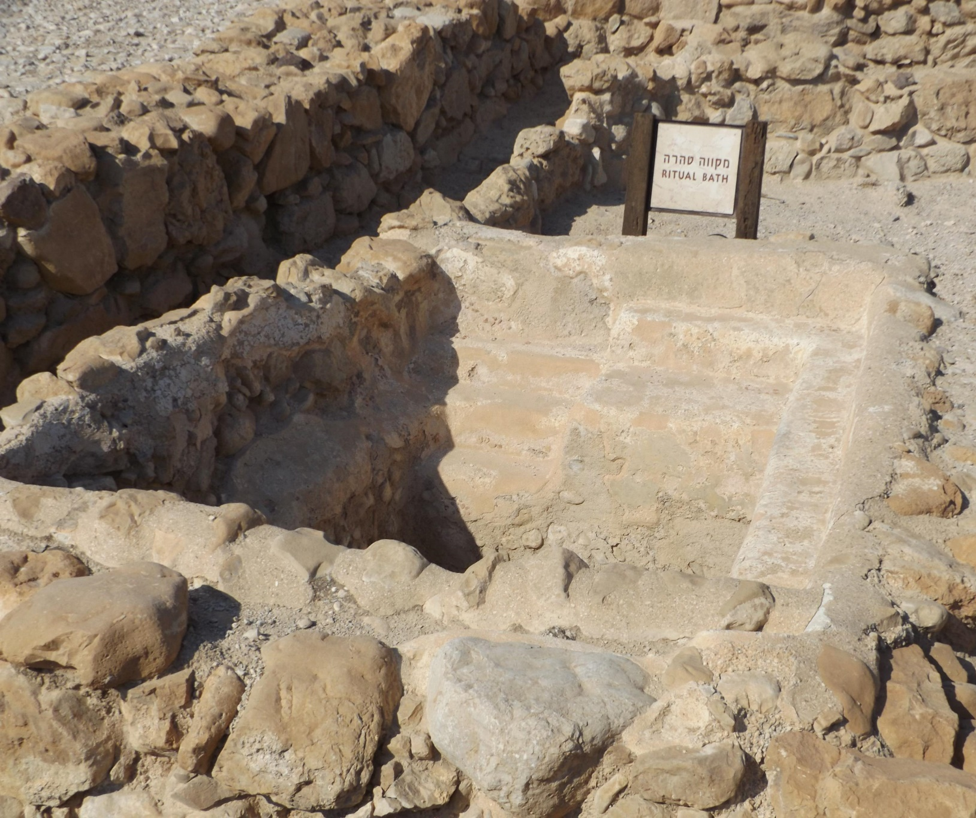
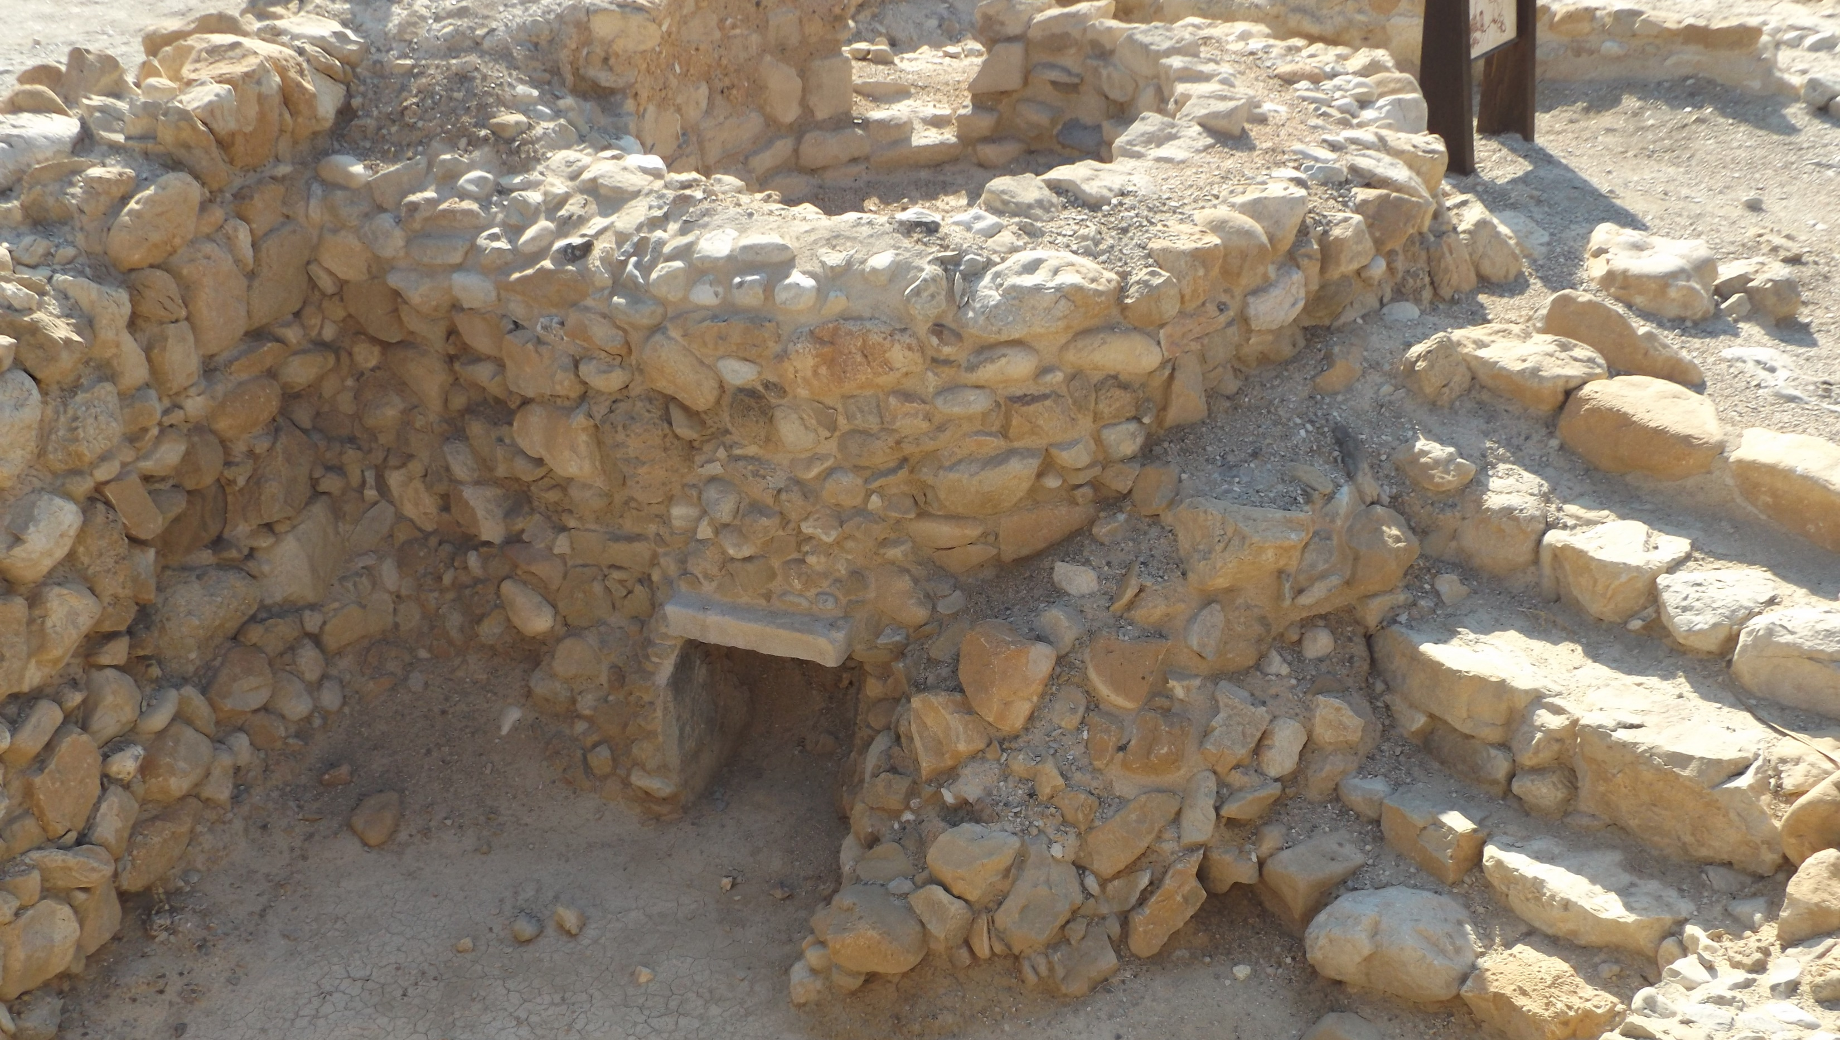
Possible Essene Ruins at Qumran
At LEFT: Ritual Bath
BELOW: Kiln

Slide 11
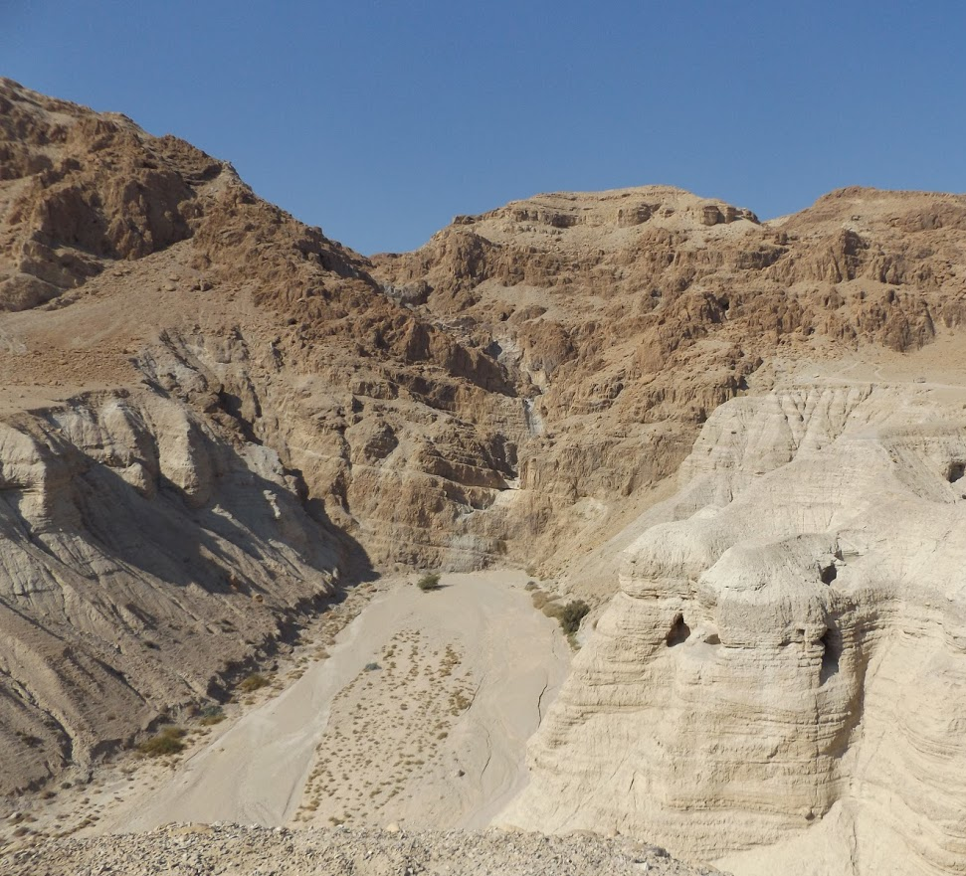
Qumran Caves & Wadi Qumran
The majority of the Dead Sea Scrolls were discovered in caves adjacent to the Qumran settlement.
The Scrolls are mainly copies of religious writings and Bible texts that date from the 3rd century B.C. to the 1st century A.D. They MAY have been produced and preserved by the Essenes.

Slide 12
The Zealots
Objected to God’s people being ruled by Gentiles, and so desired to overthrow Roman rule by force.
Began in AD 6 when Judas the Galilean and Zadduk the Pharisee rebelled against Rome.
They refused to pay taxes to Rome and regarded loyalty to Caesar as a sin.
Simon the Zealot or Canaanite (Aramaic for “zealot”) became a disciple of Christ (Luke 6:15; Acts 1:13; Mark 3:18)
Prior to doing so, he would have been a mortal enemy of Matthew the tax collector.

Slide 13
The Herodians
A small group of politically minded Jews. Connected to the Sadducees, “who supported the Herodian dynasty, and by implication, the Roman rule which had put the Herods in power” (Gundry).

Slide 14
Captivity – Return – Years of Silence
REVIEW

Slide 15
12 – Captivity
606-536 B.C. – 70 years
606/605 B.C. First captives taken; Daniel and his 3 friends. They remain pure in the midst of trial.
597 B.C. Second captives taken; Ezekiel sees visions of imminent punishment but ultimate glory.
586 B.C. Jeremiah witnesses the fall of Jerusalem. Judah is carried away captive
Notes:
2Ki 25:21 Then the king of Babylon struck them and put them to death at Riblah in the land of Hamath. Thus Judah was carried away captive from its own land.

Slide 16
Daniel
Dreams of Nebuchadnezzar
Delicacies
Dainties
Darius
Den of lions
Taken captive in 606 B.C.

Slide 17
Ezekiel (Priest & Scribe)
Exile
Everyday people
Explaining why
Egypt will fall
Edom desolate
Taken captive in 597 B.C.

Slide 18
Jeremiah (Priest & Prophet)
Judah
Jerusalem
Justice is coming
Began in 626 BC
Prophesied 40 years

Slide 19
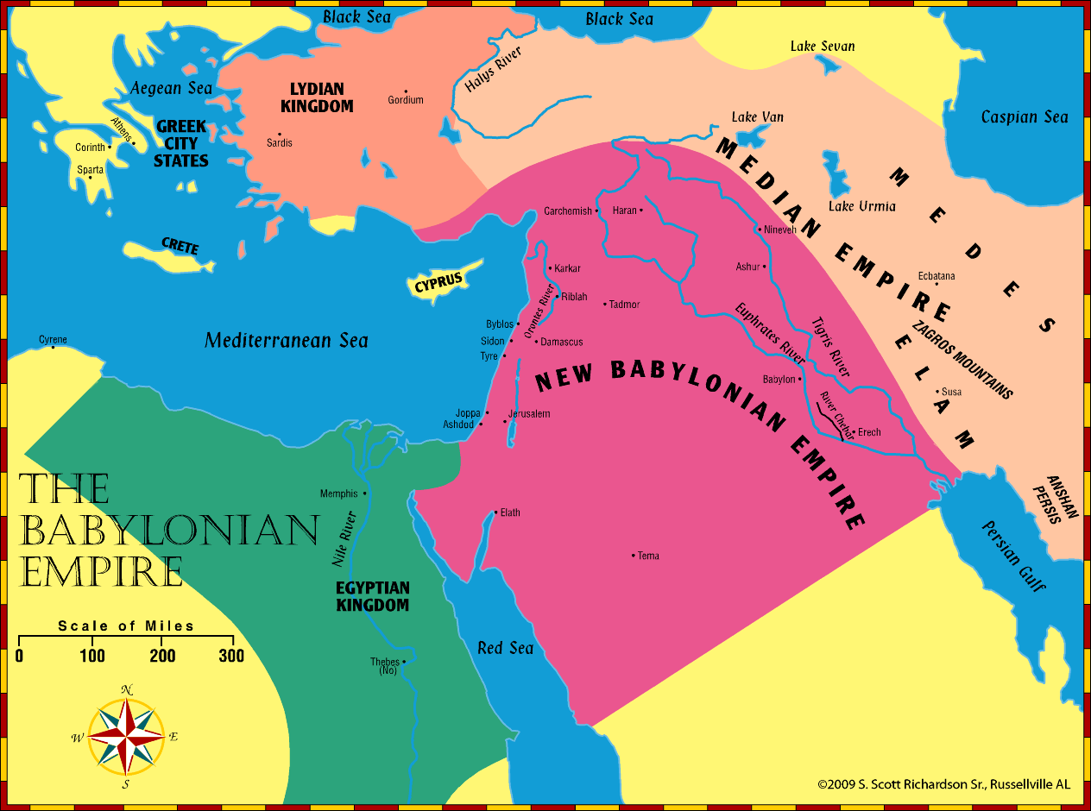
ZerubbabelEzra
Nehemiah
Haggai
Zechariah
Malachi
Esther
Nehemiah
Daniel
Jeremiah
Ezekiel

Slide 20
13 – Return from Captivity
536 B.C. – first return; decree of Cyrus king of Persia (Ezra 1:1)
Zerubbabel – built temple; not like Solomon’s, but the Messiah would bring glory to it.
483 B.C. – Esther – God preserves His people even in the lands of captivity.
458 B.C. – Ezra – restores worship
Notes:
Ezr 1:1 Now in the first year of Cyrus king of Persia, that the word of the LORD by the mouth of Jeremiah might be fulfilled, the LORD stirred up the spirit of Cyrus king of Persia, so that he made a proclamation throughout all his kingdom, and also put it in writing, saying,
2 Thus says Cyrus king of Persia: All the kingdoms of the earth the LORD God of heaven has given me. And He has commanded me to build Him a house at Jerusalem which is in Judah.

Slide 21
13 – Return from Captivity
445-443 B.C. – Nehemiah (Nehemiah 2:1, 13:6) – rebuilds walls in 52 days!
Malachi ends the period with the promise of sending “Elijah the prophet” 433/432 B.C.

Slide 22
Important Dates To Remember
612 B.C.
606 B.C.
586 B.C.
539 B.C.
536 B.C.
520 B.C.
516 B.C.
483 B.C.
458 B.C.
445 B.C.
430 B.C.
Babylon defeats Assyria
1st captives taken (Daniel & 3 friends)
Judah falls to Babylon; captivity begins
Medo-Persia defeats Babylon
– Zerubbabel (temple)
Prophecies of Haggai & Zechariah
Temple completed
Story of Esther (between Ezra 6-7)
– Ezra (spiritual infrastructure)
– Nehemiah (city walls)
Prophecy of Malachi
70
yrs
RETURN #1
RETURN #2
RETURN #3

Slide 23
14 – Years of Silence 400 BC to John the Baptist
The prophecies of Daniel 2, 7-8, and 10-12 foretell many events that would take place during the years of silence.
The rise of Greece and four subsequent kingdoms.
The troublesome conflict between the Greek kingdoms of the North and South (Seleucids & Ptolemies).
God’s people are caught in the middle in the glorious land.
A king of the North (Antiochus IV) defiles the temple and causes the daily Sacrifices to cease.
Through much conflict, God’s people throw off oppression.
Rome rises to dominate the entire Mediterranean basin.

