Slide 1



1 John
C o n f i d e n c e I n C h r i s t
Notes:
Confidence in Christ

Slide 2
1 John
C o n f i d e n c e I n C h r i s t
Introduction and Overview
Notes:
Confidence in Christ

Slide 3
The Relationship Between First John & The Gospel Of John
First John builds on the groundwork of belief that was laid in the Gospel of John.
In John we are given reasons to believe (Jn. 20:30-31).
In 1 John we are given assurance that believers are “born of God” and “have eternal life” (1 Jn. 5:1, 13).
In John we learn that Jesus is “light” (Jn. 1:4-9; 3:19-21; 8:12; 12:46).
In 1 John we are told that believers must not walk in darkness (1 Jn. 1:5-7).
Notes:
John 1:4 In Him was life, and the life was the light of men.
John 3:19 And this is the condemnation, that the light has come into the world, and men loved darkness rather than light, because their deeds were evil.
John 8:12 Then Jesus spoke to them again, saying, "I am the light of the world. He who follows Me shall not walk in darkness, but have the light of life.“
John 12:46 I have come as a light into the world, that whoever believes in Me should not abide in darkness.

Slide 4
The Relationship Between First John & The Gospel Of John
First John builds on the groundwork of belief that was laid in the Gospel of John.
John 3:16 teaches that Jesus is the gift of God’s love.
1 John 4:16 explains that whoever abides in Jesus abides in God’s love.
John 1:29 teaches that Jesus came to take away “the sin of the world.”
1 John 3:5-6 shows that whoever abides in Jesus does not sin.

Slide 5
The Relationship Between First John & The Gospel Of John
Other areas of similarity between 1 John & John:
Both present testimony that Jesus is the “Word” of God who came in the flesh (Jn. 1:1, 14; 19:35; 1 Jn. 1:1-2).
Both reveal that life is in God’s Son (John 1:4; 5:21-26; 6:47-48; 11:25; 1 John 5:11-12).
Both speak of the relationship between love and keeping commandments (John 14:15, 21, 23-24; 15:10; 1 John 2:5; 5:2-3).
Both emphasize that those who receive God’s love must love one another (John 13:34; 15:9-12; 1 John 3:16-18; 4:7-12).
Notes:
John 19:35 And he who has seen has testified, and his testimony is true; and he knows that he is telling the truth, so that you may believe.
John 5:21 For as the Father raises the dead and gives life to them, even so the Son gives life to whom He will.
John 6:47-48 Most assuredly, I say to you, he who believes in Me has everlasting life. (48) I am the bread of life.
John 11:25 Jesus said to her, "I am the resurrection and the life. He who believes in Me, though he may die, he shall live.
John 14:15 "If you love Me, keep My commandments.
John 14:21 He who has My commandments and keeps them, it is he who loves Me. And he who loves Me will be loved by My Father, and I will love him and manifest Myself to him.“
John 14:23 Jesus answered and said to him, "If anyone loves Me, he will keep My word; and My Father will love him, and We will come to him and make Our home with him.
John 15:10 If you keep My commandments, you will abide in My love, just as I have kept My Father's commandments and abide in His love.
John 13:34 A new commandment I give to you, that you love one another; as I have loved you, that you also love one another.
John 15:12 This is My commandment, that you love one another as I have loved you.

Slide 6
“That You may Know…”
First John is written for the following reasons:
“…that your joy may be full” (1 John 1:4)
“…so that you may not sin” (1 John 2:1)
“… because you know [the truth]” (1 John 2:21)
“…concerning those who try to deceive you” (1 John 2:26)
“…that you may know that you have eternal life” (1 John 5:13).
Each of these truths gives us Confidence!

Slide 7
“Concerning those who are trying to deceive you…”
John was writing to combat the effects of particular false teaching.
He plainly says that he has written “concerning those who try to deceive you” (2:26)
False prophets had gone out into the world and the spirit of the Antichrist was at work (4:1-3; 2:18-19).
The nature of the false teaching they espoused:
Denied that God’s Son came in the flesh (4:2).
May have claimed that one could know God without keeping commandments (2:4), and that one could be righteous without practicing righteousness (3:7).
Called into question the spiritual “knowledge” of true believers (2:21-22).

Slide 8

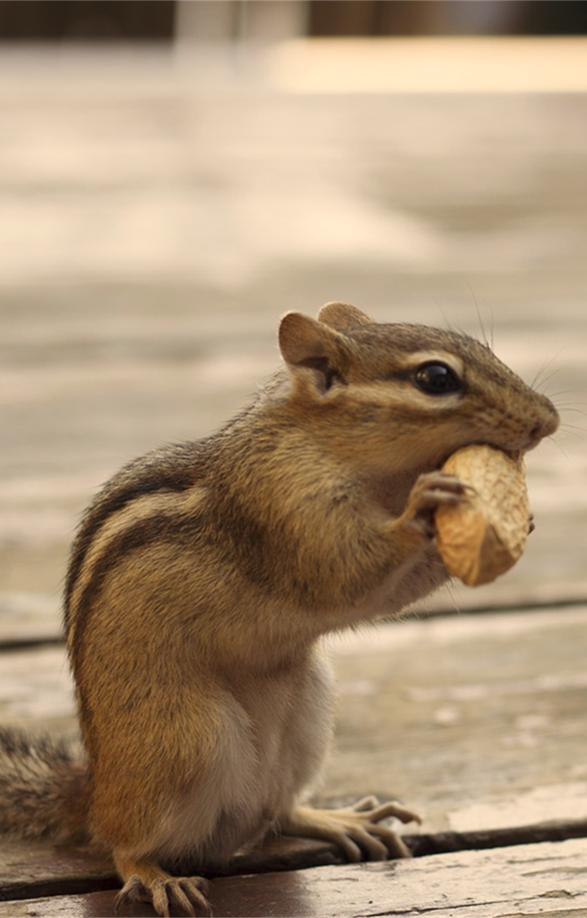
Gnosticism in a Nutshell
Redemption is in special knowledge (“gnosis”). It required enlightenment, not repentance.
All matter is evil.
The world was not created by God but by a lower spirit being (a “demiurge”).
Christ did not actually partake of humanity – He only “seemed to” (docetism).

Slide 9
Why address the errors of the Gnostics in an Inspired Book?
Because Gnosticism would become a widespread problem.
Because John himself had probably been confronted with the seeds of Gnosticism.
Because the same errors made by the Gnostics would continue to plague mankind down to the present time.
Note: This is the same reason the New Testament addresses the errors of Pharisees, Sadducees, Athenian idolaters, and the Nicolaitans – We still face the same issues!

Slide 10
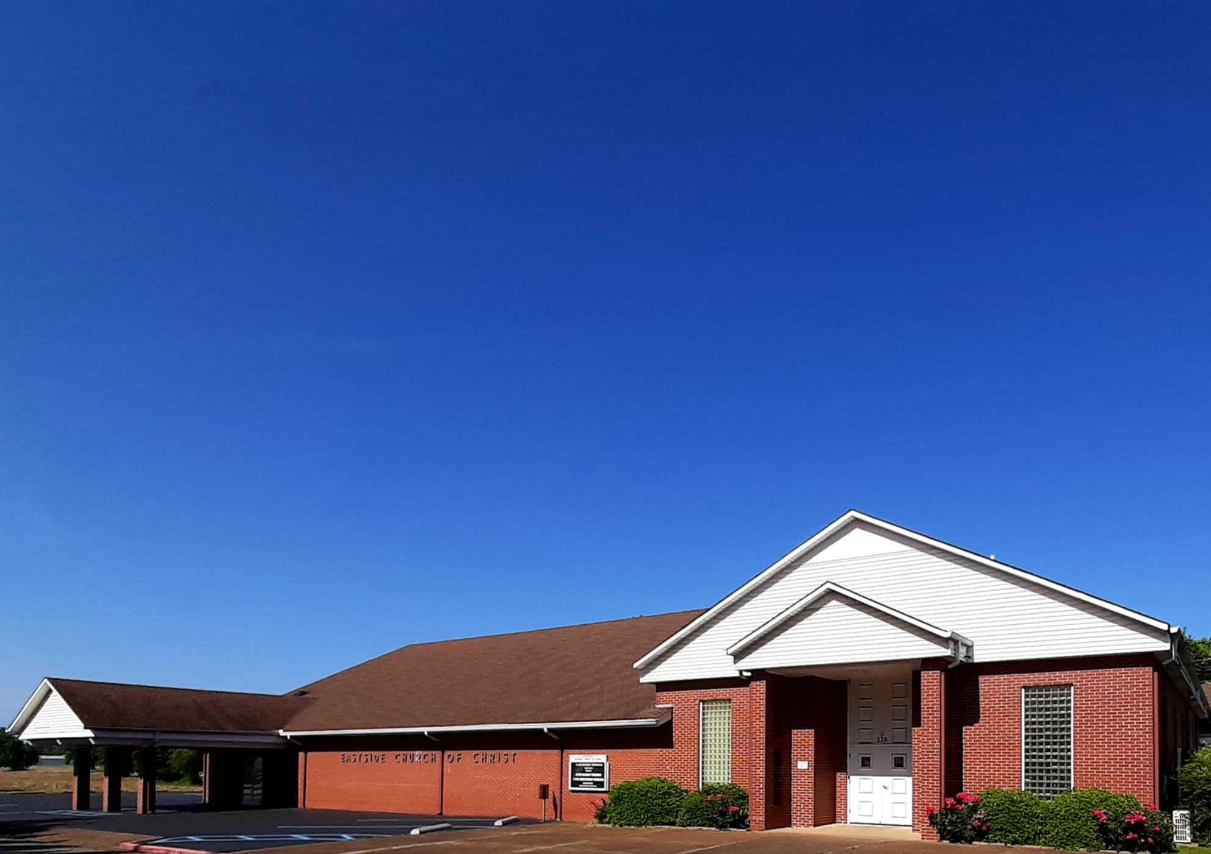
Eastside Church of Christ
Eastside-church.org

