Slide 1
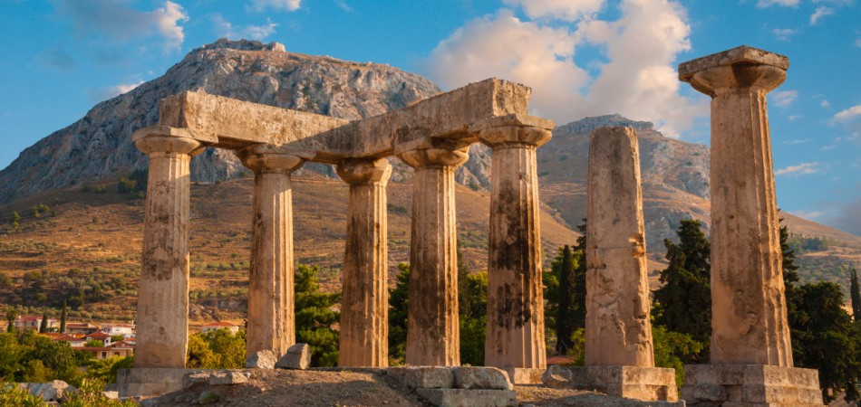
The Epistle of First Corinthians

Slide 2
Outline of 1 Corinthians
SECTION ONE: Dealing with reported problems (1:1—6:20)
A. Unity based on God’s wisdom (1:10—4:21)
  Greeting, thanksgiving, and exhortation to unity (1:1-17)
  God’s wisdom & power vs. human pride (1:18-31)
  Paul’s Example – relying on God’s wisdom and power (2:1-16)
  God’s foundation and building (3:1-23)
  The quality of Paul’s apostleship (4:1-21)
B. Dealing with sin in the church (5-6)
  Dealing with the immoral (5:1-13)
  Dealing with those filing lawsuits (6:1-11)
  Flee Sexual Immorality (6:12-20)

Slide 3
Outline of 1 Corinthians
SECTION TWO: Dealing with questions and concerns of the Corinthians (7:1--16:9)
C. Their Concerns (7-9)
  Marriage problems & issues for singles (7:1-16)
  Live as you are called (7:17-40)
  Things offered to idols (8:1-13)
  The rights and responsibilities of preachers (9:1-27)
D. Common Concerns (10-11)
  Old Testament warnings about temptation (10:1-13)
  Flee idolatry (10:14-33)
  Respecting headship when praying or prophesying (11:1-16)
  The Lord’s Supper (11:17-34)

Slide 4
Outline of 1 Corinthians
SECTION TWO: Dealing with questions and concerns of the Corinthians (7:1--16:9)
E. Spiritual Gifts (12-14)
  Gifts of Spirit (12:1-31)
  The superiority of love (13:1-13)
  Keeping tongues in perspective (14:1-22)
  Order and decorum in the assembly (14:23-40)
F. The Gospel of the Resurrection (15)
  The Gospel and the FACT of the resurrection (15:1-20)
  The Character of Resurrection (15:21-58)
G. Closing Words (16)
  Concerning the collection and Paul’s future plans (16:1-24)

Slide 5
Things Offered to Idols (8:1-13)
The Danger of Knowledge (8:1-3)
This chapter begins a section (chapters 8-10) which repeatedly shows the value of forfeiting personal rights for the benefit of others.
Paul now answers concerns about “things offered to idols”
  “We all have knowledge” may be quoted from what the Corinthians had written to Paul
Knowledge puffs up, but love builds up! (cf. Ephesians 4:15-16)
  If you think you know, you don’t! (Romans 12:16; Isaiah 5:21; Proverbs 26:12)
Notes:
Ephesians 4:15-16 but, speaking the truth in love, may grow up in all things into Him who is the head—Christ— 16 from whom the whole body, joined and knit together by what every joint supplies, according to the effective working by which every part does its share, causes growth of the body for the edifying of itself in love.
Romans 12:16 Be of the same mind toward one another. Do not set your mind on high things, but associate with the humble. Do not be wise in your own opinion.
Isaiah 5:21 Woe to those who are wise in their own eyes, And prudent in their own sight!
Proverbs 26:12 Do you see a man wise in his own eyes? There is more hope for a fool than for him.

Slide 6
Things Offered to Idols (8:1-13)
What we “know” about eating things offered to idols (8:4-6)
An idol is nothing! (Ps. 115:1-8; Isaiah 44:9-20)
There is but one God
  So called “gods” are of no significance compared to the one God, the Father, and the one Lord Jesus.
    “All things” are of God the Father (Rev. 4:11)
    We are for Him (Ephesians 1:5; Titus 2:14)
    All things are through Christ (Eph. 3:9; John 1:3; Colossians 1:16; Hebrews 1:2)
    Through Him we live (Romans 6:4, 23)
Notes:
Revelation 4:11 "You are worthy, O Lord, To receive glory and honor and power; For You created all things, And by Your will they exist and were created."
Ephesians 1:5 having predestined us to adoption as sons by Jesus Christ to Himself, according to the good pleasure of His will,
Titus 2:14 who gave Himself for us, that He might redeem us from every lawless deed and purify for Himself His own special people, zealous for good works.
Ephesians 3:9b “… God who created all things through Jesus Christ”
John 1:3 All things were made through Him, and without Him nothing was made that was made.
Colossians 1:16 For by Him all things were created that are in heaven and that are on earth, visible and invisible, whether thrones or dominions or principalities or powers. All things were created through Him and for Him.
Hebrews 1:2 has in these last days spoken to us by His Son, whom He has appointed heir of all things, through whom also He made the worlds;

Slide 7
Things Offered to Idols (8:1-13)
Avoid becoming a stumbling to someone who doesn’t know what you know (8:7-13)
Some Christians, who may formerly have been idolaters, could not eat meat sacrificed to an idol without feeling that they were sinning (8:7)
The truth is that food morally neutral (8:8; Matthew 15:11, 17-18)
  Those who understand this truth must be careful not to allow their freedom to eat to become a stumbling block to the one with a weak conscience (8:9)
  Just because you CAN do something, doesn’t mean you SHOULD!!!
Notes:
“Sacrifices unto idols. Meat that had been offered in sacrifice, and then either exposed to sale in the market, or served up at the feasts held in honor of idols, at their temples, or at the houses of their devotees. The priests, who were entitled to a part of the meat that was offered in sacrifice, would expose it to sale in the market; and it was a custom with the Gentiles to make feasts in honor of the idol gods on the meat that was offered in sacrifice; see 1Co_8:10, of this chapter, and 1Co_10:20-21. Some Christians would hold that there could be no harm in partaking of this meat any more than any other meat, since an idol was nothing; and others would have many scruples in regard to it, since it would seem to countenance idol worship. The request made of Paul was, that he should settle some “general principle” which they might all safely follow.” (Albert Barnes)
“When an animal was sacrificed, only a small portion of that animal was burned. The priests took a part of it for themselves and a part was taken by the worshiper. On some occasions, a public worship service was conducted that consisted in a feast in the idol’s temple in which the meats sacrificed to the idol were eaten. Not every sacrifice was attended by a public feast. When the sacrificed animal was divided between the priest and the worshiper, the priest used what was his as he desired, either eating it or selling it in the marketplace. No doubt meat sacrificed to an idol brought a premium price (because animals used in sacrifice were choice animals and the sacredness the pagans attached to its having been sacrificed to the god). The worshiper would take his portion home and eat it in the privacy of his home, sometimes inviting a friend or neighbor to share in his feast.” (Mike Willis)
Matthew 15:11 Not what goes into the mouth defiles a man; but what comes out of the mouth, this defiles a man.“
Matthew 15:17-18 Do you not yet understand that whatever enters the mouth goes into the stomach and is eliminated? 18 But those things which proceed out of the mouth come from the heart, and they defile a man.

Slide 8
Things Offered to Idols (8:1-13)
Avoid becoming a stumbling to someone who doesn’t know what you know (8:7-13)
If exercising your right (to eat meat) encourages a brother to violate his conscience, you have caused him to sin and perish! (Romans 14:14-23; 6:23)
By sinning against one’s brother, one sins against Christ (8:12; cf. Matthew 25:40; Acts 8:3; 9:4-5)
We must determine to forfeit any liberty or right that hinders a brother’s salvation! (8:13)
Notes:
Matthew 25:40 And the King will answer and say to them, 'Assuredly, I say to you, inasmuch as you did it to one of the least of these My brethren, you did it to Me.’
Acts 8:3 As for Saul, he made havoc of the church, entering every house, and dragging off men and women, committing them to prison.
Acts 9:3-5 As he journeyed he came near Damascus, and suddenly a light shone around him from heaven. 4 Then he fell to the ground, and heard a voice saying to him, "Saul, Saul, why are you persecuting Me?" 5 And he said, "Who are You, Lord?" Then the Lord said, "I am Jesus, whom you are persecuting. It is hard for you to kick against the goads."

Slide 9
Lesson Schedule for our study of First Corinthians
Eastside Auditorium Fall Quarter 2017

