Slide 1
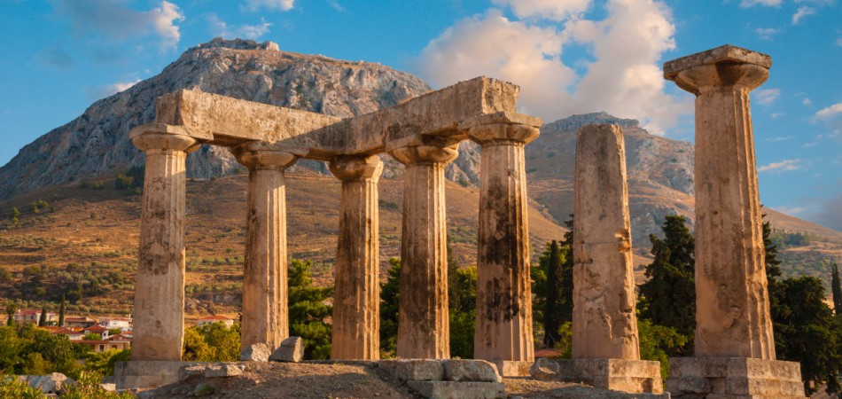
The Epistle of First Corinthians

Slide 2
Outline of 1 Corinthians
SECTION ONE: Dealing with reported problems (1:1—6:20)
A. Unity based on God’s wisdom (1:10—4:21)
  Greeting, thanksgiving, and exhortation to unity (1:1-17)
  God’s wisdom & power vs. human pride (1:18-31)
  Paul’s Example – relying on God’s wisdom and power (2:1-16)
  God’s foundation and building (3:1-23)
  The quality of Paul’s apostleship (4:1-21)
B. Dealing with sin in the church (5-6)
  Dealing with the immoral (5:1-13)
  Dealing with those filing lawsuits (6:1-11)
  Flee Sexual Immorality (6:12-20)

Slide 3
Outline of 1 Corinthians
SECTION TWO: Dealing with questions and concerns of the Corinthians (7:1--16:9)
C. Their Concerns (7-9)
  Marriage problems & issues for singles (7:1-16)
  Live as you are called (7:17-40)
  Things offered to idols (8:1-13)
  The rights and responsibilities of preachers (9:1-27)
D. Common Concerns (10-11)
  Old Testament warnings about temptation (10:1-13)
  Flee idolatry (10:14-33)
  Respecting headship when praying or prophesying (11:1-16)
  The Lord’s Supper (11:17-34)

Slide 4
Review- Chapter 8
v.1- Some were puffed up- Rom. 12:16
v.4- Idols are nothing!! Isaiah 44:14-17
v.6- one God- His will- Eph. 1:5
v.7- concerning the weak- Matt. 15:11;17-18
v.9-10- don’t cause your brother to stumble
Anybody is more important than anything!

Slide 5
1 Corinthians 9
vs. 1- Paul again establishes apostleship with rhetorical questions
vs. 2- at the very least Paul was an apostle to the Corinthians, they were his seal
vs. 3- those who question/examine Paul should answer these questions
vs. 4- do we (Paul/Barnabas) have the right to eat and drink
vs. 5- do we not have the power to take along a sister (wife) as others have; Peter

Slide 6
1 Corinthians 9
vs. 6- are Barnabas and I the only ones who can’t refrain from working for a living
vs. 7- does a soldier pay his own way, does a husbandman eat his grapes, does a shepherd drink milk of his flock
vs. 8- does human authority or God’s law allow us to do this
vs. 9- the law of Moses says even the ox can eat from the grain it treads (Deut. 25:4)
vs. 10- this speaks for our sakes; the plowman and thresher should have hope

Slide 7
1 Corinthians 9
vs. 11- we have sown spiritual things to you, is it too much to ask we reap material things from you
vs. 12- if others share a claim on you, do we not even more
vs. 13- those who work in the temple and at the altar, share in food/sacrifices
vs. 14- in this manner, the Lord commanded those who preach, should make their living from preaching
vs. 15- Paul says he has not used this right

Slide 8
1 Corinthians 9
vs. 16- Paul had nothing to glory of even though he preached the gospel
vs. 17- Paul has a reward if he preaches willingly, he was entrusted with a stewardship
vs. 18- Paul’s reward was in preaching the gospel free of charge
vs. 19- Paul became a servant to win more
vs. 20- Paul became a Jew to Jews, as under the law to those under the law

Slide 9
1 Corinthians 9
vs. 21- to those without, as being without law
vs. 22- weak to the weak, all things to all men, to save more
vs. 23- Paul did this for the gospel’s sake, to be a partaker with them
vs. 24- all run in a race, but one wins the prize
vs. 25- everyone that strives for mastery has self-restraint, but they do it for a corrupt crown, but we do it for an incorruptible crown

Slide 10
1 Corinthians 9
vs. 26- Paul therefore runs, not without knowing the object of his aim, so he fights, not just beating the air for nothing
vs. 27- Paul brings his body into subjection so when he preaches to others he will not be unfit or disqualified

