Slide 1
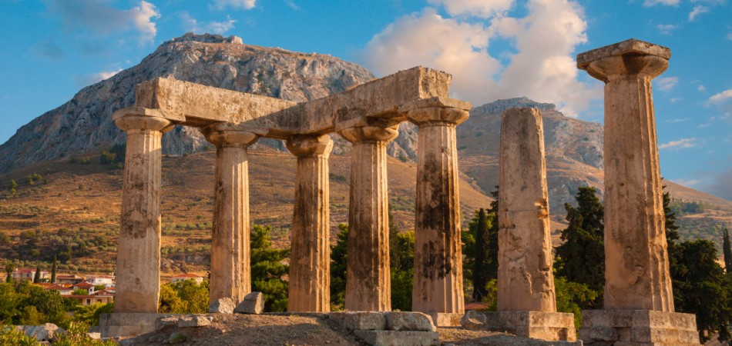
The Epistle of First Corinthians

Slide 2
Outline of 1 Corinthians
SECTION ONE: Dealing with reported problems (1:1—6:20)
A. Unity based on God’s wisdom (1:10—4:21)
Greeting, thanksgiving, and exhortation to unity (1:1-17)
God’s wisdom & power vs. human pride (1:18-31)
Paul’s Example – relying on God’s wisdom and power (2:1-16)
God’s foundation and building (3:1-23)
The quality of Paul’s apostleship (4:1-21)
B. Dealing with sin in the church (5-6)
Dealing with the immoral (5:1-13)
Dealing with those filing lawsuits (6:1-11)
Flee Sexual Immorality (6:12-20)

Slide 3
Outline of 1 Corinthians
SECTION TWO: Dealing with questions and concerns of the Corinthians (7:1--16:9)
C. Their Concerns (7-9)
Marriage problems & issues for singles (7:1-16)
Live as you are called (7:17-40)
Things offered to idols (8:1-13)
The rights and responsibilities of preachers (9:1-27)
D. Common Concerns (10-11)
Old Testament warnings about temptation (10:1-13)
Flee idolatry (10:14-33)
Respecting headship when praying or prophesying (11:1-16)
The Lord’s Supper (11:17-34)

Slide 4
Outline of 1 Corinthians
SECTION TWO: Dealing with questions and concerns of the Corinthians (7:1--16:9)
E. Spiritual Gifts (12-14)
Gifts of Spirit (12:1-31)
The Superiority of Love (13:1-13)
Keeping Tongues in Perspective (14:1-22)
Order and Decorum in the Assembly (14:23-40)
F. The Gospel of the Resurrection (15)
The Gospel and the FACT of the Resurrection (15:1-20)
The Character of Resurrection (15:21-58)
G. Closing Words (16)
Concerning the Collection and Paul’s Future Plans (16:1-24)

Slide 5
1 Corinthians 12: 1-3
Introduction and test as to the source of Spiritual gifts.
These gifts were not intended to continue until the end of time
Paul did not want them to be ignorant about Spiritual gifts
You were Gentiles going after dumb idols
I want you to understand that no man speaking by the Spirit of God calleth Jesus Christ accursed (blasphemed His name) is not of God & are imposters
The only way man can say Jesus is the Lord is by the Holy Spirit ( acknowledge Jesus as their Master)
1Jo 4:2 Hereby know ye the Spirit of God: Every spirit that confesseth that Jesus Christ is come in the flesh is of God:

Slide 6
1 Corinthians 12: 4-11
Diversities of gifts-
But same Spirit v 4
Differences of admistration-
But the same Lord v 5
Diversities of operation-
But the same God v 6
The word for “gifts” is charisma. It refers here to these spiritual and miraculous gifts, but the word is not used exclusively for miraculous gifts. It emphasizes the grace by which the gifts were given.

Slide 7
Note the emphasis of the word differences/diversities and same in verses 4-6. There was a diversity of gifts, administrations, and operations. The source of these came from; the Spirit, the Lord, and God.
The manifestation of the Spirit is given to every man to profit withal.
So what is the test of spiritual gifts?
It is that the doctrine is true?
Charismata = extraordinary powers that came to them from the grace of God
The source of these came from; the Spirit, the Lord, and God
The gifts were not earned; hence there was no room for anyone to boast about his gift

Slide 8
Administration = Service or ministering
The gifts were a service that was necessary
Operations = a work or a thing wrought
The word “same” emphasizes the common origin, design and goal of the gifts
The text lists 9 different gifts
Wisdom 6. Prophecy
Knowledge 7. Discerning of spirits
Faith 8. Kinds of tongues
Healing 9. Interpretation of
Working of Miracles Tongues

Slide 9
Wisdom and word of knowledge may be considered as practical knowledge (wisdom) and speculative knowledge we just can’t be sure about the differences of these gifts
Faith– Not saving faith which every member must possess … but a miraculous faith as mentioned in 13: 2 And though I have the gift of prophecy, and understand all mysteries, and all knowledge; and though I have all faith, so that I could remove mountains, and have not charity, I am nothing.
Mt 17:20 And Jesus said unto them, Because of your unbelief: for verily I say unto you, If ye have faith as a grain of mustard seed, ye shall say unto this mountain, Remove hence to yonder place; and it shall remove; and nothing shall be impossible unto you.

Slide 10
Mt 21:21 Jesus answered and said unto them, Verily I say unto you, If ye have faith, and doubt not, ye shall not only do this which is done to the fig tree, but also if ye shall say unto this mountain, Be thou removed, and be thou cast into the sea; it shall be done.
Healing… The ability to heal the sick through a miracle like Jesus did on many occasions. The power He gave to His disciples. Mt 10:1 ¶ And when he had called unto him his twelve disciples, he gave them power against unclean spirits, to cast them out, and to heal all manner of sickness and all manner of disease.
Working of Miracles…may include casting out demons, inflicting divine judgment as Paul did to Ananias and Sapphira Acts 5: 1-11

Slide 11
As Paul did to Elymas in Acts 13: 8-11
Prophecy… This was teaching under the inspiration of the Holy Spirit
Discerning of spirits… where one had the ability to test whether one was teaching the truth 1Co 14:9 So likewise ye, except ye utter by the tongue words easy to be understood, how shall it be known what is spoken? for ye shall speak into the air.
Kinds of tongues…The word tongue refers to a specific language and one that had not been learned …Ac 2:7 And they were all amazed and marvelled, saying one to another, Behold, are not all these which speak Galilaeans?
8 And how hear we every man in our own tongue, wherein we were born?

Slide 12
Interpretation of tongues…ability to translate a tongue from a language one does not understand
This power was given by the Holy Spirit and given to individual members as He willed
Unity of the Various Gifts 12:12-31
Paul compares the different gifts to a body that has many different members 12:12
One must remember that the different members have to work together to form one body.
So it is in Christ
1Co 12:13 For by one Spirit are we all baptized into one body, whether we be Jews or Gentiles, whether we be bond or free; and have been all made to drink into one Spirit.

Slide 13
Now we look at an analogy of the Lord’s spiritual body to a physical body 12:14-26
The Body is not just one member but many
All spiritual gifts were needed for the body (church) to function just like the various members are needed in a physical body
No part of the body is unneeded because each part contributes something to the body function
Despite there were many different gifts there was but one body.
The members co-operate to make the body function
God has designed the body so that the least honorable parts may be the most necessary

Slide 14
The parts of the body have no schism (pride) but genuine care for each other
Example.. If your knee hurts the hand rubs it
We can all understand this process from a burn or cut on our body.
The body of Christ should be the same if one member is hurting the others help
The greatest honor speaking in tongues was listed last and least honorable was near the top
It is important that all work together for the good of the body (church) and physical body

