Slide 1
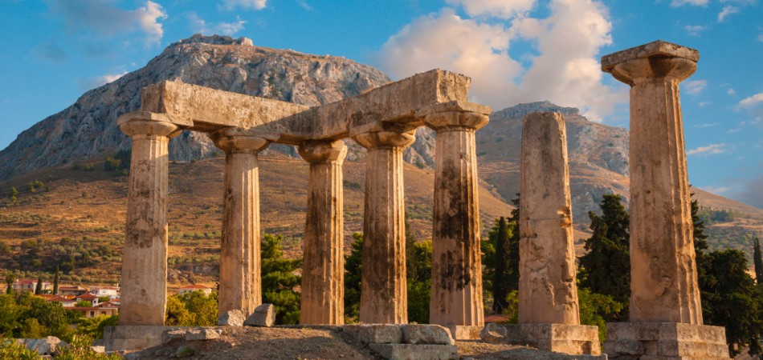
The Epistle of First Corinthians

Slide 2
Outline of 1 Corinthians
SECTION ONE: Dealing with reported problems (1:1—6:20)
A. Unity based on God’s wisdom (1:10—4:21)
Greeting, thanksgiving, and exhortation to unity (1:1-17)
God’s wisdom & power vs. human pride (1:18-31)
Paul’s Example – relying on God’s wisdom and power (2:1-16)
God’s foundation and building (3:1-23)
The quality of Paul’s apostleship (4:1-21)
B. Dealing with sin in the church (5-6)
Dealing with the immoral (5:1-13)
Dealing with those filing lawsuits (6:1-11)
Flee Sexual Immorality (6:12-20)

Slide 3
Outline of 1 Corinthians
SECTION TWO: Dealing with questions and concerns of the Corinthians (7:1--16:9)
C. Their Concerns (7-9)
Marriage problems & issues for singles (7:1-16)
Live as you are called (7:17-40)
Things offered to idols (8:1-13)
The rights and responsibilities of preachers (9:1-27)
D. Common Concerns (10-11)
Old Testament warnings about temptation (10:1-13)
Flee idolatry (10:14-33)
Respecting headship when praying or prophesying (11:1-16)
The Lord’s Supper (11:17-34)

Slide 4
Outline of 1 Corinthians
SECTION TWO: Dealing with questions and concerns of the Corinthians (7:1--16:9)
E. Spiritual Gifts (12-14)
Gifts of Spirit (12:1-31)
The superiority of love (13:1-13)
Keeping tongues in perspective (14:1-22)
Order and decorum in the assembly (14:23-40)
F. The Gospel of the Resurrection (15)
The Gospel and the FACT of the resurrection (15:1-20)
The Character of Resurrection (15:21-58)
G. Closing Words (16)
Concerning the collection and Paul’s future plans (16:1-24)

Slide 5
The Character of Resurrection (15:21-58)
Scope & Order of the Resurrection (15:20-23)
Jesus is the “firstfruits” from the dead – the pledge of more to come (15:20)
As Adam brought death to all, Christ brings life. (15:21-22; Genesis 3:19)
The order is…
Death -> Resurrection of Christ -> Resurrection of all (15:23, 45-49; John 5:28-29; 1 Thessalonians 4:16)
Notes:
Genesis 3:19 In the sweat of your face you shall eat bread Till you return to the ground, For out of it you were taken; For dust you are, And to dust you shall return.“
John 5:28-29 Do not marvel at this; for the hour is coming in which all who are in the graves will hear His voice 29 and come forth—those who have done good, to the resurrection of life, and those who have done evil, to the resurrection of condemnation.
1 Thessalonians 4:16 For the Lord Himself will descend from heaven with a shout, with the voice of an archangel, and with the trumpet of God. And the dead in Christ will rise first.

Slide 6
The Character of Resurrection (15:21-58)
Duration & purpose of Jesus’ reign (15:24-28)
The second coming will coincide with the resurrection of the dead, the defeat of the last enemy, and the end of every reign but God’s.
Christ will deliver up the kingdom to the Father (15:24).
This will occur when He has put every enemy in subjection. The last enemy to be destroyed is death (15:25-26).
The Father has subjected everything, except Himself, to the Son (15:27; Psalm 8:6; Matthew 28:18; John 17:2; Ephesians 1:20-22)
When He comes again, Christ’s kingdom will be subsumed back into the reign of the Father (15:27-28).
Notes:
Psalms 8:6 You have made him to have dominion over the works of Your hands; You have put all things under his feet, (cf. Heb. 2:5-9)
Matthew 28:18 And Jesus came and spoke to them, saying, "All authority has been given to Me in heaven and on earth.
John 17:2 as You have given Him authority over all flesh, that He should give eternal life to as many as You have given Him.
Ephesians 1:20-22 which He worked in Christ when He raised Him from the dead and seated Him at His right hand in the heavenly places, 21 far above all principality and power and might and dominion, and every name that is named, not only in this age but also in that which is to come. 22 And He put all things under His feet, and gave Him to be head over all things to the church,

Slide 7
The Character of Resurrection (15:21-58)
The Resurrection stands to Reason! (15:29-34)
Paul’s rhetorical argument for man’s resurrection:
Why are “they baptized for the dead” if “the dead do not rise at all?” (15:29)
Why would Paul risk his life daily to proclaim the resurrection if the dead are not raised? (15:30-31)
Why fight with beasts at Ephesus? (15:32; 2 Cor. 1:8-10)
Why not say “let us eat and drink, for tomorrow we die?” (15:32b; Isaiah 22:13 )
“Evil company corrupts good habits!” This quote from a well-known Greek poet* exposes doctrinal error as an evil which corrupts morals! (15:33-34)
Notes:
2 Corinthians 1:8-10 For we do not want you to be ignorant, brethren, of our trouble which came to us in Asia: that we were burdened beyond measure, above strength, so that we despaired even of life. 9 Yes, we had the sentence of death in ourselves, that we should not trust in ourselves but in God who raises the dead, 10 who delivered us from so great a death, and does deliver us; in whom we trust that He will still deliver us,
Isaiah 22:13 But instead, joy and gladness, Slaying oxen and killing sheep, Eating meat and drinking wine: "Let us eat and drink, for tomorrow we die!"
* A quotation from the poet Menander, Thais 218

Slide 8
The Character of Resurrection (15:21-58)
Key Aspects of the Resurrection (15:35-49)
The body/seed must die in order to sprout new life (15:35-36; John 12:24)
What is sown and what comes forth are not the same (15:37)
God gives each individual his own body (15:38)
Distinctions between animal bodies and celestial bodies illustrate the difference between the body we sow and the body that is raised (15:39-43)
The body that was sown is natural; the body that is raised is spiritual – it’s the difference between the earthly body of Adam and the immortal body of Christ (15:44-49; Philippians 3:20-21; 1 John 3:2)
Notes:
John 12:24 Most assuredly, I say to you, unless a grain of wheat falls into the ground and dies, it remains alone; but if it dies, it produces much grain.
Philippians 3:20-21 For our citizenship is in heaven, from which we also eagerly wait for the Savior, the Lord Jesus Christ, 21 who will transform our lowly body that it may be conformed to His glorious body, according to the working by which He is able even to subdue all things to Himself.
1 John 3:2 Beloved, now we are children of God; and it has not yet been revealed what we shall be, but we know that when He is revealed, we shall be like Him, for we shall see Him as He is.

Slide 9
The Character of Resurrection (15:21-58)
The Changed Body (15:50-54)
Flesh and blood cannot inherit the kingdom, and corruption cannot inherit incorruption (15:50)
Whether dead or alive when Christ returns, we will all be changed in an instant at the last trumpet (15:51-53; 1 Thessalonians 4:15)
“Corruptible must put on incorruption, and this mortal must put on immortality”
Our incorruptible, immortal bodies put an end to death! (15:54; Isaiah 25:8)
Notes:
1 Thessalonians 4:15 For this we say to you by the word of the Lord, that we who are alive and remain until the coming of the Lord will by no means precede those who are asleep.
Isaiah 25:8 He will swallow up death forever, And the Lord GOD will wipe away tears from all faces; The rebuke of His people He will take away from all the earth; For the LORD has spoken.

Slide 10
The Character of Resurrection (15:21-58)
God gives Victory through Christ (15:55-58)
Through Christ we have the victory! (15:55-57)
Victory over death (Timothy 1:10)
Victory over sin (Romans 6:11-14; Hebrews 9:26)
Victory over the law (Ephesians 2:15)
Knowing the truth about the resurrection and its rewards motivates us to be “steadfast, immovable, always abounding in the work of the Lord.”
“Knowing that your labor is not in vain in the Lord!”
Notes:
2 Timothy 1:10 but has now been revealed by the appearing of our Savior Jesus Christ, who has abolished death and brought life and immortality to light through the gospel,
Romans 6:11-12 Likewise you also, reckon yourselves to be dead indeed to sin, but alive to God in Christ Jesus our Lord. 12 Therefore do not let sin reign in your mortal body, that you should obey it in its lusts.
Romans 6:14 For sin shall not have dominion over you, for you are not under law but under grace.
Hebrews 9:26 He then would have had to suffer often since the foundation of the world; but now, once at the end of the ages, He has appeared to put away sin by the sacrifice of Himself.
Ephesians 2:15 having abolished in His flesh the enmity, that is, the law of commandments contained in ordinances, so as to create in Himself one new man from the two, thus making peace,

Slide 11
Lesson Schedule for our study of First Corinthians Eastside Auditorium Fall Quarter 2017

