Slide 1

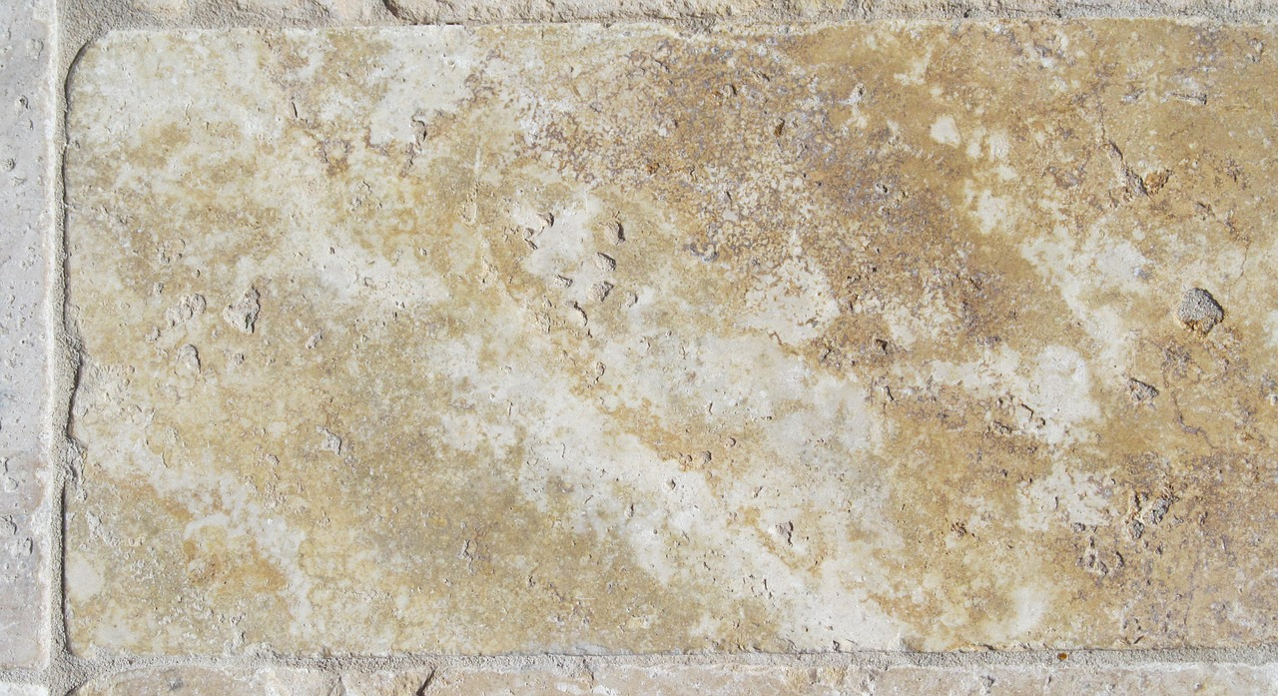

1 John
C o n f i d e n c e I n C h r i s t
Notes:
Confidence in Christ

Slide 2
1 John
C o n f i d e n c e I n C h r i s t
The Purity of the Children of God (1 John 3:1-10)
Notes:
Confidence in Christ

Slide 3
God’s Love makes us His Children
God’s great love enables us to be called His children (3:1; 2:29; 4:9; Eph. 1:4-5; Rom. 5:8; Titus 3:3-7).
  Believing in God’s loving gift provides us access into God’s family (John 1:12).
  God’s children are to be blameless and innocent – obeying without complaint (Phil 2:14-16).
  The world knows neither God nor His children (John 7:28-29; 17:25).
Confidence in our identity as God’s children gives us confidence in our eternal transformation (3:2; Phil. 3:20-21; Rom. 8:29; Luke 20:35-36).
Those who have this hope, purify themselves to be like Christ (3:3; 1 Peter 1:13-16).
Notes:
Ephesians 1:4-5 just as He chose us in Him before the foundation of the world, that we should be holy and without blame before Him in love, (5) having predestined us to adoption as sons by Jesus Christ to Himself, according to the good pleasure of His will,
Philippians 2:14-16 Do all things without complaining and disputing, (15) that you may become blameless and harmless, children of God without fault in the midst of a crooked and perverse generation, among whom you shine as lights in the world, (16) holding fast the word of life, so that I may rejoice in the day of Christ that I have not run in vain or labored in vain.
John 7:28-29 Then Jesus cried out, as He taught in the temple, saying, "You both know Me, and you know where I am from; and I have not come of Myself, but He who sent Me is true, whom you do not know. (29) But I know Him, for I am from Him, and He sent Me.“
John 17:25 O righteous Father! The world has not known You, but I have known You; and these have known that You sent Me.
Philippians 3:20-21 For our citizenship is in heaven, from which we also eagerly wait for the Savior, the Lord Jesus Christ, (21) who will transform our lowly body that it may be conformed to His glorious body, according to the working by which He is able even to subdue all things to Himself.
Romans 8:29 For whom He foreknew, He also predestined to be conformed to the image of His Son, that He might be the firstborn among many brethren.
Luke 20:35-36 But those who are counted worthy to attain that age, and the resurrection from the dead, neither marry nor are given in marriage; (36) nor can they die anymore, for they are equal to the angels and are sons of God, being sons of the resurrection.
1 Peter 1:13-16 Therefore gird up the loins of your mind, be sober, and rest your hope fully upon the grace that is to be brought to you at the revelation of Jesus Christ; (14) as obedient children, not conforming yourselves to the former lusts, as in your ignorance; (15) but as He who called you is holy, you also be holy in all your conduct, (16) because it is written, "BE HOLY, FOR I AM HOLY."

Slide 4
God’s Children do not Practice Sin
Sin is lawlessness (3:4).
Jesus was “manifested” to take away our sins (3:5; Matthew 5:17; Luke 19:10; 9:56; Hebrews 2:14).
  The Lamb of God takes away the sin of the world (John 1:29).
  Jesus became a man for this purpose (Heb. 2:17).
  Jesus’ sinlessness enables His sacrifice to take away our sins (Hebrews 4:15; 9:14; 1 Peter 1:18-20).
Whoever abides in Him does not sin (3:6).
  ESV: “No one who abides in him keeps on sinning.”
  Striving against sin is a constant issue for the child of God (1:8; 2:1; Heb. 12:4), but one who lives in sin does not know God.
Notes:
Matthew 5:17 "Do not think that I came to destroy the Law or the Prophets. I did not come to destroy but to fulfill.
Luke 19:10 for the Son of Man has come to seek and to save that which was lost.“
Luke 9:56 For the Son of Man did not come to destroy men's lives but to save them." And they went to another village.
Hebrews 2:14 Inasmuch then as the children have partaken of flesh and blood, He Himself likewise shared in the same, that through death He might destroy him who had the power of death, that is, the devil,
Hebrews 2:17 Therefore, in all things He had to be made like His brethren, that He might be a merciful and faithful High Priest in things pertaining to God, to make propitiation for the sins of the people.
Hebrews 4:15 For we do not have a High Priest who cannot sympathize with our weaknesses, but was in all points tempted as we are, yet without sin.
Hebrews 9:14 how much more shall the blood of Christ, who through the eternal Spirit offered Himself without spot to God, cleanse your conscience from dead works to serve the living God?
1 Peter 1:18-20 knowing that you were not redeemed with corruptible things, like silver or gold, from your aimless conduct received by tradition from your fathers, (19) but with the precious blood of Christ, as of a lamb without blemish and without spot. (20) He indeed was foreordained before the foundation of the world, but was manifest in these last times for you

Slide 5
Practice Proves Paternity
Those who are righteous do what is right (3:7).
  We must not allow ourselves to be deceived by anyone on this point!
  While we are not saved by our own works of righteousness, we can’t be right if we don’t do right (Titus 3:5; 1 Cor. 15:34; Eph. 5:8-10; 1 Peter 2:24).
He who makes sin his practice is of the devil who has been sinning from the beginning (3:8; Jn. 8:44).
  Jesus came to destroy the works of the devil.
He who has been born of God does not make a practice of sinning because God’s seed remains in him (3:9; 1 Peter 1:23; Psalm 119:11).
Practice proves paternity! (3:10).
Notes:
Titus 3:5 not by works of righteousness which we have done, but according to His mercy He saved us, through the washing of regeneration and renewing of the Holy Spirit,
1 Corinthians 15:34 Awake to righteousness, and do not sin; for some do not have the knowledge of God. I speak this to your shame.
Ephesians 5:8-10 For you were once darkness, but now you are light in the Lord. Walk as children of light (9) (for the fruit of the Spirit is in all goodness, righteousness, and truth), (10) finding out what is acceptable to the Lord.
1 Peter 2:24 who Himself bore our sins in His own body on the tree, that we, having died to sins, might live for righteousness—by whose stripes you were healed.
1 Peter 1:23 having been born again, not of corruptible seed but incorruptible, through the word of God which lives and abides forever,
Psalms 119:11 Your word I have hidden in my heart, That I might not sin against You.

Slide 6
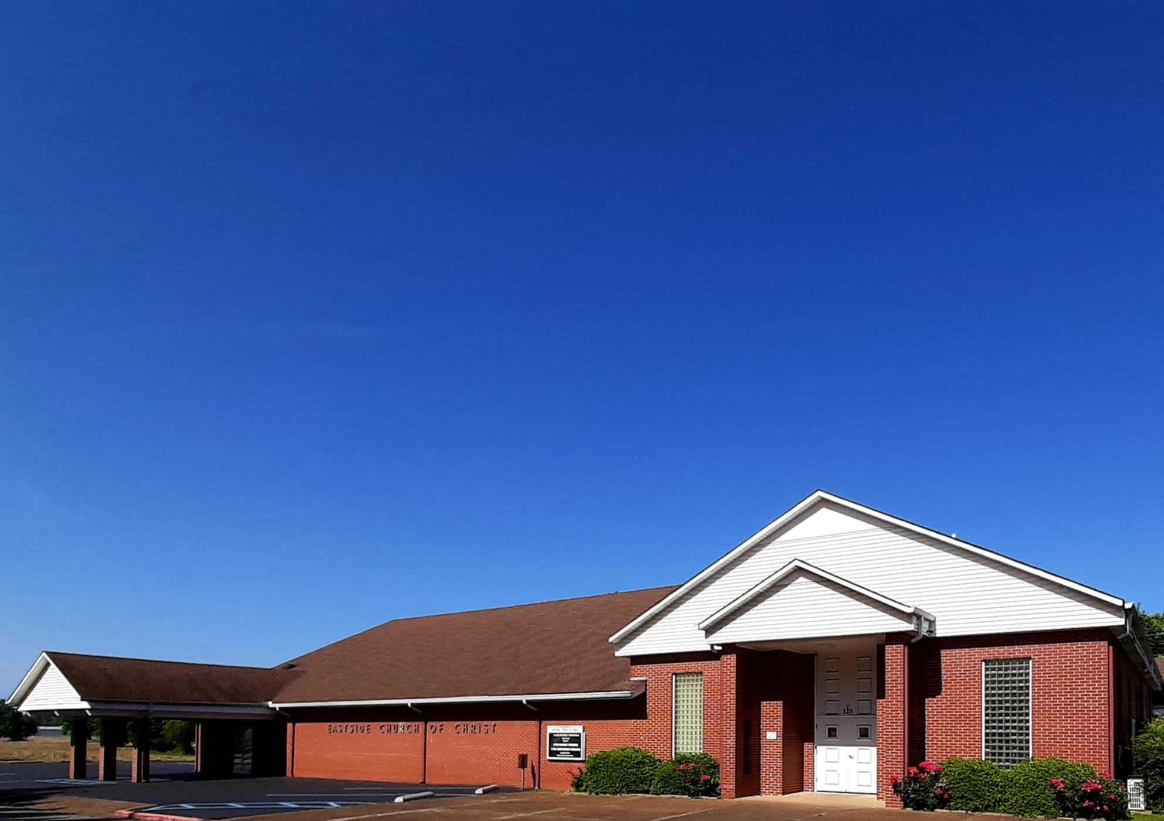
Eastside Church of Christ
Eastside-church.org

