Slide 1
The Significance of the
Twenty-Four Elders
The number 12 represents God’s people (12 tribes, 12 apostles)
Elders are respected leaders – representative of the those who rule over God’s people.
Casting their crowns before God’s throne symbolizes that they are completely subject to the rule of God – their crowns are under His crown.

Slide 2
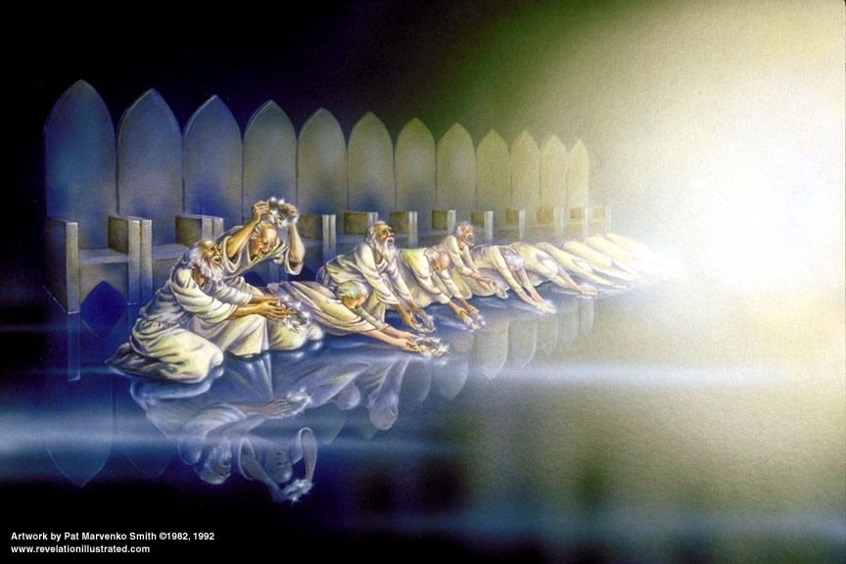
Twenty Four Elders Cast Their Crowns
Before the Throne of God
Revelation
The elders cast their crowns before the throne of God, worship Him, and acknowledge His worthiness to receive “glory and honor and power” (4:10; Psalm 99:1)
Notes:
2

Slide 3
Revelation 5:1-14
The Lamb & the Scroll
Revelation
John sees a scroll sealed with 7 seals in the right hand of the One on the throne (5:1)
  What does the scroll represent?
  Why is it in the RIGHT hand?
  Why is it sealed with 7 seals?
An angel asks, “Who is worthy to open the scroll?” (5:2-4)
  John weeps because no one is found worthy.
One of the elders informs John of One who has prevailed to open the scroll (5:5)
  The Lion of Judah (Genesis 49:9-10)
  The Root of David (2 Samuel 7:12-16; Jeremiah 23:5-6; Acts 2:30)

Slide 4
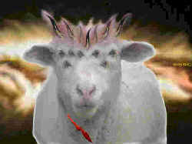
Revelation 5:1-14
The Lamb & the Scroll
Revelation
John looks and sees a Lamb in the middle of the throne scene. (5:6; Isa. 53:7; Acts 8:32-33; John 1:29; 1 Peter 1:17-19)
  The Lamb looked as if it had been slain (13:8)
  He had seven horns and seven eyes
The horns represent the power of Jesus (1 Samuel 2:10; Psalm 75:10; Matthew 28:18)
The eyes represent the omniscience of the Spirit of God (Ps. 139:7)

Slide 5
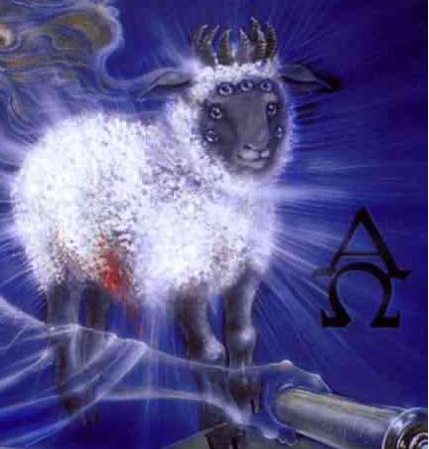
The Lamb takes the Scroll
Revelation
“Then He came and took the scroll out of the right hand of Him who sat on the throne.” (5:7)

Slide 6
Praise to the Lamb
Revelation
The four living creatures and the 24 elders fall down before the Lamb (5:8).
  Each elder has a harp (for praise) and golden bowls of incense (the prayers of the saints)
They praise the Lamb with a new song (5:9-10)
For being worthy to open
the scroll
For being slain for man’s
redemption
For making us kings &
priests who will reign on
the earth.

Slide 7
Praise to the Lamb
Revelation
The four living creatures and the 24 elders are joined in praising the Lamb by myriads of angels (5:11-12)
  They declare Him worthy “To receive power and riches and wisdom, And strength and honor and glory and blessing!”
Then every creature in heaven and on earth join in praising both the Lamb and the One on the throne (5:13)
The four living creatures say “amen” and the 24 elders fall down and worship “Him who lives forever and ever” (5:14).

