Slide 1
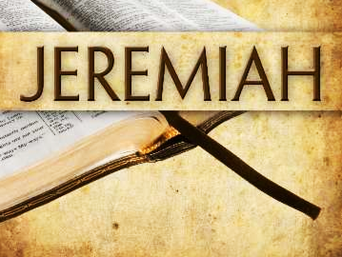
Introduction to Jeremiah

Slide 2

Overview of Jeremiah
The book of Jeremiah is both Prophecy and Narrative History, although not completely in chronological order.
  The prophet Jeremiah wrote it sometime during and/or just after 625-586 B.C.
  Chapters 1-20 are associated with King Josiah’s reign (641-610 BC)
  Chapters 21-39 contain events in the reigns of Jehoiakim & Zedekiah (609-586 BC)
  Chapters 40-52 describe the circumstances of the Jews who remain after Babylon’s conquest, and prophecies about God’s dealings with surrounding nations.

Slide 3
Overview of Jeremiah
The purpose of Jeremiah’s message was to warn of the destruction that Judah was about to face and to urge the Jews to return and submit to God.
  Jeremiah was a priest whom God calls to be His prophet.
  Jeremiah identifies the sins of the Jews and their treachery; he calls them to realize the serious consequences of their sinful ways.
  His message put him in an unfavorable light in the eyes of the people.
  His desire for justice and love for his nation make him weep!

Slide 4
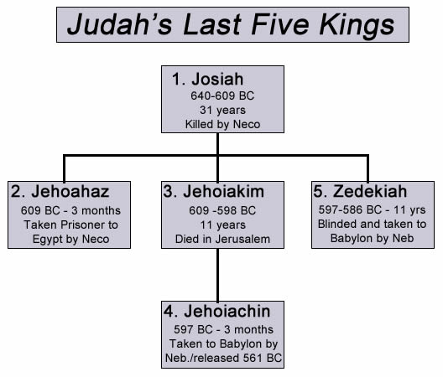
Kings who reigned in the days of Jeremiah

Slide 5
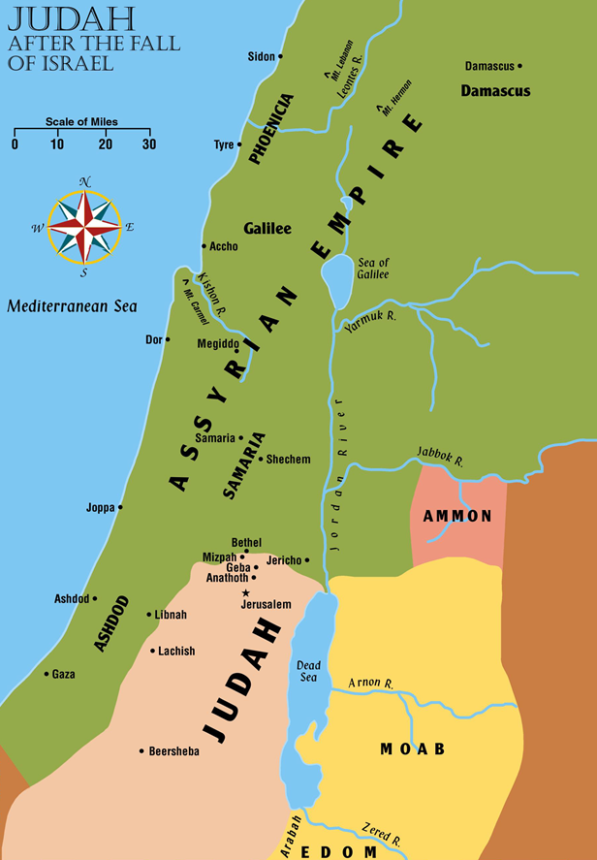
Judah after the Fall of Israel

Slide 6
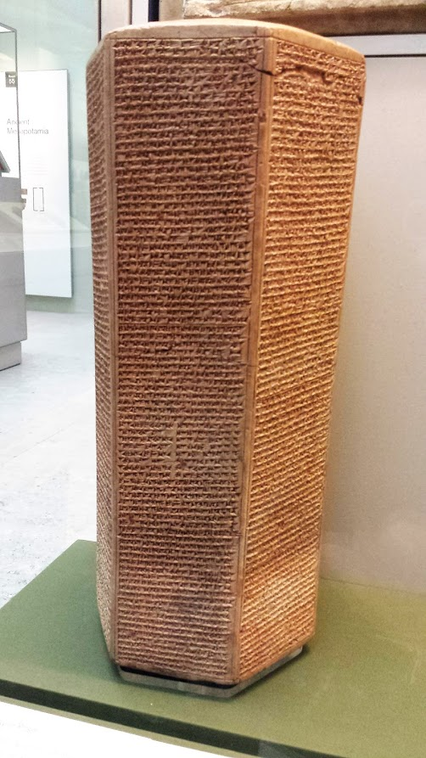
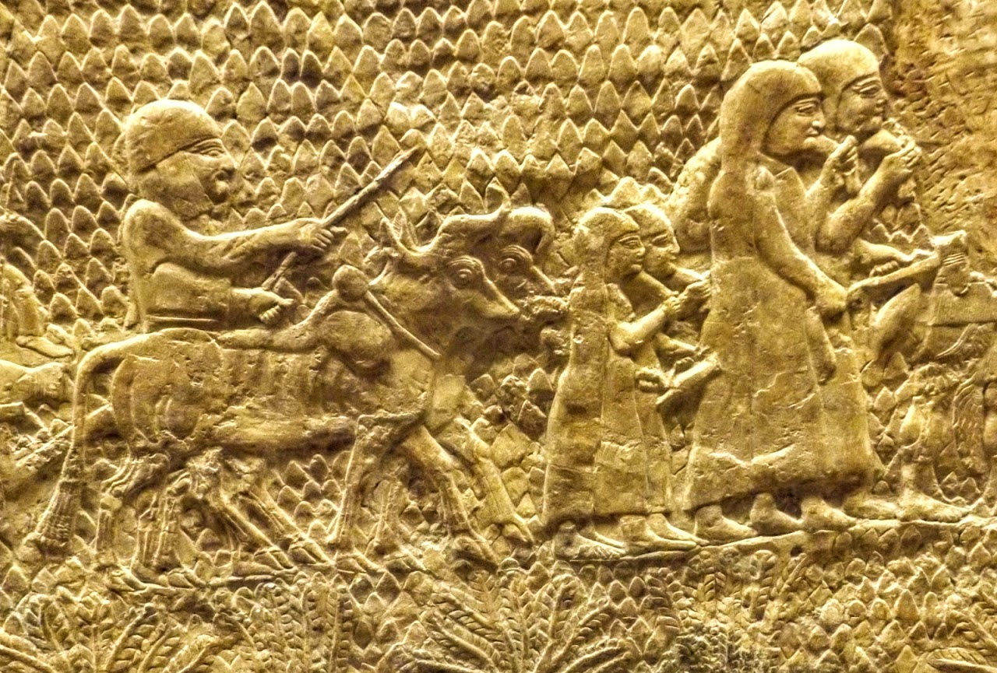
In 701 B.C. Assyria besieged Jerusalem and destroyed the fortified cities of Judah (e.g. Lachish).
The Assyrian King Sennacherib shut up Hezekiah “like a bird in a cage” and took tribute from him, but did not enter Jerusalem (2 Kings 18:23—19:37).
Judah regained some strength, and Assyria was conquered by Babylon in 612 B.C.
ABOVE: Sennacherib’s annals describe his conquest of Judah.
LEFT: Women and children being taken from Lachish into captivity by the Assyrians.

Slide 7
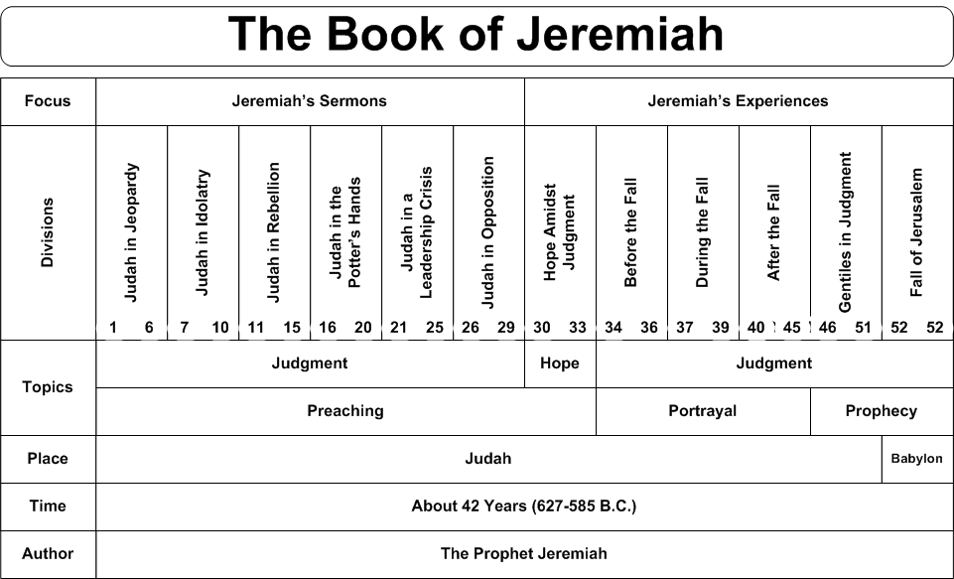

Slide 8

Overview of Jeremiah
In chapters 1-10, God calls Jeremiah and proclaims, “I have put My words in your mouth” (1:9). Jeremiah condemns Judah for their sins and attacks their faithlessness.
In chapters 11-28, Jeremiah warns of the destruction to be poured out on Judah.
  He writes of God’s impending wrath.
  Idolatry was perhaps the most grievous of Judah’s sins to God. (16:10-13; 22:8-9)
  At one point God says, “I will not listen when they call to Me because of their disaster” (12:14).

Slide 9

Overview of Jeremiah
In chapters 29-38, Jeremiah writes about the New Covenant and the hope that God would bring when He delivers them after the captivity.
In chapters 39-52, Jeremiah records the events of the fall of Jerusalem in 586 B.C. as he and other prophets of God had predicted (Deuteronomy 28:49ff, Isaiah 39:6)
  Now both kingdoms have gone into exile, the Northern Kingdom in 721 B.C. and now the Southern Kingdom in 586 B.C.

Slide 10
Overview of Jeremiah
Denunciation: God had revealed Himself & His will to His people, but they forsook Him and walked in their own ways; sin must be punished (6:9-13; 21:7; 25:11)
Invitation: Repentance brings a blessing; the people were called to mend their ways (7:3; 18:7-10)
Consolation Glory will follow the doom; Judah will be restored; glimpses of the coming Messiah (30-33)
-- Hoyt Houchen, What Is In The Book?

Slide 11
Key verses in Jeremiah
Jeremiah 10:23 O LORD, I know the way of man is not in himself; It is not in man who walks to direct his own steps.
Jeremiah 20:4 … I will give all Judah into the hand of the king of Babylon, and he shall carry them captive to Babylon and slay them with the sword.

Slide 12
Key verses in Jeremiah
Jeremiah 29:10-11, “This is what the LORD says: ‘When seventy years are completed for Babylon, I will come to you and fulfill my gracious promise to bring you back to this place. For I know the plans I have for you,’ declares the LORD, ‘plans to prosper you and not to harm you, plans to give you hope and a future.’”
Jeremiah 52:12-13, “On the tenth day of the fifth month, in the nineteenth year of Nebuchadnezzar king of Babylon, Nebuzaradan commander of the imperial guard, who served the king of Babylon, came to Jerusalem. He set fire to the temple of the LORD, the royal palace and all the houses of Jerusalem. Every important building he burned down.”

