Slide 3
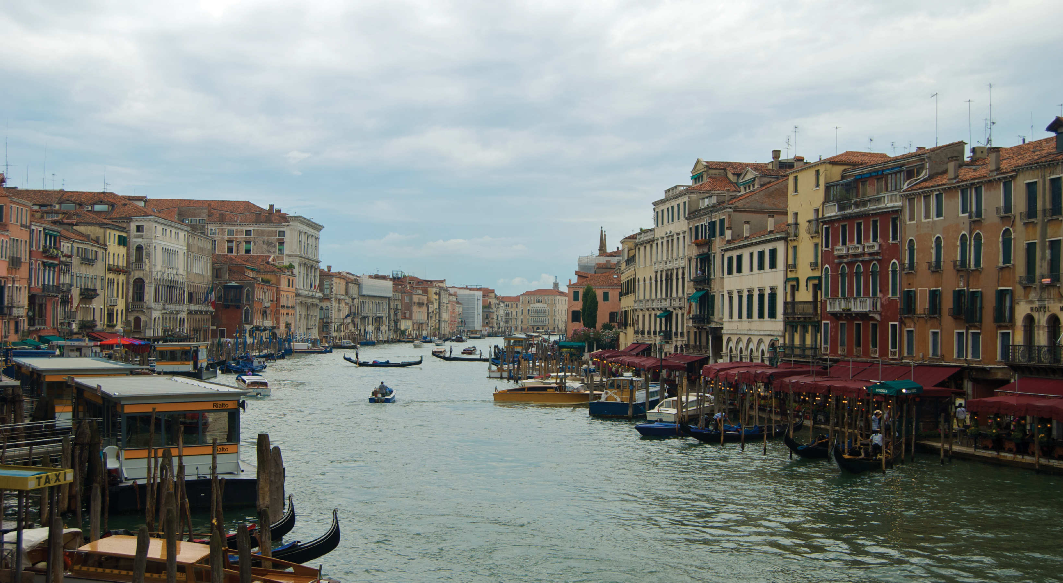

Slide 4
God’s People are Different People
⁹ But you are a chosen people, a royal priesthood, a holy nation,
a people for God’s own possession,
so that you may proclaim the excellencies of Him
who has called you out of darkness into His marvelous light;
¹⁰ for you once were not a people,
but now you are the people of God;
you had not received mercy, but now you have received mercy.
2 Peter 2:9-10

Slide 5
God’s People are Different People
Everywhere is full of people that try to be different
God always wanted His people to be like Him…
  >> Gen 1:26 – “…in Our image…”
  >> Lev 18:1-5 – “…I am the LORD…”
On the other hand, God’s people have wanted to conform…
  >> 1 Sam 8:4-5, 19-20 – “Appoint a king…like all the nations”
  >> Ezra and people intermarrying
  >> Ezek 20:5-8a
  >> Today? Rom 12:1-2 (2021 theme)

Slide 6
The Sermon on the Mount is Jesus’ “own description of what He wanted his followers to be and to do”
(Stott)
²⁸ When Jesus had finished these words,
the crowds were amazed at His teaching;
²⁹ for He was teaching them as one who had authority, and not as their scribes.
(Matt 7:28-29)

Slide 7
“And He opened His mouth and began teaching them…”
(Matt 5:2)

Slide 8

The mountain
4,265ft
(1,100ft)
3,100ft
4,500ft
5,100ft

Slide 9
Sermon on the Mount - Outline
A Christian’s character (5:3–12)
A Christian’s influence (5:13–16)
A Christian’s righteousness (5:17–48)
A Christian’s piety (6:1–18)
A Christian’s ambition (6:19–34)
A Christian’s relationships (7:1–20)
A Christian’s commitment (7:21–27)
Stott

