Slide 1
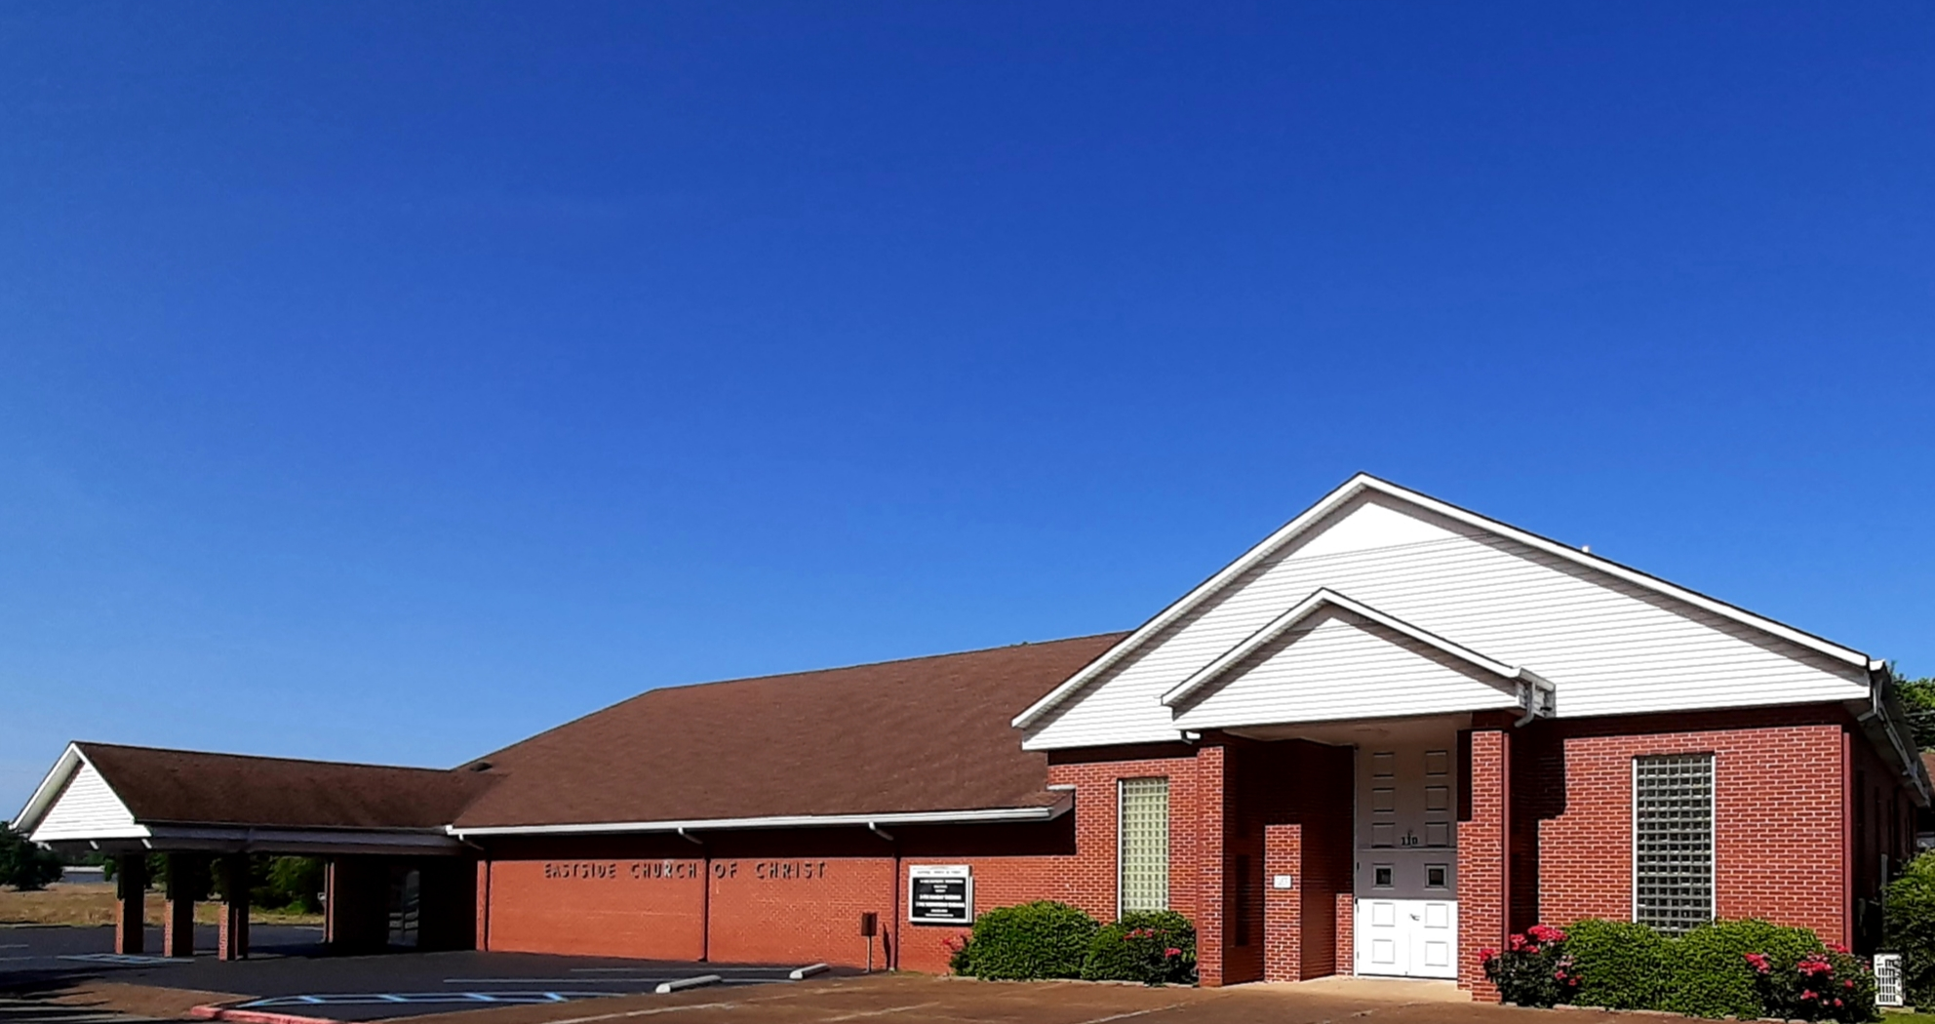


Welcome
SERVICE WILL BEGIN IN:
Services will begin in:
Welcome!
We’re Glad You’ve Come to Worship with the Eastside Church of Christ
Eastside-church.org
Sunday Morning Classes and Worship: 9:00 a.m.
Sunday Evening Worship: 5:00 p.m.
Wednesday Evening Bible Study: 7:00 p.m.

Slide 2
…

Slide 3
Lesson 17
Divided Kingdom, part 1
2 Kings 8:7-15,25-9:37
2 Chronicles 22:1-9

Slide 4
Lesson 17
2 Kings 8:7-15,25-9:37
2 Chronicles 22:1-9
Hazael becomes king in Syria
Jehu anointed king of Israel
War with Syria
Jehu kills Jehoram, Ahaziah, and Jezebel

Slide 5
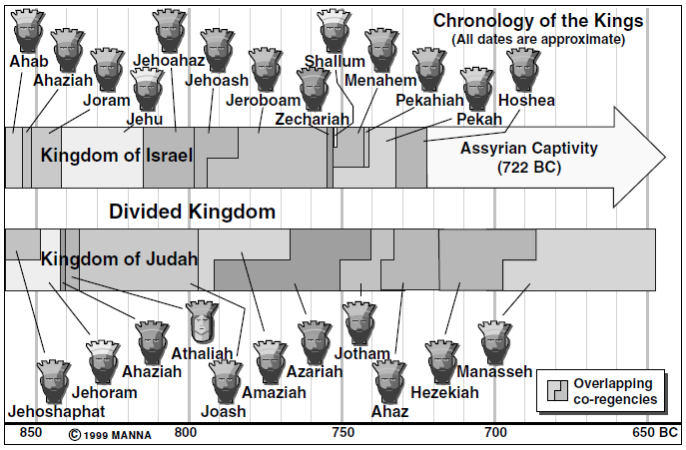

Slide 6
Kingdom Relationships
JUDAH
Jehoshaphat
Jehoram
Ahaziah
Athaliah
ISRAEL
Ahab – Jezebel
  Ahaziah
  Jehoram
  Athaliah
Jehu

Slide 7
Ahaziah (of Judah) 2 Kings 8:25ff
Son of Jehoram (very wicked)
Youngest son
  Others killed by Philistines and Arabians
Mother was Athaliah
  Daughter of Ahab and Jezebel
Jehoram (king of Israel) Ahaziah’s uncle
22 years old (2 Chron—42 yrs old)
Reigned one year – very wicked
841 BC
Notes:
Clark—
The reading in 2Ki 8:26 is right, and any attempt to reconcile this in Chronicles with that is equally futile and absurd. Both readings cannot be true; is that therefore likely to be genuine that makes the son two years older than the father who begat him?

Slide 8
Ahaziah (of Judah)
Of his wickedness (2 Kings 8:27): He walked in the way of the house of Ahab, that idolatrous bloody house; for his mother was Ahab's daughter (8:26), so that he sucked in wickedness with his milk. --The child may be expected to resemble the mother.
When men choose wives for themselves, they must remember they are choosing mothers for their children and are concerned to choose accordingly.

Slide 9
Elisha Meets with Hazael (2 Ki 8:7ff)
Elisha went to Damascus to meet Ben-Hadad, king of Syria
Ben-Hadad was sick
He sent Hazael to meet Elisha
  Forty camel-loads of goods as a gift
  “Will Ben-Hadad get well”?
Ben-Hadad would recover
Ben-Hadad would die
Notes:
Coffman—
"Hazael ... took a present with him ... forty camels' burden ... Shall I recover of
this sickness?" (2 Kings 8:9). "One camel's burden is six hundred pounds";[10] but,
"This affair must be judged according to Oriental custom of making a grand display with
the sending of presents, employing as many men or beasts of burden as possible to
carry them, each one of them carrying only a single article."[11]

Slide 10
Elisha Meets with Hazael
Elisha began to weep
2 Kings 8:12 And Hazael said, "Why is my lord weeping?" He answered, "Because I know the evil that you will do to the children of Israel: Their strongholds you will set on fire, and their young men you will kill with the sword; and you will dash their children, and rip open their women with child."

Slide 11
Elisha Meets with Hazael
2 Kings 8:13 So Hazael said, "But what is your servant-a dog, that he should do this gross thing?" And Elisha answered, “The LORD has shown me that you will become king over Syria.”
Hazael returned to Ben-Hadad and told him he would recover
The next day Hazael killed Ben-Hadad and became king of Syria
half the truth??

Slide 12
Jehu Anointed (king of Israel) 2 Ki 9
Elisha sent one of the ‘sons of the prophets’ to Ramoth-gilead
He was to take Jehu to an inner room and anoint him king of Israel
  the son of Jehoshaphat, the son of Nimshi
Then he was to flee
He found Jehu and anointed him with a message; then he fled

Slide 13
War against Syria (2 Ki 8:28; 2 Chron 22:5)
2 Ch 22:6 Then he returned to Jezreel to recover from the wounds which he had received at Ramah, when he fought against Hazael king of Syria. And Azariah the son of Jehoram, king of Judah, went down to see Jehoram the son of Ahab in Jezreel, because he was sick.
7 His going to Joram was God's occasion for Ahaziah's downfall; for when he arrived, he went out with Jehoram against Jehu the son of Nimshi, whom the LORD had anointed to cut off the house of Ahab.
Jehoram, king of Israel (son of Ahab) joined with Ahaziah, king of Judah, to war against Hazael
Jehoram was wounded
He went to Jezreel to recover
Ahaziah went to visit Jehoram
Armies are still besieging Ramoth-gilead

Slide 14
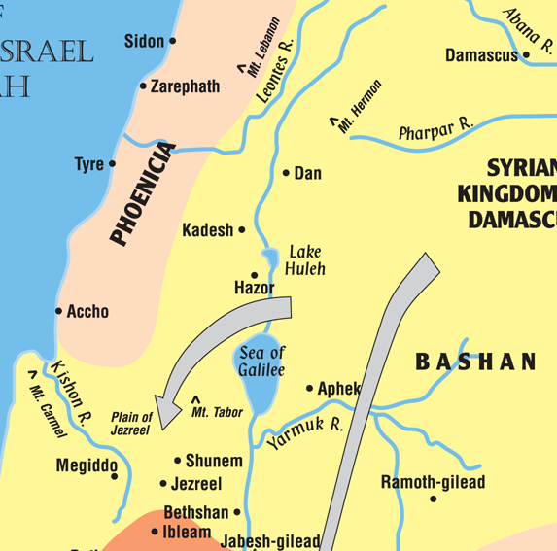

Slide 15
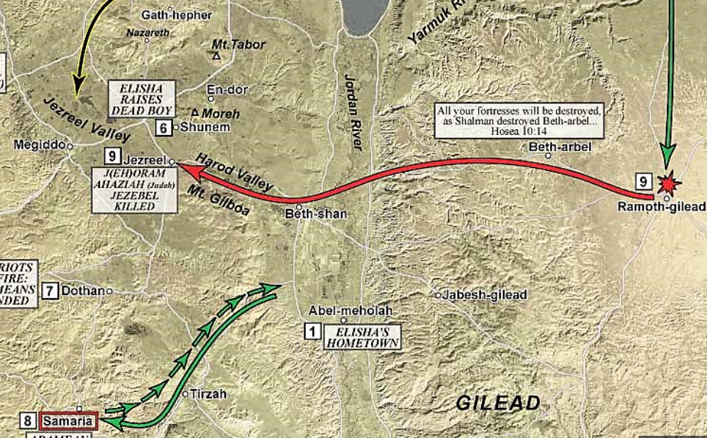

Slide 16
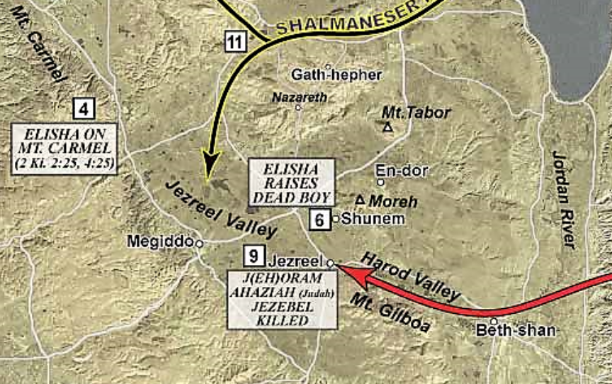

Slide 17
Jehu’s Instructions
2 Kings 9:7-10 'You shall strike down the house of Ahab your master, that I may avenge the blood of My servants the prophets, and the blood of all the servants of the LORD, at the hand of Jezebel. 'For the whole house of Ahab shall perish; and I will cut off from Ahab all the males in Israel, both bond and free. 'So I will make the house of Ahab like the house of Jeroboam the son of Nebat, and like the house of Baasha the son of Ahijah. 'The dogs shall eat Jezebel on the plot of ground at Jezreel, and there shall be none to bury her.'"

Slide 18
Jehu’s Instructions
2 Kings 9:7-10 'You shall strike down the house of Ahab your master, that I may avenge the blood of My servants the prophets, and the blood of all the servants of the LORD, at the hand of Jezebel. 'For the whole house of Ahab shall perish; and I will cut off from Ahab all the males in Israel, both bond and free. 'So I will make the house of Ahab like the house of Jeroboam the son of Nebat, and like the house of Baasha the son of Ahijah. 'The dogs shall eat Jezebel on the plot of ground at Jezreel, and there shall be none to bury her.'"

Slide 19
Jehu’s Instructions
2 Kings 9:7-10 'You shall strike down the house of Ahab your master, that I may avenge the blood of My servants the prophets, and the blood of all the servants of the LORD, at the hand of Jezebel. 'For the whole house of Ahab shall perish; and I will cut off from Ahab all the males in Israel, both bond and free. 'So I will make the house of Ahab like the house of Jeroboam the son of Nebat, and like the house of Baasha the son of Ahijah. 'The dogs shall eat Jezebel on the plot of ground at Jezreel, and there shall be none to bury her.'"

Slide 20
Jehu Kills Jehoram
Jehu left for Jezreel
Jehoram was there; Ahaziah (Judah) had come to visit
The watchman saw Jehu’s company coming
A horseman was sent to see if he came in peace
Jehu told the horseman to join him

Slide 21
Jehu Kills Jehoram
A second horseman is sent; same results
‘It is like the driving of Jehu’
King Jehoram and King Ahaziah went out to meet Jehu; on the field of Naboth
Notes:
Coffman—
"They found him in the portion of Naboth the Jezreelite" (2 Kings 9:21). Again we have evidence of how finely and with what recision the Lord times His actions. Only a few minutes variation in the exact time when Joram left Jezreel would have placed his meeting with Jehu at some other place. But, no! God had decreed that the blood of Naboth should be avenged ON THAT VERY SPOT, and so it occurred. That meeting of Joram and Jehu, "Humanly speaking was accidental. The portion of Naboth lay outside the southeastern gate of Jezreel, and at no great distance from the walls. If the king had started a little sooner, or if Jehu had driven a little slower, the meeting would have taken place somewhere else. But Divine providence so ordered matters that vengeance for the sin of Ahab was exacted upon the very scene of his guilt."

Slide 22
Jehu Kills Jehoram
The kings met Jehoram and realized Jehu’s purpose
As they fled Jehu drew his arrow and killed Jehoram
God wants contrition; a humble heart
1 Kings 21:29 "See how Ahab has humbled himself before Me? Because he has humbled himself before Me, I will not bring the calamity in his days. In the days of his son I will bring the calamity on his house."

Slide 23
Jehu Kills Jehoram
2 Kings 9:25-26 Then Jehu said to Bidkar his captain, "Pick him up, and throw him into the tract of the field of Naboth the Jezreelite; for remember, when you and I were riding together behind Ahab his father, that the LORD laid this burden upon him: 'Surely I saw yesterday the blood of Naboth and the blood of his sons,' says the LORD, 'and I will repay you in this plot,' says the LORD. Now therefore, take and throw him on the plot of ground, according to the word of the LORD."

Slide 24
Jehu Kills Ahaziah
Ahaziah saw what had happened and fled
Jehu and his men pursued
He, too, was shot while in his chariot
His servant carried him to Jerusalem for burial

Slide 25
Kingdom Relationships
JUDAH
Jehoshaphat
Jehoram
Ahaziah
Athaliah
ISRAEL
Ahab – Jezebel
  Ahaziah
  Jehoram
  Athaliah
Jehu

Slide 26
Jehu Kills Ahaziah
2 Chronicles 22:8 And it happened, when Jehu was executing judgment on the house of Ahab and found the princes of Judah and the sons of Ahaziah's brothers who served Ahaziah, that he killed them.

Slide 27
Jehu Kills Ahaziah
2 Chronicles 22:9 Then he searched for Ahaziah; and they caught him (he was hiding in Samaria), and brought him to Jehu. When they had killed him, they buried him, "because," they said, "he is the son of Jehoshaphat, who sought the LORD with all his heart." So the house of Ahaziah had no one to assume power over the kingdom.
did NOT say lineage of David was broken

Slide 28
Jezebel is Killed (2 Kings 9:30ff)
Jehu went to Jezreel
Jezebel was waiting for him
  “painted”
‘Is it peace?’
She was standing in a window; some eunuchs were with her
Jehu told them to throw her down
Jehu and his men trampled over her splattered body

Slide 29
Jezebel is Killed
Jehu went in to eat and drink
Then he sent word to bury Jezebel
  Because she was a king’s daughter
They only found a few body parts
1 Kings 21:19 "You shall speak to him, saying, 'Thus says the LORD: "Have you murdered and also taken possession?"' And you shall speak to him, saying, 'Thus says the LORD: "In the place where dogs licked the blood of Naboth, dogs shall lick your blood, even yours."'"
Notes:
Coffman—
REGARDING JEZEBEL
Like the apostle John who looked upon the Great Harlot of Revelation 17:6 (KJV), I wonder with great admiration at this evil woman, who in spite of her wickedness was a woman of great strength and achievement in the eyes of men (though, not in the eyes of
the Lord). She was not only a king's daughter, she was the wife of a king (Ahab), and the mother of one king (Joram), the grandmother of another king (Ahaziah), and the mother-in-law of another (Joram of Judah).
She manifested a great zeal for her pagan religion, and if the kings of God's people had been half as zealous to promote the true religion as she was to promote hers, she would not have been successful in the great corruption that she brought upon God's people.
It is to the great shame of the kings of Judah and Israel that their conduct was not such as could have been any encouragement to Jezebel to forsake Baal and cling to the true God.
She retained her queenly character up until the day of her death, and she died in the full regalia of her office, with her customary decorations such as the painted face and attired head (she probably wore her crown). She referred to Jehu as a regicide, another Zimri, reminding him that Zimri himself paid the penalty of his deeds. It is a great pity that a woman of such gifts never learned the worship of the true God and that she died in the hopeless paganism in which she had been reared. One may well wonder, how many associates of Christians find their behavior such a deterrent that they, like Jezebel, continue in darkness, rather than turn to the Light that lighteth every man coming into the world.

Slide 30
Jezebel is Killed
2 Kings 9:36-37 Therefore they came back and told him. And he said, "This is the word of the LORD, which He spoke by His servant Elijah the Tishbite, saying, 'On the plot of ground at Jezreel dogs shall eat the flesh of Jezebel; 'and the corpse of Jezebel shall be as refuse on the surface of the field, in the plot at Jezreel, so that they shall not say, "Here lies Jezebel."'"
1 – God’s word will prevail
2 – What He says will come to pass
Applies just as much to us in NT times

Slide 31
Ahaziah is Killed
2 Chronicles 22:6 … And Azariah the son of Jehoram, king of Judah, went down to see Jehoram the son of Ahab in Jezreel, because he was sick.
7 His going to Joram was God's occasion for Ahaziah's downfall; for when he arrived, he went out with Jehoram against Jehu the son of Nimshi, whom the LORD had anointed to cut off the house of Ahab.
Providence of God
1 – When Jehu met and killed Jehoram (Israel) exactly on Naboth’s plot of land
2 – That Ahaziah (Judah) would be visiting Jehoram just when Jehu struck so he would be killed as well

Slide 32
2 Chronicles 22:3-4
To whom do we go for counsel?
Psalm 119:105 Your word is a lamp to my feet And a light to my path.
Jehoram (Israel)
Took counsel from evil ones
“to his own destruction”
Psalm 1:1 Blessed is the man Who walks not in the counsel of the ungodly, Nor stands in the path of sinners, Nor sits in the seat of the scornful;
2 But his delight is in the law of the LORD, And in His law he meditates day and night.

Slide 33
…

Slide 34
…

Slide 35
Siege of Samaria
Review
Ben-hadad, king of Syria gathered a great army and laid siege to Samaria
Food became very expensive
This often led to cannibalism

Slide 36
Siege of Samaria
Review
A woman pleaded the king for help
She and another woman ate her son yesterday
They agreed to eat the other son today
The woman had hid her son

Slide 37
Siege of Samaria
Review
The wicked king of Israel blamed God
He swore to have the head of Elisha
The king of Israel had no faith in God
Elisha told them tomorrow food would be very, very inexpensive
Four Israelite men with leprosy go to the Syrian camp looking for mercy
No one is there!!!
Notes:
Maxson—
"The leprous person who has the disease shall wear torn clothes and let the hair of his head hang loose, and he shall cover his upper lip and cry out, 'Unclean, unclean.' He shall remain unclean as long as he has the disease. He is unclean. He shall live alone. His dwelling shall be outside the camp."
Leviticus 13:45-46
There are fates that are worse than death. Leprosy would qualify as one of those.
Nothing could have been worse than leprosy in ancient Israel. It was painful. It was a slow and certain death sentence. But it was more than that. To the Israelite, leprosy was uncleanness. It was loneliness. It forced you to live in a leper colony (where you would be surrounded with other dying people like yourself). It took you from your community, your friends, and your family. Indeed, it was a fate worse than death.

Slide 38
Siege of Samaria
Review
Jehovah had caused the Syrians to hear noise of chariots and the sound of horses
They thought the king of Israel has hired help and a great army was coming
They fled leaving everything behind

Slide 39
Siege of Samaria
Review
The lepers found no one they ate and drank
They decided to go back and tell the ones in the city
The people rushed to the camp
They found food and took all the spoils

Slide 40
Siege of Samaria
Review
The time of this event is uncertain
Ben-hadad was a title for Syrian kings
We know of a Ben-hadad in Ahab’s time
This Ben-hadad’s son had the same name
Time is not important
The lesson of God’s attempts to bring His people back is important

Slide 41
Shunammite Woman
Review
Woman in whose house Elisha stayed
Elisha had raised her son from dead
Elisha told her a seven-year famine was coming
Leave your home until it is over
She moved to coastal plain
  Philistine territory

Slide 42
Shunammite Woman
Review
After famine is over, she goes home
She goes to the king
  Asking for her property to be restored
Gehazi is there talking to the king
  Elisha’s servant
He knows of her history with Elisha
King assigns official to take care of her
  Give her everything belonging to her

Slide 43
Lessons
Review
Israel is very wicked
They have totally abandoned God
Yet, He is patient with them
He shows them time and again that He is God and He wants them to repent
However, time will run out
Apply to us…

