Slide 1
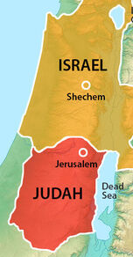
The Divided Kingdom
(Part 1)
“Till There Was No Remedy”
(2 Chronicles 36:16)

Slide 2

17 Periods of Bible History
United kingdom
Divided kingdom
Judah alone
Captivity
Return from captivity
Years of silence
Life of Christ
Early church
Letters to Christians
Before the flood
Flood
Scattering of the people
Patriarchs
Exodus
Wandering in wilderness
Invasion & conquest
Judges

Slide 3
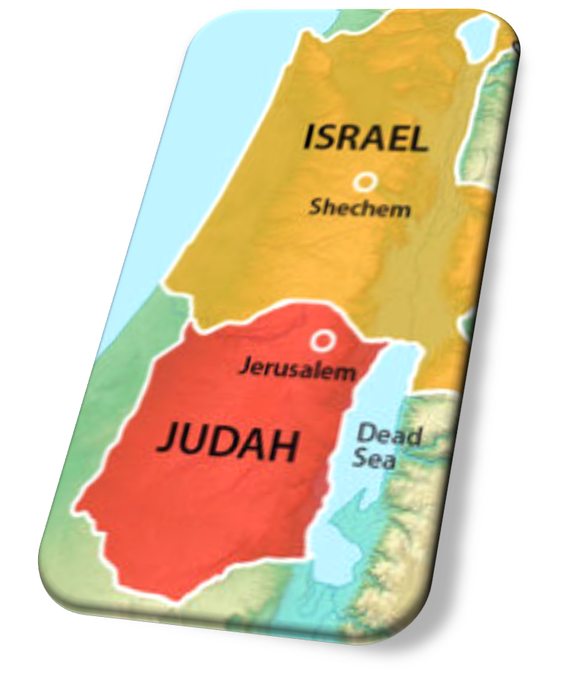
Divided Kingdom: Lesson 18
Jehu’s Continued Killing
Jehu & Jehonadab
Jehu Removes Baal In Israel
God Judges Jehu
Athaliah Seizes Judah’s Throne
  2 Kings 10:1 – 11:3
  2 Chron 22:10-12

Slide 4
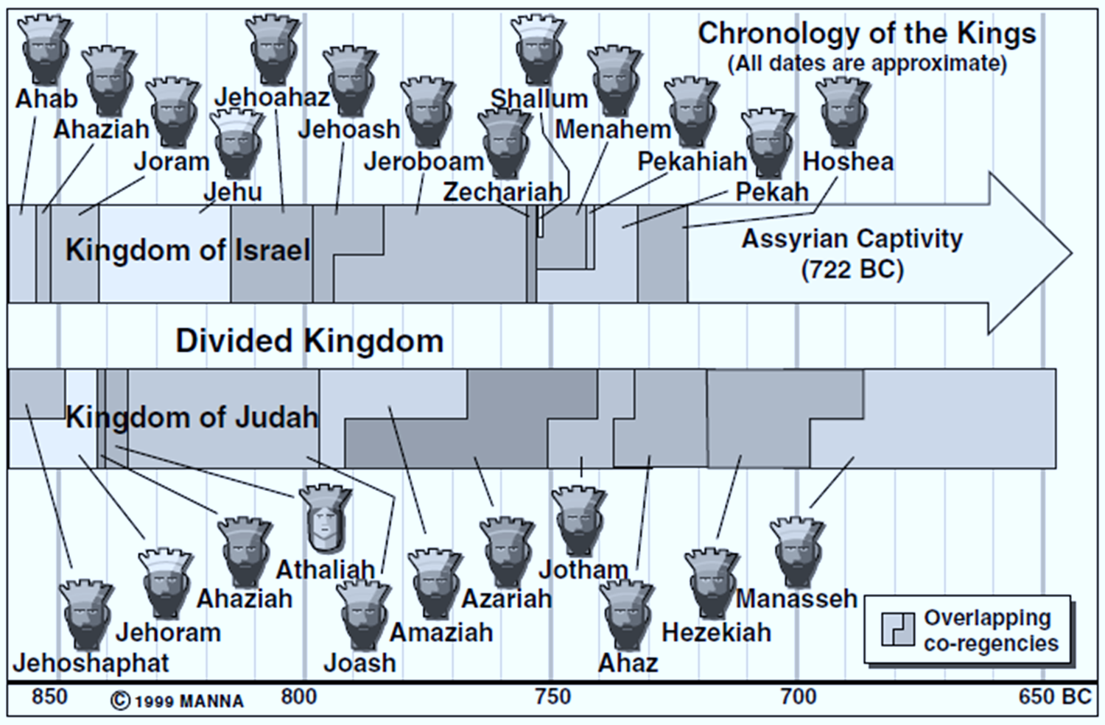

Slide 5
Jehu’s Continued Killing
(2 Kings 10:1-14)
The date for Jehu’s actions in 2 Kings 9-10 is estimated to be around 841 B.C.
  If correct, this means in about 120 years Israel will be taken captive by the Assyrians.
When Jehu killed Jehoram & Jezebel (2 Kings 9), he started a bloody campaign that concludes with events in this lesson (2 Kings 10).
Jehu moves with great haste to carry out what he knew God wanted him to do; although his actions were good, his motivations were not pleasing to God.

Slide 6
Jehu’s Continued Killing
(2 Kings 10:1-14)
The 70 sons of Ahab in Samaria (1-10)
  Jehu writes letters to Jezreel’s leaders who were guardians of Ahab’s sons.
  He challenges them to fight for Israel’s throne.
  The guardians refuse; they agreed to be Ahab’s servants.
  To prove their loyalty, Jehu demands the heads of all 70 sons be brought to him
    NOTE: It is 20+ miles from Samaria to Jezreel.
  When he receives them, he piles them up in 2 heaps by the city gate.
  Jehu reassures the people that not a word of Elijah’s prophecy would fail; Ahab’s house would be utterly destroyed (cf. 1 Kings 21:21).
Notes:
1 Kings 21:21 'Behold, I will bring calamity on you. I will take away your posterity, and will cut off from Ahab every male in Israel, both bond and free.

Slide 7
Jehu’s Continued Killing
(2 Kings 10:1-14)
Other relatives, acquaintances, and allies of Ahab left in Jezreel (11)
  Anyone left with any connection to Ahab was executed. No survivors!
The princes of Judah related to Ahaziah (12-14)
  Ahaziah, king of Judah = Ahab’s grandson (son of Athaliah).
  As Jehu traveled back to Samaria (likely to claim the throne), he encountered 42 relatives of Ahaziah who appeared to be on their way to greet the king (Ahaziah) and the queen mother (Athaliah).
  Jehu orders them to be taken alive, only to have them executed; again, he leaves no survivors.

Slide 8
Jehu Meets Jehonadab
(2 Kings 10:15-17)
Continuing to Samaria, Jehu met Jehonadab (15).
  He was a descendant of Rechab, who was the father of a noteworthy line of people the Scripture portrays in a good light (Jer. 35:8-10, 12-16).
Jehu asks him if he was with him, and Jehonadab affirms he is. Jehu says, “Come with me and see my zeal for the Lord” (15b-16).
When Jehu arrived in Samaria, he killed anyone else that was left than had any connection to Ahab’s house.
All this was done to fulfill the word of the Lord spoken to Elijah following the episode at Naboth’s vineyard (17, cf. 1 Kings 21:19-24).
Notes:
Once again, we see an example of Divine providence
God’s instructions to Jehu by Elisha 2 Kings 9:6-10 (holy, righteous)
Jehu’s choice of behavior to accomplish his task -- sinful, selfish
God using man’s self interest and/or wickedness to fulfill His will = PROVIDENTIAL

Slide 9
Jehu Destroys Baal Worship In Israel
(2 Kings 10:18-28)
Jehu summons all Baal worshipers to a sacrifice (18-19).
  Jehu deceitfully declares, “Ahab served Baal a little; Jehu will serve him much.”
  Any leader of Baal worship in Israel who did not attend would be put to death.
    This was a deceitful plan to lure them to their death.
    Idolators were already liable to death under Mosaic Law (Deut. 17:1-5).
    It was unnecessary to lie to get them in one place for their execution.

Slide 10
Jehu Destroys Baal Worship In Israel
(2 Kings 10:18-28)
Jehu’s plan (20-25)
  He proclaims a solemn assembly; this ensured good attendance.
  He arranges for all attendees to be properly attired.
  He ensures no worshipers of Jehovah were among them.
  He stations 80 guards outside the temple, warning them if anyone inside the temple escapes, they would forfeit their own lives.
  After he emerges from offering a sacrifice, he gives the order for those 80 men to enter Baal’s temple and kill everyone inside.

Slide 11
Jehu Destroys Baal Worship In Israel
(2 Kings 10:18-28)
The temple of Baal is also destroyed (26-28).
  The pillars were torn down and burned, and the temple became a latrine.*
  “Thus Jehu destroyed Baal from Israel!”
Notes:
Various translation have “refuse dump” or “draught house.”

Slide 12
God Judges Jehu
(2 Kings 10:29-33)
All that Jehu did was not from the proper motivation (29-31).
  God acknowledged that Jehu had “done well in doing what is right in My sight…”
  As a result, 4 generations of his progeny would sit on Israel’s throne.
  Jehu did not depart from Jeroboam’s sins; the golden calves plagued Israel all through her years.
  This demonstrated that Jehu did not “walk in the law of the LORD God of Israel with all his heart.”
Israel suffered due to Jehu’s sins (32-33).
  The Lord cut off the portions of Israel’s territory in the trans-Jordan (Gad, Ruben, and Manasseh)

Slide 13
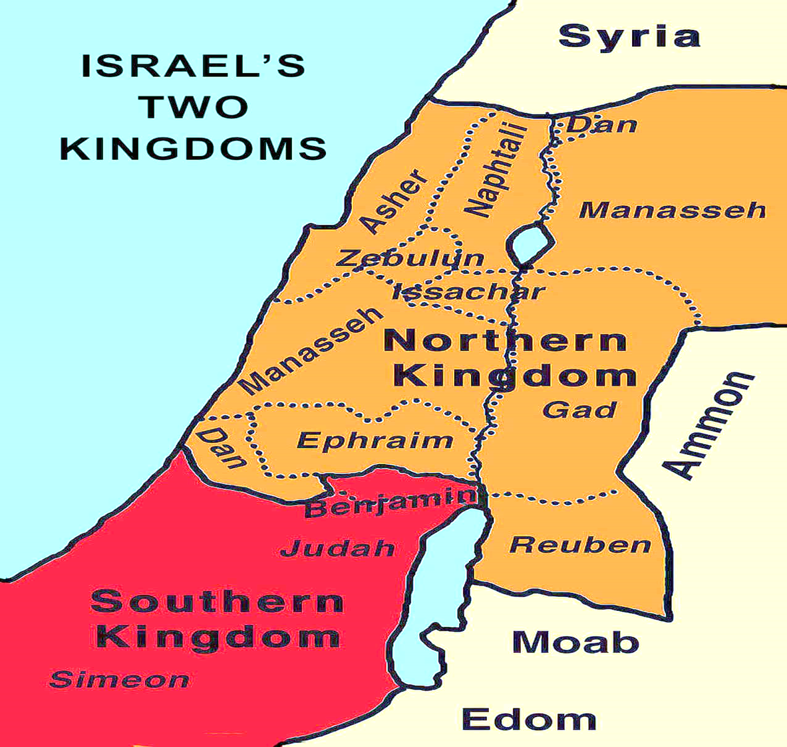
Territory trimmed from Israel due to Jehu’s sins.

Slide 14
Athaliah Usurps Judah’s Throne
(2 Kings 11:1-3; 2 Chronicles 22:10-12)
Ahaziah’s death at the hands of Jehu was of God because he went with Jehoram of Israel to oppose Jehu (2 Chron. 22:7).
When his mother Athaliah heard of his death, she killed all the royal offspring and assumed the throne – She killed her own grandchildren!
Her step-daughter Jehoshabeath (wife of Jehoiada the priest) hid her infant nephew Joash in the house of God safely for 6 years while Athaliah unlawfully reigned in Jerusalem.
  Jehoshabeath was Jehoram’s daughter by another wife (cf. Josephus, Antiquities Of The Jews, 9.7.1).
Notes:
This was the 3rd time Judah was left with only 1 heir
– Jehoram…he killed his brothers
– Ahaziah…the Arabs killed his brothers
– Joash…Athaliah killed his brothers, other heirs
“A promise hanging by a thread”

Slide 15
Lesson for Today
God keeps His promises without fail.
  Illustrated by the purging of Ahab’s descendants by Jehu and Athaliah (cf. 1 Kings 21:21).
  Illustrated by Jehoshabeath hiding the infant Joash from Athaliah.
    God had previously sworn to David he would have a descendant upon his throne “forever” (2 Sam 7:13).
    God cannot lie (Heb 6:18).
    Even when conditions appear to thwart God’s promise from being realized, His word will not fail; what He has promised will come to pass.
Notes:
1 Kings 21:21 'Behold, I will bring calamity on you. I will take away your posterity, and will cut off from Ahab every male in Israel, both bond and free.

