Slide 1
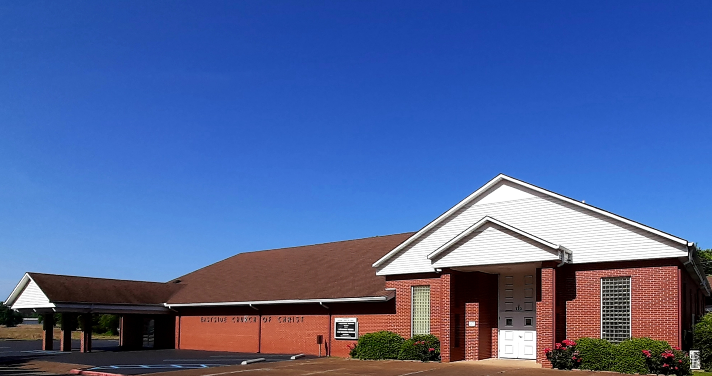
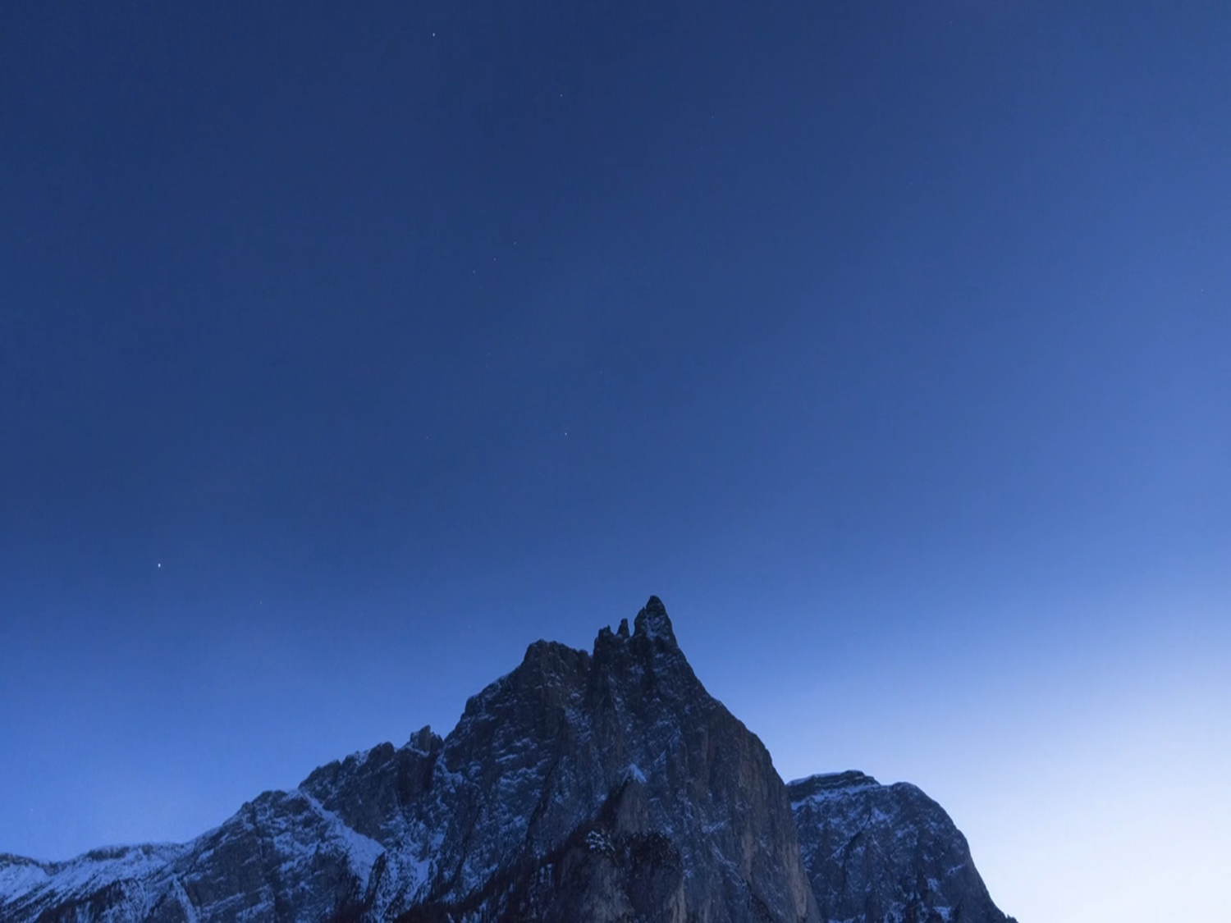
Welcome
SERVICE WILL BEGIN IN:
Services will begin in:
Welcome! We’re Glad You’ve Come to Worship with the Eastside Church of Christ
Eastside-church.org
Sunday Morning Classes and Worship: 9:00 a.m.
Sunday Evening Worship: 5:00 p.m.
Wednesday Evening Bible Study: 7:00 p.m.

Slide 2
…

Slide 3
Lesson 20
Joel
2 Kings 11:17-21
2 Chronicles 23:16-24:3

Slide 4
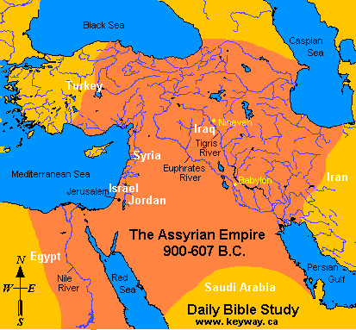

Slide 6
Jehoiada Renews the Covenant
Joash is only seven years old
Jehoiada is the true leader
When new king is appointed Jehoiada calls on the people to renew their covenant with Jehovah
Same covenant made at Mt Sinai

Slide 7
Jehoiada Renews the Covenant
John 14:15 "If you love Me, keep My commandments.
“I will be your God, if you will be My people”
Only way to expect God’s blessings
The people agree
The temple of Baal is destroyed
Joash, a true descendant of David is on the throne
Daniel 9:4 And I prayed to the LORD my God, and made confession, and said, "O Lord, great and awesome God, who keeps His covenant and mercy with those who love Him, and with those who keep His commandments

Slide 8
Jehoiada Renews the Covenant
As long as Jehoiada lives, Joash is faithful to Jehovah
The majority of Judah is faithful, also
Contrast this to what happened in Israel after Jehu destroyed the temple of Baal???
Complete obedience;
not just what pleases me

Slide 9
Jehoiada Renews the Covenant
Lesson
As long as Jehoiada lives, Joash is faithful to Jehovah
The majority of Judah is faithful, also
Contrast this to what happened in Israel after Jehu destroyed the temple of Baal???
our children

Slide 10
Joash
Joash takes two wives and has sons and daughters
The temple of Jehovah (Solomon's) has been abused during the worship of Baal (see 2 Chronicles 29)
Joash instructed the priest to collect a ‘tax’ from the people to repair it
The priest ‘delayed’ in doing this

Slide 11
Joel
Time not certain; perhaps in early days of Joash—830 B.C.
Some believe post-exile 500 B.C.
Little is known about the prophet
Son of Pethuel
His work was in Judah
No king is named
Notes:
Mike Willis in Truth Commentary on dating of the book—
Conclusion on the Date of Joel. Because Joel 3:2ff. so strongly
suggest the catastrophe of 586 B.C. as a past event, it seems best
to date Joel in the postexilic period unless there are compelling
reasons otherwise, and these are not to be found. Instead, as one
looks at all of the other lines of evidence, the postexilic view is
either compatible with the known facts or is the preferred explanation
for the evidence. All things considered, 500 B.C. appears to
be the best approximate working date for the book of Joel, roughly
contemporary with Haggai and Zechariah.
While this is the conclusion of the present study, it would be a
mistake to leave an impression of certainty. We must emphasize
once again the tenuous nature of this conclusion, just as we did at
the beginning. For the commentator on Joel, it has become almost
obligatory to quote the words of John Calvin:
As there is no certainty it is better to leave the time in which he
taught undecided; and as we shall see, this is of no great importance.
Not to know the time of Hosea would be to readers a great loss,
for there are many parts which could not be explained without a
knowledge of history; but as to Joel there is less need of this, for
the import of his doctrine is evident, though his time be obscure
and uncertain (Calvin xv).
The important thing about the book of Joel is that the message is a
timeless revelation from God that remains relevant today.

Slide 12
Joel
Judah had been influenced by bad kings and Athaliah
Joel’s work, like Jehoiada’s was to win the people back to God
Warns of coming judgement
Calls for repentance
To avoid destruction
Like locust had done

Slide 13
Overview of Joel
Joel speaking for God
God speaking
The Devastation of the Locusts
Call to Repentance
The Day of the Lord
Second Call to Repentance
Promise of Blessings
Outpouring of God’s Spirit
Victory Promised to God’s People

Slide 14
Joel
There was a severe invasion of locust in the land of Judah
They had come in waves
They had eaten everything green and even the bark from trees
All society is affected
Elders, farmers, priests

Slide 15
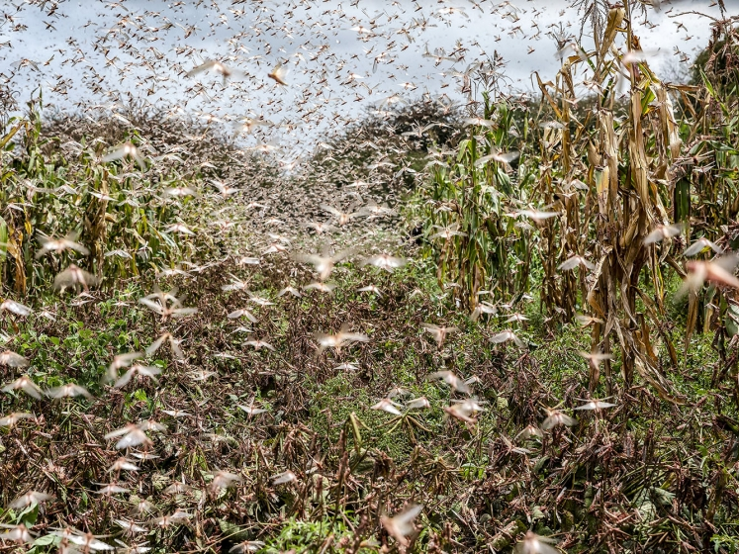

Slide 16
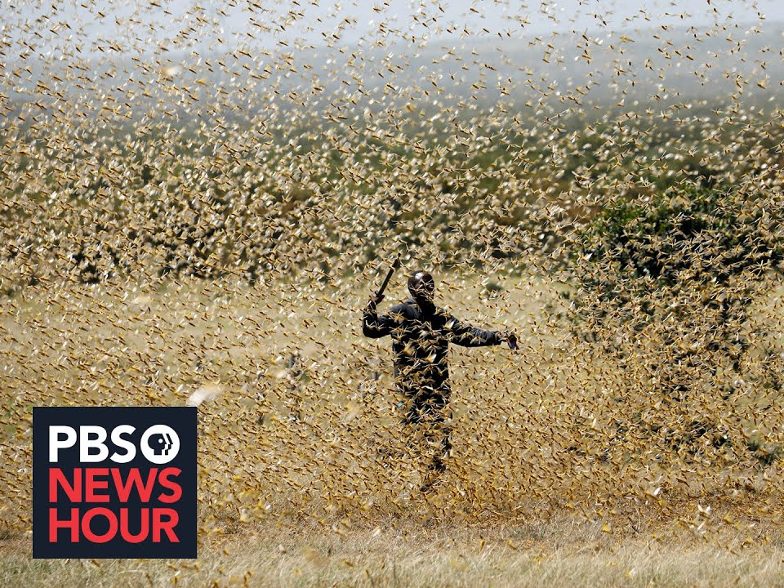

Slide 17
Joel
Joel calls on the priest to repent; to call a sacred assembly to fast and mourn
The land (people) are suffering
Food has been cutoff (locust)

Slide 18
Joel
It is time to call upon the Lord
“The day of Jehovah”
An expression for a day of judgment
Joel use the invasion of the locust to illustrate the invasion of an army of destruction that will come
The remedy—true, heartfelt repentance

Slide 19
Warnings of Moses
Deut 28:38,42; Joel 1:4,7
Locust
Deut 28:39-40; Joel 1:10-12
Failure of vineyard and olive tree
Deut 28:24; Joel 1:17-20
Everything dried up for lack of rain
Deut 28:25,33,47-53; Joel 2:1-11
Invasion by destroying army

Slide 20
The only hope
Deut 30:1-10; Joel 2:12-21
Turn to God in true repentance
God will deliver

Slide 21
Joel
“Rend your hearts and not your garments” 2:13
Pray for God’s mercy
God will restore the land
Then you shall know that I am in the midst of Israel: I am the LORD your God And there is no other. My people shall never be put to shame. 2:27

Slide 22
Salvation is two-fold
Grace and mercy of God
Joel 2:13—He is gracious and merciful
Joel 3:21—I will acquit them of the guilt
Repentance and obedience of man
Joel 1:13-14—Lie all night in sackcloth; cry to the Lord
Joel 2:12-13—Rend your heart; return to the Lord your God

Slide 23
Joel 2:28-32 (Acts 2:16-21)
"And it shall come to pass afterward That I will pour out My Spirit on all flesh; Your sons and your daughters shall prophesy, Your old men shall dream dreams, Your young men shall see visions. And also on My menservants and on My maidservants I will pour out My Spirit in those days. "And I will show wonders in the heavens and in the earth: Blood and fire and pillars of smoke.

Slide 24
Joel 2:28-32 (Acts 2:16-21)
The sun shall be turned into darkness, And the moon into blood, Before the coming of the great and awesome day of the LORD. And it shall come to pass That whoever calls on the name of the LORD Shall be saved. For in Mount Zion and in Jerusalem there shall be deliverance, As the LORD has said, Among the remnant whom the LORD calls.
Notes:
Cofman—
Wonders in the heaven above, and signs on the earth beneath ... Several of the
most spectacular wonders ever seen on earth had occurred right there in Jerusalem the
day Jesus was crucified only fifty-three days before Peter thus spoke. The very sun's
light failed; and, as it was the full moon, the satellite appeared as blood. Pontius Pilate
30
wrote to the Emperor Tiberius that "The moon, being like blood, did not shine the whole
night, and yet she happened to be at the full."[27] Thus the sun and the moon were
"wonders in heaven"; and the earthquake, the rending of the veil of the temple, and the
resurrection of many of the dead, were signs on the earth beneath. See

Slide 25
Joel
Lesson
The remedy—true, heartfelt repentance
“Rend your hearts and not your garments” 2:13
Pray for God’s mercy
God will restore the land
Then you shall know that I am in the midst of Israel: I am the LORD your God And there is no other. My people shall never be put to shame. 2:27

Slide 26
Joel 2:28-32 (Acts 2:16-21)
Lesson
Acts 22:16 'And now why are you waiting? Arise and be baptized, and wash away your sins, calling on the name of the Lord.'
The sun shall be turned into darkness, And the moon into blood, Before the coming of the great and awesome day of the LORD. And it shall come to pass That whoever calls on the name of the LORD Shall be saved. For in Mount Zion and in Jerusalem there shall be deliverance, As the LORD has said, Among the remnant whom the LORD calls.

Slide 27
Salvation is two-fold
Grace and mercy of God
Joel 2:13—He is gracious and merciful
Joel 3:21—I will acquit them of the guilt
Repentance and obedience of man
Joel 1:13-14—Lie all night in sackcloth; cry to the Lord
Joel 2:12-13—Rend your heart; return to the Lord your God

Slide 28
Examples
Jehu
Tore his garment, not his heart
Jehoiada
They tore their hearts instead of their garments

Slide 29
Reading
Maybe 300 years later than our current time
Judah is in captivity
Taken by Babylon
Now Medo-Persian empire is the world power
Daniel is in captivity
Daniel 9:1-13

Slide 30
…

Slide 31
…

Slide 32
Help, please…
There are 23 classes this quarter
I need to set up the last class
I would like to know what stood out to you this quarter?
A lesson we talked about
Something we didn’t talk about
Hand me a note or email me, please
WayneMHolt@gmail.com

Slide 33
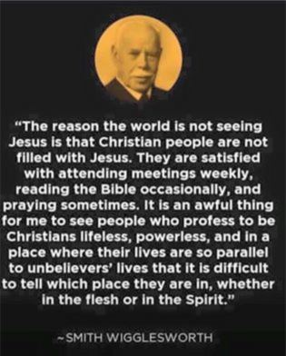
…

Slide 34
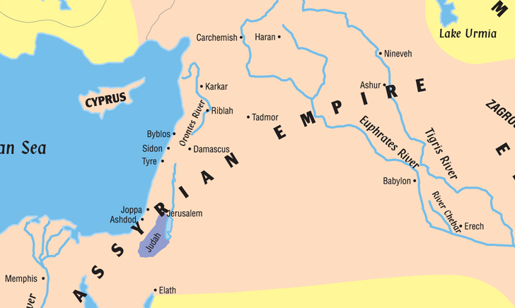

Slide 35
Assyrian Empire
Review
"I am powerful, I am omnipotent, I am a hero, I am gigantic, I am colossal!“ One of King Esarhaddon of Assyria's inscriptions, 7th century BC

Slide 37
Assyria and Israel
Review
In 853 BC a coalition which was formed by the kingdoms of Egypt, Hamath, Arvad, the Ammonites, "Ahab of Israel" and other neighboring states, under the leadership of king Hadadezer of Damascus, defeated the Assyrian king at Battle of Qarqar. However, the Assyrian king persevered in his attempts to subjugate Israel and Syria. Other battles soon followed in 849 BC and 846 BC.

Slide 38
Assyria and Israel
Review
Against Israel
Jehu bows before Shalmaneser III.
In 842 BC, Shalmaneser campaigned against Hadadezer's successor Hazael, forcing him to take refuge within the walls of his capital. While Shalmaneser was unable to capture Damascus, he devastated its territory, and Jehu of Israel (whose ambassadors are represented on the Black Obelisk now in the British Museum), together with the Phoenician cities, prudently sent tribute to him in 841 BC.

Slide 39
Shalmaneser III
Review
859 – 824 B.C.
853 B.C. (days of Ahab) attempted to invade Canaan
Turned away by a coalition
Led by Irhulein king of Hamath
Ben-hadad king of Syria
Ahab king of Israel

Slide 40
Hazael king of Syria
Review
Became king in 842 B.C.
Shalmaneser III king of Assyria
Just before Jehu became king of Israel
Shalmaneser attacked Damascus in 841 B.C.
Hazael had no help
Shalmaneser could not take the heavily fortified city

Slide 41
Jehu king of Israel
Review
Submitted himself to Shalmaneser
Monument erected
Black Obelisk
“The tribute to Jehu, son of Omri”
Shalmaneser’s last attempt to subdue Syria was in 837 B.C.
No more threats for 25 years
Hazael turns attention to Israel

Slide 42
“Cut Israel Short”
Review
2 Kings 10:32 In those days the LORD began to cut off parts of Israel; and Hazael conquered them in all the territory of Israel
33 from the Jordan eastward: all the land of Gilead-Gad, Reuben, and Manasseh…
Israel’s territory is shrinking
Note Elisha’s words in 2 Kings 8:12

Slide 43
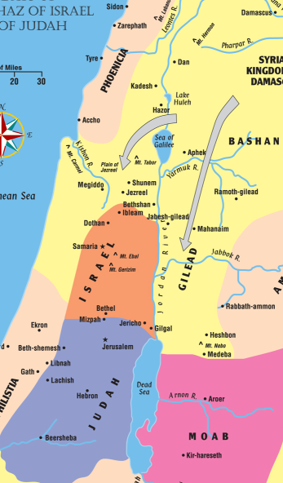

Slide 44
Jehu Dies
Review
Jehu dies and is buried in Samaria
He reigned 28 years
Jehoahaz, his son, is king of Israel

Slide 45
Background on Joash
Review
Athaliah
Daughter of Ahab and Jezebel
Mother of Ahaziah who was king of Judah
Killed all the royal heirs
After Ahaziah died
Joash, son of Ahaziah, was hid and not killed
Joash was hid in the house of the Lord for 6 years

Slide 46
Athaliah’s Death
Review
Joash is made king of Judah
Athaliah heard the noise
She came to the temple and saw the king
“Treason! Treason!”
Jehoiada gave command to take her away and kill her
And, kill anyone who follows her

