Slide 1
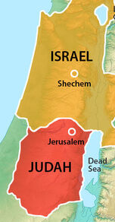
The Divided Kingdom
(Part 1)
“Till There Was No Remedy”
(2 Chronicles 36:16)

Slide 2

17 Periods of Bible History
United kingdom
Divided kingdom
Judah alone
Captivity
Return from captivity
Years of silence
Life of Christ
Early church
Letters to Christians
Before the flood
Flood
Scattering of the people
Patriarchs
Exodus
Wandering in wilderness
Invasion & conquest
Judges

Slide 3
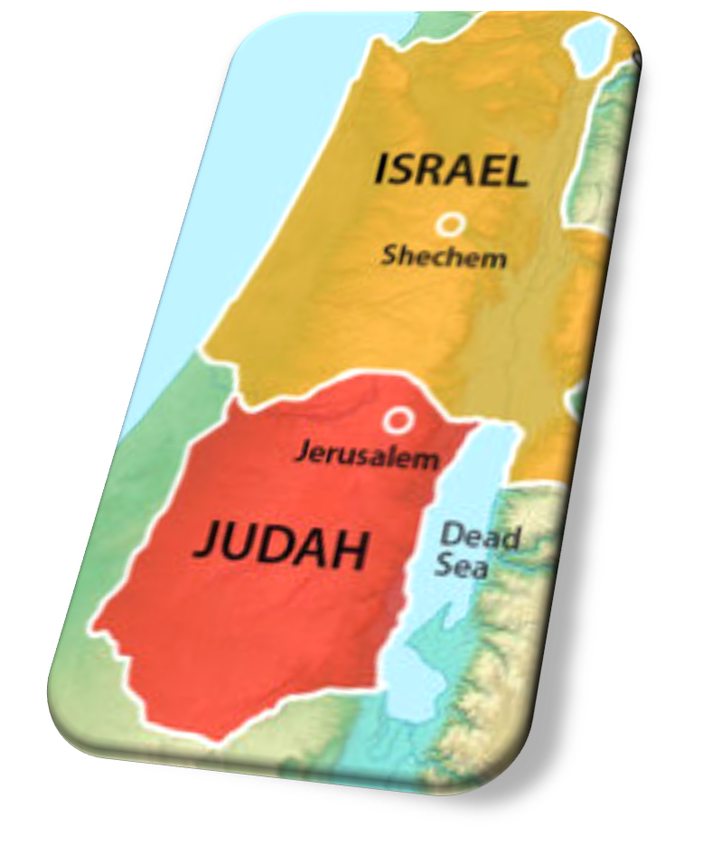
Divided Kingdom: Lesson 4
Nadab & Baasha (Israel)
Asa’s Faithfulness (Judah)
  1 Kings 15:9-34
  2 Chron. 14:1—16:6

Slide 4
Divided Kingdom: Lesson 4
JUDAH
ISRAEL
Rehoboam [B] 17 yrs
Abijah [B] 3 yrs
Asa [G] 41 yrs
Jeroboam [B] 22 yrs
Nadab [B] 2 yrs
Baasha [B] 24 yrs

Slide 5
Nadab & Baasha Become Kings In Israel
(1 Kings 15:25-34)
Following Jeroboam’s death his son Nadab became king in Asa’s second year (15: 25-26).
  He only ruled a portion of two years, continuing in Jeroboam’s wickedness.
Baasha (from Issachar) conspires against Nadab and kills him while he was laying siege to Gibbethon of the Philistines. Baasha became king in Israel in Asa’s third year in Judah (15:27-28, 33).
Baasha immediately strikes Jeroboam’s house, killing all who belonged to him (15:29-30).
  His killing spree fulfilled Ahijah’s prophecy (1 Kings 14:4-16).
Baasha did not stop all the wickedness in Israel; he appears to be more concerned with power than with reforming the nation (15:33-34).

Slide 6
Asa’s Early Years In Judah
(2 Chronicles 14:1-8)
Asa is good and righteous (14:2)
His reforms destroy the idols and tear down the high places in Judah set up by his father and grandfather (14:3, 5a).
He sought the Lord and commanded his citizens to seek the Lord and observe the Law (14:4).
He fortified many cities and enlarged his military; 300,000 in Judah and 280,000 in Benjamin (14:8).
The land enjoyed rest during these years because “…the Lord had given him rest” (14:5b-6).
  This appears to be the 10 years mentioned in 14:1.

Slide 7
Asa Delivered From The Ethiopians
(2 Chronicles 14:9-15)
Zera the Ethiopian invades Judah at Mareshah (14:9).
  He had 1,000,000* men and 300 chariots
Asa cries to God for help (14:10-11)
  “LORD, it is nothing for You to help, whether with many or with those who have no power.”
  “Help us, O LORD our God, for we rest on You.”
  “You are our God; do not let man prevail against You!”
God hears Asa’s cry, routing the Ethiopian army (14:12-15).
  Asa and Judah pursue them southward as they flee.
  Judah carries away enormous spoil.
Notes:
Literal Hebrew “a thousand thousand” (an innumerable host)

Slide 8
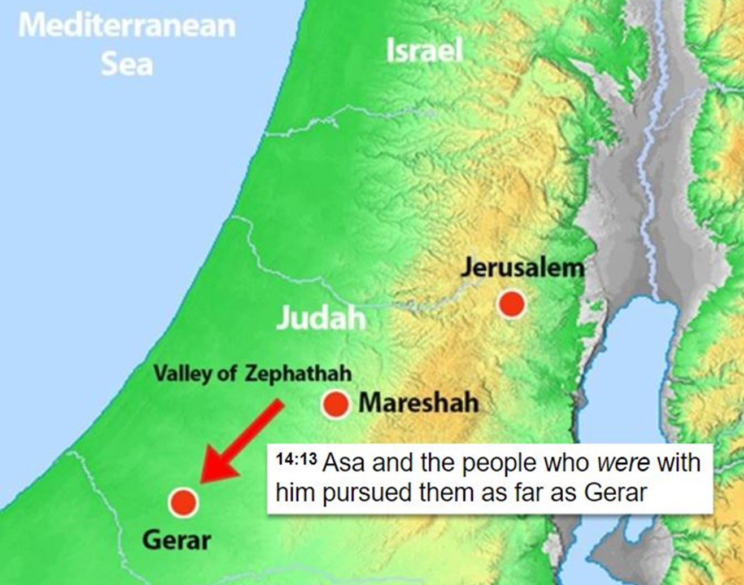
Notes:
Abraham visited Gerar in Genesis 20:1ff. And lied to King Abimelech about his relationship with Sarah.
Isaac dwelt there in Genesis 26.
2 Chronicles 14 is the final mention of the place in Scripture.

Slide 9
Azariah Admonishes Asa
(2 Chronicles 15:1-7)
Following Asa’s great victory over the Ethiopians, God sends the prophet Azariah to him with a warning and encouraging reminder.
  The Lord is with those who are with Him.
  Those who seek God will find Him (Acts 17:27).
  Those who forsake God will be forsaken by Him (15:2).
  For a long time, Israel has been without the true God, a teaching priest, or God’s Law. Yet when Israel sought God, they found Him.
      This references the situation in Israel under Solomon, Rehoboam, and Abijah, and perhaps earlier.
  “Be strong and do not let your hands be weak, for your work shall be rewarded!”
Notes:
Acts 17:27 so that they should seek the Lord, in the hope that they might grope for Him and find Him, though He is not far from each one of us;

Slide 10
Asa Enacts Reforms & Renews Covenant (1 Kings 15:9-15; 2 Chronicles 15:8-19)
Moved by Azariah’s encouraging words, Asa continues his reforms (2 Chron. 15:8-16).
  He purges more idols from Judah and cities in Israel he had captured, and He restored the altar of the Lord (2 Chron. 15:8).
  He even demotes his grandmother Maacah from being Queen Mother because of her idolatry (2 Chron. 15:16).
  He leads an assembly in Jerusalem of people from Judah and Israel as they renew their covenant with God through sacrifices and an oath (2 Chron. 15:9-15).
    NOTE: Those who would not join in these efforts would be put to death (2 Chron. 15:12).
  Asa was loyal to the Lord; there was no war until his 35th year (2 Chron. 15:17-19).

Slide 11
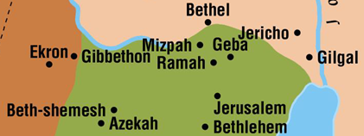
Asa’s War With Baasha
(1 Kings 15:16-22; 2 Chron 16:1-6)
Following Asa’s victory over the Ethiopians, there was about 14 years of peace.
Baasha fortified Ramah between Israel and Judah to prevent any more citizens in Israel from defecting to Judah (2 Chron. 16:1)
  NOTE: Ramah is 4 to 5 miles from Jerusalem.
Notes:
Micah Clem shared this illustration:
As a visual/example, the Eastside church building is exactly 4 miles from 306 BBQ (driving).
As the crow flies, Eastside is 4.6 miles from Buc-ee’s

Slide 12
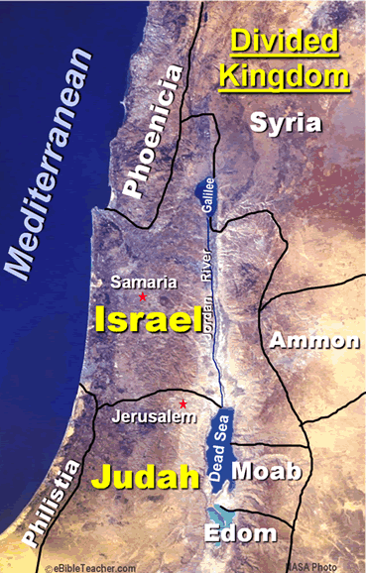
Asa’s War With Baasha
(1 Kings 15:16-22; 2 Chron. 16:1-6)
To counter Baasha, Asa seeks a covenant with Ben-hadad of Syria (2 Chron. 16:1-7).
  Asa gives him treasures from the Lord’s house king’s palace.
  He asked Ben-hadad to break his existing treaty with Baasha and begin a new treaty with him.
  Ben-hadad agrees and attacks cities in Israel.
  As a result, Baasha withdraws his forces from Ramah.
  Asa uses stones and timber Baasha left behind to build Geba and Mizpah.
Notes:
As a visual/example, the Eastside church building is exactly 4 miles from 306 BBQ (driving).
As the crow flies, Eastside is 4.6 miles from Buc-ee’s
OBSERVATIONS ABOUT THESE EVENTS:
Asa’s response to Baasha’s actions was disappointing
When the Ethiopians came upon him, Asa turned to the Lord for help and deliverance, asking for Divine protection
When Baasha threatened him, Asa sought human assistance through a political alliance with Ben-hadad & Syria
In this crisis, Asa showed he trusted man more than he trusted God… not what he had prayed earlier 2 Chron 14:11 cp. Psa 118:8-9

Slide 13
Asa’s War With Baasha
(1 Kings 15:16-22; 2 Chron. 16:1-6)
Asa’s response to Baasha’s actions is disappointing.
  When the Ethiopians came upon him, Asa turned to the Lord for help and deliverance, asking for Divine protection.
  When Baasha threatened him, Asa sought human assistance through a political alliance with Ben-hadad and Syria.
  In this crisis, Asa showed he trusted man more than he trusted God. This is not what he had prayed earlier (2 Chron 14:11; cp. Psa 118:8-9).
Notes:
Psalms 118:8-9 It is better to trust in the LORD Than to put confidence in man. 9 It is better to trust in the LORD Than to put confidence in princes.

Slide 14
Lessons for Today
God helps those who trust in Him and will not abandon them.
  Illustrated by Asa in his battle with the Ethiopians.
  We face situations that can be extremely challenging, that may even appear to be “insurmountable odds.”
  God will help His children when they cannot help themselves (Psa. 25:2; 44:6).
God’s people should never grow weary in doing His will (Galatians 6:9).
  Indicated in Azariah’s encouraging words to Asa.
Notes:
Psalms 25:2 O my God, I trust in You; Let me not be ashamed; Let not my enemies triumph over me.
Psalms 44:6-7 For I will not trust in my bow, Nor shall my sword save me. 7 But You have saved us from our enemies, And have put to shame those who hated us.
Galatians 6:9 And let us not grow weary while doing good, for in due season we shall reap if we do not lose heart.

