Slide 1
Judah Alone
Lesson 19
Jeremiah 26
Habakkuk

Slide 2
This Day In History 2600 Years Ago
Israel has been taken captive by Assyria
Nineveh has been destroyed by the Medes and Babylonians
Josiah is dead
Jehoahaz (Josiah’s son) has been taken captive to Egypt by Pharaoh Necho
Eliakim/Jehoiakim (Josiah’s son) has paid a massive tax (100 talents of silver a 1 talent of gold) to Egypt by taxing the people

Slide 3
Today’s Lesson
Jeremiah 26
Habakkuk

Slide 4
Jeremiah 26

Slide 5
Jeremiah 26
“In the beginning of the reign of Jehoiakim”
The Lord told Jeremiah:
  Stand in the court of the Lord’s house, and speak…all the words that I command you to speak…”
  He was to speak to those “which come to worship in the Lord’s house”
  “Do not diminish a word”

Slide 6
Jeremiah 26
  It was the Lord’s desire that the people would repent so that He would “relent concerning the calamity which I purpose to bring on them because of the evil of their doings”
  God had sent His prophets “both rising up early and sending them” (early and often we might say)
  If they would not listen and obey God, then He would:
    Make this house (the Lord’s house) like Shiloh (Josh 18:1; 1 Sam 1:3, 9; Jer 7:1-4, 12-15; Ps 78:60)
    Make Jerusalem “a curse to all the nations of the earth”

Slide 7
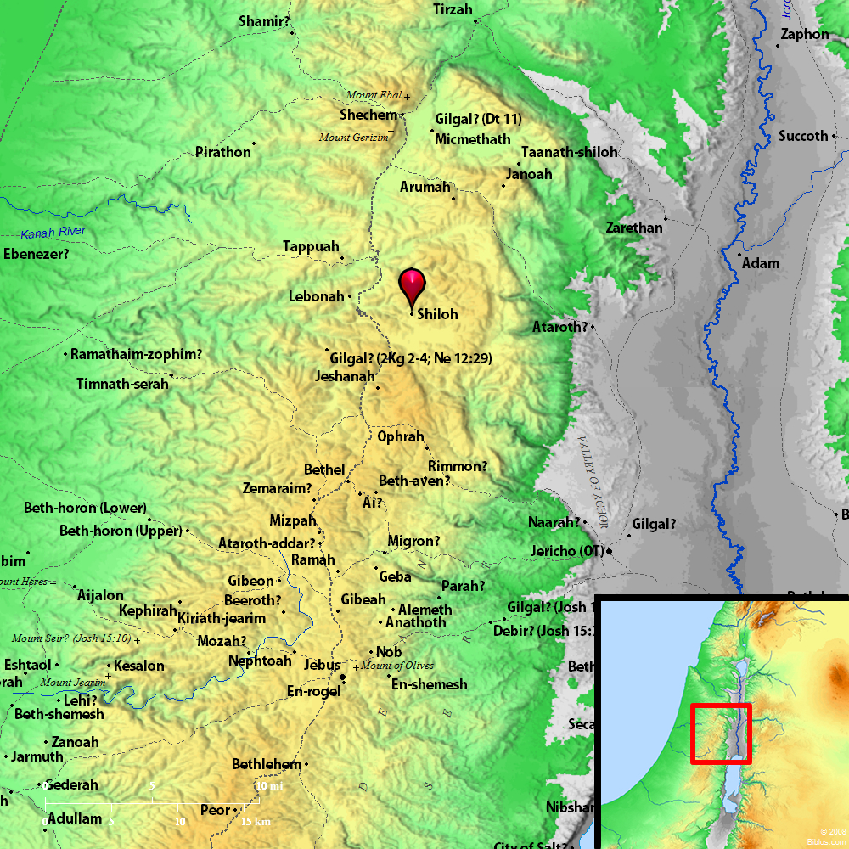
Notes:
Shiloh was in the tribe of Ephraim – Josh 16:5-6
At Shiloh:
Josh 18:1 The ten of meeting was set up there
Josh 19:51 The division of the land among the tribes was at Shiloh
Judges 21:19 There was an anuual festival to the Lord there. That was where they got some of the wives for Benjamin.
I Sam 1:3 Was where Elkanah (Samuel’s dad) went to worship
1 Sam 1:9 Was where Eli the priest was
I Sam 4:3 The ark of the covenant went from Shiloh and was taken by the Philistines in battle

Slide 8
Jeremiah 26
The priests, prophets, and all the people listened till Jeremiah finished speaking all the Lord had commanded him
They understood what Jeremiah was saying:
  “this city shall be desolate, without an inhabitant”
They seized him and said “You will surely die”
All the people were against Jeremiah in the house of the Lord

Slide 9
Jeremiah 26
The “princes of Judah” heard something was going on and came to the house of the Lord to find out what was happening
The priests and prophets told the princes that Jeremiah “deserves to die! For he has prophesied against this city”

Slide 10
Jeremiah 26
Jeremiah told the princes:
  The Lord sent me
  If you repent, the Lord will relent
  Do with me what you want. You will be spilling innocent blood!
The princes told everyone that Jeremiah did not deserve to die

Slide 11
Jeremiah 26
Some “of the elders of the land” reminded the people what Micah had prophesied:
“Zion shall be plowed like a field,
Jerusalem shall become heaps of ruins,
And the mountain of the temple
Like the bare hills of the forest.” (Micah 3:12)

Slide 12
Jeremiah 26
The elders went on to say: (Read v16-19)
  Did Hezekiah put Micah to death?
  Did Hezekiah not fear the Lord and seek His favor?
  The Lord relented of the doom that had been pronounced
  “we are doing great evil against ourselves”

Slide 13
Jeremiah 26
Read v20-24
Urijah prophesied the same things Jeremiah did
When Urijah fled to Egypt when he heard that Jehoiakim wanted to kill him
Jehoiakim fetched him from Egypt and killed him
Jehoiakim “cast his body into the graves of the common people”

Slide 14
Jeremiah 26
Nevertheless the hand of Ahikam the son of Shaphan was with Jeremiah, so that they should not give him into the hand of the people to put him to death.
26:24
Notes:
Ahikam was the son of Shaphan the scribe.
Ahikam’s son, Gedaliah, was made governor of Judah by the Babylonians after Jerusalem’s destruction.

Slide 15
Habakkuk

Slide 16
Habakkuk
Don’t know who he was
Don’t know exactly when he wrote the book (625-605BC??)
Must have had a good relationship with God based on the questions he asked God and the answers God gave him
Different than most prophets in that most have a direct message to the people from God. Habakkuk is written as a dialog with God.

Slide 17
Habakkuk Quoted in New Testament
“Look among the nations and watch— Be utterly astounded!
For I will work a work in your days
Which you would not believe, though it were told you. – Hab 1:5
‘Behold, you despisers, Marvel and perish! For I work a work in your days,
A work which you will by no means believe,
Though one were to declare it to you.’ - Acts 13:41

Slide 18
Habakkuk Quoted in New Testament
For the vision is yet for an appointed time;
But at the end it will speak, and it will not lie.
Though it tarries, wait for it; Because it will surely come,
It will not tarry. – Hab 2:3
“For yet a little while,
And He who is coming will come and will not tarry.”
- Heb 10:37

Slide 19
Habakkuk Quoted in New Testament
“Behold the proud, His soul is not upright in him;
But the just shall live by his faith.– Hab 2:4
For in it the righteousness of God is revealed from faith to faith; as it is written, “The just shall live by faith.” – Rom 1:17
Also see Gal 3:11 & Heb 10:38

Slide 20
Habakkuk
Habakkuk goes from questioning if God was even listening and knew what was going on (chapter 1)
TO
Saying I trust God no matter what! (Chapter 3)
How did he get there?

Slide 21
Habakkuk Outline
Chapter 1
  Habakkuk’s First Question
  God’s Answer
  Habakkuk’s Second Question
Chapter 2
  God’s Answer
Chapter 3
  Habakkuk’s Prayer

Slide 22
Habakkuk First Question
Habakkuk observes that:
  There is violence
  There is injustice
  There is oppression
  The law is ineffective
  The wicked restrict the righteous
  Justice has been perverted
“O Lord, how long shall I cry, And You will not hear?”

Slide 23
Habakkuk – God Responds to First Question
The short answer – The Chaldeans are coming to take care of it!
God goes into some description about the Chaldeans and they were a nation to be feared!

Slide 24
Habakkuk – God Responds to First Question
The Chaldeans were:
  A bitter and hasty nation
  Terrible and dreadful
  Their views of justice stemmed from themselves
  Violent
  Gathering captives like sand
  Scoffing at kings
  Building siege ramps to capture cities

Slide 25
Habakkuk – God Responds to First Question
The Chaldeans:
  Had horses swifter than leopards and “more fierce than evening wolves”
  Calvary covered a lot of territory quick!
  Thought their idols gave them their strength

Slide 26
Habakkuk Second Question
Habakkuk observes:
  That the Chaldeans capture people like fish in a net
  The Lord had appointed the Chaldeans for judgment against Judah
  The Lord had purer eyes than to look on evil
“Why do You look on those who deal treacherously, And hold Your tongue when the wicked devours a person more righteous than he?” (1:13)
“Shall they therefore empty their net, And continue to slay nations without pity?” (1:17)

Slide 27
Habakkuk Second Question
  “I will stand my watch
  And set myself on the rampart,
  And watch to see what He will say to me,
  And what I will answer when I am corrected” (2:1)

Slide 28
God Responds to Second Question
Read 2:2-5
The proud man (Babylon?)
  Transgresses by wine
  Does not stay at home
  Cannot be satisfied
  Gathers captives of all nations

Slide 29
God Responds to Second Question
Then the Lord pronounces 5 “Woes”:
  To him who increases what is not his
  To him who covets evil gain for his house
  To Him who builds a town with bloodshed
  To him who gives drink to his neighbor to make him drunk
  To him who says to wood “Awake”

Slide 30
God Responds to Second Question
Woe 1 - To him who increases what is not his (v6)
  He steals
  He charges usury for loans
  Those who he has plundered will plunder him!

Slide 31
God Responds to Second Question
Woe 2 - To Him who covets evil gain for his house (v9)
  Greed
  Wiped out many peoples
  Sinned against themselves
  Their own house will cry against them

Slide 32
God Responds to Second Question
Woe 3 - To Him who builds a town with bloodshed and iniquity (v12)
  People labor for things that don’t last
  What lasts is God’s glory!

Slide 33
God Responds to Second Question
Woe 4 - To him who gives drink to his neighbor to make him drunk (v15)
  To see their nakedness
  They are filled with shame
  “The cup of the Lord’s right hand will be turned against you” (v16)

Slide 34
God Responds to Second Question
Woe 5 - To him who says to wood “Awake”
  They worshipped idols
  The idols were covered with precious materials but “in it is no breath at all”
  “But the Lord is in His hold temple. Let all the earth keep silence before him.” (v20)

Slide 35
Habakkuk’s Prayer

Slide 36
Habakkuk’s Prayer
The Lord’s answers made Habakkuk afraid
Habakkuk prayed the Lord would “revive Your work” (Israel?) and would show mercy

Slide 37
Habakkuk’s Prayer
Then Habakkuk praises God
  In many ways sounds like what God said about Himself in Nahum 1
  Read 3:1-15

Slide 38
Habakkuk’s Prayer
Then Habakkuk praises God
  For His glory
    His glory covered the heavens
    Earth full of His praise
    His brightness like the light
    Rays flashing from His hand
  God’s glory is awesome!

Slide 39
Habakkuk’s Prayer
Then Habakkuk praises God
  For His power
    Before Him went pestilence
    He startled the nations
    The mountains scattered before Him
    People’s tents everywhere trembled before Him
    He divided the earth with rivers

Slide 40
Habakkuk’s Prayer
Then Habakkuk praises God
  For His power (cont)
    Mountains tremble before Him
    Sun and moon stand still before Him
    He tramples the nations in anger
    He saves His people, His anointed
    He strikes the head of the wicked
    He treads the sea with his horses

Slide 41
Habakkuk’s Prayer
Read 3:16-19
Habakkuk shows his confidence/faith in God

Slide 42
Habakkuk - Observations
Shows he’s a man like us. He has questions. Sometimes I don’t think of the prophets as humans. They are superhumans sent from God. We talked at the first of the quarter at the incredibly hard tasks that the prophets were sent to do. But they were humans just like us.

Slide 43
Habakkuk - Observations
2. He trembles when he hears the answers to the questions. Partly he realizes what’s about to come. Partly isn’t what he was expecting. Sometime we think if ONLY we had a better President or governor or …. They either still have a good King (Josiah) or had just went through 31 years of a good king

Slide 44
Habakkuk - Observations
3. God thinks a LONG way ahead of us. He already had plans for Babylon’s destruction!!!!

Slide 45
Summary

Slide 46
Next Class
The First Invasion
2 Kings 23:34-24:6
2 Chron 36:4-8
Daniel 1:1-7

Slide 47
For Extra Credit…

Slide 48
Habakkuk
Now Mount Sinai was completely in smoke, because the Lord descended upon it in fire. Its smoke ascended like the smoke of a furnace, and the whole mountain quaked greatly.
– Ex 19:18

Slide 49
Habakkuk
For behold, the Lord is coming out of His place;
He will come down
And tread on the high places of the earth.
The mountains will melt under Him,
And the valleys will split
Like wax before the fire,
Like waters poured down a steep place – Micah 1:3-4

Slide 50
Habakkuk
The mountains quake before Him,
The hills melt,
And the earth heaves at His presence,
Yes, the world and all who dwell in it. – Nahum 1:5

Slide 51
Habakkuk
The mountains saw You and trembled;
The overflowing of the water passed by.
The deep uttered its voice,
And lifted its hands on high.– Hab 3:10

