Slide 1
Divided Kingdom II
Lesson #1
Jonah The Prophet
Waldron Book “Till There Was No Remedy” pages 89-91
Sunday May 5, 2024

Slide 2
Introduction to The Divided Kingdom Part II
This quarter’s highlights:
– Israel’s end in captivity (722 B.C.)
– Judah alone as God’s people for ~136 years
– Judah’s end (last captives) (586 B.C.)
We’ll examine more of the prophets and their books than we did last quarter
See syllabus for the reading assignment for each class

Slide 3
Why Study the Old Testament?
All Scripture is inspired by God and profitable (2 Tim. 3:16)
It is a tutor to bring us to Christ (Gal. 3: 8-9; 22-25)
It is written for our learning (Rom. 15:4)
Its prophecies serve as evidence of the inspiration of Scripture
It teaches God’s character and His expectations

Slide 4
Divided Kingdom/ Kings studied last quarter
Israel
Jeroboam
Nadab
Baasha
Elah
Zimri
Omri
Ahab
Ahaziah
Jehoram
Jehu
Jehoahaz
Joash
Jereboam II
(786-745 BC)
Judah
Rehoboam
Abijah
Asa
Jehoshaphat
Jehoram
Ahaziah
Athaliah
Joash
Amaziah
Uzziah (27th year of Jereboam II)
II Kings 14:25 says that, “He restored the border of Israel from the entrance of Hamath unto the sea of the Araba, according to the word of Jehovah, the God of Israel, which He spoke by His servant Jonah the son of Amittai, the prophet, who was of Gath-Hepher.”
Jonah ~790 BC

Slide 5
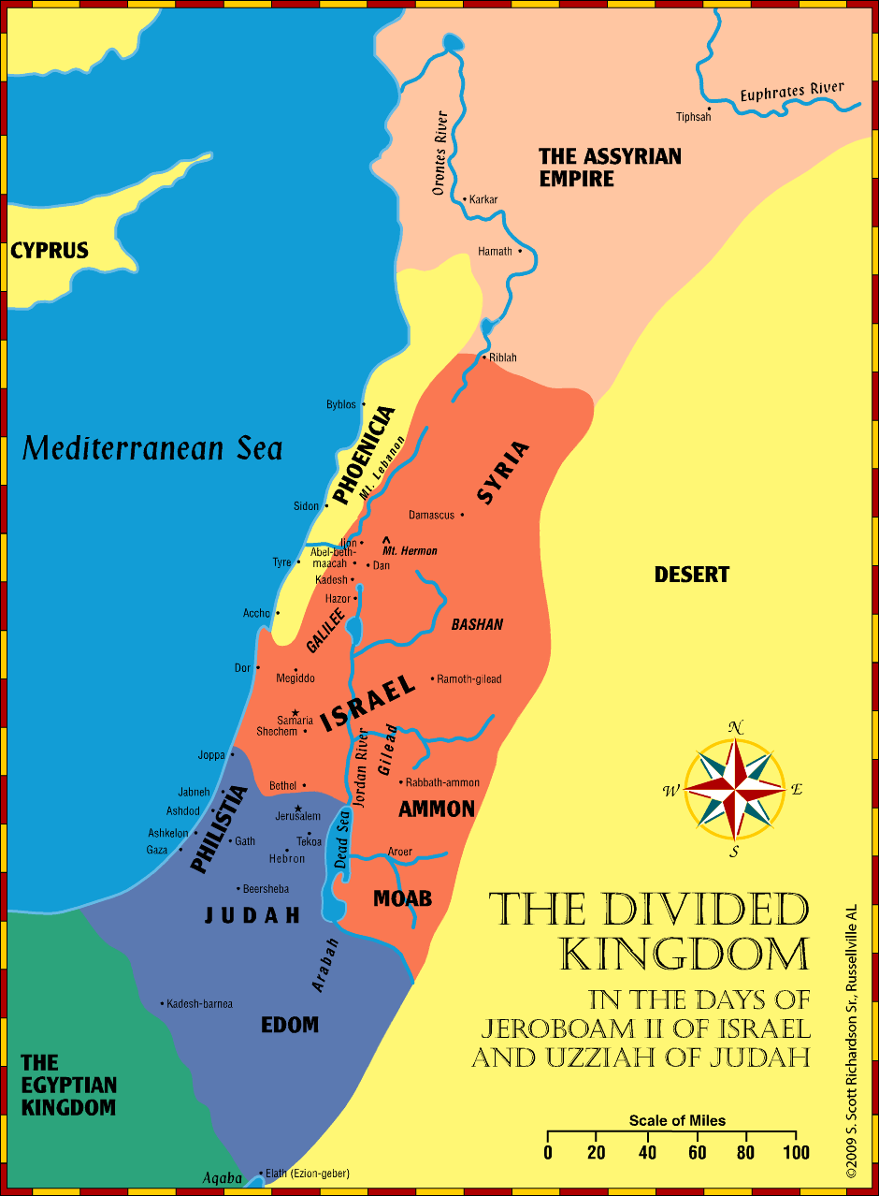

Slide 6
Divided Kingdom/ Kings We Will Cover This Quarter
Israel
Jereboam II
Zechariah
Shallum
Menahem
Pekahiah
Pekah
Hoshea
Assyrian Captivity 722BC
Judah
Amaziah
Uzziah (Azariah)
Jotham
Ahaz
Hezekiah
Manasseh
Amon
Josiah
Jehoahaz
Jehoiakim
Jehoiachin
Zedekiah

Slide 7
Jonah (A Different Prophet)
Prophet:
One who tells the future
One who proclaims God’s message
One who becomes the illustration?
In this case, yes; the prophet is used as the illustration to make God’s point clear: I am God, obey My will
Hosea is also used in this way

Slide 8
Jonah
(Who is He?)
One of the “Minor Prophets”; small book, important message
Son of Amittai (no info on him) Jon 1:1
From Gath-Hepher 2 Kings 14:25 (territory of Zebulun, NE of Nazareth Josh 19:13)
Prophetic call was to Nineveh (Assyria) Jon 1:2
Prophesied during the reign of Jeroboam II
2 Kings 14:23-25
He was a “sign” that Jesus spoke about Mt 12:39-41 Lk 11:30

Slide 9
Matthew 12:38-42 The Scribes and Pharisees Ask for a Sign
“38 Then some of the scribes and Pharisees answered, saying, “Teacher, we want to see a sign from You.” 39 But He answered and said to them, “An evil and adulterous generation seeks after a sign, and no sign will be given to it except the sign of the prophet Jonah. 40 For as Jonah was three days and three nights in the belly of the great fish, so will the Son of Man be three days and three nights in the heart of the earth. 41 The men of Nineveh will rise up in the judgment with this generation and condemn it, because they repented at the preaching of Jonah; and indeed a greater than Jonah is here. 42 The queen of the South will rise up in the judgment with this generation and condemn it, for she came from the ends of the earth to hear the wisdom of Solomon; and indeed a greater than Solomon is here

Slide 10
Jonah
(A Different Prophet)
Myth, fiction, legend? No
Fable, Satire, Allegory, Parable? No
Historical, True? Yes

Slide 11
Jonah Outline
Jonah runs away from God (Ch 1)
Jonah runs toward God (Ch 2)
Jonah runs with God (Ch 3)
Jonah runs ahead of God (Ch 4)
Jonah flees (Ch 1)
Jonah relents & prays (Ch 2)
Jonah preaches (Ch 3)
Jonah pouts (Ch 4)

Slide 12
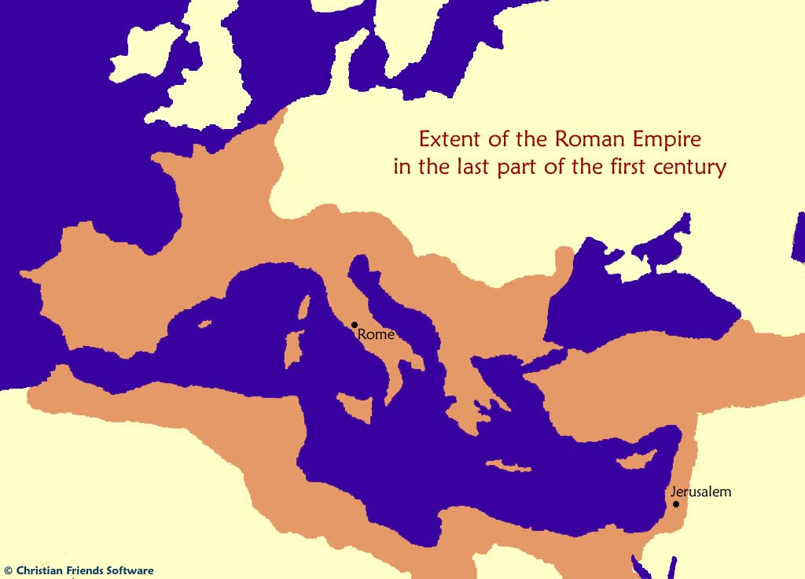
Jonah Runs Away From God
But Jonah arose to flee to Tarshish from the presence of the LORD. He went down to Joppa, and found a ship going to Tarshish; so he paid the fare, and went down into it, to go with them to Tarshish from the presence of the LORD. (1:3)
Arise, go to Nineveh, that great city, and cry out against it; for their wickedness has come up before Me. (1:2)
Nineveh and Tarshish were in
opposite directions!
Tarshish
Nineveh

Slide 13
Jonah Runs Away From God
A Great Storm (1:4)
How bad is the storm that the mariners would throw the cargo over?
All crying out to their gods
Jonah sleeps (1:5)
Tarshish
Nineveh

Slide 14
Jonah Runs Away From God
A Great Storm
Captain finds Jonah; What do you mean, sleeper? (1:6); Lots are cast which find that he is the cause of the trouble
Jonah’s God is different (to be feared-Controls all nature!)
Jonah tells them everything
He teaches them about the true God (creator of land and sea) (1:9)
He even gives them a solution (1:12); throw me out
They try to row back to land (1:13)
They pray to God (1:14)
They throw him over (1:15)
They worship in awe once the sea calms (1:16)
Tarshish
Nineveh

Slide 15
Jonah Runs to God
A Great Fish
When Jonah is thrown over, what would he think is about to happen?
What is going through his mind as he sinks ? See chapter 2
What does God have prepared? Fish (Sea Creature)
Tarshish
Nineveh

Slide 16
Jonah Runs to God
A Great Fish
Notice chapter 2 verses 3-4a & 5-6a; what does the future look like for Jonah? Desperation; Cast out into darkness and death
Now notice the “yet” ; what picture is shown following the “yet” in 4b & 6b? Salvation!
What is Jonah’s attitude in 2:9?
I will obey the Lord; thankfulness
Tarshish
Nineveh

Slide 17
Jonah Runs with God
God instructs Jonah a 2nd time: Go tell Nineveh -> Yet 40 days and Nineveh will be overthrown (3:4)
A great city (3 days’ journey);
The People and King repented
Called a fast; showed remorse
God relents from destroying Ninevah (3:10)
God shows mercy based on a repentant heart

Slide 18
Jonah Runs Ahead of God What a Great Shame!
God’s mercy angered Jonah! Why? He doesn’t want mercy for Ninevah, but destruction
compare the shipmen’s concern for Jonah to his concern for Ninevites
“I knew you would do this!”
It is better if I die! (4:3)
Is it right for you to be angry, Jonah? (4:4); Very self- serving attitude; Do we ever act this way?
Nineveh did what Israel failed to do!

Slide 19
Jonah Runs Ahead of God What a Great Shame!
Jonah’s further actions (leaves to go wait and watch hoping God will destroy) v. 5
God teaches Jonah (and us) a lesson vv. 6-11
– Again, God uses His power over nature (plant, worm, sun, scorching wind)
– Jonah’s hypocrisy needed exposing, and his
perspective needed correcting
What about us?

Slide 20
Jonah
(Applications)
Matthew 12:38-42
Jonah in the Great Fish was a sign regarding Jesus in the Tomb
Those pagan people of Ninevah will rise up in judgement of Israel because they repented when they heard God’s message, and Israel didn’t
We must repent and serve God in His way!
Notes:
.

Slide 21
Jonah
(Applications)
Can’t hide from God
No effort can overcome God’s plan
God can use any situation to show His power
The men on the boat learned who God is
They learned they could not overcome His plan
They worshiped the true God when they learned WHO HE IS

Slide 22
Jonah
(Applications)
Are we ready to stand up and answer when someone asks us, who is your God?
Would we offer excuses where Jonah boldly spoke of God?
When we are at our lowest, we must pray! God IS Merciful
Notes:
Mercy
Have you ever wanted someone to get in trouble
What if they were given a way out?
Would we respond like Jonah when they are shown mercy?
God is “Gracious and merciful God, slow to anger and abundant in loving kindness, One who relents from doing harm.”
Are we ready to forgive?

Slide 23
Jonah
(Applications)
God wishes that all would repent (2 Pet. 3:9)!
God shows mercy when we want to show hate (judgement)!
Do we really want sinners to repent?
Notes:
Mercy
Have you ever wanted someone to get in trouble
What if they were given a way out?
Would we respond like Jonah when they are shown mercy?
God is “Gracious and merciful God, slow to anger and abundant in loving kindness, One who relents from doing harm.”
Are we ready to forgive?

Slide 24
Next Time
Death of Amaziah, Introduction to Amos
2 Kings 14:15-15:4; 2 Chron 25:26-26:23
Waldron Book, pages 91-93
Johnny George
Wednesday May 8, 2024
Notes:
Mercy
Have you ever wanted someone to get in trouble
What if they were given a way out?
Would we respond like Jonah when they are shown mercy?
God is “Gracious and merciful God, slow to anger and abundant in loving kindness, One who relents from doing harm.”
Are we ready to forgive?

