Slide 1
MAKING A DEFENSE

Slide 2
APOLOGETICS
Not an apology for your faith
To make a defense regarding a stance
Comes from the Greek word “Apologia”
Used in scripture 8 times

Slide 3

“Apologia”
Acts 22:1, ““Brethren and fathers, hear my defense which I now offer to you.”
I Cor 9:3, “My defense to those who examine me is this”
Philippians 1:16, “the latter do it out of love, knowing that I am appointed for the defense of the gospel”

Slide 4
“Apologia”
“…but sanctify Christ as Lord in your hearts, always being ready to make a defense to everyone who asks you to give an account for the hope that is in you, yet with gentleness and reverence”
              1 Peter 3:15

Slide 5




CATEGORIES OF BELIEVERS
Believe No Matter What
Believe, but Beginning to Have Doubt
Don’t Believe, but Curious About God
Atheist Who is Happy in Their Beliefs
CONTINUUM OF BELIEF

Slide 6
“YOU DON’T NEED EVIDENCE”
Acts 1:1-3, “The first account I composed, Theophilus, about all that Jesus began to do and teach, until the day when He was taken up to heaven, after He had by the Holy Spirit given orders to the apostles whom He had chosen. To these He also presented Himself alive after His suffering, by many convincing proofs, appearing to them over a period of forty days and speaking of the things concerning the kingdom of God.”

Slide 7
“YOU DON’T NEED EVIDENCE”
1 Corinthians 15:3-8, “For I delivered to you as of first importance what I also received, that Christ died for our sins according to the Scriptures, and that He was buried, and that He was raised on the third day according to the Scriptures, and that He appeared to Cephas, then to the twelve. After that He appeared to more than five hundred brethren at one time, most of whom remain until now, but some have fallen asleep; then He appeared to James, then to all the apostles; and last of all, as to one untimely born, He appeared to me also.”

Slide 8
“YOU DON’T NEED EVIDENCE”
John 4:28-29, “So the woman left her waterpot, and went into the city and said to the men, “Come, see a man who told me all the things that I have done; this is not the Christ, is it?”

Slide 9
“YOU DON’T NEED EVIDENCE”
1 John 1:1-4, “What was from the beginning, what we have heard, what we have seen with our eyes, what we have looked at and touched with our hands, concerning the Word of Life— and the life was manifested, and we have seen and testify and proclaim to you the eternal life, which was with the Father and was manifested to us— what we have seen and heard we proclaim to you also, so that you too may have fellowship with us; and indeed our fellowship is with the Father, and with His Son Jesus Christ. These things we write, so that our joy may be made complete.”

Slide 10
COMMON ATHEIST ARGUMENTS

Slide 11
“THERE IS NO EVIDENCE FOR GOD’S EXISTENCE”
The Cosmological Argument
The Design Argument
The Fine-Tuning Argument
The Moral Argument

Slide 12
“IF GOD CREATED EVERYTHING, WHO CREATED GOD”
Outside of Space
He had to exist apart from what He created
Outside of Time
He had to exist prior to what He created
Immaterial
He is not composed of what He created
Uncaused
He had to be the Original “unmoved mover”
All Powerful
He would have to be immensely powerful
Personal
He created personal beings

Slide 13
“Jesus Never Existed”
This is a relatively new claim
It is a favorite claim of people who claim atheism today
There are no scholarly historians who hold this view

Slide 14
Atheist NT Scholar Bart D. Ehrman
“The idea that Jesus did not exist is a modern notion. It has no ancient precedents. It was made up in the eighteenth century. One might as well call it a modern myth, the myth of the mythical Jesus”

Slide 15
“The idea of Jesus was stolen from other ancient myths, like Mithras”
This is a popular new claim that can really damage the faith of young people
The claim is that there are other mythical god stories that have very similar attributes to Jesus
The claim follows that the writers of the NT stole these attributes for Jesus

Slide 16
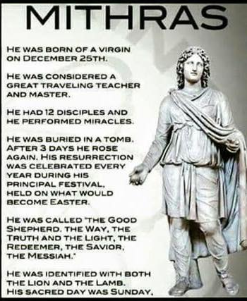

Claims About Mithras

Slide 17



Was Jesus copied from Mithras?
Born of a Virgin
Born on December 25
Birth attended by Shepherds
A great travelling teacher
Promised his followers immortality
Sacrificed himself for world peace
Crucified
Risen on the 3rd day
Had 12 followers
Called “The Good Shepherd”
Identified with the Lion & Lamb
Called the Way, Truth, & Light
Followers celebrated on Sunday
Took a “Lord’s Supper”

Slide 18
“That’s your truth that God exists. I have my truth.”
This is generally a misunderstanding of the nature of truth
Truth can be subjective or objective, based on the claim
Subjective truth is opinion based – What is your preference?
Objective truth is inherent in the object being considered
God’s existence is not based on anyone’s opinion

