Slide 2
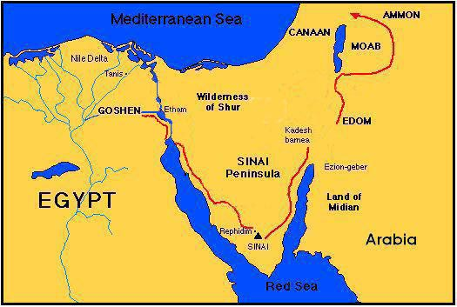

Slide 3
Noah
Shem
Assyria
Elam
Chadeans
Lydia
Aramaeans
Arabian Tribes
Israelites
Edomites
Moabites
Ammonites
Ham
Ethiopians
Egyptians
Libyans
Canaanites
Sidon
Heth (Hittites)
Jebusites
Amorites
Girgasites
Hivites
Southern Arabians
Early Babylonians
Philistines
Japheth
Javan
Greece
Italy
Spain
Cyprus
Medes
Persians
Parthians

Slide 4
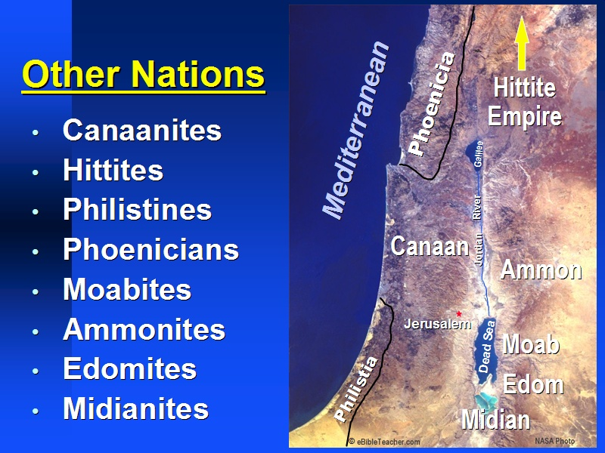

Slide 5
Moses’ Life 1st 40: In Egypt (Acts 7:23) 2nd 40: In Midian (Ex 7:7) 3rd 40: Wandering (Deut 34:7)

Slide 6
Exodus Chapter Content Chapter 1: Bondage Chapter 2: Moses 1st 40 Chapter 3: Burning Bush, Excuses Chapter 4: Signs, More excuses Chapter 5: Pharaoh: Make Bricks Chapter 6: God’s Covenant Chapter 7: Aaron’s Rod, Water to Blood

