Slide 1

Therefore I intend always to remind you of these qualities, though you know them and are established in the truth that you have.
-- II Peter 1:12

Slide 2

Who Is My Brother?

Slide 3
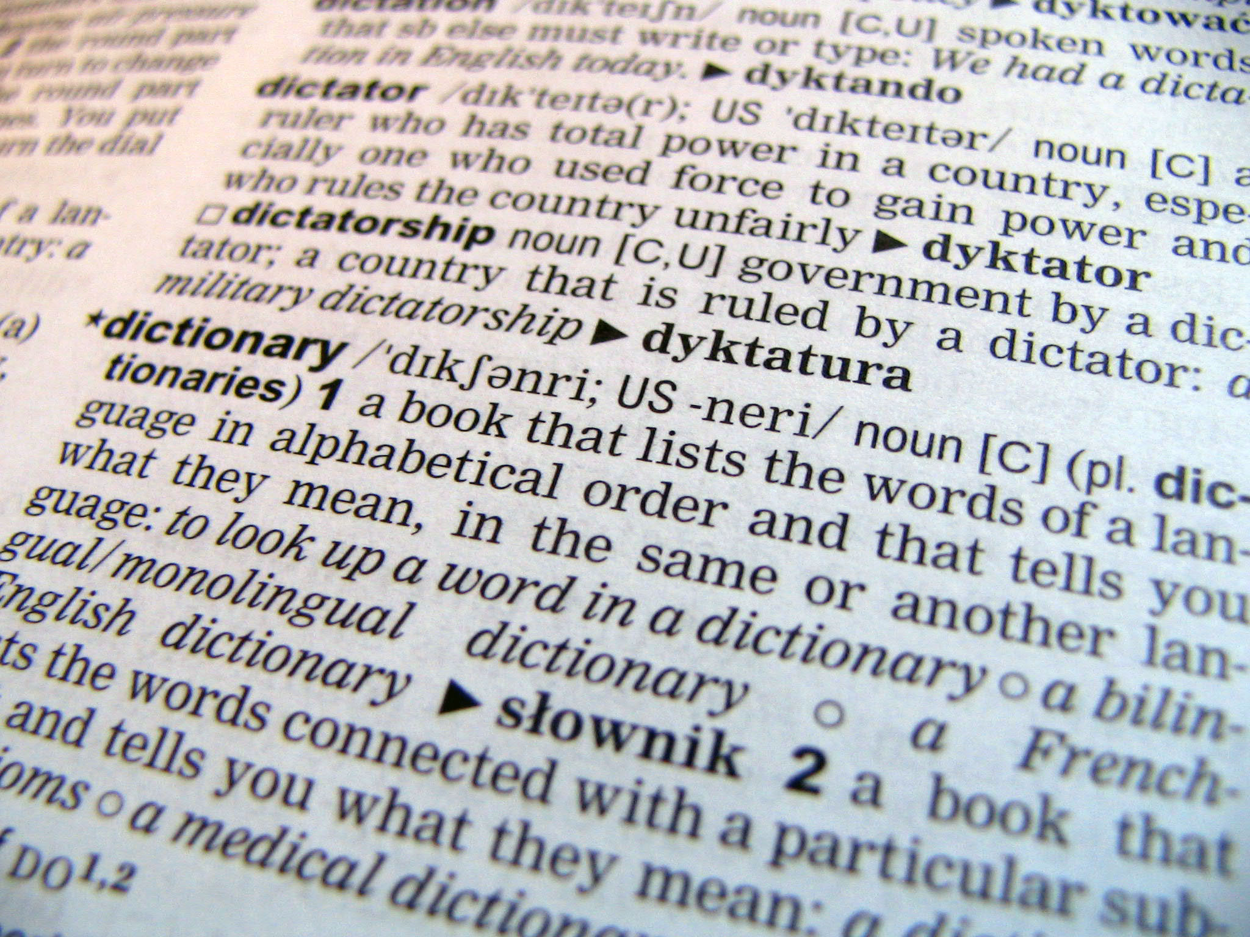

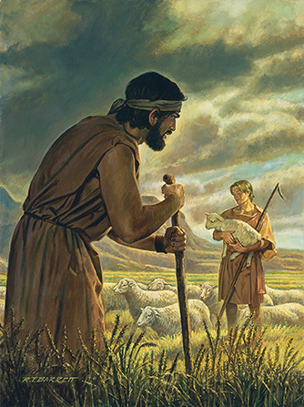
Defining Terms
Those From the Same Parent(s)
  Then the Lord said to Cain, “Where is Abel your brother?” He said, “I do not know; am I my brother's keeper?” – Genesis 4:9

Slide 4
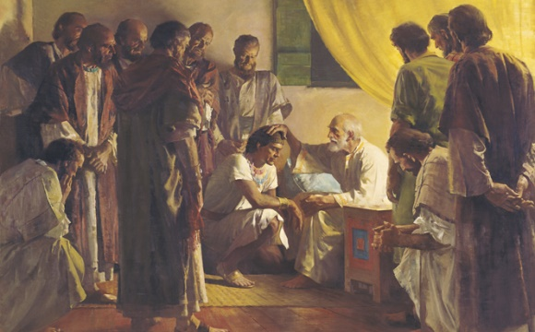
Defining Terms
Those From the Same Parent(s)
  So ten of Joseph's brothers went down to buy grain in Egypt. But Jacob did not send Benjamin, Joseph's brother, with his brothers, for he feared that harm might happen to him. -- Genesis 42:3-4

Slide 5
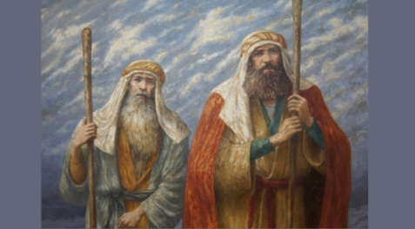
Defining Terms
Those From the Same Parent(s)
  Then the anger of the Lord was kindled against Moses and he said, “Is there not Aaron, your brother, the Levite? I know that he can speak well. Behold, he is coming out to meet you, and when he sees you, he will be glad in his heart. -- Exodus 4:14

Slide 6
Defining Terms
Those of Common Ancestry
  If your brother becomes poor and cannot maintain himself with you, you shall support him as though he were a stranger and a sojourner, and he shall live with you. – Leviticus 25:35

Slide 7
Defining Terms
Those Sharing a Common Situation
  Sometimes used metaphorically
    I am a brother of jackals and a companion of ostriches. -- Job 30:29
    Whoever is slack in his work is a brother to him who destroys. – Proverbs 18:9

Slide 8
Defining Terms
Sometimes Alludes to “Sameness”
  So they tied sackcloth around their waists and put ropes on their heads and went to the king of Israel and said, “Your servant Ben-hadad says, ‘Please, let me live.’” And he said, “Does he still live? He is my brother.” – I Kings 20:32

Slide 9
Every Usage Implies Some Type of Commonality

Slide 10

Finding Brothers in the New Testament
For I know their works and their thoughts, and the time is coming to gather all nations and tongues. And they shall come and shall see my glory, and I will set a sign among them. And from them I will send survivors to the nations, to Tarshish, Pul, and Lud, who draw the bow, to Tubal and Javan, to the coastlands far away, that have not heard my fame or seen my glory. And they shall declare my glory among the nations. And they shall bring all your brothers from all the nations as an offering to the Lord – Isaiah 66:18-20a

Slide 11
So the saying spread abroad among the brothers that this disciple was not to die; yet Jesus did not say to him that he was not to die, but, “If it is my will that he remain until I come, what is that to you? -- John 21:23
Therefore, brothers, pick out from among you seven men of good repute, full of the Spirit and of wisdom, whom we will appoint to this duty. – Acts 6:3
I appeal to you, brothers, by the name of our Lord Jesus Christ, that all of you agree, and that there be no divisions among you, but that you be united in the same mind and the same judgment. – I Corinthians1:10

Slide 12
But now I am writing to you not to associate with anyone who bears the name of brother if he is guilty of sexual immorality or greed, or is an idolater, reviler, drunkard, or swindler—not even to eat with such a one. -- I Corinthians 5:11
And all the brothers who are with me,: To the churches of Galatia – Galatians 6:1
And most of the brothers, having become confident in the Lord by my imprisonment, are much more bold to speak the word without fear. – Philippians 1:14
Whoever says he is in the light and hates his brother is still in darkness. -- I John 2:9

Slide 13
Finding Brothers in the New Testament
How is one included in this number?
  How is one included in a physical family?
“Physical” terms in a “spiritual” family
  God – the Father
    Blessed be the God and Father of our Lord Jesus Christ, the Father of mercies and God of all comfort -- II Corinthians 1:3

Slide 14
Finding Brothers in the New Testament
How is one included in this number?
  How is one included in a physical family?
“Physical” terms in a “spiritual” family
  Born into the family
    Since you have been born again, not of perishable seed but of imperishable, through the living and abiding word of God – I Peter 1:23

Slide 15
Finding Brothers in the New Testament
How is one included in this number?
  How is one included in a physical family?
“Physical” terms in a “spiritual” family
  Children of the Father
    See what kind of love the Father has given to us, that we should be called children of God – I John 3:1a

Slide 16
Finding Brothers in the New Testament
When Is One Born Into This Family?
  Everyone who believes that Jesus is the Christ has been born of God, and everyone who loves the Father loves whoever has been born of him. By this we know that we love the children of God, when we love God and obey his commandments. For this is the love of God, that we keep his commandments. And his commandments are not burdensome. – I John 5:1-3

Slide 17
Finding Brothers in the New Testament
When Is One Born Into This Family?
  Everyone who believes that Jesus is the Christ has been born of God, and everyone who loves the Father loves whoever has been born of him. By this we know that we love the children of God, when we love God and obey his commandments. For this is the love of God, that we keep his commandments. And his commandments are not burdensome. – I John 5:1-3

Slide 18
Finding Brothers in the New Testament
When Is One Born Into This Family?
  Jesus answered him, “Truly, truly, I say to you, unless one is born again he cannot see the kingdom of God.” Nicodemus said to him, “How can a man be born when he is old? Can he enter a second time into his mother's womb and be born?” Jesus answered, “Truly, truly, I say to you, unless one is born of water and the Spirit, he cannot enter the kingdom of God. – John 3:3-5

Slide 19
Finding Brothers in the New Testament
When Is One Born Into This Family?
  And Peter said to them, “Repent and be baptized every one of you in the name of Jesus Christ for the forgiveness of your sins, and you will receive the gift of the Holy Spirit. – Acts 2:38
  For as many of you as were baptized into Christ have put on Christ. – Galatians 3:27

Slide 20
Finding Brothers in the New Testament
Who is My Brother?
  One who believes in God
  One who submits to God
  One baptized into Christ for forgiveness of sins
  Brethren Who Share the Same Father, Ancestry, and Common Situation

Slide 21

Answering the Charge of Exclusivism
  Exclusive. They may say, "We're the only ones with the truth; everyone else is wrong; and if you leave our group your salvation is in danger.“ - Christianity Today Website

Slide 22
Answering the Charge of Exclusivism
“Unlike that, Christians accept Jesus as their Savior and Lord. Still, they recognize that he has followers in many different Christian denominations and nondenominational churches who accept Christ. We don't believe that the truth is available only to a select few—instead, salvation through Jesus is open to everyone. We also believe that God is above any human leader.”

Slide 23
Answering the Charge of Exclusivism
  Exclusive. They may say, "We're the only ones with the truth; everyone else is wrong; and if you leave our group your salvation is in danger.“
“Christians accept Jesus as their Savior and Lord”
-- Eliminates those following Muhammad, Buddha, etc. as having truth?

Slide 24
Answering the Charge of Exclusivism
  Exclusive. They may say, "We're the only ones with the truth; everyone else is wrong; and if you leave our group your salvation is in danger.“
“Followers in many different Christian denominations and nondenominational churches who accept Christ”
-- Does this mean Jews and Muslims are wrong?

Slide 25
Answering the Charge of Exclusivism
  Exclusive. They may say, "We're the only ones with the truth; everyone else is wrong; and if you leave our group your salvation is in danger.“
“Salvation through Jesus is open to everyone”
-- Does this mean atheists are not saved?

Slide 26
Answering the Charge of Exclusivism
  Is Christianity Exclusive?
    God desires that all be saved
    Salvation excludes any who will not submit to Him
      Determined by His Standards, not human standards
God’s Children Are Those Who Submit To Their Father
Those Who Submit To The Father Are Brethren To One Another

Slide 27
