Slide 1

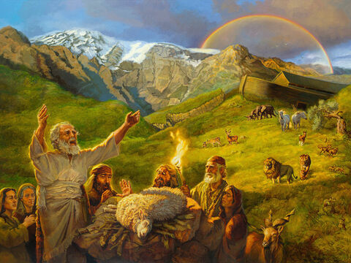
Studies in
Genesis
Class will begin in:
The Faith and Failings of First Families
Notes:
Artwork by Jan van 't Hoff/Gospelimages.com.

Slide 2
Studies in Genesis
The Faith and Failings of First Families
Notes:
Artwork by Jan van 't Hoff/Gospelimages.com.

Slide 3
Genesis 18-19
Lesson 11
Abraham Receives Strangers
Abraham Intercedes For Sodom
Sodom’s Depravity
Sodom and Gomorrah Destroyed

Slide 4
Melchizedek
Review
Melchizedek is a title meaning King of righteousness
King of Salem; Salem later named Jerusalem ; Salem means peace, so he was King of peace
He was a priest, not by lineage (Levitical Priesthood comes later), but from appointment by God

Slide 5
Melchizedek
Review
A man (Heb 7:4), but much about him is a mystery as discussed in more detail in Hebrews 7
  No mother, no father, no genealogy
  No beginning of days or end of life
Abram honored Melchizedek’s priesthood by giving him a tithe (10 %) of all

Slide 6
Melchizedek
Review
He blessed Abram
He is better than Abram because the “lesser is blessed by the better” (Heb 7:7)
Melchizedek is used by the Hebrew writer to describe Christ- Our King and Priest forever (Heb 7:3,17)

Slide 7
The Lord Speaks to Abram: Great Nation Promise Repeated
Chapter 15
Review
An heir is coming
  It will not be the servant (v4)
  Heir will be from your own body (v4)
Can you count the stars? (v5)
So shall your descendants be (A Great Nation from your own body) (v5)
God lets Abram know- He is in Control

Slide 8
Abram’s Reaction
Review
Genesis 15:6 And he believed in the LORD, and He accounted it to him for righteousness.
Romans 4:21
  ²¹ and being fully convinced that what He had promised He was also able to perform.
That his descendants would be as many as the stars in the sky, yet he had no son

Slide 9
God Repeats Promise of Land Given to Abram’s Descendants
I brought you out of Ur (v7)
To give you this land (v7)
Abram asks God for confirmation: How shall I know that I will inherit it? (v8)
Review

Slide 10
Abram in Deep Sleep/ God Shows the Future (All Knowing)
Review
God foretells of the future of Abram’s descendants
  Will be strangers in a land-not theirs (Egypt) (13)
  Servants for 400 years (generic timeframe)
  Specific time 430 years (ref Ex 12:40)
  God will Judge that nation (14)
  Abraham’s descendants will come out with great possessions (14)

Slide 11
Abram in Deep Sleep/ God Shows the Future (All Knowing)
Review
Abram will be buried at a good old age
(v 15)
After four generations, your descendants shall return here
The time was not ready to take the land
  In God’s time it will happen

Slide 12
God Repeats
Promise of Land
Review
On this same day, the Lord made a Covenant with Abram (v18)
To your descendants I have given this land
  From River of Egypt (Not Nile) to Euphrates
After 400 years in a strange land

Slide 13
Sarai’s plan for An Heir
Chapter 16
Review
Offers her handmaid to Abram
  To bring an heir (v2)
Abram complies (v2)
  Hagar conceives (v4)
Trouble begins

Slide 14
Sarai’s Regret
Review
Sarai’s plan backfires
Sarai is despised by Hagar (v4)
Sarai blames Abram (v5)
Abram reacts: “Indeed your maid is in your hand; do to her as you please.” (v6)
Sarai deals harshly with Hagar (v6)
Hagar flees toward Shur (Heading back to Egypt?)(v6)

Slide 15
Angel of The Lord Appears to Hagar
Review
Referred to as “Hagar, Sarai’s maid”; Where are you going? (v8)
She responds-I am fleeing from Sarai
Angel tells her to return and submit to Sarai (v9)

Slide 16
Angel of The Lord Appears to Hagar
Review
Promise made to Hagar
  I will multiply your descendants exceedingly (v10)
Foretells her son’s future
Commanded to name the child Ishmael (God hears your affliction) (v11)
  He will be a wild man (v12)
  In constant strife (v12)
Abram is 86 when Ishmael is born (v16)
Is this the heir God promised Abram? No! God is in Control, Not Sarai, Not Abram

Slide 17
Abraham: Father of Many Nations
Chapter 17
Review
Abram is 99 years old (v1)
  Thirteen years after Ishmael born
  Still no heir
God will make a covenant
Abram fell on his face (v3)

Slide 18
Abraham: Father of Many Nations
Review
Name changed
  Abram – exalted father
  Abraham – father of a multitude
Make many nations from you (v6)
Kings shall come from you (v6)
Everlasting covenant (7-8); Nation and Land

Slide 19
The Sign of God’s Covenant
Review
I will be your God-Abraham’s Descendants (v7,8)
I give to you the land (v8)
  As an everlasting possession
You and your descendants shall keep my covenant
  Throughout your generations (v9)
The sign of the covenant to be kept -Circumcision of every male, born in your house -8 days old or one bought with money (v 10-14)
  Otherwise, they will be cutoff (death or cast away because of their rebellion)

Slide 20
Sarah is not Barren/ Mother of Nations
Review
Sarai changed to Sarah (princess) (17:15)
  No longer barren
  Mother of nations; Kings born from here
Abraham laughed (overjoyed/not doubtful) at promise of child
  Abraham 99/ almost 100 years old (v17,24)
  Sarah 90 years old (v17)
Abraham petitions for Ishmael (v18)
  As a substitute heir

Slide 21
Sarah is not Barren/
Mother of Nations
Review
God answers No concerning Ishmael; Sarah will bear you a son (19)
  His name will be Isaac (laughter)
  The covenant will be given to him and his descendants (19,21)
  Ishmael will be blessed (great nation) but will not be the son of promise (v20)
  By this time next year Isaac will be born (21)
Abraham circumcises all males in his household that same day (v23-26)
Abraham is 99, Ishmael is 13

Slide 22
Faith and Failings of Families
lessons
Faith
  Abraham fully convinced of God promises
  Abraham obeys God’s command to implement circumcision- the same day
Failings
Sarai’s plan for an heir
Hagar despises Sarai
Hagar flees, does not submit to Sarai’s authority

Slide 23
Abraham Receives Visitors
Genesis 18:1-8
18 Then the Lord appeared to him by the terebinth trees of Mamre, as he was sitting in the tent door in the heat of the day. ² So he lifted his eyes and looked, and behold, three men were standing by him; and when he saw them, he ran from the tent door to meet them, and bowed himself to the ground,

Slide 24
Abraham Receives Visitors
Genesis 18:1-8
³ and said, “My Lord, if I have now found favor in Your sight, do not pass on by Your servant. ⁴ Please let a little water be brought, and wash your feet, and rest yourselves under the tree. ⁵ And I will bring a morsel of bread, that you may refresh your hearts. After that you may pass by, inasmuch as you have come to your servant.”
They said, “Do as you have said.”

Slide 25
Abraham Receives Visitors
Genesis 18:1-8
⁶ So Abraham hurried into the tent to Sarah and said, “Quickly, make ready three measures of fine meal; knead it and make cakes.” ⁷ And Abraham ran to the herd, took a tender and good calf, gave it to a young man, and he hastened to prepare it. ⁸ So he took butter and milk and the calf which he had prepared, and set it before them; and he stood by them under the tree as they ate.

Slide 26
Abraham Receives Visitors
Abraham showed hospitality to strangers
We are reminded by the Hebrew writer to do the same
Hebrews 13:2 Do not forget to entertain strangers, for by so doing some have unwittingly entertained angels.

Slide 27
Abraham Receives Visitors
To Abraham these visitors appeared at first as three men not supernatural beings (v2)
He bows in respect and uses the term “My Lord” (vs 2,3); this seems to be translated in a manner meaning one deserving of honor and respect- not meaning God
Jehovah is the translation used starting in verse 13 (after foretelling of Isaac’s birth); the other two men are angels (ref 18:22, 19:1)
Abraham and Sarah provide the strangers with water to wash their feet, rest, and a meal (bread, young calf, butter, and milk)

Slide 28
God Decides It Is Time for The Heir To Be Born
Genesis 18:9-15
⁹ Then they said to him, “Where is Sarah your wife?”
So he said, “Here, in the tent.”
¹⁰ And He said, “I will certainly return to you according to the time of life, and behold, Sarah your wife shall have a son.”
(Sarah was listening in the tent door which was behind him.)

Slide 29
God Decides It Is Time for The Heir To Be Born
Genesis 18:9-15
¹¹ Now Abraham and Sarah were old, well advanced in age; and Sarah had passed the age of childbearing. ¹² Therefore Sarah laughed within herself, saying, “After I have grown old, shall I have pleasure, my lord being old also?”
¹³ And the Lord said to Abraham, “Why did Sarah laugh, saying, ‘Shall I surely bear a child, since I am old?’

Slide 30
God Decides It Is Time for The Heir To Be Born
Genesis 18:9-15 (God speaks)
¹⁴ Is anything too hard for the Lord? At the appointed time I will return to you, according to the time of life, and Sarah shall have a son.”
¹⁵ But Sarah denied it, saying, “I did not laugh,” for she was afraid.
And He said, “No, but you did laugh!”

Slide 31
Promise Of A Son
God says: According to the time of life (9 months?) Sarah shall have a son (10,14)
(11,12) Sarah laughed (with doubt based on her age and Abraham’s age); Abraham’s laughter prior seems to have been with trust and joy
God asks Abraham why did Sarah laugh and doubt Me? (13)

Slide 32
Promise Of A Son
Abram is 99 years old/Sarah is 90
Sarah laughed/doubted within herself—Many years of being barren seems to have weakened her faith. Sarah treated the announcement as too incredible
Genesis 18:14 "Is anything too hard for the LORD? At the appointed time I will return to you, according to the time of life, and Sarah shall have a son.“
I am in Control-Trust Me!

Slide 33
Promise Of A Son
Genesis 18:15 But Sarah denied it, saying, “I did not laugh,” for she was afraid. And He said, “No, but you did laugh!”
Acts 5:3 But Peter said, “Ananias, why has Satan filled your heart to lie to the Holy Spirit and keep back part of the price of the land for yourself?”
You can’t lie to God!!
  You can’t deceive God!!
  All Knowing

Slide 34
Is Anything Too Difficult for The Lord?
God created the earth and everything in it and on it by His spoken word.
Why would Sarah doubt His power to do ‘anything?’
Luke 1:37 “For with God nothing will be impossible.”
We need to put our full trust in God’s promises
What do you and I learn from this?

Slide 35
Sarah’s Replaces Doubt With Faith
Hebrews 11:11
¹¹ By faith Sarah herself also received strength to conceive seed, and she^{[a]} bore a child when she was past the age, because she judged Him faithful who had promised.

Slide 36
Looking Toward Sodom
Genesis 18:16-19
¹⁶ Then the men rose from there and looked toward Sodom, and Abraham went with them to send them on the way. ¹⁷ And the Lord said, “Shall I hide from Abraham what I am doing, ¹⁸ since Abraham shall surely become a great and mighty nation, and all the nations of the earth shall be blessed in him? ¹⁹ For I have known him, in order that he may command his children and his household after him, that they keep the way of the Lord, to do righteousness and justice, that the Lord may bring to Abraham what He has spoken to him.”
Notes:
Since – Inasmuch as; because

Slide 37
Looking Toward Sodom
Genesis 18:20-21 (God speaks now to where Abraham can hear)
²⁰ And the Lord said, “Because the outcry against Sodom and Gomorrah is great, and because their sin is very grave, ²¹ I will go down now and see whether they have done altogether according to the outcry against it that has come to Me; and if not, I will know.”
Notes:
Since – Inasmuch as; because

Slide 38
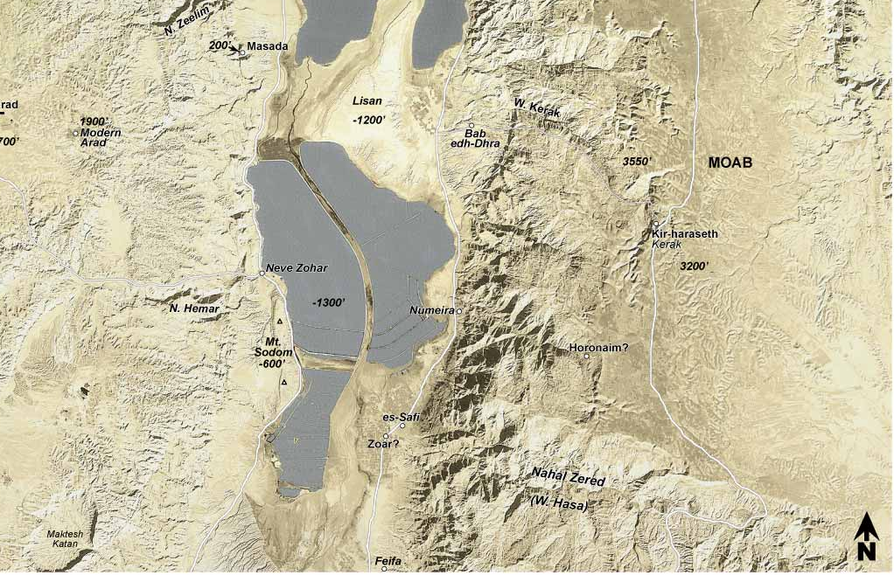

Slide 39
Looking Toward Sodom
The two angels leave for Sodom (22)
Abraham knows Lot is in Sodom
Abraham ‘negotiates’ (pleads) with the Lord to save the righteous in Sodom

Slide 40
Abraham Pleads for Sodom
Genesis 18:23-33
²³ And Abraham came near and said, “Would You also destroy the righteous with the wicked? ²⁴ Suppose there were fifty righteous within the city; would You also destroy the place and not spare it for the fifty righteous that were in it? ²⁵ Far be it from You to do such a thing as this, to slay the righteous with the wicked, so that the righteous should be as the wicked; far be it from You! Shall not the Judge of all the earth do right?”
²⁶ So the Lord said, “If I find in Sodom fifty righteous within the city, then I will spare all the place for their sakes.”

Slide 41
Abraham Pleads for Sodom
Genesis 18:23-33
The Lord tells Abraham that he will not destroy Sodom if he finds the number of righteous people that Abraham asks Him to spare- in the entire city
45? I will not destroy
40? I will not destroy
30? I will not destroy
20? I will not destroy
10? I will not destroy
God leaves Abraham; Abraham returns home (33)

Slide 42
Lot In Sodom
Genesis 19:1-3
19 Now the two angels came to Sodom in the evening, and Lot was sitting in the gate of Sodom. When Lot saw them, he rose to meet them, and he bowed himself with his face toward the ground. ² And he said, “Here now, my lords, please turn in to your servant’s house and spend the night, and wash your feet; then you may rise early and go on your way.”

Slide 43
Lot In Sodom
Genesis 19:1-3
And they said, “No, but we will spend the night in the open square.”
³ But he insisted strongly; so they turned in to him and entered his house. Then he made them a feast, and baked unleavened bread, and they ate.

Slide 44
Lot In Sodom
Remember Lot’s choice?
  Genesis 13:12 Abram dwelt in the land of Canaan, and Lot dwelt in the cities of the plain and pitched his tent even as far as Sodom. But the men of Sodom were exceedingly wicked and sinful against the LORD.
Strangers (Angels) come to Sodom (1)
Lot insisted strongly that they stay in his house-not out in the streets (Why?)
Lot shows hospitality(3)
  similar to Abraham (rest, eat, get cleaned up)

Slide 45
Evil Men Of Sodom
Genesis 19:4-5
⁴ Now before they lay down, the men of the city, the men of Sodom, both old and young, all the people from every quarter, surrounded the house. ⁵ And they called to Lot and said to him, “Where are the men who came to you tonight? Bring them out to us that we may know them carnally.”
so that we may take our pleasure with them. (BBE)
have sex with them. (NIV)
The word Sodomy (homosexuality) comes from this evil city

Slide 46
Homosexuality and Approvers of It Are Deserving of Death
Romans 1:26-32
²⁶ For this reason God gave them up to vile passions. For even their women exchanged the natural use for what is against nature. ²⁷ Likewise also the men, leaving the natural use of the woman, burned in their lust for one another, men with men committing what is shameful, and receiving in themselves the penalty of their error which was due.
²⁸ And even as they did not like to retain God in their knowledge, God gave them over to a debased mind, to do those things which are not fitting;

Slide 47
Homosexuality and Approvers of It Are Deserving of Death
Romans 1:26-32
²⁹ being filled with all unrighteousness, ^{[d]}sexual immorality, wickedness, ^{[e]}covetousness, ^{[f]}maliciousness; full of envy, murder, strife, deceit, evil-mindedness; they are whisperers, ³⁰ backbiters, haters of God, violent, proud, boasters, inventors of evil things, disobedient to parents, ^{31 [g]}undiscerning, untrustworthy, unloving, ^{[h]}unforgiving, unmerciful; ³² who, knowing the righteous judgment of God, that those who practice such things are deserving of death, not only do the same but also approve of those who practice them.

Slide 48
Evil Men Of Sodom
Genesis 19:6-8
⁶ So Lot went out to them through the doorway, shut the door behind him, ⁷ and said, “Please, my brethren, do not do so wickedly! ⁸ See now, I have two daughters who have not known a man; please, let me bring them out to you, and you may do to them as you wish; only do nothing to these men, since this is the reason they have come under the shadow of my roof.”
Lot shockingly offers up his own daughters to appease the wicked men

Slide 49
Lot’s Offer to the Evil Men
He seems to feel that it is worse to allow his guests to be molested than his own daughters
He was willing to protect the guests at all costs.
But in this offer he did very wrong, and showed the weakness of his faith in God.

Slide 50
Lot’s Offer to the Evil Men
Of two moral evils we should choose neither, and should never commit sin to avoid any supposed evil, or obtain any supposed good. The only course of wisdom and safety is to trust in God and do right.

Slide 51
Evil Men Of Sodom
Genesis 19:9-11
⁹ And they said, “Stand back!” Then they said, “This one came in to stay here, and he keeps acting as a judge; now we will deal worse with you than with them.” So they pressed hard against the man Lot, and came near to break down the door. ¹⁰ But the men reached out their hands and pulled Lot into the house with them, and shut the door¹¹ And they struck the men who were at the doorway of the house with blindness, both small and great, so that they became weary trying to find the door.

Slide 52
The Angels Save Lot
Pulled Lot back in the house (10)
The angels strike the men with blindness (11)
These men were so evil, that even after being blinded, they become weary trying to find the door

Slide 53
Destruction Announced
^{Genesis 19:12-13}
¹² Then the men said to Lot, “Have you anyone else here? Son-in-law, your sons, your daughters, and whomever you have in the city—take them out of this place! ¹³ For we will destroy this place, because the outcry against them has grown great before the face of the Lord, and the Lord has sent us to destroy it.”

Slide 54
Lot Warns His Sons-In-Law
¹⁴ So Lot went out and spoke to his sons-in-law, who had married his daughters, and said, “Get up, get out of this place; for the Lord will destroy this city!” But to his sons-in-law he seemed to be joking.
  Who were to marry his daughters (ESV)
  Who were pledged to marry his daughters (NIV)
Two virgin daughters (19:8); not married yet but betrothed makes the most sense; other possibilities as well
Sons-in-law thought he was joking; didn’t listen

Slide 55
Escape For Your Life!
^{Genesis 19:15-17}
¹⁵ When the morning dawned, the angels urged Lot to hurry, saying, “Arise, take your wife and your two daughters who are here, lest you be consumed in the punishment of the city.” ¹⁶ And while he lingered, the men took hold of his hand, his wife’s hand, and the hands of his two daughters, the Lord being merciful to him, and they brought him out and set him outside the city. ¹⁷ So it came to pass, when they had brought them outside, that ^{[d]}he said, “Escape for your life! Do not look behind you nor stay anywhere in the plain. Escape to the mountains, lest you be ^{[e]}destroyed.”

Slide 56
Lot Pleads to go to Zoar instead of the Mountains
Lot- Not the mountains, lest some evil overtake me and I die (18-19)
Lot- Let me flee to this little city, and my soul shall live (20)
The angels agree to not destroy the little city (21) (Zoar meaning little) (22)
Hurry, escape there. For I cannot do anything until you arrive there.” (22)

Slide 57
Sodom Is Destroyed
^{Genesis 19:24-25}
²⁴ Then the Lord rained brimstone and fire on Sodom and Gomorrah, from the Lord out of the heavens. ²⁵ So He ^{[g]}overthrew those cities, all the plain, all the inhabitants of the cities, and what grew on the ground.
Brimestone: sulphur, hot ash, lava??

Slide 58
Lot’s Wife Disobeyed
Angels commanded -Don’t look back (19:17)
Lot’s wife disobeyed this command; she looked back and became a pillar (column) of salt (26)
In the morning, Abraham surveys the land toward Sodom (like the smoke of a burning furnace) (26-27)
God remembers Abraham and saves Lot from the overthrow (28)

Slide 59
The Descendants of Lot
Genesis 19:30-38
Lot and daughters are in Zoar
They leave Zoar out of fear to live in a cave in the mountains (30)
The oldest daughter comes up with an evil plan to “preserve the lineage of our father” (31-36)
She claims there is no man on earth to come into them (31); Is this correct?

Slide 60
The Descendants of Lot
Genesis 19:30-38
The daughters get Lot drunk
They lay with him on back-to-back days
He had no idea what occurred because he was so drunk (33,35)
Both daughters have children by Lot (36)
From the older – Moab (Moabites)
From the younger – Ben-Ammi (Ammonites)

Slide 61
Does The End Justify The Means?
The daughters knew their father would not commit such an act with them knowingly, so they got him drunk; they knew he would have considered this act as profane (sin); yet, they decided the end justified the means
Do we ever use this method of decision making?

Slide 62
Faith and Failings of Families
lessons
Faith
  Abraham entertains strangers
  Sarah’s Faith to Conceive
  Lot entertains strangers
Failings
Sarah’s doubt (laughs)
Lot’s poor choice in residence
Homosexual men in Sodom
Lot’s wife disobeys
Lot gets drunk
Lot’s daughters’ evil scheme

Slide 63
…

