Slide 1

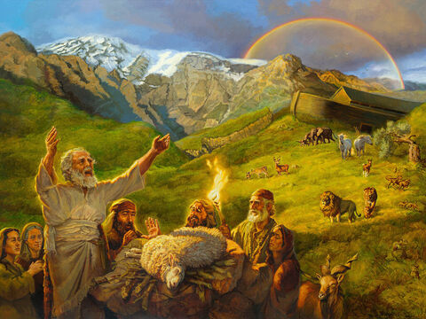
Studies in Genesis
Class will begin in:
The Faith and Failings of First Families
Notes:
Artwork by Jan van 't Hoff/Gospelimages.com.

Slide 2
Studies in Genesis
The Faith and Failings of First Families
Notes:
Artwork by Jan van 't Hoff/Gospelimages.com.

Slide 3
Genesis 24-25:18
Lesson 14

Slide 4
Abraham Obeys God
review
Abraham rose early in the morning
Saddled his donkey
Took two of his young men with him
Isaac his son
Wood for the burnt offering
They traveled for three days—then saw the place afar off

Slide 5
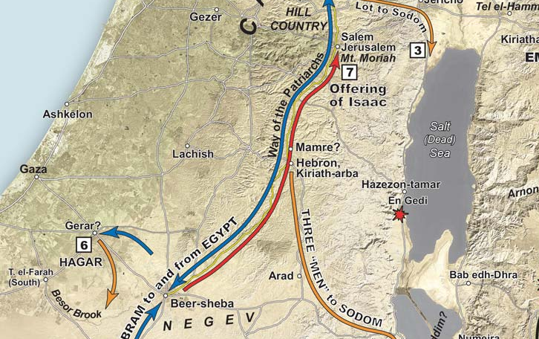

Slide 6
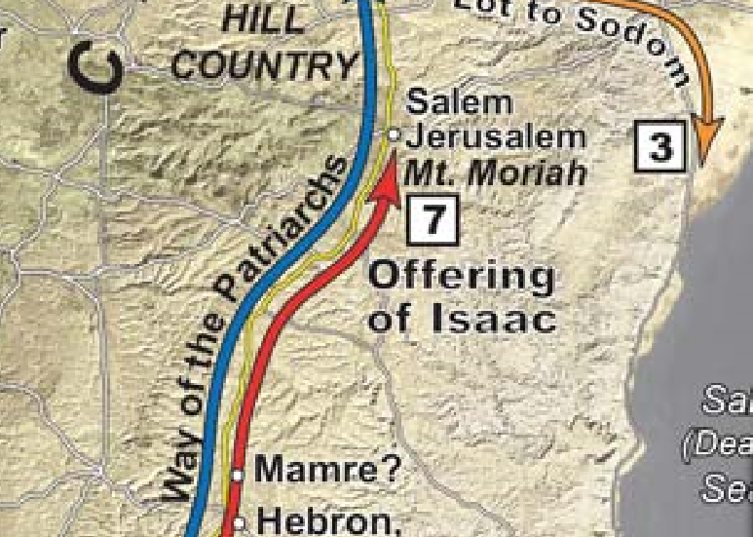

Slide 7
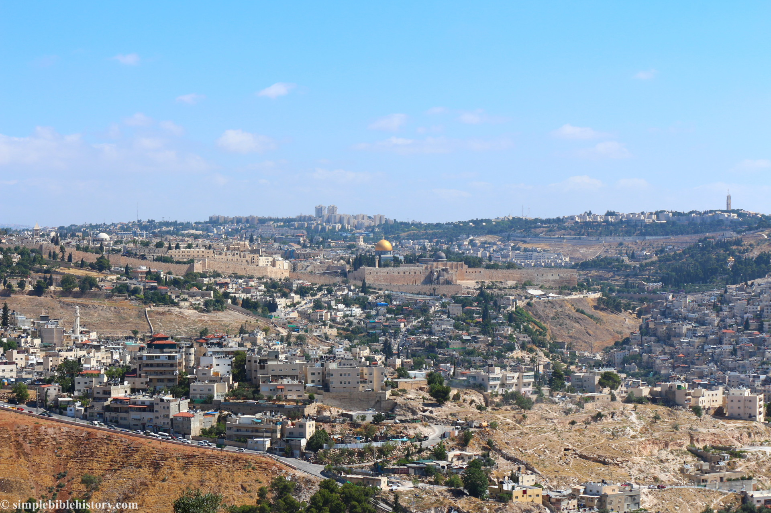

Slide 8
Complete Obedience
review
Built an altar
Placed the wood in order
Bound Isaac his son
Laid him on the altar, upon the wood
Stretched out his hand and took the knife to slay his son
Obedience?
Faith?

Slide 9
Obedience
review
Genesis 22:18 "In your seed all the nations of the earth shall be blessed, because you have obeyed My voice.“

Slide 10
Promises Repeated
review
Nation – I will multiply your descendants as the stars of the heaven and as the sand which is on the seashore
Land – your descendants shall possess the gate of their enemies
Seed – in your seed all the nations of the earth shall be blessed

Slide 11
Sarah Dies
review
Age 127
Abraham seeks a burial place for Sarah
Abraham’s reputation—
Genesis 23:6 "Hear us, my lord: You are a mighty prince among us; bury your dead in the choicest of our burial places. None of us will withhold from you his burial place, that you may bury your dead."
←--Lesson

Slide 12
A Wife For Isaac
Genesis 25:1-3
Now Abraham was old, well advanced in age; and the Lord had blessed Abraham in all things. ² So Abraham said to the oldest servant of his house, who ruled over all that he had, “Please, put your hand under my thigh, ³ and I will make you swear by the Lord, the God of heaven and the God of the earth, that you will not take a wife for my son from the daughters of the Canaanites, among whom I dwell;

Slide 13
A Wife For Isaac
Genesis 25:4-6
⁴ but you shall go to my country and to my family, and take a wife for my son Isaac.” ⁵ And the servant said to him, “Perhaps the woman will not be willing to follow me to this land. Must I take your son back to the land from which you came?”
⁶ But Abraham said to him, “Beware that you do not take my son back there.

Slide 14
A Wife For Isaac
Genesis 25:7-9
⁷ The Lord God of heaven, who took me from my father’s house and from the land of my family, and who spoke to me and swore to me, saying, ‘To your descendants I give this land,’ He will send His angel before you, and you shall take a wife for my son from there. ⁸ And if the woman is not willing to follow you, then you will be released from this oath; only do not take my son back there.” ⁹ So the servant put his hand under the thigh of Abraham his master, and swore to him concerning this matter.

Slide 15
A Wife For Isaac
Abraham is old; about 140 years old (ref 25:20 Isaac is 40 when married); 100 when Isaac was born (24:1)
He has been greatly blessed by the Lord
Instructs his oldest servant (in-charge; most trusted) to get a wife for Isaac (2-4)
Made servant swear—very important to Abraham
DO NOT take a wife from the Canaanites, among whom I dwell but from my family (3-4)
Recall from Gen 9:25 (Noah) : Then he said: "Cursed be Canaan; A servant of servants He shall be to his brethren.“ (Because Ham saw his nakedness)
Notes:
Read Genesis 24:1-9
Ge 15:2 But Abram said, "Lord GOD, what will You give me, seeing I go childless, and the heir of my house is Eliezer of Damascus?“
Ge 9:24 So Noah awoke from his wine, and knew what his younger son had done to him.
25 Then he said: "Cursed be Canaan; A servant of servants He shall be to his brethren."

Slide 16
A Wife For Isaac
Go back to my homeland (4) (Mesopotamia- Nahor’s city/dwelling place))
Do not take Isaac back there (6,8)
God’s angel will guide you (7)
If she will not come, you will be released from the oath (8)
The servant agrees (swore an oath to Abraham) (9)

Slide 17
Parent’s concern
Parents (who are worth being parents) are concerned about the future of their children
We should not have the mindset of when our child graduates from high school, or turns 18, they are on their own
Let's help guide our children into adulthood so that when they get married, they will choose to live godly lives
Abraham is a good example of a parent that saw the importance of helping his child choose a godly spouse

Slide 18
Servant Goes To Abraham’s Family’s Homeland
^{Genesis 24:10-11}
¹⁰ Then the servant took ten of his master’s camels and departed, for all his master’s goods were in his hand. And he arose and went to Mesopotamia, to the city of Nahor. ¹¹ And he made his camels kneel down outside the city by a well of water at evening time, the time when women go out to draw water.

Slide 19
Servant Prays to God for Success
^{Genesis 24:12-14}
¹² Then he said, “O Lord God of my master Abraham, please give me success this day, and show kindness to my master Abraham. ¹³ Behold, here I stand by the well of water, and the daughters of the men of the city are coming out to draw water. ¹⁴ Now let it be that the young woman to whom I say, ‘Please let down your pitcher that I may drink,’ and she says, ‘Drink, and I will also give your camels a drink’—let her be the one You have appointed for Your servant Isaac. And by this I will know that You have shown kindness to my master.”

Slide 20
Servant Goes To Abraham’s Family’s Homeland
Took 10 camels and gifts then departed (10)
When he came to a well, he made the camels kneel because it was the “time the women go out to draw water” (11)
Quick note—
Women drawing the water—hard work
Young, unmarried women
Learn to work
Managing a household and children is hard work
Notes:
Read Genesis 24:10-14
Ge 24:10 Then the servant took ten of his master's camels and departed, for all his master's goods were in his hand. And he arose and went to Mesopotamia, to the city of Nahor.

Slide 21
Prayer for success
1
Abraham’s servant prays to God for success in his mission (12-14)
Trained by Abraham to know God
Prayer was not for his personal gain
Prayer was for the satisfaction of Abraham and wellbeing of Isaac
Brief prayer “at the exact time of need”
Lesson for us?
Notes:
Servant would have been circumcised.

Slide 22
Servant Meets Rebekah
^{Genesis 24:15-17}
¹⁵ And it happened, before he had finished speaking, that behold, Rebekah,^{[c]} who was born to Bethuel, son of Milcah, the wife of Nahor, Abraham’s brother, came out with her pitcher on her shoulder. ¹⁶ Now the young woman was very beautiful to behold, a virgin; no man had known her. And she went down to the well, filled her pitcher, and came up. ¹⁷ And the servant ran to meet her and said, “Please let me drink a little water from your pitcher.”

Slide 23
Servant Meets Rebekah
^{Genesis 24:18-20}
¹⁸ So she said, “Drink, my lord.” Then she quickly let her pitcher down to her hand, and gave him a drink. ¹⁹ And when she had finished giving him a drink, she said, “I will draw water for your camels also, until they have finished drinking.” ²⁰ Then she quickly emptied her pitcher into the trough, ran back to the well to draw water, and drew for all his camels.

Slide 24
Servant Meets Rebekah
^{Genesis 24:21-23}
²¹ And the man, wondering at her, remained silent so as to know whether the Lord had made his journey prosperous or not. So it was, when the camels had finished drinking, that the man took a golden nose ring weighing half a shekel, and two bracelets for her wrists weighing ten shekels of gold, ²³ and said, “Whose daughter are you? Tell me, please, is there room in your father’s house for us ^{[d]}to lodge?”

Slide 25
Servant Meets Rebekah
Rebekah comes to draw water (15-17)
Draws for him to drink and to water all his camels “until they have finished drinking” (19)
A thirsty camel can drink 30 gallons of water in about 13 minutes; How much she water did she provide? (10 camels x 10 gallons =100 gallons)
In this service, Rebekah is shown to be hardworking, industrious, hospitable and generous
Notes:
Read Genesis 24:15-23
sn I will also give your camels water. It would be an enormous test for a young woman to water ten camels. The idea is that such a woman would not only be industrious but hospitable and generous.
https://net.bible.org/#!bible/Genesis+24:3
A thirsty camel can drink 30 gallons of water in about 13 minutes

Slide 26
Servant Meets Rebekah
The situation plays out exactly as he had prayed it would happen
He gives her a nose ring and bracelets (22)
Asked about her family and a place to stay (23)
She tells him she is the daughter of Bethuel, granddaughter of Nahor and Milcah (24)
She tells him we have enough straw, feed, and room to lodge (25)
Notes:
Read Genesis 24:15-23
sn I will also give your camels water. It would be an enormous test for a young woman to water ten camels. The idea is that such a woman would not only be industrious but hospitable and generous.
https://net.bible.org/#!bible/Genesis+24:3
A thirsty camel can drink 30 gallons of water in about 13 minutes

Slide 27
Abraham’s Servant Meets the Family
2
The servant paused to thank God for the success in meeting Rebekah v 26
Rebekah runs home to tell her mother’s household all these things (28)
Laban, the brother goes to meet the servant at the well (29-30)
Laban invites the servant inside (31)
“I have prepared the house, and a place for the camels.”
Notes:
Read Genesis 24:24-49

Slide 28
Abraham’s Servant Meets the Family
Water is provided to wash their feet and food was offered (32-33)
“I will not eat until I have told about my errand.”
Servant recounts the story to Laban and Bethuel (ref vs 50)
I am Abraham’s servant (34)
God has blessed Abraham greatly with many material blessings (35)
Abraham and Sarah had a son in their old age (36)
He (Isaac) is the heir and has been given everything (36)
Notes:
Read Genesis 24:24-49

Slide 29
Abraham’s Servant Meets the Family
Abraham made me swear that I would take a wife for Isaac from his family (Nahor’s kin) and not the Canaanites (37-38)
I was told an angel would prosper my journey (40)
I was told that I would be clear of the oath if the family would not let her go with me (41)
I prayed to God to reveal the woman to me by her response when I ask her for water (42-44)
and she says to me, “Drink, and I will draw for your camels also,”—let her be the woman whom the Lord has appointed for my master’s son.’ (44)
Notes:
Read Genesis 24:24-49

Slide 30
Abraham’s Servant Meets the Family
After my prayer, the events happened in the manner that I requested of God (45-46)
She told me she was the daughter of Bethuel, Nahor’s son (47)
I gave her a nose ring and bracelets
I bowed my head and worshiped God for leading me to finding a wife from my master’s brother (Nahor’s family) (48)
Now if you will deal kindly and truly with my master, tell me. And if not, tell me, that I may turn to the right hand or to the left.” (49)
Notes:
Read Genesis 24:24-49

Slide 31
Decision Made
Genesis 24:50-52
Then Laban and Bethuel answered and said, “The thing comes from the Lord; we cannot speak to you either bad or good. ⁵¹ Here is Rebekah before you; take her and go, and let her be your master’s son’s wife, as the Lord has spoken.” ⁵² And it came to pass, when Abraham’s servant heard their words, that he worshiped the Lord, bowing himself to the earth.

Slide 32
Decision Made
Genesis 24:53-55
⁵³ Then the servant brought out jewelry of silver, jewelry of gold, and clothing, and gave them to Rebekah. He also gave precious things to her brother and to her mother. ⁵⁴ And he and the men who were with him ate and drank and stayed all night. Then they arose in the morning, and he said, “Send me away to my master.” ⁵⁵ But her brother and her mother said, “Let the young woman stay with us a few days, at least ten; after that she may go.”

Slide 33
Decision Made
Genesis 24:56-58
⁵⁶ And he said to them, “Do not hinder me, since the Lord has prospered my way; send me away so that I may go to my master.” ⁵⁷ So they said, “We will call the young woman and ask her personally.” ⁵⁸ Then they called Rebekah and said to her, “Will you go with this man?”
And she said, “I will go.”

Slide 34
Decision Made
Genesis 24:59-61
⁵⁹ So they sent away Rebekah their sister and her nurse, and Abraham’s servant and his men. ⁶⁰ And they blessed Rebekah and said to her: “Our sister, may you become The mother of thousands of ten thousands; And may your descendants possess The gates of those who hate them.” ⁶¹ Then Rebekah and her maids arose, and they rode on the camels and followed the man. So the servant took Rebekah and departed.

Slide 35
Decision Made
Laban (brother) and Bethuel (father) talk to servant about Rebekah
This is of the Lord; He has spoken
We cannot refuse (50-51)
Again, a prayer of thanksgiving
Not only had he met Rebekah, but he had also received permission for her to be wife for Isaac v 52
3
Notes:
Read Genesis 24:50-61

Slide 36
Return to Abraham (and Isaac)
They stayed the night (54)
The next morning the servant is ready to leave (54)
Rebekah’s brother and mother say “Let her stay at least ten days” (it is hard to let go) (55)
Servant says- Do not hinder me (56)
Rebekah’s family asks her “will you go”; she says, “I will go” (57-58)

Slide 37
Return to Abraham (and Isaac)
The family blesses her and sends her with the servants (59-61)
In the evening Isaac is in the field meditating (nervous? about to meet wife? mourning mother?) (62-63)
Isaac sees the camels approaching him (63)
Rebekah sees a man in the distance; asks who is this man…? Servant says, it is my master (Isaac); she veils herself (64-65)
Servant recounts events to Isaac (66)
Isaac took Rebekah into Sarah’s tent, and she becomes his wife; He loved her (67)
Notes:
Read Genesis 24:62-67 (after first point on slide)

Slide 38
“He Loved Her”
Different customs
No courtship
No lovers’ spats and makeups
No ‘try it’ and see what happens
Lessons for us?
We are husband and wife
His duty is to love his wife
Her allegiance is to her husband
Eph 5:25 Husbands, love your wives, just as Christ also loved the church and gave Himself for her,
Notes:
Eph 5:25 Husbands, love your wives, just as Christ also loved the church and gave Himself for her,

Slide 39
Abraham, Keturah, and Their Descendants
Gen 25:1-4 Abraham, at some point, took another wife—Keturah; has six other sons
Not sure of chronology (could have been many years sooner)
One of the sons was Midian (Midianites); Moses stays with a Midianite family when he flees Egypt; Israelites will be enemies with them for most of their history
Abraham gave gifts to his other sons; Gave all that he had (inheritance) to Isaac, the heir (25:5-6)
Notes:
Read Genesis 25:1-18 (skipping genealogies?)

Slide 40
Abraham Dies
^{Genesis 25:7-11}
⁷ This is the sum of the years of Abraham’s life which he lived: one hundred and seventy-five years. ⁸ Then Abraham breathed his last and died in a good old age, an old man and full of years, and was gathered to his people. ⁹ And his sons Isaac and Ishmael buried him in the cave of Machpelah, which is before Mamre, in the field of Ephron the son of Zohar the Hittite, ¹⁰ the field which Abraham purchased from the sons of Heth. There Abraham was buried, and Sarah his wife. ¹¹ And it came to pass, after the death of Abraham, that God blessed his son Isaac. And Isaac dwelt at Beer Lahai Roi.

Slide 41
Abraham dies
Abraham dies at 175, at a good old age as God promised him (ref chapter 15) (25:7-8)
Buried by his sons Isaac and Ishmael
In cave of Machpelah with Sarah
God blesses Isaac; he dwells at Beer Lahai Roi (named by Hagar-the well of The Living One who sees) (11)
Gen 25:12-18 Ishmael’s descendants
Ishmael dies at 137 (about 50 years after Abraham dies)
Notes:
Read Genesis 25:1-18 (skipping genealogies?)

Slide 42
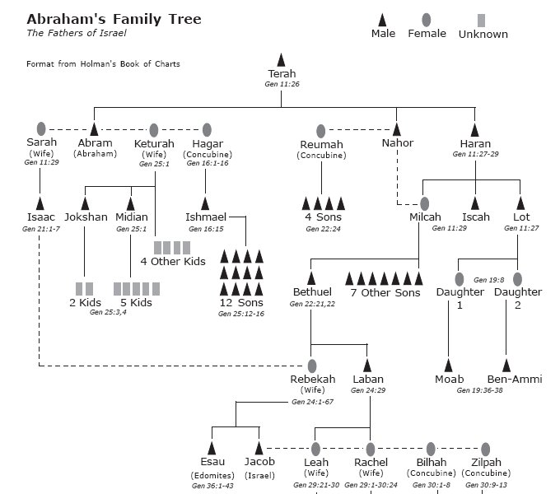

Slide 43
Isaac
Note from net.bible.org –
We learn here that Isaac married thirty-five years before Abraham died, that Rebekah was barren for twenty years, and that Abraham would have lived to see Jacob and Esau begin to grow up (about 15 years old). The death of Abraham was recorded in the first part of the chapter as a “tidying up” of one generation before beginning the account of the next.

Slide 44
Faith and Failings of Families
Faith
Abraham taught his servants to worship God
Rebekah had a mind to work
Failings

Slide 45
We Need to Learn to Work
lessons
After returning from captivity, while rebuilding the wall of Jerusalem
Nehemiah 4:6 So we built the wall, and the entire wall was joined together up to half its height, for the people had a mind to work.

Slide 46
We Need to Learn to Work
lessons
From the apostle Paul
2 Thessalonians 3:8 nor did we eat anyone's bread free of charge, but worked with labor and toil night and day, that we might not be a burden to any of you, not because we do not have authority, but to make ourselves an example of how you should follow us.

Slide 47
We Need to Learn to Work
lessons
From the apostle Paul—continued
10 For even when we were with you, we commanded you this: If anyone will not work, neither shall he eat.
11 For we hear that there are some who walk among you in a disorderly manner, not working at all, but are busybodies.

Slide 48
We Need to Learn to Work
lessons
The lazy man in Proverbs
Proverbs 26:14 As a door turns on its hinges, So does the lazy man on his bed. The lazy man buries his hand in the bowl; It wearies him to bring it back to his mouth. The lazy man is wiser in his own eyes Than seven men who can answer sensibly.

Slide 49
A Worthy Woman Works with Her Hands
lessons
Proverbs 31:10-31
10 For her worth is far above rubies.
11 The heart of her husband safely trusts her
12 She does him good and not evil All the days of her life.
13 She…willingly works with her hands.

Slide 50
Momentary prayer
lessons
Abraham’s servant prays to God for success in mission for his master
Brief prayer “at the exact time of need”
He remembered to thank God for success in meeting Rebekah
Again, a prayer of thanksgiving when they agreed to let her go

Slide 51
Momentary prayer
lessons
Sometimes we can take time for longer prayers
Sometimes there is just time enough for one sentence
Ask for guidance
Ask for help
Give special thanks

Slide 52
Momentary prayer
lessons
1 Thessalonians 5:17 pray without ceasing
Constantly in an attitude of prayer
Always having a prepared heart
Ready in an instant to approach God
Remembering to give thanks

Slide 53
For Wednesday
Genesis 25:19—28:9

Slide 54
Genesis
1
Creation
2
Adam and Eve in the Garden
3
First Sin
4
Cain and Abel

Slide 55
Genesis
5
Generations of Adam
6
Wickedness; building of ark
7
Flood
8
Waters recede

Slide 56
Genesis
9
Meat for food; rainbow promise; capital punishment; sin of Noah
10
Generations of Noah
11
Tower of Babel; scattering of the people

Slide 57
Genesis
12
Promises to Abraham; lie in Egypt
13
Abraham and Lot separate
14
Abraham rescues Lot
15
God’s covenant with Abraham

Slide 58
Genesis
16
Birth of Ishmael
17
Covenant of circumcision
18
Strangers visit Abraham
19
Destruction of Sodom

Slide 59
Genesis
20
Abraham and Abimelech
21
Birth of Isaac
22
Test of faith
23
Death of Sarah

Slide 60
Genesis
24
Wife for Isaac
25
Jacob and Esau

Slide 61
…

