Slide 1

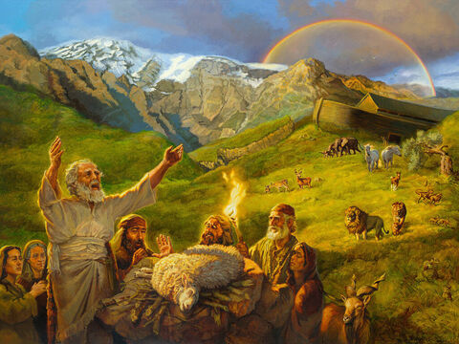
Studies in Genesis
Class will begin in:
The Faith and Failings of First Families
Notes:
Artwork by Jan van 't Hoff/Gospelimages.com.

Slide 2
Studies in Genesis
The Faith and Failings of First Families
Notes:
Artwork by Jan van 't Hoff/Gospelimages.com.

Slide 3
Genesis 25:19—28:9
Lesson 15
Notes:
W Holt

Slide 4
A wife for Isaac
review
Abraham is old
He has been greatly blessed
Instructs his oldest servant (in-charge; most trusted) to get a wife for Isaac
Made servant swear—very important
DO NOT take a wife from the Canaanites, among whom I dwell

Slide 5
A wife for Isaac
review
Go back to my homeland
Do not take Isaac back there
God’s angel will guide you
If she will not come, you are released from the oath

Slide 6
Servant goes to homeland
review
Took gifts and departed
When he came to well it was the “time the women go out to draw water”
Quick note—
Women drawing the water—hard work
Young, unmarried women
Learn to work!

Slide 7
Prayer for success
review
1
Abraham’s servant prays to God for success in mission for his master
Learned from Abraham
Not for his personal gain
For the satisfaction of Abraham and wellbeing of Isaac
Brief prayer “at the exact time of need”

Slide 8
Servant meets Rebekah
review
Rebekah comes to draw water
Draws for him to drink and to water all his camels “until they have finished drinking”
Exactly as he had prayed would happen
Gives her nose ring and bracelets
Asked about a place to stay
Notes:
sn I will also give your camels water. It would be an enormous test for a young woman to water ten camels. The idea is that such a woman would not only be industrious but hospitable and generous.
https://net.bible.org/#!bible/Genesis+24:3

Slide 9
Meets the family
review
2
But first, he remembered to thank God for success in meeting Rebekah
Not enough to make request of God (or parents or others), but take time to say “thank you”
Laban, the brother
Granddaughter of Nahor, Abraham’s brother
Recounts the purpose of his visit

Slide 10
Decision made
review
Laban (brother) and Bethuel (father) talk to servant about Rebekah
This is of the Lord
We cannot refuse
Again, a prayer of thanksgiving
Not only had he met Rebekah, but he had also received permission for her to be wife for Isaac
3

Slide 11
Ready to go?
review
They stayed the night
Next morning servant is ready to leave
“Let her stay at least ten days”
Ask Rebekah
“I will go”
Leave father and mother and be joined to husband (???? wow!!)

Slide 12
Return to Abraham (and Isaac)
review
The family blesses her and sends her with the servants
In the evening Isaac is in the field meditating (loss of mother?)
Servant recounts events to Isaac
Took Rebekah into Sarah’s tent
She became his wife

Slide 13
“he loved her”
review
Different customs
No courtship
No lovers’ spats and makeups
No ‘try it’ and see what happens
Just a given
We are husband and wife
His duty is to love his wife
Her allegiance is to her husband
Ephesians 5:25

Slide 14
Abraham dies
review
Take another wife—Keturah
Not sure of chronology
One of the sons was Midian
Gifts to his sons; inheritance to Isaac
Abraham dies at 175
Buried by Isaac and Ishmael
In cave of Machpelah
(Ishmael dies at 137)
Notes:
Note from net.bible.org –
sn Some valuable information is provided here. We learn here that Isaac married thirty-five years before Abraham died, that Rebekah was barren for twenty years, and that Abraham would have lived to see Jacob and Esau begin to grow up. The death of Abraham was recorded in the first part of the chapter as a “tidying up” of one generation before beginning the account of the next.

Slide 15
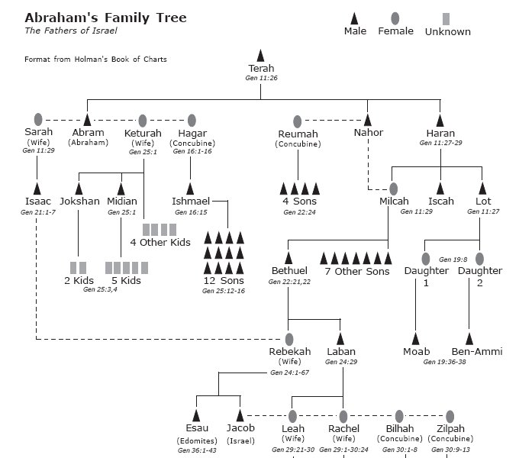

Slide 16
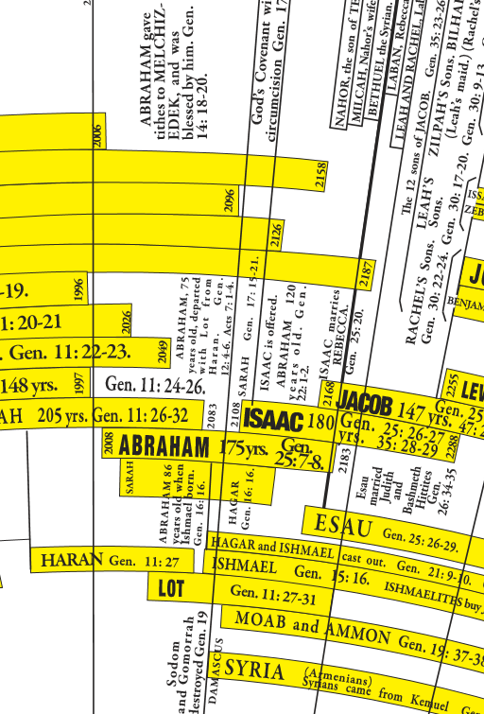

Slide 17
Isaac
Isaac married Rebekah
Isaac is 40 years old
Rebekah becomes pregnant
Isaac is now 60 years old
Twin boys
Esau
Jacob
Abraham is now 160 years old
Notes:
Read Genesis 25:19-26

Slide 18
Isaac
Genesis 25:23 And the LORD said to her: “Two nations are in your womb, Two peoples shall be separated from your body; One people shall be stronger than the other, And the older shall serve the younger.”
Two nations (two sons)
One stronger
Older serve the younger

Slide 19
The Sons
Esau was a skillful hunter, a man of the field
Isaac loved Esau because he ate of his game
Jacob was a mild man, dwelling in tents
Rebekah loved Jacob
Notes:
Read Genesis 25:27-34

Slide 20
Birthright
Esau called Edom (red)—father of Edomites
(some debate)—Esau means ‘hairy’
Esau tired, weary, and hungry
Original word means ‘starving’
Jacob cooking stew
Esau foolishly sells his birthright to Jacob for a bowl of stew
“Thus Esau despised his birthright”
Notes:
Famished; literally about to die??

Slide 21
Repeat Of Promises
I will be with you and bless you
To you and your descendants I give all these lands
I will make your descendants multiply as the stars of heaven; I will give to your descendants all these lands
In your seed all the nations of the earth shall be blessed
“because Abraham obeyed My voice and kept My charge, My commandments, My statutes, and My laws”
Notes:
Read Genesis 26:1-5

Slide 22
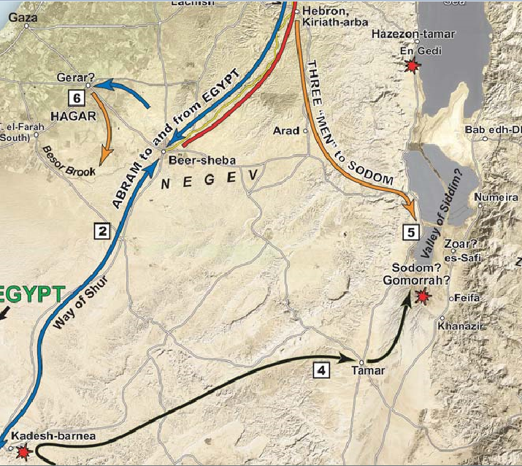

Slide 23
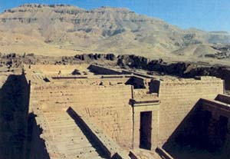
Notes:
BAR 8:04, Jul/Aug 1982
What We Know About the Philistines

Slide 24
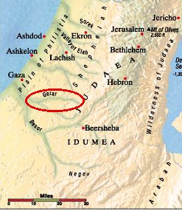
Notes:
Valley of Gerar???

Slide 25
Abimelech
Isaac is in Gerar
territory of Abimelech
Agrees with Rebekah that she would say she was his sister, not his wife
Abimelech finds out and reacts—you would have brought guilt on us
Sounds very similar to Abraham!
Notes:
Read Genesis 26:6-11

Slide 26
Abimelech
The Lord blesses Isaac (his crop)
Abimelech sends Isaac out of their territory—fear
you are mightier than we
Remember Isaac inherited much wealth from Abraham
He is increasing even more

Slide 27
Re-digging The Wells
Isaac re-digs the wells of Abraham and quarrels with the herdsmen of Gerar over water
Think about amount of water needed for large flocks
Isaac travels to Beersheba
The Lord promises to bless Isaac
Notes:
SKIP for time--Read Genesis 26:12-25

Slide 28
Esau’s wives
Covenant between Abimelech and Isaac
Beersheba named
Esau takes wives from the land
Daughters of the Hittites
His parents are grieved
Notes:
For sake of time, skip down to Genesis 26:34-35
Grieve--cause great distress to (someone).

Slide 29
Birthright and Blessings
Isaac knew what God told Rebekah
The older would serve the younger
Did Isaac know Esau had sold his birthright?
If so, then why will Isaac try to give the blessing to Esau?
His favorite?
Notes:
Read Genesis 27:1-8

Slide 30
Birthright and Blessings
Did Rebekah intervene because she knew what was right?
Or to protect her favorite son?

Slide 31
Isaac Is Old
Isaac is old and nearly blind
He sends Esau to hunt for game
Make him food and receive his blessing before he dies
Rebekah hears the plan
Tells Jacob to do exactly as I say
She adds that any curse was to be on her

Slide 32
Deceit
Rebekah plots with Jacob to deceive his father
Jacob lies to his father and receives the blessing
Multiple lies

Slide 33
Deceit
Esau returns to find what has happened
He asks Isaac for a blessing also
There is none
Esau weeps
“he cried with an exceedingly great and bitter cry”

Slide 34
Esau’s Future
Isaac tells Esau that he will dwell ‘away from’ the fatness of the earth and the dew of heaven
He would live by the sword and serve his brother
Later he would break the yoke from his neck
Herod, the Edomite, in the NT ruled the Jews

Slide 35
Esau vs Jacob
Esau hates Jacob and threatens to kill him
(remember this)
Rebekah learns of Esau’s plans and tells Jacob to go away—back to her brother Laban in Haran—for a ‘few days’
She tells Isaac that Jacob should not take a wife from the people of the land
Notes:
Read Genesis 27:41-46

Slide 36
Wives
Isaac agrees and tells Jacob that he should not take a wife from the daughters of Canaan
Go to Padan Aram to take a wife from the daughters of Laban
Jacob and Esau are 77 at this time
After a short time of following Isaac, the narrative will now shift primarily to Jacob
Notes:
Read Genesis 28:1-5

Slide 37
Wives
Esau knew that Isaac did not want Jacob to marry the Canaanite daughters
He took as a wife Mahalath
the daughter of Ishmael
Mặ hặ lath
Notes:
Read Genesis 28:6-9

Slide 38
Summary
Favoritism
Lies
Deceit
Trickery
Hatred
Spouse selection
Rebellion toward parents
Promises of God repeated

Slide 39
Faith and Failings
FAITH
Isaac
FAILINGS
Isaac
Rebekah
Jacob
Esau
Notes:
Faith—Isaac in praying for Rebekah to have children
Failings—
Isaac—child favoritism
Rebekah—child favoritism, deceit
Jacob—deceit, lying
Esau—profane birthright, hatred, spouse selection, rebellion

Slide 40
Profane
lessons
“Thus Esau despised his birthright”
Hebrews 12:16 lest there be any fornicator or profane person like Esau, who for one morsel of food sold his birthright.
characterized by irreverence or contempt for God or sacred principles or things; irreligious
to treat or use (something sacred) with irreverence

Slide 41
Profane
lessons
The word profane here refers to one who, by word or conduct, treats religion with contempt, or has no reverence for that which is sacred. This may be shown by words; by the manner of life; by a sneer

Slide 42
Profane
lessons
From the word for “threshold,” i.e., that which is stepped on as people go in and out
Antonym of ‘holy’
It describes persons who are prepared to turn their backs on that which is holy in order to focus their attention on that which is immediately present

Slide 43
Profane
lessons
His insistence on the gratification of his immediate needs led him to overlook the importance of his rights as the firstborn.
How often are we tempted to lose focus of the future for the now?

Slide 44
Context Hebrews 12:14-17
lessons
Pursue peace and holiness
Without which no one will see the Lord
Notes:
Heb 12:14 Pursue peace with all people, and holiness, without which no one will see the Lord:
15 looking carefully lest anyone fall short of the grace of God; lest any root of bitterness springing up cause trouble, and by this many become defiled;
16 lest there be any fornicator or profane person like Esau, who for one morsel of food sold his birthright.
17 For you know that afterward, when he wanted to inherit the blessing, he was rejected, for he found no place for repentance, though he sought it diligently with tears.

Slide 45
Context Hebrews 12:14-17
lessons
Looking carefully (same as 1 Peter 5:2 overseer)
Lest we fall short of the grace of God
Lest any root of bitterness cause trouble
Lest we be a fornicator or profane person
Esau was rejected; wishing he could go back and change what had been done
Notes:
Heb 12:14 Pursue peace with all people, and holiness, without which no one will see the Lord:
15 looking carefully lest anyone fall short of the grace of God; lest any root of bitterness springing up cause trouble, and by this many become defiled;
16 lest there be any fornicator or profane person like Esau, who for one morsel of food sold his birthright.
17 For you know that afterward, when he wanted to inherit the blessing, he was rejected, for he found no place for repentance, though he sought it diligently with tears.
1Pe 5:2 Shepherd the flock of God which is among you, serving as overseers
Steve—verb form of episkopos in both references. Only places this word is used as a verb in NT.

Slide 46
Sunday morning
Genesis 28:10 through
end of chapter 30

Slide 47
Genesis
1
Creation
2
Adam and Eve in the Garden
3
First Sin
4
Cain and Abel

Slide 48
Genesis
5
Generations of Adam
6
Wickedness; building of ark
7
Flood
8
Waters recede

Slide 49
Genesis
9
Meat for food; rainbow promise; capital punishment; sin of Noah
10
Generations of Noah
11
Tower of Babel; scattering of the people

Slide 50
Genesis
12
Promises to Abraham; lie in Egypt
13
Abraham and Lot separate
14
Abraham rescues Lot
15
God’s covenant with Abraham

Slide 51
Genesis
16
Birth of Ishmael
17
Covenant of circumcision
18
Strangers visit Abraham
19
Destruction of Sodom

Slide 52
Genesis
20
Abraham and Abimelech
21
Birth of Isaac
22
Test of faith
23
Death of Sarah

Slide 53
Genesis
24
Wife for Isaac
25
Jacob and Esau

Slide 54
…

Slide 55
Video Link
http://www.youtube.com/watch?v=I4OK9DmLpCY&feature=player_embedded

Slide 56
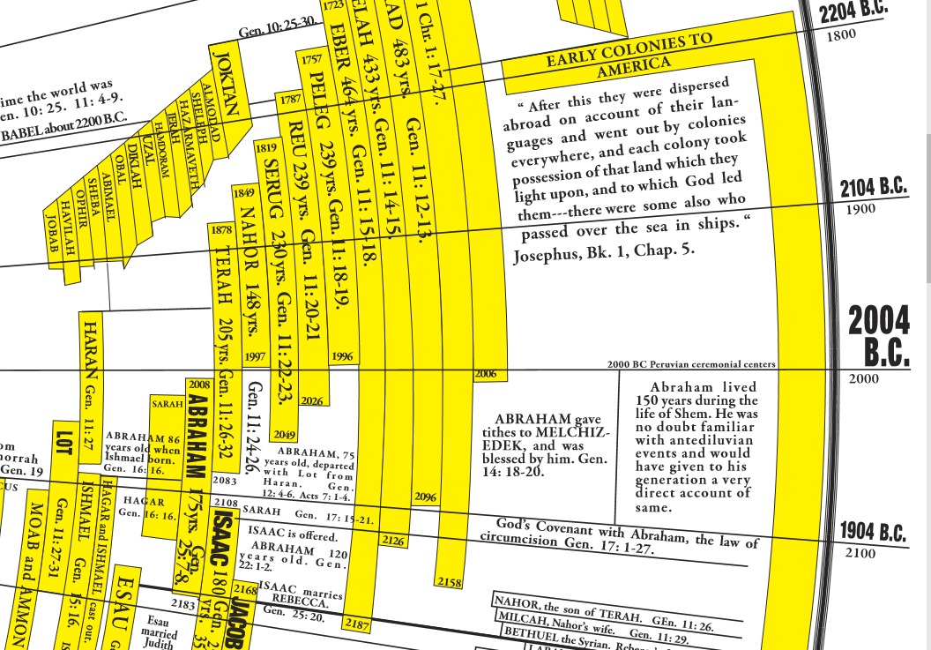

Slide 57
Take a wife…
lessons
Esau takes wives from the land
His parents are grieved
Esau knew that Isaac did not want Jacob to marry the Canaanite daughters
He took as a wife Mahalath
the daughter of Ishmael

Slide 58
Who are you going to marry?
lessons
Genesis 2:24 Therefore a man shall leave his father and mother and be joined to his wife, and they shall become one flesh.
Lifetime commitment
Matthew 19:6 "So then, they are no longer two but one flesh. Therefore what God has joined together, let not man separate."

Slide 59
Who are you going to marry?
lessons
Ephesians 5:22 Wives, submit to your own husbands, as to the Lord.
Ladies, marry someone you can submit to. Someone you can trust as your leader and guide—not someone that will depend on you for the leadership. Someone with knowledge, determination, gumption.
initiative; aggressiveness; resourcefulness

Slide 60
Who are you going to marry?
lessons
Ephesians 5:25 Husbands, love your wives, just as Christ also loved the church and gave Himself for her
Ephesians 5:28 So husbands ought to love their own wives as their own bodies; he who loves his wife loves himself.
Genesis 24:67 Then Isaac brought her into his mother Sarah's tent; and he took Rebekah and she became his wife, and he loved her.

Slide 61
Who are you going to marry?
lessons
Here is a grand rule for every husband
Love your wife as Christ loved the Church
How did Christ love the Church?
He gave himself for it-he laid down his life for it.
So then husbands should, if necessary, lay down their lives for their wives: …

Slide 62
Who are you going to marry?
lessons
More implied in the words than mere protection and support
Christ gave himself for the Church to save it
Husbands should, by all means in their power, promote the salvation of their wives, and their constant edification in righteousness.
Spiritual welfare of the family

Slide 63
Who are you going to marry?
lessons
The duty of the wife is to obey
The right of the husband is to command
Paul would guard against the abuse of that right by placing such a spirit on the husband as would secure obedience on the part of the wife.
Husband’s attitude toward wife

Slide 64
Who are you going to marry?
lessons
The husband, in all his relationships with his wife…
Should manifest the same spirit which Jesus did towards His church
Paul holds up the conduct of Christ towards the church as the model for a husband to imitate

Slide 65
Who are you going to marry?
lessons
A short, simple rule for husbands…
Ephesians 5:25 Husbands, love your wives, just as Christ also loved the church and gave Himself for her

Slide 66
Who are you going to marry?
lessons
Ladies, will he care for you physically and lead and guide you spiritually?
Are you willing to follow his leadership realizing your eternal destiny depends on it?
Guys, will you ‘love her as your own body’ always putting her needs before your own?
Will you guide you family to heaven?

