Slide 1

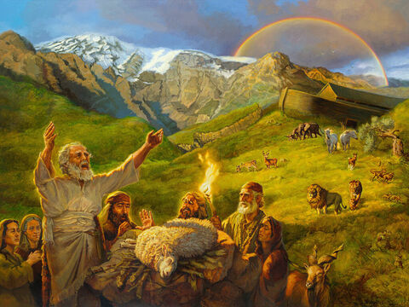
Studies in Genesis
Class will begin in:
The Faith and Failings of First Families
Notes:
Artwork by Jan van 't Hoff/Gospelimages.com.

Slide 2
Studies in Genesis
The Faith and Failings of First Families
Notes:
Artwork by Jan van 't Hoff/Gospelimages.com.

Slide 3
Genesis 28:10-30:43
Lesson 16

Slide 4
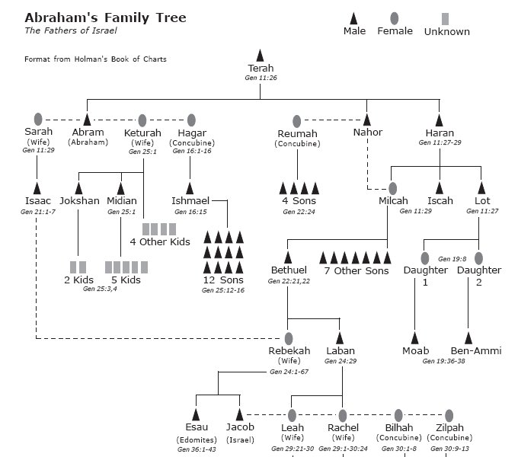

Slide 5
Isaac, Rebekah, and Twins
review
Isaac married Rebekah (Gen 24:67)
Isaac is 40 years old when they marry (25:20)
Rebekah becomes pregnant (after being barren for 20 years)(25:21)
Isaac is now 60 years old (25:26)
Twin boys are born to them (25:24)
Esau (15 when Abraham dies)
Jacob (15 when Abraham dies)
Abraham is now 160 years old (100 when Isaac was born) (21:5)

Slide 6
Isaac, Rebekah, and Twins
review
Genesis 25:23
God explains to Rebekah:
Two nations (two sons) are in your womb
One will be stronger
The older will serve the younger

Slide 7
Isaac, Rebekah, and Twins
review
Esau (hairy) is born first- red and hairy all over (25)
Jacob (supplanter) comes out grabbing the heal of Esau (26)
Supplanter: someone who seizes, circumvents, or usurps; one who takes one down (by the heel)

Slide 8
The Sons Grow
review
Esau becomes a skillful hunter (27)
Isaac loved Esau because he ate of his game (28)
Jacob was a mild man, dwelling in tents; becomes a shepherd (27)
Rebekah loved Jacob (28)
Lesson: Parents showing favoritism will cause all sorts of issues

Slide 9
Esau Despises His Birthright
review
Esau comes in tired and weary (29-30)
Jacob is cooking stew (29-30)
Esau called Edom (red; from the stew)—Father of Edomites (30)
Jacob doesn’t treat his brother with kindness; instead of serving him he demands payment
Esau foolishly sells his birthright to Jacob for a bowl of stew (31-33)
“Thus Esau despised his birthright” (33)

Slide 10
Profane
lessons
“Thus Esau despised his birthright”
Hebrews 12:16 lest there be any fornicator or profane person like Esau, who for one morsel of food sold his birthright.

Slide 11
Repeat Of Promises to Isaac
review
Genesis 26:1-5 God speaks to Isaac
I will be with you and bless you
To you and your descendants I give all these lands
I will make your descendants multiply as the stars of heavenIn your seed all the nations of the earth shall be blessed
“because Abraham obeyed My voice and kept My charge, My commandments, My statutes, and My laws”

Slide 12
Isaac and Abimelech
review
Isaac is in Gerar (26:1,6)
territory of Abimelech
Tells the men of Gerar that Rebekah was his sister, not his wife (7); she is beautiful
Abimelech sees Isaac treating her with endearment—you would have brought guilt on us (8-10)
Sounds very similar to Abraham’s travels with Sarah
Abimelech commands that no one touch (11)

Slide 13
Isaac Prospers
review
The Lord blesses Isaac greatly (12-14)
He prospers greatly so the Philistines envied him (14)
Abimelech sends Isaac out of their territory—fear
you are mightier than we (16)
Remember Isaac inherited much wealth from Abraham
He is increasing even more

Slide 14
Re-digging The Wells
review
The Philistines had stopped up all the wells of Abraham (15)
Isaac re-digs the wells of Abraham and quarrels with the herdsmen of Gerar over whose water it is (17-22)
He eventually moves far enough away that they do not quarrel- He calls that well Rehoboth (The Lord has made room for us) (22)
Isaac travels to Beersheba (23)
The Lord again promises to bless Isaac

Slide 15
Re-digging The Wells
review
Covenant is made between Abimelech and Isaac (26-31)
Beersheba named (Well of the oath)(33)
Esau (40 years old) takes wives from the Canaan (Judith, Basemath)
His parents are grieved because of them

Slide 16
Isaac Is Old
review
Isaac is old and nearly blind (27:1)
He sends Esau to hunt for game (3)
Make him food and receive his blessing before he dies (137; lives for 43 more years, ref Waldron page 85) (4)
Rebekah hears the plan (5)

Slide 17
Deceit
review
Rebekah plots with Jacob to deceive Isaac into thinking he is Esau (5-17)
She puts goat’s hair on Jacob’s neck and hands; he wears Esau’s clothes
Jacob lies to his father multiple times ( I am Esau) and receives the blessing (18-28)
Esau returns to find what has happened (30-33)
He asks Isaac for a blessing, also (34,36)
There is none (35)
Esau weeps (36-38)

Slide 18
Esau’s Future
review
Isaac tells Esau that he will dwell ‘away from’ the fatness of the earth and the dew of heaven (39)
He would live by the sword and serve his brother (40)
Later he would break the yoke from his neck (40)
Herod, the Edomite, in the NT ruled the Jews

Slide 19
Esau vs Jacob
review
Esau hates Jacob and threatens to kill him (27:41)
(remember this)
Rebekah learns of Esau’s plans and tells Jacob to go away—back to her brother Laban in Haran—for a ‘few days’ (42-44)
She tells Isaac that Jacob should not take a wife from the people of the land (46)

Slide 20
Wives
review
Isaac tells Jacob that he should not take a wife from the daughters of Canaan (28:1)
Go to Padan Aram to take a wife from the daughters of Laban (2)
Jacob and Esau are 77 at this time
The narrative will now shift primarily to Jacob

Slide 21
Wives
review
Esau knew that Isaac did not want Jacob to marry the Canaanite daughters
He took another wife Mahalath
the daughter of Ishmael

Slide 22
Jacob Flees Esau/ Rests at Luz
^{Genesis 28:10-12}
¹⁰ Now Jacob went out from Beersheba and went toward Haran. ¹¹ So he came to a certain place and stayed there all night, because the sun had set. And he took one of the stones of that place and put it at his head, and he lay down in that place to sleep. ¹² Then he dreamed, and behold, a ladder was set up on the earth, and its top reached to heaven; and there the angels of God were ascending and descending on it.

Slide 23
Jacob Dreams/ God Gives Promises
Genesis 28:13-15
¹³ And behold, the Lord stood above it and said: “I am the Lord God of Abraham your father and the God of Isaac; the land on which you lie I will give to you and your descendants. ¹⁴ Also your descendants shall be as the dust of the earth; you shall spread abroad to the west and the east, to the north and the south; and in you and in your seed all the families of the earth shall be blessed. ¹⁵ Behold, I am with you and will keep^{[c]} you wherever you go, and will bring you back to this land; for I will not leave you until I have done what I have spoken to you.”

Slide 24
Jacob Awakes and is in Awe
^{Genesis 28:16-19}
¹⁶ Then Jacob awoke from his sleep and said, “Surely the Lord is in this place, and I did not know it.” ¹⁷ And he was afraid and said, “How awesome is this place! This is none other than the house of God, and this is the gate of heaven!”
¹⁸ Then Jacob rose early in the morning, and took the stone that he had put at his head, set it up as a pillar, and poured oil on top of it. ¹⁹ And he called the name of that place Bethel; but the name of that city had been Luz previously.

Slide 25
Jacob Vows to Serve God
^{Genesis 28:20-22}
²⁰ Then Jacob made a vow, saying, “If God will be with me, and keep me in this way that I am going, and give me bread to eat and clothing to put on, ²¹ so that I come back to my father’s house in peace, then the Lord shall be my God. ²² And this stone which I have set as a pillar shall be God’s house, and of all that You give me I will surely give a tenth to You.”

Slide 26
Jacob Flees Esau
Leaves from Beersheba going to Haran (Laban’s family)
About 500 miles
Stopped at Luz (He will rename it Bethel) to rest at night
About 50-60 miles from Beersheba

Slide 27
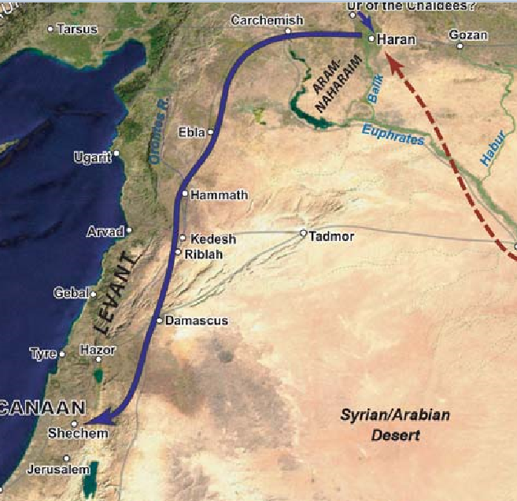
Beersheba

Slide 28
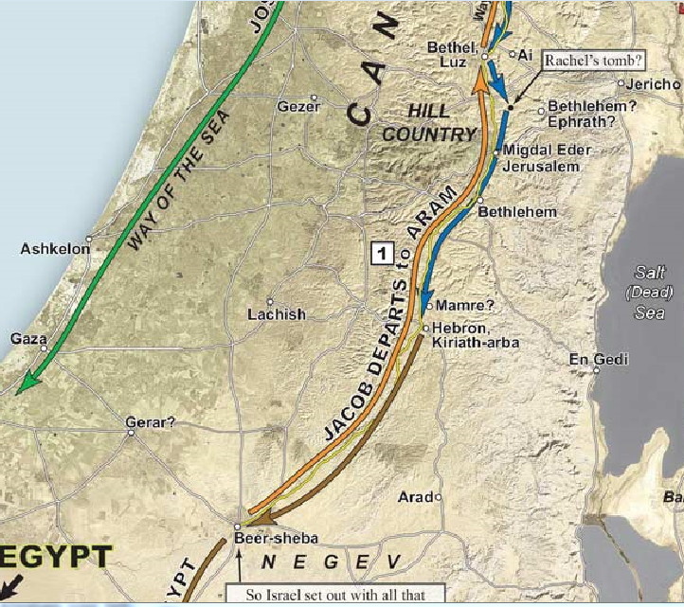

Slide 29
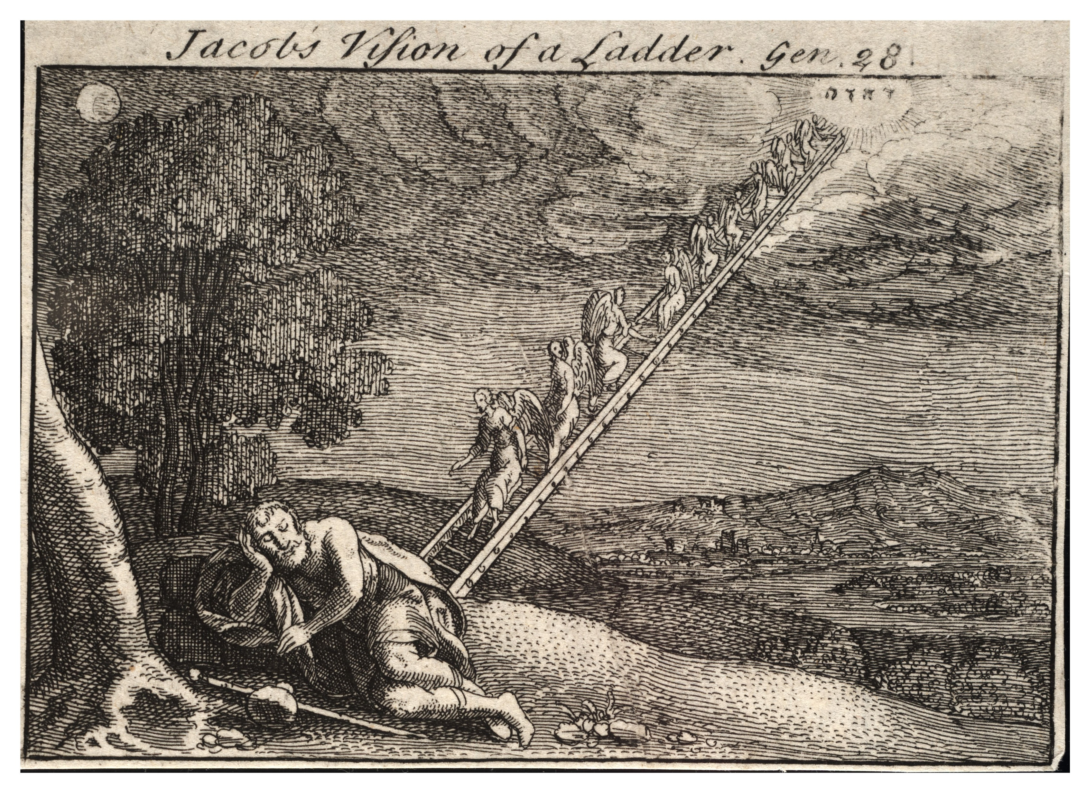
Jacob flees
Going from Beersheba to Haran
Stopped at Luz/Bethel
Dreamed of a ladder reaching into heaven
(not staircase)

Slide 30
Jacob Dreams/ God Gives Promises
Going from Beersheba to Haran (28:10)
Stopped at Luz/Bethel (28:11,19)
Dreamed of a ladder reaching into heaven; angels ascending and descending (12)
(not staircase)
God appeared above the ladder (13)
Repeated land, nation, and seed promises to Jacob (13-15)
Personal blessing: Behold I am with you wherever you go (15)
Genesis 28:15 "Behold, I am with you and will keep you wherever you go, and will bring you back to this land; for I will not leave you until I have done what I have spoken to you."

Slide 31
Jacob Awakes and is in Awe/ Vows to Serve God
Awoke from his sleep (16)
How awesome is this place (17)
awesome: inspiring an overwhelming feeling of reverence, admiration, or fear; causing or inducing awe
Sets up a memorial pillar, calls the place Bethel (House of God) (18-19)
Vowed that the LORD would be his God (21)
Vowed to give God a tenth of all God would give to him (22)
Goes on to the East toward Haran (29:1)
"If God will be with me, and keep me in this way that I am going…
give me bread to eat,
clothing to put on,
come back to my father's house in peace

Slide 32
Jacob Meets Rachel
Jacob arrives at a well in Padan Aram
Recall, he is 77; fleeing from Esau so no gifts/possessions
Jacob asks some men if they know Laban and if he is well (29:4-6)
The men say his daughter Rachel is coming towards us now to water the sheep (6)
Rachel arrives to water her sheep as the men are talking (9)
Daughter of Laban; Jacob’s mother’s brother
Jacob waters Laban’s flock for her (10)
Jacob kissed her and wept and told her he was her father’s relative (11-12)

Slide 33
Jacob Meets Rachel
She runs home and tells Laban (12)
Laban gives Jacob a very warm welcome and brings him to his house (13)
And Laban said to him, “Surely you are my bone and my flesh.” (14)
Jacob stayed with him for a month (14)
They enter discussions concerning wages for Jacob

Slide 34
Jacob Loved Rachel
^{Genesis 29:15-18}
¹⁵ Then Laban said to Jacob, “Because you are my relative, should you therefore serve me for nothing? Tell me, what should your wages be?” ¹⁶ Now Laban had two daughters: the name of the elder was Leah, and the name of the younger was Rachel. ¹⁷ Leah’s eyes were delicate, but Rachel was beautiful of form and appearance. ¹⁸ Now Jacob loved Rachel; so he said, “I will serve you seven years for Rachel your younger daughter.”

Slide 35
Jacob Served Laban Seven Years For Rachel but it Seemed A Few Days
^{Genesis 29:19-23}
¹⁹ And Laban said, “It is better that I give her to you than that I should give her to another man. Stay with me.” ²⁰ So Jacob served seven years for Rachel, and they seemed only a few days to him because of the love he had for her. ²¹ Then Jacob said to Laban, “Give me my wife, for my days are fulfilled, that I may go in to her.” ²² And Laban gathered together all the men of the place and made a feast. ²³ Now it came to pass in the evening, that he took Leah his daughter and brought her to Jacob; and he went in to her.

Slide 36
Jacob Discovers That Laban Deceived Him
^{Genesis 29:24-27}
²⁴ And Laban gave his maid Zilpah to his daughter Leah as a maid. ²⁵ So it came to pass in the morning, that behold, it was Leah. And he said to Laban, “What is this you have done to me? Was it not for Rachel that I served you? Why then have you deceived me?” ²⁶ And Laban said, “It must not be done so in our ^{[h]}country, to give the younger before the firstborn. ²⁷ Fulfill her week, and we will give you this one also for the service which you will serve with me still another seven years.”

Slide 37
Jacob Discovers That Laban Deceived Him
^{Genesis 29:28-30}
²⁸ Then Jacob did so and fulfilled her week. So he gave him his daughter Rachel as wife also. ²⁹ And Laban gave his maid Bilhah to his daughter Rachel as a maid. ³⁰ Then Jacob also went in to Rachel, and he also loved Rachel more than Leah. And he served with Laban still another seven years.

Slide 38
Jacob Works 7 Years for Rachel?
Leah is older and ‘eyes were delicate’; not attractive to Jacob (17)
Rachel, the younger, is beautiful (17)
Jacob offers to work seven years for Rachel (18)
Time seemed as only a few days because he loved her (20)
Jacob says to Laban: my 7 years has been fulfilled, give me my wife (21)
Laban prepares a marriage feast (22)

Slide 39
Jacob Works 7 Years for Rachel?
Leah is given to Jacob instead of Rachel (23)
Jacob doesn’t know until the morning (dark tent? Her face veiled?); Surprise!
Jacob: Was it not for Rachel that I served you? Why then have you deceived me?” (25)
Laban says older must marry first (26)
A ‘known’ custom?? Not to Jacob
Laban says fulfill her (Leah) week, then you will be given Rachel; Jacob agrees to work seven more years (27-28,30)

Slide 40
Jacob Works 7 More Years for Rachel
Zilpah maiden for Leah (24)
Rachel is given to Jacob (28)
Bilhah maiden for Rachel (29)
Jacob loved Rachel more than Leah (30)
Leah was ‘unloved’ ; because of this, God opens her womb; Rachel is barren for now (31)
The “cold war” (conflict) between Leah and Rachel takes off in a race to bear children for Jacob; including giving their Jacob (29:31- 30:23)

Slide 41
Coffman Commentary
What happened to Jacob here was as mean and despicable a fraud as was ever perpetrated by one human being against another. One may only wonder if Jacob remembered the fraud that he and his mother had committed against Isaac. Did the remembrance of it lead to his rather meek acceptance of what Laban did to him? This time, "the heel-catcher" (the meaning of the name Jacob) was himself taken by the heel, the deceiver was deceived. Laban also, in turn, would learn the solemn truth that "as men sow, so shall they reap."

Slide 42
Coffman Commentary
Something else - it appears that for seven years, Jacob had lived above the devices of fraud and deception, but in the action here, Laban aroused the passion in Jacob's heart to return to the old ways, and would eventually find out that he had more than met his match in Jacob! Laban might have been doing fairly well, until he tricked Jacob! Within the span of two decades, Jacob would move out of Laban's territory, taking with him both of Laban's daughters as his wives, and all their children, who were doubtless dear to Laban, and the vast wealth which he had taken away from Laban. In this, Laban might have been able to read his "just recompense of reward."

Slide 43
Children are Born to Jacob
Leah (Gen 29:31-35); 4 sons (for now- more to come)
Ruben (behold, a son!); “surely the Lord has looked on my affliction”, “now my husband will love me”
Simeon (to be heard); “because the Lord has heard that I am unloved”
Levi (attached);”my husband will become attached to me” “because I have born him 3 sons”
Judah (to praise); “I will praise the Lord”
She stopped bearing for a while (29:35;30:9)

Slide 44
Children are Born to Jacob
Gen 30:1-4
Now when Rachel saw that she bore Jacob no children, Rachel envied her sister, and said to Jacob, “Give me children, or else I die!” ² And Jacob’s anger was aroused against Rachel, and he said, “Am I in the place of God, who has withheld from you the fruit of the womb?” ³ So she said, “Here is my maid Bilhah; go in to her, and she will bear a child on my knees, that I also may ^{[o]}have children by her.”
⁴ Then she gave him Bilhah her maid as wife, and Jacob went in to her.

Slide 45
Children are Born to Jacob
Recall Sarai’s plan to produce an heir for Abraham by using Haggar; Rachel does the same
Bilhah (Rachel’s maid): 2 sons for Rachel
Dan (Judged) Rachel said: “God has judged my case…given me a son”
Naphtali (my wrestling/struggle); Rachel said, “With great wrestlings I have wrestled with my sister, and indeed I have prevailed.”

Slide 46
Children are Born to Jacob
Zilpah (Leah’s maid); 2 Sons for Leah who had stopped bearing children for a period of time (30:9)
Gad (a troop comes/fortunate); She is boasting that she is producing an army of children for Jacob
Asher (happy); Leah said, “I am happy, for the daughters will call me blessed.”

Slide 47
Rachel Gives Leah Jacob for a Night to Get Some Mandrakes
^{Genesis 30:14-16}
¹⁴ Now Reuben went in the days of wheat harvest and found mandrakes in the field, and brought them to his mother Leah. Then Rachel said to Leah, “Please give me some of your son’s mandrakes.” ¹⁵ But she said to her, “Is it a small matter that you have taken away my husband? Would you take away my son’s mandrakes also?” And Rachel said, “Therefore he will lie with you tonight for your son’s mandrakes.” ¹⁶ When Jacob came out of the field in the evening, Leah went out to meet him and said, “You must come in to me, for I have surely hired you with my son’s mandrakes.” And he lay with her that night.

Slide 48
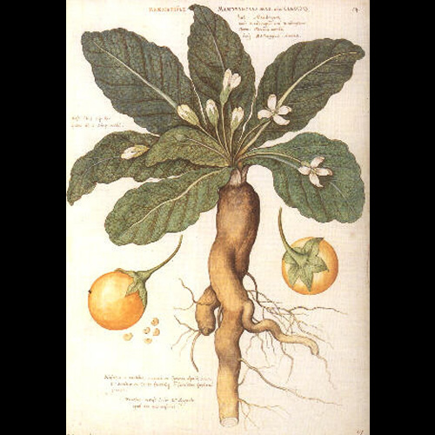
Mandrakes
a Mediterranean plant with white or purple flowers and large yellow berries.
Resembles little yellow apples; Bedouins used them as an aid to childbearing (Rachel and Leah might have thought this as well??)

Slide 49
Children are Born to Jacob
Leah (God hears her) (30:17)
Leah bears 2 more Sons and a daughter
Issachar (reward/hire); “God has given me my wages, because I have given my maid to my husband.”
Zebulun (to dwell with honor); “now my husband will dwell with me, because I have borne him six sons.”
Dinah (daughter) (30:21)

Slide 50
Children are Born to Jacob
²² Then God remembered Rachel, and God listened to her and opened her womb. ²³ And she conceived and bore a son, and said, “God has taken away my reproach.” ²⁴ So she called his name ^{[y]}Joseph, and said, “The Lord shall add to me another son.”
Rachel (1 son now/ 1 later)
Joseph (To add/increase);
Benjamin will be born later in Canaan (chapter 35)
Therefore,11 sons and 1 daughter are born in the 7 years following Jacob’s marriage to Rachel (Sibling Rivalry)

Slide 51
Leah’s Pre-eminence in the Rivalry with Rachel
Pre-eminence: Superiority
She was the actual mother of six sons; half of the twelve patriarchs, and one daughter (Dinah)
Her son Judah succeeded to the headship of the Chosen Nation, through whom the Messiah was born
Her posterity became the principal element in the true Israel, following the defection and loss of the Northern Israel

Slide 52
Leah’s Pre-eminence in the Rivalry with Rachel
David the king who gave his name and title to Christ himself ("the son of David") was her descendant
Her son Judah gave his name and title to Christ, "The Lion of the Tribe of Judah."
She was buried by Jacob's side in the cave of Machpelah at Hebron

Slide 53
Jacob Wants to Leave
Jacob had been in Haran 14 years (91 years old)
Ready to take his family and return to the land promised to him by God (30:25-26)
Laban pleads for him to stay because he knows God has blessed Jacob (27)
Wages are negotiated (28-33)
Jacob gets spotted and speckled sheep and goats (32)
Jacob gets brown lambs (32)
Laban agrees to this and keeps all the rest
Jacob’s flocks are sent three days away with Laban’s sons; Jacob continues to take care of Laban’s flocks (35-36)
Notes:
Ge 30:31 So he said, "What shall I give you?" And Jacob said, "You shall not give me anything. If you will do this thing for me, I will again feed and keep your flocks:
32 "Let me pass through all your flock today, removing from there all the speckled and spotted sheep, and all the brown ones among the lambs, and the spotted and speckled among the goats; and these shall be my wages.
33 "So my righteousness will answer for me in time to come, when the subject of my wages comes before you: every one that is not speckled and spotted among the goats, and brown among the lambs, will be considered stolen, if it is with me."
34 And Laban said, "Oh, that it were according to your word!"
35 So he removed that day the male goats that were speckled and spotted, all the female goats that were speckled and spotted, every one that had some white in it, and all the brown ones among the lambs, and gave them into the hand of his sons.
36 Then he put three days' journey between himself and Jacob, and Jacob fed the rest of Laban's flocks.
From Adam Clark—
It is extremely difficult to find out, from Ge 30:32 and Ge 30:35, in what the bargain of Jacob with his father-in-law properly consisted. It appears from Ge 30:32, that Jacob was to have for his wages all the speckled, spotted, and brown among the sheep and the goats; and of course that all those which were not party-coloured should be considered as the property of Laban. But in Ge 30:35 it appears that Laban separated all the party-coloured cattle, delivered them into the hands of his own sons; which seems as if he had taken these for his own property, and left the others to Jacob. It has been conjectured that Laban, for the greater security, when he had separated the party-coloured, which by the agreement belonged to Jacob, see Ge 30:32, put them under the care of his own sons, while Jacob fed the flock of Laban, Ge 30:36, three days' journey being between the two flocks. If therefore the flocks under the care of Laban's sons brought forth young that were all of one colour, these were put to the flocks of Laban under the care of Jacob; and if any of the flocks under Jacob's care brought forth party-coloured young, they were put to the flocks belonging to Jacob under the care of Laban's sons. This conjecture is not satisfactory, and the true meaning appears to be this: Jacob had agreed to take all the party-coloured for his wages. As he was now only beginning to act upon this agreement, consequently none of the cattle as yet belonged to him; therefore Laban separated from the flock, Ge 30:35, all such cattle as Jacob might afterwards claim in consequence of his bargain, (for as yet he had no right;) therefore Jacob commenced his service to Laban with a flock that did not contain a single animal of the description of those to which he might be entitled; and the others were sent away under the care of Laban's sons, three days' journey from those of which Jacob had the care. The bargain, therefore, seemed to be wholly in favour of Laban; and to turn it to his own advantage, Jacob made use of the stratagems afterwards mentioned. This mode of interpretation removes all the apparent contradiction between Ge 30:32 and Ge 30:35, with which commentators in general have been grievously perplexed. From the whole account we learn that Laban acted with great prudence and caution, and Jacob with great judgment. Jacob had already served fourteen years; and had got no patrimony whatever, though he had now a family of twelve children, eleven sons and one daughter, besides his two wives, and their two maids, and several servants. See Ge 30:43. It was high time that he should get some property for these; and as his father-in-law was excessively parsimonious, and would scarcely allow him to live, he was in some sort obliged to make use of stratagem to get an equivalent for his services.

Slide 54
Jacob’s Success
Power of imagination (30:37-42)
Jacob exposed the flocks to mixed color sticks to produce mixed colored animals
No proof that this works
May have been used by shepherds in Canaan
God was prospering Jacob not the scheme of striped sticks

Slide 55
Jacob’s Success
Many speckled and spotted animals are born
Jacob separates his flocks from those born to Laban’s flock
His flocks are strong, but Laban’s are weak (42)
The LORD is blessing Jacob as He promised
Genesis 30:43 Thus the man became exceedingly prosperous, and had large flocks, female and male servants, and camels and donkeys.

Slide 56
Faith and Failings of Families
Faith
Jacob’s vow to serve God
Jacob’s work ethic
God’s promises kept which provides for Jacob’s successes
Failings
Laban’s deceit (sending Leah to Jacob)
Sibling Rivalry (strife between sisters)

Slide 57
For Wednesday
Genesis 31—33:17

Slide 58
Genesis
1
Creation
2
Adam and Eve in the Garden
3
First Sin
4
Cain and Abel

Slide 59
Genesis
5
Generations of Adam
6
Wickedness; building of ark
7
Flood
8
Waters recede

Slide 60
Genesis
9
Meat for food; rainbow promise; capital punishment; sin of Noah
10
Generations of Noah
11
Tower of Babel; scattering of the people

Slide 61
Genesis
12
Promises to Abraham; lie in Egypt
13
Abraham and Lot separate
14
Abraham rescues Lot
15
God’s covenant with Abraham

Slide 62
Genesis
16
Birth of Ishmael
17
Covenant of circumcision
18
Strangers visit Abraham
19
Destruction of Sodom

Slide 63
Genesis
20
Abraham and Abimelech
21
Birth of Isaac
22
Test of faith
23
Death of Sarah

Slide 64
Genesis
24
Wife for Isaac
25
Jacob and Esau
26
Jacob and Abimelech
27
Jacob gets the blessing

