Slide 1

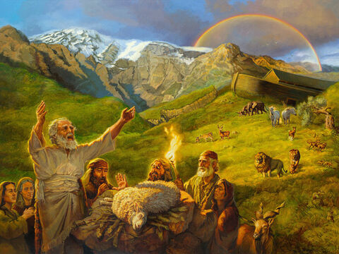
Studies in Genesis
Class will begin in:
The Faith and Failings of First Families
Notes:
Artwork by Jan van 't Hoff/Gospelimages.com.

Slide 2
Studies in Genesis
The Faith and Failings of First Families
Notes:
Artwork by Jan van 't Hoff/Gospelimages.com.

Slide 3
Genesis 6-9
Lesson 6
Notes:
Jeff Shaver

Slide 4
Cain/Abel Bring Offerings to the Lord
Review
Cain brought an offering of the fruit of the ground to the LORD (gave of what he wanted to give)
Abel also brought of the firstborn of his flock and of their fat (By faith Heb 11:4)
And the LORD respected Abel and his offering
But He did not respect Cain and his offering
Cain was very angry, and his countenance fell

Slide 5
God Questions Cain
Review
Genesis 4:7 “If you do well, will you not be accepted? And if you do not do well, sin lies at the door. And its desire is for you, but you should rule over it.”
It was Cain’s choice. Do well, or not. He chose sin. Sin had been introduced and was waiting on Cain.
He was capable of ruling over sin but he chose murder; (lacked Self Control)

Slide 6
Sins Multiply
Review
9 Then the LORD said to Cain, "Where is Abel your brother?" He said, "I do not know. Am I my brother's keeper?"
Wrong sacrifice
Anger
Jealousy
Hatred
Murder
Lying
Disrespectful to God

Slide 7
Cain’s Punishment
Review
Genesis 4:10 And He said, "What have you done? The voice of your brother's blood cries out to Me from the ground.
God already knew what Cain had done
4:11-12 "So now you are cursed from the earth, which has opened its mouth to receive your brother's blood from your hand. When you till the ground, it shall no longer yield its strength to you. A fugitive and a vagabond you shall be on the earth."

Slide 8
Punishment Too Much?
Review
Genesis 4:13 And Cain said to the LORD, "My punishment is greater than I can bear!
What an overwhelming sense of misery; but no sign of repentance, nor cry for forgiveness
God was merciful to Cain by allowing him to live; we will discuss later that murder yields a death sentence after the Flood

Slide 9
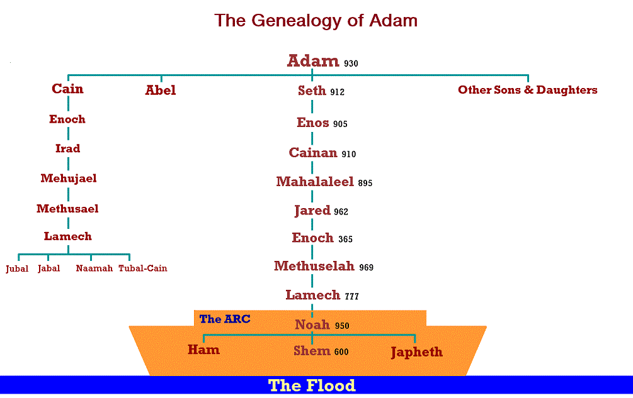
The family of Adam-Gen 5
Review

Slide 10
The family of Adam-Gen 5
Review
Only the line of Adam through Seth (Noah) will survive the flood
Cain’s line ends
Christ will come through the line of Adam/Seth/Noah

Slide 11
Enoch
Review
Genesis 5:21 Enoch lived sixty-five years, and begot Methuselah.
Enoch ... begat Methuselah—This name means, He dies, at the sending forth
It seems Enoch gave his son this name as prophecy of the coming flood. It is computed that Methuselah died in the year of the Flood

Slide 12
Enoch
Review
Gen 5:22 So all the days of Enoch were three hundred and sixty-five years. And Enoch walked with God; and he was not, for God took him.
“walked with God” denotes a constant and familiar association

Slide 13
Noah
Review
Genesis 5:32 And Noah was five hundred years old, and Noah begot Shem, Ham, and Japheth.

Slide 14
Wicked Marriages lead to Destruction
Gen 6:1-2 Now it came to pass, when men began to multiply on the face of the earth, and daughters were born to them, ² that the sons of God saw the daughters of men, that they were beautiful; and they took wives for themselves of all whom they chose.

Slide 15
Wicked Marriages lead to Destruction
Gen 6:3-4 And the Lord said, “My Spirit shall not strive with man forever, for he is indeed flesh; yet his days shall be one hundred and twenty years.” ⁴ There were giants (tyrants) on the earth in those days, and also afterward, when the sons of God came in to the daughters of men and they bore children to them. Those were the mighty men who were of old, men of renown.

Slide 16
Wicked Marriages lead to Destruction
Sons of God, were not angels who married women and produced a race of giants as some interpret
Most likely refers to men who believed in God, The Creator
Daughters of men, most likely refers to women who did not know God (Cain’s lineage??)

Slide 17
Wicked Marriages lead to Destruction
These men poorly chose wives based on beauty alone
Jesus taught that angels do not marry, so this passage is referring to men
Matthew 22:30
For in the resurrection they neither marry nor are given in marriage, but are like angels of God in heaven.

Slide 18
Destruction is Coming
(verse 3) God decides that mankind’s days are numbered to 120 more years (Noah would be 480 years old)
Gives Noah time to prepare the Ark
1 Peter 3:20
who formerly were disobedient, ^{[a]}when once the Divine longsuffering waited in the days of Noah, while the ark was being prepared, in which a few, that is, eight souls, were saved through water.

Slide 19
Destruction is Coming
Gives Noah time to preach and warn (2 Peter 2:5)
2 Peter 2:5
and did not spare the ancient world, but saved Noah, one of eight people, a preacher of righteousness, bringing in the flood on the world of the ungodly;

Slide 20
Destruction is Coming
The 120 years was not a reference to how long men would live going forward, as men would live much longer than that but of time until the flood
The offspring produced mighty men, not super humans (v4); it also produced great wickedness

Slide 21
Overwhelming Wickedness
Gen 6:5-6: Then the Lord saw that the wickedness of man was great in the earth, and that every intent of the thoughts of his heart was only evil continually. ⁶ And the Lord was sorry that He had made man on the earth, and He was grieved in His heart.

Slide 22
God Will Destroy His Creation
Gen 6:7: So the Lord said, “I will destroy man whom I have created from the face of the earth, both man and beast, creeping thing and birds of the air, for I am sorry that I have made them.”

Slide 23
God Cares
Sorry He made man (v6,7)
Grieved in His heart (v6)
We are hurt when someone we care about does us wrong

Slide 24
Noah Pleases God
Gen 6:9-10
This is the genealogy of Noah. Noah was a just man, perfect in his generations. Noah walked with God. ¹⁰ And Noah begot three sons: Shem, Ham, and Japheth.
In an Evil World, Noah pleased God
We can stand up for God even when the world around us is evil

Slide 25
From Paradise to Corruption
Genesis 6:11-12 The earth also was corrupt before God, and the earth was filled with violence. So God looked upon the earth, and indeed it was corrupt; for all flesh had corrupted their way on the earth.
How far from Adam and Eve’s condition in the garden

Slide 26
Noah Receives Instructions To build an Ark
Make an Ark (box, barge) (v14)
Use gopher wood (we may not know what this type of tree is but Noah knew) (v14)
Build rooms in it (v14)
Cover it inside and out with pitch (14)
Length 450 ft (300 cubits), Width 75 feet (50 cubits), and Height 45 feet (30 cubits) (v15)

Slide 27
Noah Receives Instructions To build an Ark
Prepare a window in the side for light, one cubit from the roof (v 16)
Set a door in its side (v16)
Prepare 3 internal decks (v16)

Slide 28
God Will Destroy all Mankind Except for Noah’s Family
Gen 6:17-18
And behold, I Myself am bringing floodwaters on the earth, to destroy from under heaven all flesh in which is the breath of life; everything that is on the earth shall die. ¹⁸ But I will establish My covenant with you; and you shall go into the ark—you, your sons, your wife, and your sons’ wives with you.

Slide 29
God Also Spares Two of Every Living Thing
Gen 6:19-21
Bring two of every sort of animal, bird, and creeping thing (male and female)
Gather and store food for your family and the living things to eat

Slide 30
Noah’s obedience
Displays how he ‘walked with God’
Genesis 6:22 Thus Noah did; according to all that God commanded him, so he did.
Complete, total obedience
Did ‘all’ God commanded him

Slide 31
The Flood: Children’s Story or Fact?
Jesus taught His disciples: But as the days of Noah were, so also will the coming of the Son of Man be. For as in the days before the flood, they were eating and drinking, marrying and giving in marriage, until the day that Noah entered the ark, and did not know until the flood came and took them all away, so also will the coming of the Son of Man be. (Matthew 24:37–39; cf. Luke 17:26–27)

Slide 32
The Flood: Children’s Story or Fact?
Jesus taught His disciples of the Flood and Noah’s Ark
If we believe in Jesus Christ we must also believe in the Flood, Noah , the Ark, the saving of animals, birds, and creeping things which were brought on two by two
God is in control; all nature is in submission to Him

Slide 33
Noah’s obedience leads to the Saving of His Household
Genesis 7:1 Then the Lord said to Noah, “Come into the ark, you and all your household, because I have seen that you are righteous before Me in this generation.
Verse 4- The flood is coming in 7 more days
It will rain for 40 days and 40 nights
Noah is 600 years old now

Slide 34
Number of Clean and Unclean Animals on the Ark
7 pairs of each type of clean animals (male and female)
1 pair of each type of unclean animals (male and female)
7 pairs of each type of bird (male and female)
God said they would come to him, he would not have to go find them (Gen 6:20)

Slide 35
Number of Clean and Unclean Animals on the Ark
Clean and Unclean animals have not been mentioned yet in the Bible record
Noah obviously knows what the difference is; the clean animals may be used for animal sacrifice to God

Slide 36
Two by Two Life is Spared
Gen 7:7-16
Two by two, male and female, man and animal enter the Ark
Noah and his wife
Shem, Ham, Japheth and their wives
Clean and Unclean animals

Slide 37
Two by Two Life is Spared
Birds
Creeping things
Then The Lord Shuts them in (v16)
The flood begins 7 days later (2nd month, 17th day of Noah’s 600th year)
Fountains of the great deep are opened (11)
The rain begins and continues for 40 days and nights (12)

Slide 38
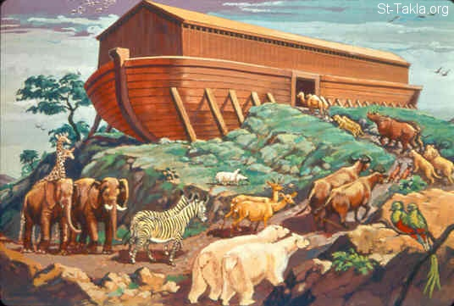
2 by 2

Slide 39
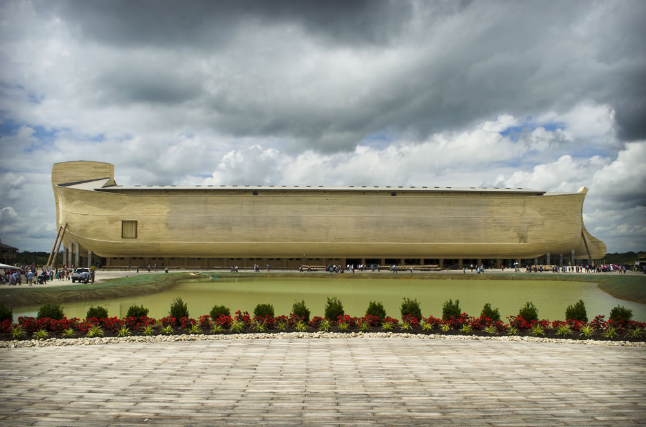

Slide 40
The Waters Cover the Earth
Gen 7:17-24
Waters increased and lifted up the Ark high above the earth (17)
Ark moves about the surface of the waters (18)
All High Hills on earth covered (19)
Waters prevailed 15 cubits above the mountains

Slide 41
The Waters Cover the Earth
Gen 7:17-24
ALL living things on the earth were destroyed by God (21-23)
Only Noah’s family and the animals on the Ark remained alive (23)
The waters prevailed for 150 days

Slide 42
God remembers Noah and All Life on the Ark
(8:1) Then God remembered Noah, and every living thing, and all the animals that were with him in the ark. And God made a wind to pass over the earth, and the waters subsided.

Slide 43
God remembers Noah and All Life on the Ark
Waters start receding (150 days have past)
The Ark comes to rest on Mount Ararat (8:4)
The waters continue to recede until on the first day of the 10th month, in which the tops of the mountains could be seen (8:5)

Slide 44
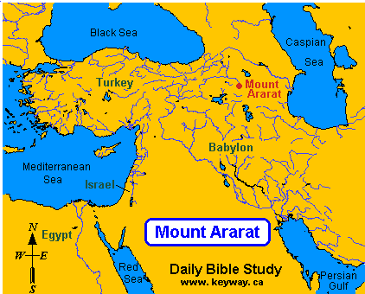
Genesis 6-10
The Flood

Slide 45
Noah Inspects for of Dry land
Gen 8:6-14
40 days after the tops of the mountains could be seen, Noah sends out a Raven through the window; It does not return (vs 6-7)
Next, he sends out a dove; however, it returns after finding no resting place (vs 8-9)
Noah waits 7 days and sends the dove out again; she returns with an olive leaf (v 10-11)

Slide 46
Noah Inspects for of Dry land
Gen 8:6-14
Noah knows there is dry ground (no standing water)
Noah waits 7 more days and re-sends the dove; she does not return (v12)

Slide 47
Noah Inspects for of Dry land
Gen 8:6-14
In the 1st month on the 1st day of the month of Noah’s 601st year, the waters are dried up and Noah removes the covering from the Ark; He could see the dry ground for himself! (v13)
(v14) In the second month, on the 27th day, the entire earth was dried up (about a year and 10 days since the flood began)

Slide 48
The Flood is Over
God commands Noah to vacate the Ark with every living thing so that they may abound on earth (8:15-18)
God commands all life to “Be fruitful and multiply” (v18)
Noah immediately worships God by offering burnt offerings of the clean animals and birds (like Abel- by faith) (v20)

Slide 49
God makes Covenant with Creation
God’s promise (Gen 8:21-22)
Then the Lord said in His heart, “I will never again curse the ground for man’s sake, although the imagination of man’s heart is evil from his youth; nor will I again destroy every living thing as I have done. (8:21)

Slide 50
God Gives Laws
Man is ruler of the animal kingdom
Animals, birds, fish will fear and dread you (v2)
Similar to what was told Adam (Gen 1:28)
Every living thing is given to man for food (9:3); this law will be modified in the Law of Moses to separate clean and unclean animals

Slide 51
God Gives Laws
You shall not eat flesh with its blood (v4); repeated in Law of Moses and New Testament
Leviticus 17:10 …I will set My face against that person who eats blood, and will cut him off from among his people.
Acts 15:20 "but that we write to them to abstain from things polluted by idols, from sexual immorality, from things strangled, and from blood.

Slide 52
God Gives Laws
Life for a life; A settlement is required
Genesis 9:5 "Surely for your lifeblood I will demand a reckoning; from the hand of every beast I will require it, and from the hand of man. From the hand of every man's brother I will require the life of man.
6 "Whoever sheds man's blood, By man his blood shall be shed; For in the image of God He made man.

Slide 53
Rainbow: God Gives a sign of His Covenant with Creation
Gen 9:8-17 God
Genesis 9:11 "Thus I establish My covenant with you: Never again shall all flesh be cut off by the waters of the flood; never again shall there be a flood to destroy the earth.“
I set My rainbow in the cloud, and it shall be for the sign of the covenant between Me and the earth. (9:13)

Slide 54

Rainbow: God Gives a sign of His Covenant with Creation

Slide 55
God will Destroy Earth One Day But Not By Flood
2 Peter 3:10 But the day of the Lord will come as a thief in the night, in which the heavens will pass away with a great noise, and the elements will melt with fervent heat; both the earth and the works that are in it will be burned up.

Slide 56
Noah Curses Ham’s Descendants
Gen 20-27
Noah plants a vineyard (20)
Noah gets intoxicated from wine that he made and is found naked in his tent by Ham (21-22)
This story shows Noah was not a perfect person and like all mankind sometimes makes bad decisions
Ham tells his 2 brothers; Ham seems to have handled the situation dis-respectfully; entered a private area without permission and saw his father’s nakedness; laughed about it to his brothers (speculation)??

Slide 57
Noah Curses Ham’s Descendants
Gen 20-27
Shem and Japheth enter the tent with a garment and walk backwards ensuring not to see their father’s nakedness; they cover Noah (v23)
Noah awakes and knew what Ham had done (v24)
Noah curses Canaan, son of Ham; may his descendants be servants to the descendants of Shem and Japheth (24-27)

Slide 58
Noah Curses Ham’s Descendants
Canaan’s descendants made their home in the little strip of land…..that God ultimately promised to the descendants of Abraham, who were the descendants of Shem. And indeed, Abraham’s descendants, the Israelites, took the land of Cannan with God’s help and made the remaining Canaanites their slaves. (Bob Waldron commentary)
Noah lives to be 950 years old (28); last man to live over 900 years; the lifespan of man rapidly decreases after the flood

Slide 59
Choosing a spouse
lessons
It matters who you choose to be your lifetime companion
Guys, she will affect your future more than anyone can ever get you to understand
Ladies, he will be the father of your children—the most precious ones on earth to you

Slide 60
Faith and Failings
lessons
Faith
Noah’s obedience in All things God commanded
Noah’s family submits to Noah
Failings
Mankind-every thought was evil
Noah’s drunkenness
Ham disrespects Noah

Slide 61
What About Us?
lessons
Do we stand up for God in a world who practices evil?
Does persecution hold us back from doing right?
How do we handle mistakes? Excuses or Repentance?

Slide 62
Comments?
Next Time: Sunday AM February 20
Lesson 7: Genesis 10-11 Tower of Babel

Slide 63
…

