Slide 1
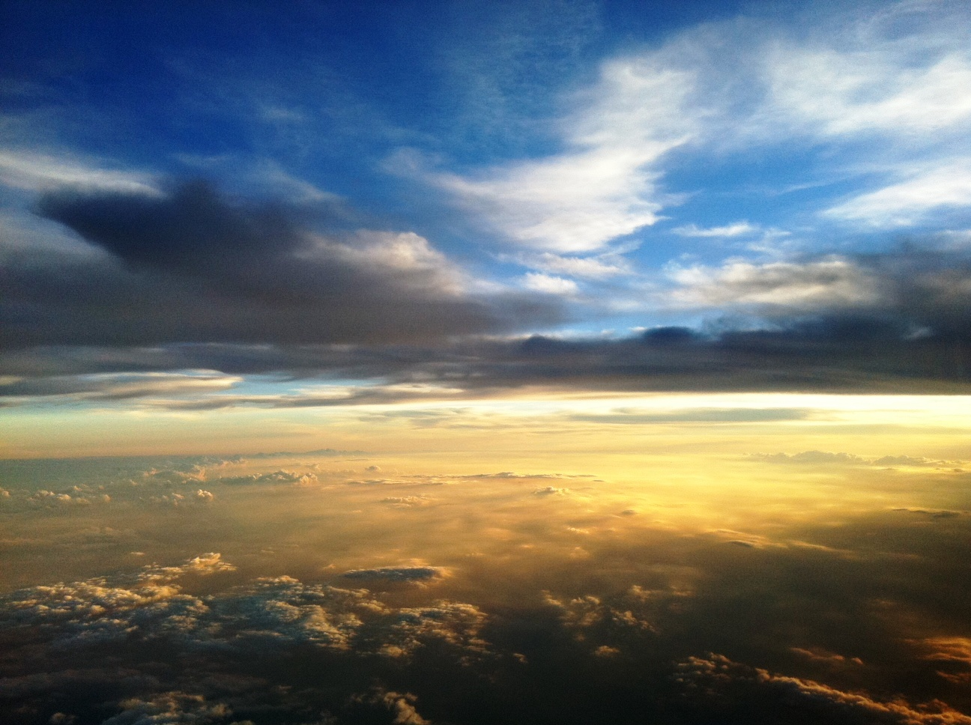


Slide 2
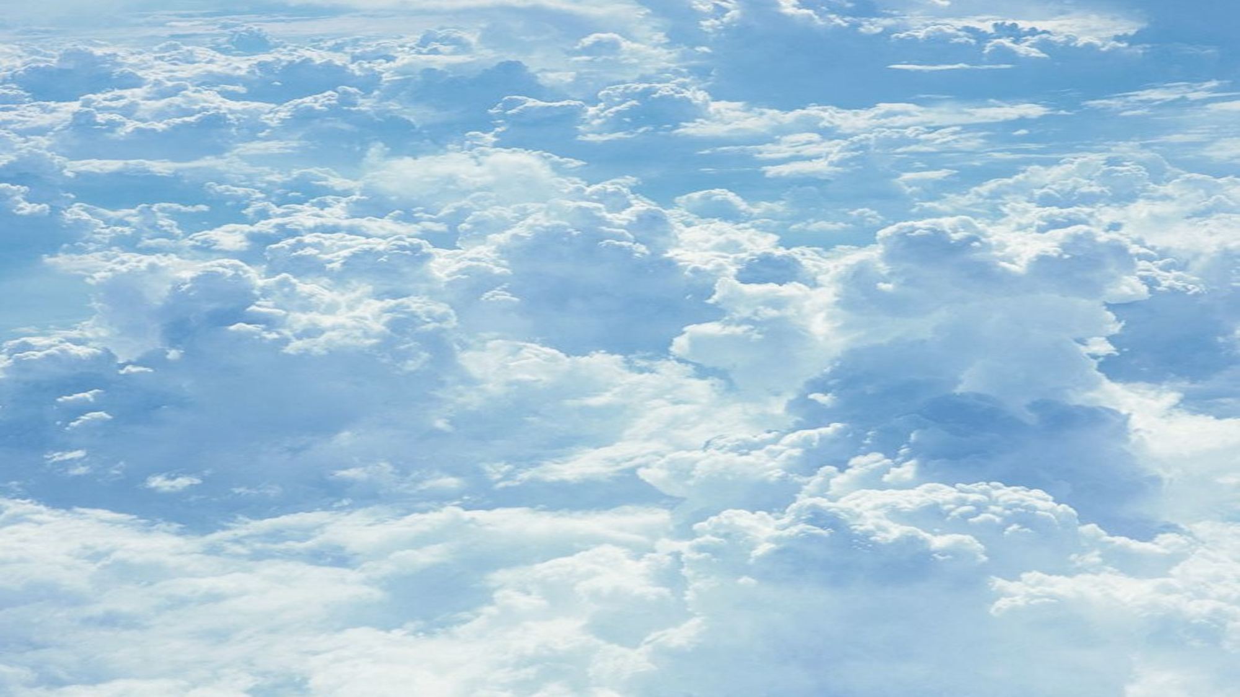
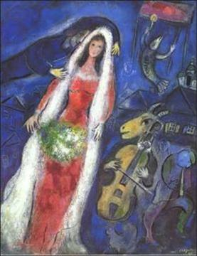
“Paint me a Picture”
“I, John, saw the holy city, New Jerusalem, coming down out of heaven from God, prepared as a bride adorned for her husband” (Rev. 21:2)

Slide 3
“Paint Me a Picture”
The Bride: Symbol of the Saved in Heaven
Revelation is a book filled with visual symbols (Rev. 1:11, 20, 16; Heb. 4:12; Eph. 6:17).
The sword that comes from the mouth of Jesus is the Word of God, which is used to fight against and conquer the unrepentant (Rev. 2:16; 19:15, 21).
The “Bride” is the church, the body of the saved (cf. 2 Cor. 11:2; Eph. 5:25-27).

Slide 4
“Paint Me a Picture”
The Bride: Symbol of the Saved in Heaven
Is the bride the saved on earth or in heaven?
On earth, the church is the “betrothed” of Christ (2 Cor. 11:2).
In Revelation, it is only after the great historical events of the book that the bride is said to have “made herself ready” for marriage (Rev. 19:7-8).
The vision of the bride in Revelation 21 occurs after the final judgment depicted in Revelation 20:11-15.
The “tree of life” which is available in the Bride is before the throne of God, in heaven (Rev. 2:7; 22:2).
The future tense is used predominately in the description of the bride (Rev. 21:7, 24-27; 22:3-5).

Slide 5
“Paint Me a Picture”
Fellowship with God: Destiny of the Redeemed
Heaven is being at home with our heavenly Father!
In the heavenly city, “the tabernacle of God is with men, and He will dwell with them” (21:3).
There is no need to go to a temple to approach God’s presence, for He is always at hand (Rev. 21:22).
Inhabitants are bathed in the light of the glory of His presence (Rev. 21:23, 25).
There is no death, sorrow, crying, or pain because God is present, and He will wipe away every tear (Rev. 21:4).

Slide 6
“Paint Me a Picture”
Only the Holy
Heaven is a place for those who have prepared for their spiritual wedding day (Rev. 21:2,10; Heb. 12:14)
This new realm of existence will be characterized by righteousness (Rev. 21:1, 5, 27; 2 Pet. 3:13).
The “sea” of wicked human society is gone (Rev. 8:8-9; 12:12; 16:3; 18:17-21).
The holy are at home, but the wicked have no place (Rev. 21:27; 20:12, 15; 3:5; 21:8l; Exo. 32:32-33; Phil. 4:3).
The knowledge of this reality does not ruin heaven for God, and it won’t ruin it for the saved either.

Slide 7
“Paint Me a Picture”
The Perfect Home for God’s people
Heaven is our perfect home (Heb. 13:14; 11:10)
The prominence of the number 12 indicates that the city is designed for us! (Rev. 21:12-21) The number twelve symbolizes the people of God.
Jacob had twelve sons whose descendants became the twelve tribes of the nation of Israel; they were the specially chosen people of God (Ezek. 20:5).
Jesus chose twelve apostles and promised them that they would “sit on twelve thrones, judging the twelve tribes of Israel” (Matt. 10:1-5; 19:28).
In Revelation, the number 12 is repeatedly used symbolically for the people of God (Rev. 7; 12:1)

