Slide 1
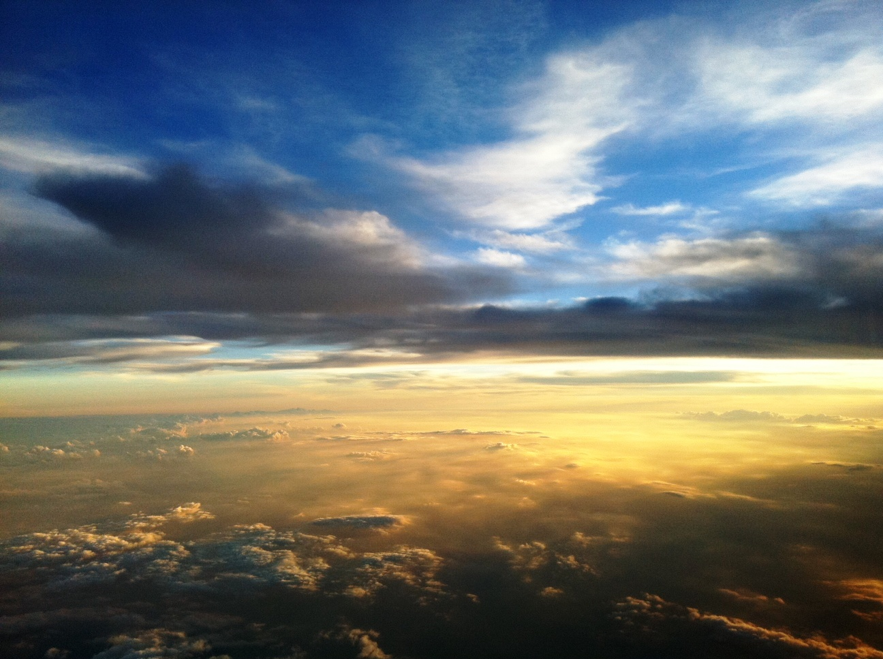


Slide 2
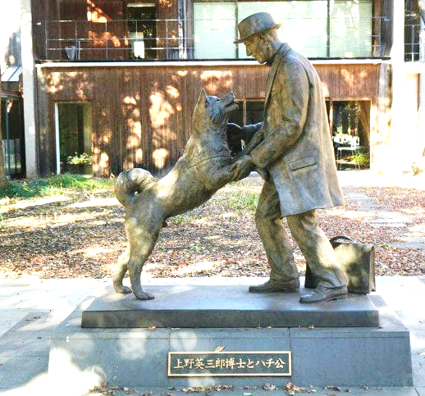
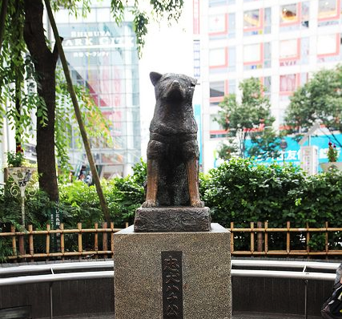
The Glorious Day: When We All Get To Heaven
Statues of Hachi, loyal Akita
The statue on the left was unveiled in 2015 at the University of Tokyo.
The statue on the right has long stood at the Shibuya train station.

Slide 3

The Glorious Day: When We All Get To Heaven
The Day of The Lord Will Come
The faithful are waiting in anticipation of their Master’s return (Matt. 24:42,44)
Some scoff at the idea of His return (2 Peter 3:3-4)
But “the day of the Lord will come,” and those who wait for it anticipate it in holiness (2 Peter 3:1-13)
The Master and His messengers promised His return! (John 14:1-3; Acts 1:9-11)
Our bodies will be gloriously changed (1 Corinthians 15:42-52; Romans 8:19)
It won’t be a great day for everyone (2 Thess. 1:7-10)

Slide 4
The Glorious Day: When We All Get To Heaven
Watching the Sky
The Scriptures commend vision that is focused on our spiritual walk and destination (Prov. 4:25-27; Deut. 5:32-33; 2 Peter 3:12-13)
We look for Jesus to come on the clouds (Acts 1:9-11; 1 Thess. 4:16-17; Rev. 1:7)

Slide 5
The Glorious Day: When We All Get To Heaven
Not a Small World, It’s a Big Family
Heaven will involve a “family” reunion (Eph. 1:5)
We will see the Lord (Psalm 17:15; 2 Thess. 1:10)
We will reunite with loved ones who died as faithful saints or innocent children (2 Samuel 12:23)
We will sit down with great heroes of faith (Matt. 8:11-12; Luke 16:19-31)
We are “heirs together” and we will be glorified together” (1 Peter 3:7; Romans 8:16-17)
We will rejoice to see those with whom we shared the gospel (1 Thess. 2:19-20)

Slide 6
The Glorious Day: When We All Get To Heaven
“They Shall See His Face”
Judgment will be like an awards ceremony for the faithful child of God (Rev. 22:12; Matt. 25:21)
We will see God’s face (Exo. 33:18-23; Rev. 22:4)
The saints are set on display by God, and they shine forth as a lasting tribute to the One who made them masterpieces (Matt. 13:43)

Slide 7
The Glorious Day: When We All Get To Heaven
And It Does Not Fade Away
“Blessed be the God and Father of our Lord Jesus Christ, who according to His abundant mercy has begotten us again to a living hope… to an inheritance incorruptible and undefiled and that does not fade away, reserved in heaven for you”
– 1 Peter 1:3-4

