Slide 1



Slide 2

“Conformed to the Image of His Son”
God’s Eternal Intention
“He chose us in Him before the foundation of the world…having predestined us to adoption as sons by Jesus Christ to Himself, according to the good pleasure of His will” (Eph. 1:4-5).
In Romans 8:29, the Scripture says that “whom He foreknew, He also predestined to be conformed to the image of His Son that He might be the firstborn among many brethren.”
God’s intention is not just to have a lot of children, but to have a lot of children who are like His first child.

Slide 3
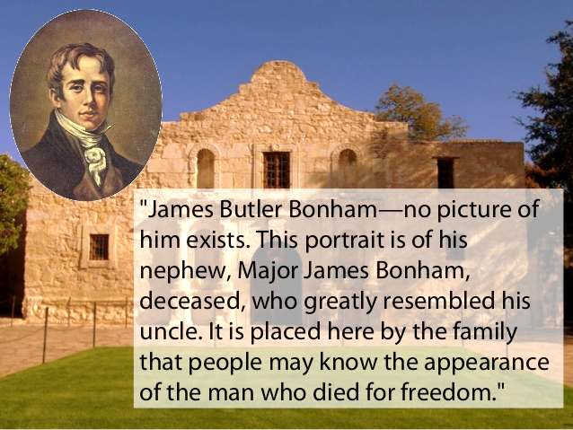
“A family Resemblance”

Slide 4
“Conformed to the Image of His Son”
A Family Resemblance
In becoming children of God, we “put on” Christ (Gal. 3:26-27)
We grow up to resemble Christ! (Eph. 4:13)
  We are to “morph” into Christ-likeness (Gal. 4:19; Rom. 13:14)
  Christ lives in us! (Gal. 2:20)

Slide 5
“Conformed to the Image of His Son”
Conforming by Copying
We desire to become like Christ (1 Cor. 15:49)
To become like Him, we must gain knowledge of what He is like! (Col. 3:10; 2 Peter 3:18; Luke 6:40)
We must visualize the transformation! (2 Cor. 3:18; cf. Matt. 17:2; Rom. 12:2)
We are to become imitators or mimics of God “as dear children” (Eph. 5:1)

Slide 6
“Conformed to the Image of His Son”
Transformation Through Trial
Jesus left us an example of sinless suffering (1 Pet. 2:21; Heb. 2:10)
Those who desire to be like Him, are willing to suffer (1 Pet. 4:1; Luke 9:23)
No one can fully know Christ or imitate Him until he knows “the fellowship of His sufferings” (Phil. 3:10). It is the cost of discipleship!

Slide 7
“Conformed to the Image of His Son”
Actuality or Acting?
A “hypocrite” is an actor or a pretender (Matthew 23:27)
We must lay aside “hypocrisy…as newborn babes” (1 Peter 2:1)
Hypocrites just won’t go to heaven (Matthew 24:51)

Slide 8
“Conformed to the Image of His Son”
The Eternal Makeover
Our transformation will be completed in the world to come (1 John 3:2; 1 Corinthians 15:47-59, Luke 20:35-36)
There should be a yearning in each of us for that final moment of transformation (Philippians 3:20-21)

Slide 9
“Conformed to the Image of His Son”
“For us this is the end of all the stories…but for them it was only the beginning of the real story. All their life in this world had only been the cover and the title page; now at last they were beginning Chapter One of the Great Story, which no one on earth has read, which goes on forever and in which every chapter is better than the one before.”
(C.S. Lewis, The Chronicles of Narnia)

