Slide 1
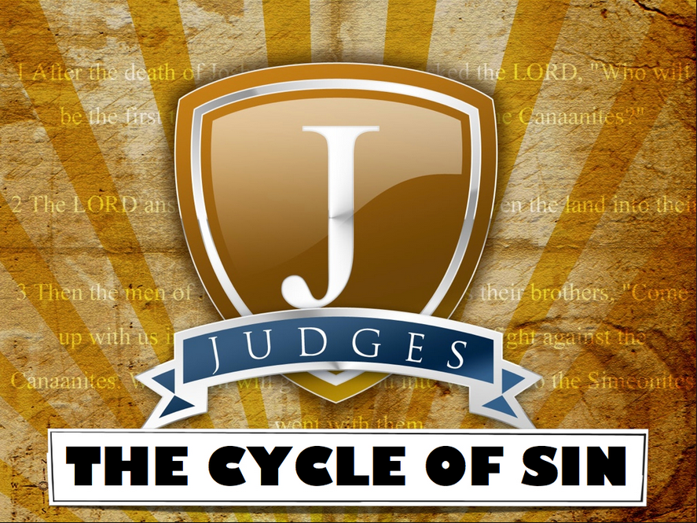
Peace
Deliverance
Sin
Repentance
Oppression

Slide 2
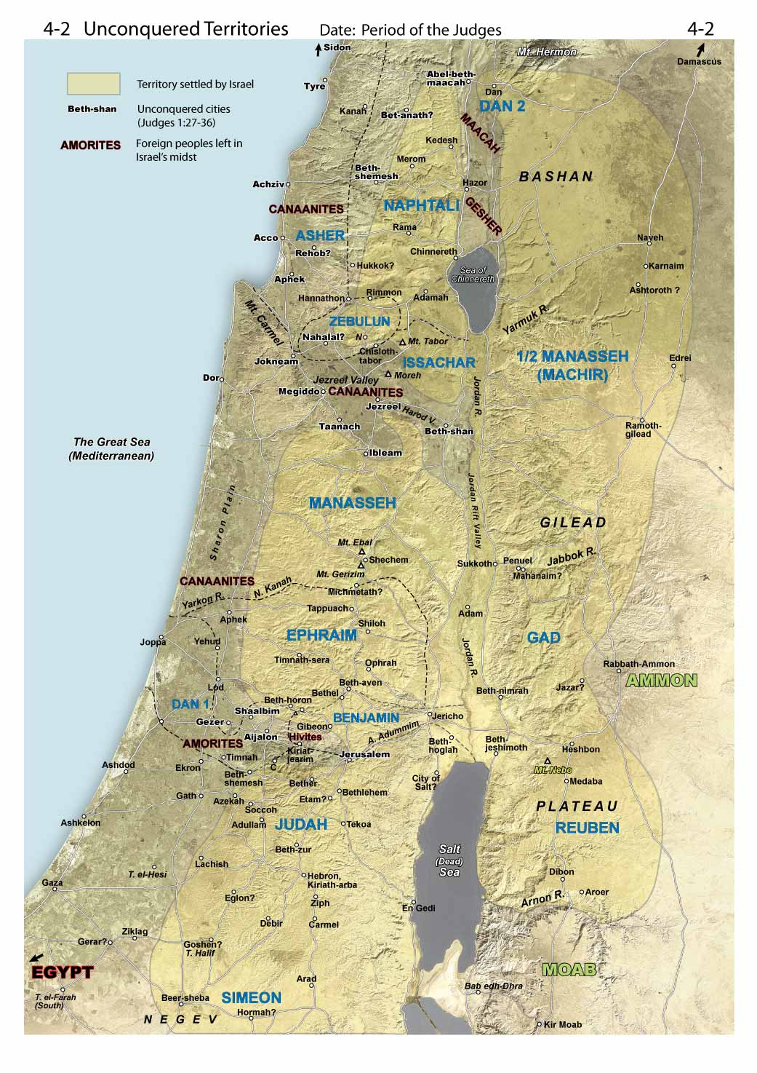
Jephthah – 6 years
Ibzan (12:8-10) – 7 years
Elon (12:11-12) – 10 years
Abdon (12:13-15) – 8 years
Pirathon

Slide 3

Samson
Cycle
Sin v. 13:1
Oppression 13:1 (40 yrs)
Repentance ?
Deliverance 14:1 - ff
Peace – 1 Sam. 7:12-13

Slide 4
Samson
God Makes It Clear Who is in Control (Samson’s Parents, Samson, Israel, Philistines, etc…)
Possible Timeframe Overlap
A Different Kind of Judges
Deliverer vs. Judicial/Spiritual Judgement
Samson vs. Deborah

Slide 5
Samson
An Interesting Character
His Parents Seem Faithful
Knew His Strength Came From God
He Relied on God
He Maintained the Nazirite Vow
He Prayed to God for Help
He Was Highlighted For His Faith (Heb. 11:32)
He Was Immoral
He Appears Flippant With Parents and Philistines
God Uses Him As He Is

Slide 6
Pirathon

Slide 7
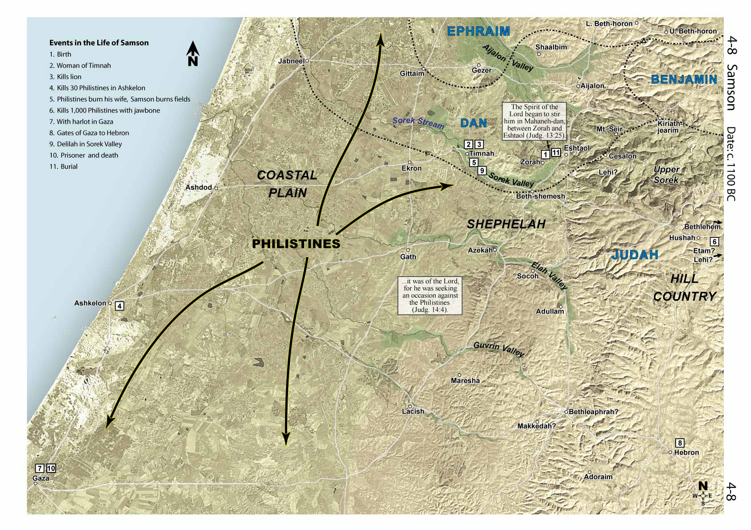
Pirathon

Slide 8
Applications
Israel
God is in control
Their problems were due to their sins
All
God uses both the evil and the good to bring about his plan (providence)
God made it clear the deliverance was from Him (Holy Spirit)
Samson’s female weakness (Satan will use anyone)
Samson’s troubles come from his weaknesses

Slide 9
Review
Othniel
Ehud
Shamgar
Deborah
Gideon
Abimelech**
Tola
Jair
Jepthar
Ibzan
Elon
Abdon
Samson
Eli
Samuel

