Slide 1
…
Notes:
The following are notes from Zoom session with Pablo and others in Colombia (Gregory Roark translating) 12/4/2020-wmh—
Opening comments—
I am not a preacher and, this may not be the best choice for a lesson for you. My purpose today is to do an overview of John chapter 15, first to remind us of the content of the chapter and second to see some short lessons for us from this chapter. ///
John 15
Setting—
Chapter 12 ends John’s record of Jesus’ public ministry. In chapter 13 He eats the Passover with his apostles, He washes their feet (teaching them a lesson in humility and service to one another), and Judas departs to arrange the betrayal of Jesus. Beginning in chapter 14 Jesus has final words for them before His death. /// The apostles have had a very difficult time understanding that the Messiah, their Master would be killed by the Jewish leaders. Perhaps their understanding became clearer as they made that final assent from Jericho up toward Jerusalem just a few days before this time. /// In chapter 14 He tries to comfort them, “Let not your heart be troubled.” He will send a Helper to them. These final words from the Master will continue in chapters 15 and 16. ///
Important—The first task in studying John 14-15-16 is to decide what applied specifically to the apostles and what if anything applies to us. There is no doubt Jesus was in conversation with the eleven (Judas having already left) as they finished the supper in the upper room. Do all the things He said to them also apply directly to us today? Keep this in mind as we look at chapter 15. ///
Overview—
This chapter continues the circumstance and main theme of chapter 14, namely, the Lord’s intimate conversation with His apostles/friends about His love and concern for them through the distressing experiences that lie ahead. /// His imminent separation from them is the immediate subject, and this leads Him to speak to them of their need to continue united spiritually with Him. /// This is essential because they can only take strength for the spiritual life from Him, and thus produce the essential fruit which life in Him brings forth. /// In this chapter He puts this forward under three main headings: (1) The Union of the Disciples With Christ, as illustrated by the parable of the vine and the branches (vs 1-11); (2) Their Love For One Another In Him (vs 12-17); and, (3) The World’s Hatred of Him and Them (vs 18-25). (Truth, modified)
Section 1 – Union of the Disciples with Christ
/// you read vs 1-11 in Spanish
John 15:1 "I am the true vine, and My Father is the vinedresser.
2 "Every branch in Me that does not bear fruit He takes away; and every branch that bears fruit He prunes, that it may bear more fruit.
3 "You are already clean because of the word which I have spoken to you.
4 "Abide in Me, and I in you. As the branch cannot bear fruit of itself, unless it abides in the vine, neither can you, unless you abide in Me.
5 "I am the vine, you are the branches. He who abides in Me, and I in him, bears much fruit; for without Me you can do nothing.
6 "If anyone does not abide in Me, he is cast out as a branch and is withered; and they gather them and throw them into the fire, and they are burned.
7 "If you abide in Me, and My words abide in you, you will ask what you desire, and it shall be done for you.
8 "By this My Father is glorified, that you bear much fruit; so you will be My disciples.
9 "As the Father loved Me, I also have loved you; abide in My love.
10 "If you keep My commandments, you will abide in My love, just as I have kept My Father's commandments and abide in His love.
11 "These things I have spoken to you, that My joy may remain in you, and that your joy may be full.
Jesus has told them (previous chapters) that He is going away, and they cannot come (13:33). He has promised to send “another Comforter” to guide them (14:16,26) and that He and the Father would be with them (14:20). /// Now he represents their relationship to Him as branches in Him as the vine—the ‘true’ vine (Jn 1:6; 6:32). The Father is the landowner, the caretaker of the vineyard. ///
Jesus is the true vine (another of the “I AM’ verses we find in John’s gospel). The branches are the individual disciples who will bear fruit. /// The Father is the caretaker who will prune and care for the vineyard to keep it healthy. He will remove branches that are not bearing fruit.
1 Cor 5:5-7 purge out the one guilty of sexual immorality
Gal 5:4 …you have fallen from grace
Heb 12:14-15 be careful that you don’t fall short of the grace of God ///
These apostles (vs 3) were clean through their obedience to the words of Jesus, but the Father, as the vinedresser, will continually purge non-productive branches (1 Jn 1:7-10; Jn 17:17; 1 Pet 1:22-23). ///
Three basic lessons from Jesus’ use of this illustration of vine and branches—
1—Spiritual life is in Christ (v 4; Gal 3:26-27 those baptized into Christ have put on Christ) ///
2—A branch must bear fruit, or it will be cut off (v 2; Mt 25:41-46; Gal 5:22-23). Christianity is a DOING religion. In chapter 13 He showed them they must SERVE one another. ///
3—Individual disciples (“you” v5) are branches (not various churches/religions) (1 Cor 1:10-13). ///
The promise (v 7) “ask what you desire, and it shall be done for you” is conditioned by the ‘if’ phrase “If you abide in Me, and My words abide in you.” This is not an open promise to ask and expect to receive just anything and everything. ///
Jas 4:3 You ask and do not receive, because you ask amiss, that you may spend it on your pleasures. ///
1 Jo 3:22 And whatever we ask we receive from Him, because we keep His commandments and do those things that are pleasing in His sight. ///
1 Jo 5:14 Now this is the confidence that we have in Him, that if we ask anything according to His will, He hears us. ///
The disciple will be sure to bear much fruit so the Father will be glorified (v 8). Nothing gives glory to God the Father more than fruitful service. And nothing gives more abiding satisfaction to the child of God, as with Jesus before Him, than to see God glorified. (Truth)
Mt 5:16 "Let your light so shine before men, that they may see your good works and glorify your Father in heaven. ///
Jesus assures His disciples of His love for them (v 9) by comparing it to the love His Father has for Him. He requires more than words for the disciple to show his love for Jesus. “If you keep My commandments” is the true indication of the disciple’s love for Jesus. /// He sets a strong comparison in stating He abides in His Father’s love by keeping the Father’s commandments, thus the disciple is to keep Jesus’ commandments to abide in His love.
1 Jo 5:3 For this is the love of God, that we keep His commandments
Joh 14:15 "If you love Me, keep My commandments.
Joh 14:23 Jesus answered and said to him, "If anyone loves Me, he will keep My word ///
Section 2 – The disciples love for one another (vs 12, 17)
/// you read vs 12-17 in Spanish
John 15:12 "This is My commandment, that you love one another as I have loved you.
13 "Greater love has no one than this, than to lay down one's life for his friends.
14 "You are My friends if you do whatever I command you.
15 "No longer do I call you servants, for a servant does not know what his master is doing; but I have called you friends, for all things that I heard from My Father I have made known to you.
16 "You did not choose Me, but I chose you and appointed you that you should go and bear fruit, and that your fruit should remain, that whatever you ask the Father in My name He may give you.
17 "These things I command you, that you love one another..
By these words (this discourse) Jesus is telling them where He is going and why it must be so. He is preparing them for the coming of the Spirit and the effect it will have on them. /// Remaining in Him and in His love and having love one for another would fill their joy (1 Jn 3:16-18). He was about to demonstrate the greatest love possible by giving His own (sinless) life for His disciples (Jn 13:34). ///
Jesus’ giving His very life for the disciples (for the world) illustrates the supreme limit He was willing to endure to show His love for His friends (the disciples). His command is that the disciples love one another sufficiently to do the same for each other. ///
Another ‘if’ clause in vs 14—“if you do whatever I command you.” Jesus is the Master and can expect His servants to obey without question. /// Now He calls them “My friends” if they choose to do His commands. As friends, he would hold them closer than just servants. He would share with them all things told Him by the Father thereby building their faith (Rom 10:17; Eph 3:3-5; Rom 16:25-26). ///
As stated earlier, we must determine which passages in this discourse apply to the apostles’ hearing Jesus speak and which do/can apply to all disciples. V 16 is one of these verses. /// Jesus is speaking directly to the eleven. He had chosen them (Lk 6:12-16) and appointed them to the special role as His apostles. (This passage is not teaching the Calvinist doctrine of ‘unconditional election.’) /// All Christians are called by the gospel (2 Thess 2:13-14), but not in the way Jesus chose these men.
2 Th 2:13 But we are bound to give thanks to God always for you, brethren beloved by the Lord, because God from the beginning chose you for salvation through sanctification by the Spirit and belief in the truth,
14 to which He called you by our gospel, for the obtaining of the glory of our Lord Jesus Christ.
Again in vs 16 and 17, He repeats the instruction to pray to the Father in His name and to love one another. ///
Section 3 – The world had hated Jesus and would hate the apostles
/// you read vs 18-27 in Spanish
John 15:18 "If the world hates you, you know that it hated Me before it hated you.
19 "If you were of the world, the world would love its own. Yet because you are not of the world, but I chose you out of the world, therefore the world hates you.
20 "Remember the word that I said to you, 'A servant is not greater than his master.' If they persecuted Me, they will also persecute you. If they kept My word, they will keep yours also.
21 "But all these things they will do to you for My name's sake, because they do not know Him who sent Me.
22 "If I had not come and spoken to them, they would have no sin, but now they have no excuse for their sin.
23 "He who hates Me hates My Father also.
24 "If I had not done among them the works which no one else did, they would have no sin; but now they have seen and also hated both Me and My Father.
25 "But this happened that the word might be fulfilled which is written in their law, 'They hated Me without a cause.'
26 "But when the Helper comes, whom I shall send to you from the Father, the Spirit of truth who proceeds from the Father, He will testify of Me.
27 "And you also will bear witness, because you have been with Me from the beginning.
Jesus’ disciples are to be different from the world (1 Jn 2:15-17 Do not love the world; 2 Cor 6:17 Come out from among them and be separate). Jesus set an example for His followers. /// His disciples can expect persecution (Mt 5:10-12 men will revile and persecute you). He said, “I chose you out of the world,” and His disciples make a choice to live differently from the world and suffer the consequences. ///
Jesus expected His disciples would receive the same treatment He received (Lk 6:40). He is preparing them for what to expect as they begin preaching His gospel to the world (Acts 5:17-18 put in prison for preaching Jesus; 7:54-60 Stephen is stoned to death). ///
Jews would resent the name “Christ” by which the Christians identified Jesus as the Messiah. /// The Romans on the other hand would resent the exclusive claim that He was “Lord,” a title by which the Emperor was known. /// But besides these “names” by which He was called by them, there is their belief that He is divine. He wears the divine name, “God” (Isa. 9:6) Phil. 2:6-7, 9 “. . . who existing in the form of God, counted not the being on an equality with God a thing to be grasped, but emptied Himself . . . wherefore also God highly exalted him, and gave unto Him the name which is above every name.” (Truth) They would be persecuted because they wore the name of Christ. ///
All these things they will do to Him (v 21)... at His death—the hatred, disobedience, mockery, persecution, lying at His trials, scourging, and death itself, etc., which marked the treatment of Christ by the world; and Jesus' promise here is that nothing will be left out in the world's similar treatment of the apostles. ///
The works (miracles) (v 24) Jesus did among His people, the Jews, gave them an opportunity to know Him as the Messiah. They rejected Him and thereby rejected the Father. /// He is not speaking (v 22) of sinning in general (Rom 3:23). Jesus gave them a way (“I am the way”) to have forgiveness of their sins. The Jewish leaders chose to reject His offer even to the extent of enough hate to kill Him (Jn 5:16-18 the Jews wanted to kill Him for {according to them} breaking the Sabbath; 7:1). ///
V 25 is a quotation from Psalm 35:19 or Psalm 69:4, and Jesus speaks of it as part of the “law” (Law of Moses). Jesus put the Psalms into the Law. It is referenced this way at times and at other times the Psalms are mentioned separate from the Law. ///
Though the world may hate these apostles, the Helper/Comforter will be with them to testify of Jesus (v 26). The apostles had been with Jesus from the beginning of His earthly ministry and would testify of Him (even more after seeing Him following His resurrection). ///
The Spirit is to bear witness because He “proceeds from the Father.” However, the apostles are to offer their testimony “because you have been with Me from the beginning.” They were to fulfill the role of “eyewitnesses and ministers of the word” (Luke 1:2), because of their unique perspective in having accompanied the Lord throughout his earthly ministry (Acts 1:21). (Truth) ///
Some short one sentence lessons for us—
We must be “in Christ” and we must abide (continue to be “in Christ”). Abide—to remain stable or fixed; to continue in place. So, we are to be fixed in Christ. ///
We must bear fruit, or we will be cut off. While bearing fruit we will be pruned. Pruning allows for new growth and also prevents undesired infestations (think various sins and false doctrines). ///
Our Father is glorified when we bear much fruit. ///
We are cleaned by following the words of Jesus. ///
We must keep Jesus’ commandments to abide in His love. ///
We are to love one another. ///
We will be hated (and persecuted) by the world because we love Jesus. ///
We cannot be apostles (special ambassadors) because we have not been with Christ from the beginning of His ministry. ///

Slide 2


The Gospel of
John

Slide 3

The Gospel of
John
JOHN 15
The Period of Conference
Conference on Relationships

Slide 4
Private time
John 13
review
John ends the public ministry of Jesus in ch 12
Chapters 13-14-15-16-17 are activities and conversation with the chosen twelve
John 13 begins this private time as Jesus is at supper with the twelve
He reveals some very troubling news in ch 13

Slide 5
Troubling news
review
Supper is finished
Devil has entered Judas’ heart to betray Jesus
Judas has left the upper room
Jesus tells the eleven He is going away
  And they cannot come
Jesus tells Peter he will deny Him three time this very night
  They all will flee from Him
Notes:
Truth—
Ancient authorities are about evenly balanced as to whether this verse should begin with the words “Supper was now in progress. . .” (deipnou ginomenou) or “Supper having ended. . .” (deipnou genomenou), but the context seems clearly in favor of the former. Later the author makes it clear that the meal had not ended (vv. 12, 23-26, 30).

Slide 6
Context
A significant point to keep in mind as we study John 14-15-16…
Who is Jesus talking to?
What is He telling them?
What is the context?
Is the same point/promise made elsewhere?
Notes:
For example--In Eph 1 look at the pronouns us/we/our down through vs 12; then starting in vs 13 it is you/your, etc. Why the change. Is Paul speaking of the Jews (his nation) in the first part then including the Gentiles (Ephesians) beginning in vs 13?
So, in John 14ff, who is Jesus speaking to? Who is included in the things He is saying? Are there teachings elsewhere that would include more than just the apostles? Example—Going to prepare a place and come again to get you. Matt 25; Col 3 and other passages would include more than just the apostles with this promise.

Slide 7
John 15 overview
Union of the Disciples With Christ, as illustrated by the allegory of the vine and the branches
(vs 1-11)
Their Union With One Another In Him
(vs 12-17) “love one another”
World’s Hatred of Him and Them
(vs 18-25)
Notes:
Joh 15:12 "This is My commandment, that you love one another as I have loved you.
Joh 15:17 "These things I command you, that you love one another.
Gene Taylor—
Relationship of the Believers to Jesus (1-11)
Relationship of the Believers to Each Other (12-17)
Relationship of the Believers to the World (18-27)

Slide 8
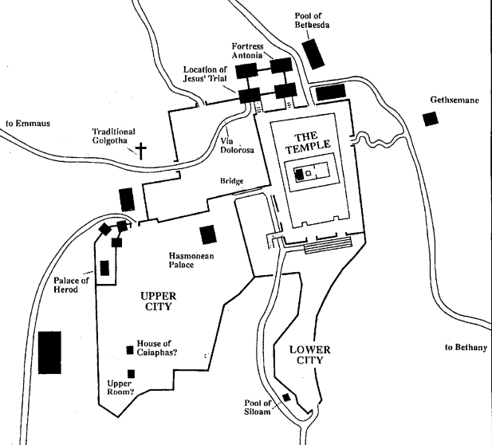
“Arise, let us go from here”
Notes:
Arise and let us go hence ... Some believe that Jesus and his disciples immediately
rose up and left the scene of the last supper; but Hendriksen believed it likely that the
next three chapters, which might easily have been spoken in ten or fifteen minutes,
were uttered while they were standing and prior to leaving. As he stated it:
This context implies there are still some things Jesus wished to say to his disciples
(John 14:30) ... How often it happens even among us Westerners that between
exhortation, "Now, let us be going," and the actual departure there is a period of ten
minutes? ... Speaking calmly and deliberately, with no attempt to rush himself, Jesus
might have uttered the contents of John 15 through John 17 within a period of TEN
MINUTES. When a company has been together several hours, what are ten minutes? ...
Accordingly, we shall proceed upon the assumption that the contents of John 14-17
comprise a unit, and that all of this was spoken that night in the upper room.[

Slide 9
Vine and the branches
John 15:1-8
“I am the true vine”
  Another of the “I AM” passages in John
A relationship representation
  Jesus is the vine
  The disciples are the branches
  The Father is the landowner/husbandman
"I am the bread of life" (6:35, 48, 51).
"I am the light of the world (8:12, cf. 9:5).
"I am the gate for the sheep" (10:7, 9).
"I am the good shepherd" (10:11, 14).
"I am the resurrection and the life" (11:25).
"I am the way, the truth, and the life" (14:6).
"I am the vine" (15:1, 5)

Slide 10
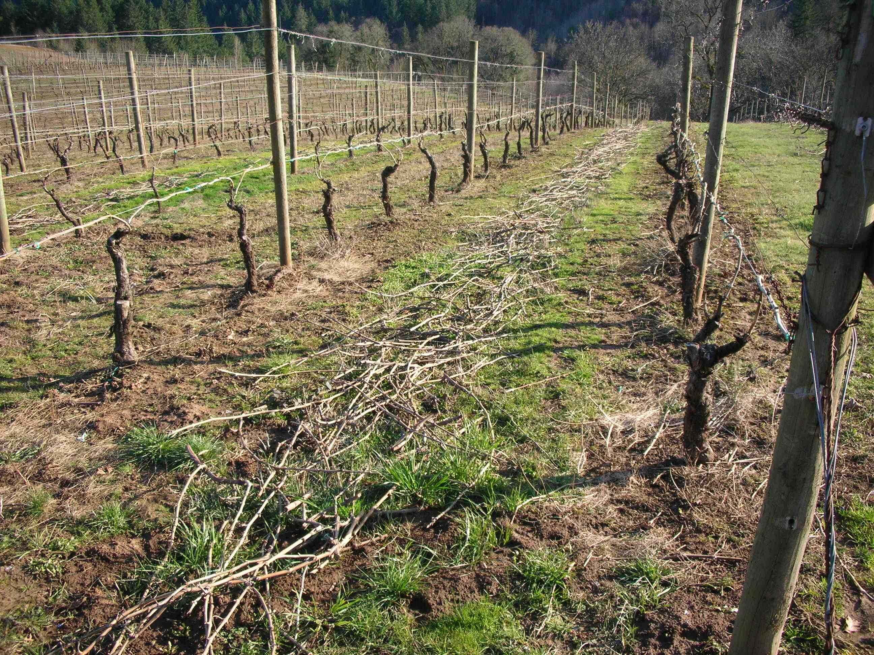
Vine and the branches
Each branch is expected to bear fruit
If not, the branch is cut off and burned
Branches that bear fruit are pruned to bear more fruit
These facts are based on the proper care of a grape vine and how it is pruned for fruit production

Slide 11
Vine and the branches
A branch must abide in the vine to produce fruit
It is a two-way process
  Abide in Me and I in you (vs 4-5)
Branch it to bear “much” fruit
Otherwise, will be cut off and cast into fire
Without the vine the branches cannot do anything
Notes:
Joh 15:4 "Abide in Me, and I in you. As the branch cannot bear fruit of itself, unless it abides in the vine, neither can you, unless you abide in Me.
5 "I am the vine, you are the branches. He who abides in Me, and I in him, bears much fruit; for without Me you can do nothing.
Joh 14:20 "At that day you will know that I am in My Father, and you in Me, and I in you.
21 "He who has My commandments and keeps them, it is he who loves Me. And he who loves Me will be loved by My Father, and I will love him and manifest Myself to him."

Slide 12
Vine and the branches
A branch can be in Christ and bearing fruit then stop producing fruit and be cut off and burned
A Christian can be ‘in Christ’ and bearing fruit then turn away, be cutoff and burned
A Christian can “fall from grace”
  Denied by many today
  Refutes “once saved, always saved”
Notes:
Coffman—
Salvation for every man ever born turns
upon just two questions: (1) is he "in Christ"? and (2) does he remain "in Christ"? Given
an affirmative answer to those two key questions, a man's salvation is absolutely
secure. There is no way to be lost if one, "being in Christ." remains "in him" until
probation is ended. "Blessed are the dead who die in the Lord" (Revelation 14:13).
Gal 5:4 …you have fallen from grace
Heb 12:14-15 be careful that you don’t fall short of the grace of God
1 Cor 5:5-7 purge out the one guilty of sexual immorality

Slide 13
Vine and the branches
IF,
  You abide in Me
  My words abide in you
  THEN, ask what you desire, it will be done
  (conditions and limits are explained in other passages)
Bearing much fruit glorifies the Father
  Matthew 5:16
Notes:
The promise (v 7) “ask what you desire, and it shall be done for you” is conditioned by the ‘if’ phrase “If you abide in Me, and My words abide in you.” This is not an open promise to ask and expect to receive just anything and everything.
Jas 4:3 You ask and do not receive, because you ask amiss, that you may spend it on your pleasures. ///
1 Jo 3:22 And whatever we ask we receive from Him, because we keep His commandments and do those things that are pleasing in His sight. ///
1 Jo 5:14 Now this is the confidence that we have in Him, that if we ask anything according to His will, He hears us.
The disciple will be sure to bear much fruit so the Father will be glorified (v 8). Nothing gives glory to God the Father more than fruitful service. And nothing gives more abiding satisfaction to the child of God, as with Jesus before Him, than to see God glorified. (Truth)
Mt 5:16 "Let your light so shine before men, that they may see your good works and glorify your Father in heaven.

Slide 14
Love as the Father
John 15:9
Christ compares His love for the disciples to the love the Father has for Him
Again, the true way to express love for Jesus is to keep His commandments
  Just as He kept the Father’s commandments
Notes:
Jesus assures His disciples of His love for them (v 9) by comparing it to the love His Father has for Him. He requires more than words for the disciple to show his love for Jesus. “If you keep My commandments” is the true indication of the disciple’s love for Jesus. He sets a strong comparison in stating He abides in His Father’s love by keeping the Father’s commandments, thus the disciple is to keep Jesus’ commandments to abide in His love.
1 Jo 5:3 For this is the love of God, that we keep His commandments
Joh 14:15 "If you love Me, keep My commandments.
Joh 14:23 Jesus answered and said to him, "If anyone loves Me, he will keep My word

Slide 15
Love one another
John 15:10-12
Jesus is about to give His very life for His disciples
  Actually, for the world
This illustrates the supreme limit He was willing to endure to show His love for His friends
  His disciples
His command is that the disciples love one another sufficiently to do the same for each other
Notes:
By these words (this discourse) Jesus is telling them where He is going and why it must be so. He is preparing them for the coming of the Spirit and the effect it will have on them. Remaining in Him and in His love and having love one for another would fill their joy (1 Jn 3:16-18). He was about to demonstrate the greatest love possible by giving His own (sinless) life for His disciples (Jn 13:34).

Slide 16
Friends
John 15:13-15
Jesus calls the disciples His friends; not servants
  IF you do what I command you
A friend is much more special than a servant
A friend knows the plans of the Master
Jesus has revealed His plans to them
The plans came from His Father
Notes:
Another ‘if’ clause in vs 14—“if you do whatever I command you.” Jesus is the Master and can expect His servants to obey without question. Now He calls them “My friends” if they choose to do His commands. As friends, he would hold them closer than just servants. He would share with them all things told Him by the Father thereby building their faith (Rom 10:17; Eph 3:3-5; Rom 16:25-26).

Slide 17
Chosen and appointed
John 15:16-17
Who is the ‘you’ in vs 16?
A call to apostleship
  “one sent on a mission: such as one of an authoritative New Testament group sent out to preach the gospel and made up especially of Christ’s twelve original disciples and Paul”
Jesus repeats the command to love one another (v 17)
Notes:
As stated earlier, we must determine which passages in this discourse apply to the apostles’ hearing Jesus speak and which do/can apply to all disciples. V 16 is one of these verses. /// Jesus is speaking directly to the eleven. He had chosen them (Lk 6:12-16) and appointed them to the special role as His apostles. (This passage is not teaching the Calvinist doctrine of ‘unconditional election.’) All Christians are called by the gospel (2 Thess 2:13-14), but not in the way Jesus chose these men.
2 Th 2:13 But we are bound to give thanks to God always for you, brethren beloved by the Lord, because God from the beginning chose you for salvation through sanctification by the Spirit and belief in the truth,
14 to which He called you by our gospel, for the obtaining of the glory of our Lord Jesus Christ.

Slide 18
Hated by the world
John 15:18-19
Jesus was hated first
Disciples are to be different from the world
The world loves its ‘own type’
Since they are different, they would be hated
Disciples must make a choice to keep Jesus’ commandments and be different from the world
Notes:
Jesus’ disciples are to be different from the world (1 Jn 2:15-17 Do not love the world; 2 Cor 6:17 Come out from among them and be separate). Jesus set an example for His followers. His disciples can expect persecution (Mt 5:10-12 men will revile and persecute you). He said, “I chose you out of the world,” and His disciples make a choice to live differently from the world and suffer the consequences.

Slide 19
Persecuted
John 15:20-21
If the Master is persecuted, then so will be the follower
Those willing to hear Jesus’ word would hear the apostles also
The world would not hear Jesus (or the ones He sent) because they did not know the Father
Notes:
Jesus expected His disciples would receive the same treatment He received (Lk 6:40). He is preparing them for what to expect as they begin preaching His gospel to the world (Acts 5:17-18 put in prison for preaching Jesus; 7:54-60 Stephen is stoned to death).
Jews would resent the name “Christ” by which the Christians identified Jesus as the Messiah. The Romans on the other hand would resent the exclusive claim that He was “Lord,” a title by which the Emperor was known. But besides these “names” by which He was called by them, there is their belief that He is divine. He wears the divine name, “God” (Isa. 9:6) Phil. 2:6-7, 9 “. . . who existing in the form of God, counted not the being on an equality with God a thing to be grasped, but emptied Himself . . . wherefore also God highly exalted him, and gave unto Him the name which is above every name.” (Truth) They would be persecuted because they wore the name of Christ.
Coffman—
All these things ... are the hatred, disobedience, mockery, persecution, lying trials, scourging, and death itself, etc., which marked the treatment of Christ by the world; and Jesus' promise here is that nothing will be left out in the world's similar treatment of the apostles. The holy Saviour was the object of Satan's unrelenting scorn, hatred, and opposition; and the apostles who would bear his name before kings, Gentiles, and the children of Israel would incur the full measure of satanic opposition. That Satan is actually the author of all such opposition is implicit in the fact that long after that generation had descended into the grave, the same bitterness and hatred continued against the truth, only with a new set of human opponents in each succeeding generation. Only Satan could continue unabated the organization, marshaling, and deployment of his devices in one unending campaign throughout all history, with a hundred generations in turn playing out the same role of hating the Saviour of the world, telling the same lies, sneering the same sneers, sinning the same sins, repeating the same mockeries, and shutting their eyes to the same truths - just like always! In nearly two millennia NOT ONE NEW THING has been alleged by the devil and his servants against the Christ of glory. The war has already been won, but so many do not know it.

Slide 20
Hated by the world
John 15:22-25
Jesus is speaking of being hated by the world
If He had not come, they would not have been guilty of the sin related to His death
He performed miracles to show who He was
  But they rejected Him
Notes:
The works (miracles) (v 24) Jesus did among His people, the Jews, gave them an opportunity to know Him as the Messiah. They rejected Him and thereby rejected the Father. He is not speaking (v 22) of sinning in general (Rom 3:23). Jesus gave them a way (“I am the way”) to have forgiveness of their sins. The Jewish leaders chose to reject His offer even to the extent of enough hate to kill Him (Jn 5:16-18 the Jews wanted to kill Him for {according to them} breaking the Sabbath; 7:1).
V 25 is a quotation from Psalm 35:19 or Psalm 69:4, and Jesus speaks of it as part of the “law” (Law of Moses). Jesus put the Psalms into the Law. It is referenced this way at times and at other times the Psalms are mentioned separate from the Law.

Slide 21
Hated by the world
John 15:22-25
They hate Him and therefore, they hate the Father
They are too blind to see the Father in Him
They had no just cause to hate Him
Notes:
The works (miracles) (v 24) Jesus did among His people, the Jews, gave them an opportunity to know Him as the Messiah. They rejected Him and thereby rejected the Father. He is not speaking (v 22) of sinning in general (Rom 3:23). Jesus gave them a way (“I am the way”) to have forgiveness of their sins. The Jewish leaders chose to reject His offer even to the extent of enough hate to kill Him (Jn 5:16-18 the Jews wanted to kill Him for {according to them} breaking the Sabbath; 7:1).
V 25 is a quotation from Psalm 35:19 or Psalm 69:4, and Jesus speaks of it as part of the “law” (Law of Moses). Jesus put the Psalms into the Law. It is referenced this way at times and at other times the Psalms are mentioned separate from the Law.

Slide 22
Bearing witness
John 15:26-27
Jesus would send the Helper (Spirit of truth) from the Father
  Notice three separate persons
The Spirit would testify of Jesus
The apostles would testify of Jesus
  They were witnesses from the beginning
  Requirement for apostleship
  (Acts 1:21-22)
  Not true of every believer
Notes:
Though the world may hate these apostles, the Helper/Comforter will be with them to testify of Jesus (v 26). The apostles had been with Jesus from the beginning of His earthly ministry and would testify of Him (even more after seeing Him following His resurrection).
The Spirit is to bear witness because He “proceeds from the Father.” However, the apostles are to offer their testimony “because you have been with Me from the beginning.” They were to fulfill the role of “eyewitnesses and ministers of the word” (Luke 1:2), because of their unique perspective in having accompanied the Lord throughout his earthly ministry (Acts 1:21). (Truth)

Slide 23
Short lessons
We must be “in Christ” and we must abide (continue to be “in Christ”). Abide—to remain stable or fixed; to continue in place. So, we are to be fixed in Christ.
We must bear fruit, or we will be cut off. While bearing fruit we will be pruned. Pruning allows for new growth and also prevents undesired infestations (think various sins and false doctrines).

Slide 24
Short lessons
Our Father is glorified when we bear much fruit.
We are cleaned by following the words of Jesus.
We must keep Jesus’ commandments to abide in His love.
We are to love one another.
We will be hated (and persecuted) by the world because we love Jesus.
Notes:
Some short one sentence lessons for us—
We must be “in Christ” and we must abide (continue to be “in Christ”). Abide—to remain stable or fixed; to continue in place. So, we are to be fixed in Christ.
We must bear fruit, or we will be cut off. While bearing fruit we will be pruned. Pruning allows for new growth and also prevents undesired infestations (think various sins and false doctrines).
Our Father is glorified when we bear much fruit.
We are cleaned by following the words of Jesus.
We must keep Jesus’ commandments to abide in His love.
We are to love one another.
We will be hated (and persecuted) by the world because we love Jesus.
We cannot be apostles (special ambassadors) because we have not been with Christ from the beginning of His ministry.

Slide 25
The Gospel of
John
SUNDAY MORNING – JOHN 16

Slide 26
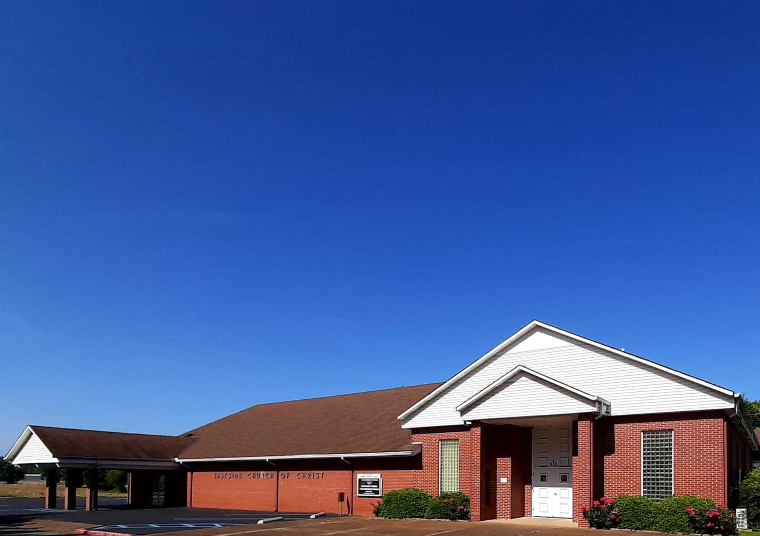
Eastside Church of Christ
Eastside-church.org

Slide 27
…

