Slide 1

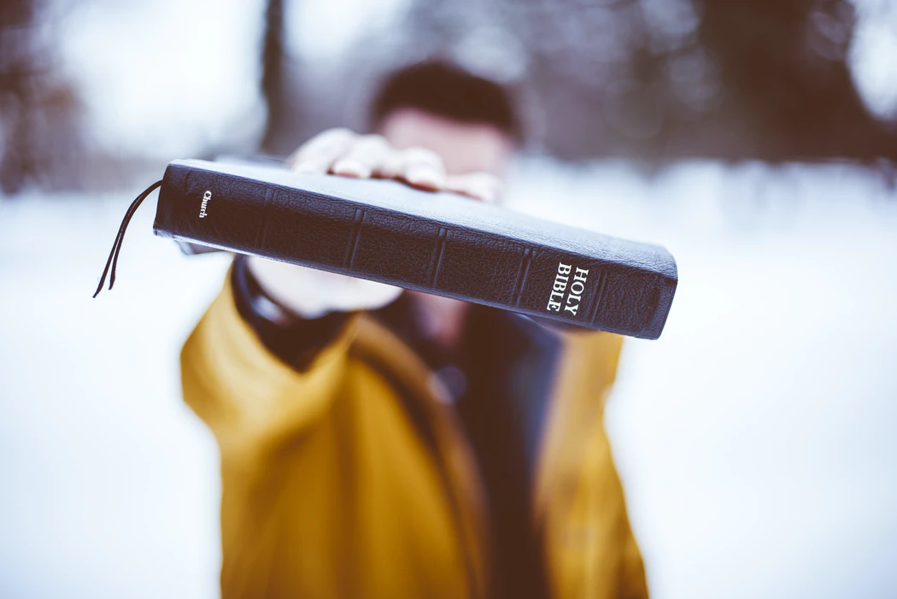
A Study of
Second Peter and Jude
Growing and Guarding our Like Precious Faith
“Contend Earnestly for the Faith”
Jude 3
Notes:
Make your calling and election sure!

Slide 2
2 Peter 3:10-13
God’s Promise of Judgment is Sure
Since judgment is coming, we must be holy!
  We “ought” to be the “manner of persons” who are holy and godly in conduct.
    Heaven’s citizens anticipate with longing the coming of the day of the Lord, looking forward to the new heavens and a new earth (Phil. 3:20).
    The new heavens and earth are the new eternal abode or dwelling for the righteous! (Revelation 21:1, 5, 27)
Notes:
One of the more literal definitions of the phrase “what manner” is “from what country” The word is ποταπός which Thayer Defines as 1) from what country, nation or tribe 2) of what sort or quality (what manner of)
Philippians 3:20 For our citizenship is in heaven, from which we also eagerly wait for the Savior, the Lord Jesus Christ,
New is καινός Thayer Definition: 1) new as respects form recently made, fresh, recent, unused, unworn
1b) as respects substance of a new kind, unprecedented, novel, uncommon, unheard of

Slide 3
2 Peter 3:14-18
Looking Forward to These Things
Be diligent to “be found by Him in peace, without spot and blameless” (cf. Phil. 2:15).
Understand that the purpose of God’s longsuffering is salvation.
  Don’t twist Paul’s writings or other Scriptures to justify procrastination or any error (cf. Rom. 2:4-5).
“Beware” of falling “from your own steadfastness” by being “led” into the error of the wicked (1:10, 12; 2:1).
GROW in the grace and knowledge of Jesus!
To Him be the glory forever.*
Notes:
Romans 2:4-5 Or do you despise the riches of His goodness, forbearance, and longsuffering, not knowing that the goodness of God leads you to repentance? (5) But in accordance with your hardness and your impenitent heart you are treasuring up for yourself wrath in the day of wrath and revelation of the righteous judgment of God,
“forever” is Literally “The day of eternity”

Slide 4
The Epistle of Jude
Introduction and Overview
Authorship
The author is “Jude, a bondservant of Jesus Christ, and brother of James”
  Jude the apostle OR Jude the brother of Jesus* could fit this description (Matt. 13:55; Luke 6:16; Acts 1:13)
  Jude 17-18 appears to rule out Jude the apostle.
Date
Probably written AFTER Second Peter.
  2nd Peter warns of false teachers in the future tense (2:1-3, 3:3), but Jude says they’ve arrived (4, 12).
  Many conservative scholars believe that Jude was written between 70-90 AD.*
Notes:
Matthew 13:55 Is this not the carpenter's son? Is not His mother called Mary? And His brothers James, Joses, Simon, and Judas?
Luke 6:16 Judas the son of James, and Judas Iscariot who also became a traitor.
Acts 1:13 (in the list of the names of the 11 apostles) Judas the son of James. (both Luke and Acts are translated “brother of” in the KJV)
Paul indicates that Jesus’ brothers were supported (along with their families) in the preaching of the gospel. 1 Corinthians 9:5 Do we have no right to take along a believing wife, as do also the other apostles, the brothers of the Lord, and Cephas?
Eusebius of Caesarea records that “during the reign of Domitian, the grandchildren of the Lord’s brother Jude were interrogated before the emperor and their property was seized. (Kyle Pope, cf. Ecclesiastical History, 3.20.1-11).
Clement of Alexandria (c. 150–215 AD) wrote in his work "Comments on the Epistle of Jude" that Jude, the Epistle of Jude's author, was a son of Joseph and a brother of Jesus (without specifying whether he was a son of Joseph by a previous marriage or of Joseph and Mary)
NOTE: "More remarkable is the evidence that by the end of the second century Jude was widely accepted as canonical."[Bauckham]. Clement of Alexandria, Tertullian, and the Muratorian canon considered the letter canonical.
* Wikipedia. Clinton Hamilton says the same and lists Moorehead, Zahn, Lumby, Salmon, Sieffert, Chase, Green, Reicke, and Thiessen.

Slide 5
The Epistle of Jude
Introduction and Overview
Theme: “Contend earnestly for the faith which was once for all delivered to the saints.”
The threat to the faith is that “certain ungodly men have crept in unnoticed” and imperil us.
  Much like 2nd Peter, Jude warns of false teachers and promises their destruction.
  And like Peter, Jude tells his readers to guard their faith and themselves by remembering things they already know (Jude 5, 17).

Slide 6
The Epistle of Jude
Contend Earnestly for the Faith!
The Reason we must contend : “Ungodly men have crept in”
  Their Destruction is Certain (5-7)
  They Disrespect Authority (8-10)
  Their Direction follows Cain , Balaam, and Korah (11)
  Their Depravity (12-13)
  Their Destiny is Determined (14-15)
  They Deceive with Flattery (16)
The Way we must contend: Remember, Renovate, Rescue!
  Remember the words of the apostles (17-19)
  Renovate & preserve ourselves spiritually (20-21)
  Rescue the perishing (22-23)

Slide 7
The Epistle of Jude
Contend Earnestly for the Faith!
Salutation (vs. 1-2)
To those who are called, sanctified by God the Father, and preserved in Jesus Christ.
Mercy, peace, and love be multiplied to you.
Purpose (v. 3)
Jude’s effort to write “concerning our common salvation” was necessarily focused on encouraging his readers to “contend earnestly for the faith” (cf. 2 Peter 1:1).
The faith was “once for all delivered to the saints”
  There would be no future alterations to “the faith.”
Notes:
“Picked, pickled and preserved!”
V3 – While, “when I gave” KJV, “While I was giving” (RV, ASV), “While I was making” (NASB), NOT “although” (ESV, NIV) – there is no “although” or “but” in the original.
Jude may mean that he intended to write about one thing, but found it necessary to write about another, but it is just as likely that he means that while intending to write about one thing, he found it necessary to write about it in this particular way or with this particular focus.
Does “I found it necessary” imply that the Holy Spirit informed Him it was necessary?
“Contend” is from

Slide 8
The Epistle of Jude
Contend Earnestly for the Faith!
Contending for the Faith
Jude focuses on guarding against false teachers by remembering the apostles’ words and thus “building yourselves up on your most holy faith” (17, 20).
As expressed elsewhere in the New Testament:
Watch and stand firm in the faith (I Cor. 16:13).
Walk worthy of the gospel and stand firm/strive in one spirit and one mind for the faith (Philippians 1:27).
Examine ourselves to see if you are in the faith (2 Corinthians 13:5).
Continue in the faith, firmly, rooted and established in what you’ve been taught (Colossians 1:23; 2:7).
Notes:
1 Corinthians 16:13 Watch, stand fast in the faith, be brave, be strong.
Philippians 1:27 Only let your conduct be worthy of the gospel of Christ, so that whether I come and see you or am absent, I may hear of your affairs, that you stand fast in one spirit, with one mind striving together for the faith of the gospel,
2 Corinthians 13:5 Examine yourselves as to whether you are in the faith. Test yourselves. Do you not know yourselves, that Jesus Christ is in you?—unless indeed you are disqualified.
Colossians 1:23 if indeed you continue in the faith, grounded and steadfast, and are not moved away from the hope of the gospel which you heard, which was preached to every creature under heaven, of which I, Paul, became a minister.

Slide 9
The Epistle of Jude
Contend Earnestly for the Faith!
False Teachers – the reason we must contend
Certain men crept in unnoticed (2 Peter 2:1; Gal. 2:4).
They were marked out for destruction long ago.
They turn the grace of God into lewdness (2 Peter 2:18-19; Romans 6:1)
They “deny the only Lord God and our Lord Jesus Christ.”
  They may profess to know God, but the Lordship of the Father and the Son are rejected (Titus 1:16; Luke 6:46)
Notes:
2 Peter 2:1 But there were also false prophets among the people, even as there will be false teachers among you, who will secretly bring in destructive heresies, even denying the Lord who bought them, and bring on themselves swift destruction.
Galatians 2:4 And this occurred because of false brethren secretly brought in (who came in by stealth to spy out our liberty which we have in Christ Jesus, that they might bring us into bondage),
Romans 6:1 What shall we say then? Shall we continue in sin that grace may abound?
Titus 1:16 They profess to know God, but in works they deny Him, being abominable, disobedient, and disqualified for every good work.
Luke 6:46 "But why do you call Me 'Lord, Lord,' and not do the things which I say?

