Slide 1
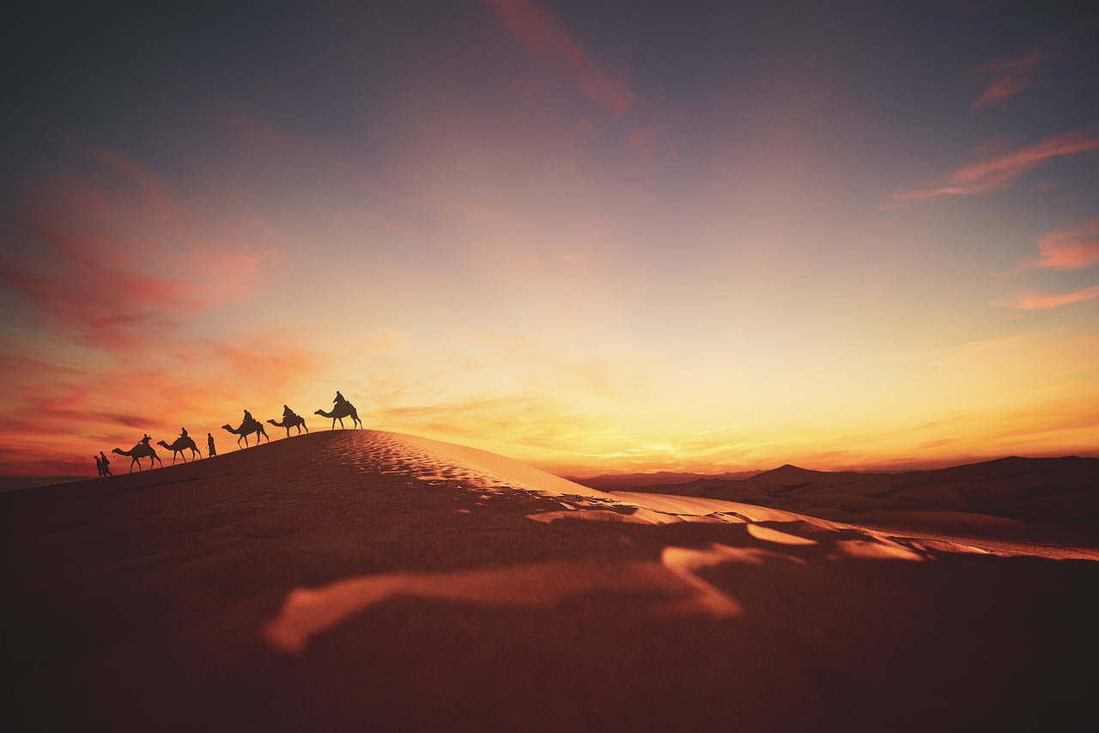
The Epistle of FIRST PETER
Guidance for the Pilgrim

Slide 2
The Epistle of FIRST PETER
Guidance for the Pilgrim
1 Peter 1:13 – 2:12
Sanctification Enables the Pilgrim’s Progress
Notes:
The pilgrim is not conformed to this world. He maintains a certain detachment, not a lack of compassion for those in those world. But his passion for the world to come does not allow for attachment to the things that are here. 1 Peter 2:11 Beloved, I beg you as sojourners and pilgrims, abstain from fleshly lusts which war against the soul,

Slide 3
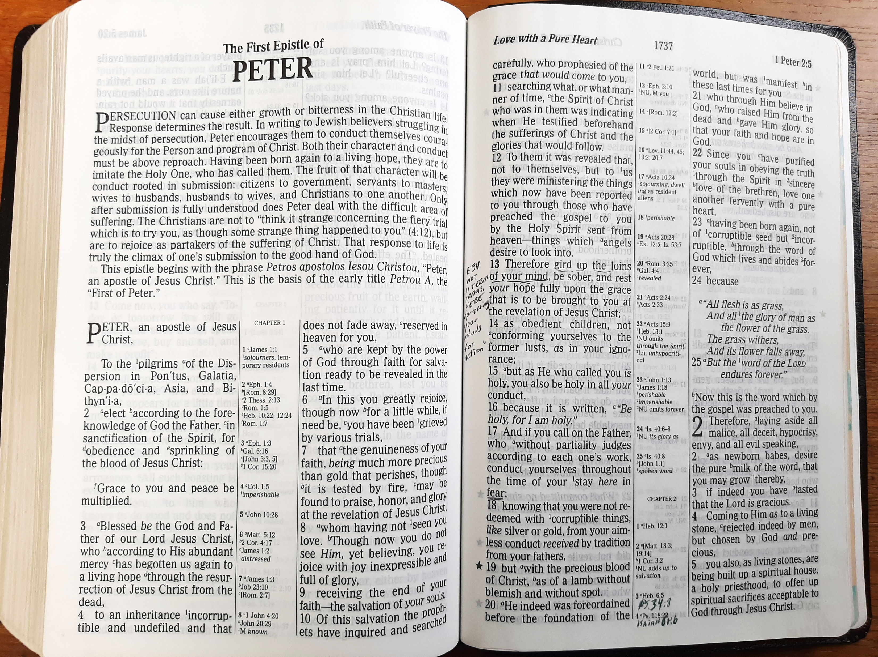
Our Salvation Demands Our Holiness (1 Peter 1:13-16)
Since we have such a wondrous salvation, the pilgrim must “therefore” get his mind right!
Gird up the loins of our mind
Be sober
Rest our hope fully on the coming of Christ
We do these things as “obedient children.”
Not conforming to our old ignorant desires
But emulating the holiness of our Father (Ephesians 5:1)
Notes:
Ephesians 5:1 Therefore be imitators of God as dear children.

Slide 4
The Precious Price of the Pilgrim’s Salvation (1 Peter 1:17-21)
If we “call on the Father” we should pass the time of our sojourn in fear!
For this life is a journey to an impartial judgment (Heb. 9:27; Eccl. 12:13-14)
We have been redeemed at an immense cost
Jesus’ life paid the ransom (Mark 10:45)
The price of our redemption carries important implications and expectations for our CONDUCT! (1:15, 17, 18, Titus 2:14)
Notes:
Ecclesiastes 12:13-14 Let us hear the conclusion of the whole matter: Fear God and keep His commandments, For this is man's all. (14) For God will bring every work into judgment, Including every secret thing, Whether good or evil.
Titus 2:14 who gave Himself for us, that He might redeem us from every lawless deed and purify for Himself His own special people, zealous for good works.
The word translated redeemed (λυτρόω) means “to be liberated by the payment of a ransom.” (the noun “Lutron” is found Mark 10:45 For even the Son of Man did not come to be served, but to serve, and to give His life a ransom for many.“)
Titus 2:14 who gave Himself for us, that He might redeem us from every lawless deed and purify for Himself His own special people, zealous for good works.

Slide 5
The Precious Price of the Pilgrim’s Salvation (1 Peter 1:17-21)
The Father had determined to pay our ransom before the foundation of the world (1:20; Revelation 13:8).
It was done “for you!”
The ransom God paid and the resurrection He empowered compel us to place all of our hope and faith in God! (1:21)
Notes:
Revelation 13:8 All who dwell on the earth will worship him, whose names have not been written in the Book of Life of the Lamb slain from the foundation of the world.

Slide 6
God’s Word: Salvation’s Incorruptible Seed (1 Peter 1:22-25)
We have been purified by obeying the truth.
From our purified hearts comes love for one another that is pure, fervent, and unfeigned (1:22; Rom.12:9)
We have been born again by the germination of the incorruptible seed of God’s word (1:23; Luke 8:11)
Since the word endures forever, those who have been begotten by it endure forever as well.
Notes:
PURIFIED is from hagnizō “to make clean, that is, (figuratively) sanctify (ceremonially or morally): - purity (self)” [Strong’s]
Rom 12:9 Let love be without hypocrisy.

Slide 7
God’s Word Sustains our Sanctification (1 Peter 2:1-3)
“Therefore” we must lay aside those things that would hinder God’s word in us.
All malice = wickedness or evil (James 1:21)
All deceit (2 Corinthians 4:2-4)
Hypocrisy
Envy (Acts 13:45)
All evil speaking
Notes:
James 1:21 Therefore lay aside all filthiness and overflow of wickedness, and receive with meekness the implanted word, which is able to save your souls.
2 Corinthians 4:2-4 But we have renounced the hidden things of shame, not walking in craftiness nor handling the word of God deceitfully, but by manifestation of the truth commending ourselves to every man's conscience in the sight of God. (3) But even if our gospel is veiled, it is veiled to those who are perishing, (4) whose minds the god of this age has blinded, who do not believe, lest the light of the gospel of the glory of Christ, who is the image of God, should shine on them.
Acts 13:45 But when the Jews saw the multitudes, they were filled with envy; and contradicting and blaspheming, they opposed the things spoken by Paul.

Slide 8
God’s Word Sustains our Sanctification (1 Peter 2:1-3)
Like newborn babes we must…
Desire
Our craving is initiated by “tasting” (2:3; cf. Job 23:12)
The “pure milk” of the word (Psalm 119:40)
“Pure” refers to “unadulterated” and “genuine” (Barnes)
That we may GROW! The nutrition of God’s word causes growth in babes and sustains the mature (Matthew 4:4)
“Up to salvation” {NKJV margin} (Eph. 4:15)
Notes:
DESIRE: From epipotheo, to “intensely crave” (Strong’s Dictionary)
Psalms 119:40 Behold, I long for Your precepts; Revive me in Your righteousness.
Job 23:12 I have not departed from the commandment of His lips; I have treasured the words of His mouth More than my necessary food.
Ephesians 4:15 but, speaking the truth in love, may grow up in all things into Him who is the head—Christ—

Slide 9
God’s Son: The Cornerstone of our Sanctification (1 Peter 2:4-8)
We rest on a foundation stone Who is…
Living
Chosen by God and Precious to Him
Precious to believers
Because it is the foundation of our salvation (Acts 4:11-12; Ps. 118:21-23)
Rejected by disobedient men (Matthew 21:42-44; Isaiah 8:14-15)
Those who reject the Chief Cornerstone are those who disobey the word. But that same word has given new life and a desire for more to every pilgrim! (1:23—2:3)
Notes:
Acts 4:11-12 This Jesus is the stone that was rejected by you, the builders, which has become the cornerstone. (12) And there is salvation in no one else, for there is no other name under heaven given among men by which we must be saved.”
Psalms 118:21-23 I thank you that you have answered me and have become my salvation. (22) The stone that the builders rejected has become the cornerstone. (23) This is the LORD's doing; it is marvelous in our eyes.
Matthew 21:42-44 Jesus said to them, “Have you never read in the Scriptures: “‘The stone that the builders rejected has become the cornerstone; this was the Lord's doing, and it is marvelous in our eyes’? (43) Therefore I tell you, the kingdom of God will be taken away from you and given to a people producing its fruits. (44) And the one who falls on this stone will be broken to pieces; and when it falls on anyone, it will crush him.”
Isaiah 8:14-15 And he will become a sanctuary and a stone of offense and a rock of stumbling to both houses of Israel, a trap and a snare to the inhabitants of Jerusalem. (15) And many shall stumble on it. They shall fall and be broken; they shall be snared and taken.”

Slide 10
God’s Son: The Cornerstone of our Sanctification (1 Peter 2:4-8)
We ourselves, like living stones are being built into…
A spiritual house
In which the Spirit of God dwells (Ephesians 2:19-21; 1 Cor. 3:16-17)
A holy priesthood
In order to offer spiritual sacrifices (Hebrews 13:15-16)
Notes:
Ephesians 2:19-21 Now, therefore, you are no longer strangers and foreigners, but fellow citizens with the saints and members of the household of God, (20) having been built on the foundation of the apostles and prophets, Jesus Christ Himself being the chief cornerstone, (21) in whom the whole building, being fitted together, grows into a holy temple in the Lord,
1 Corinthians 3:16-17 Do you not know that you are the temple of God and that the Spirit of God dwells in you? (17) If anyone defiles the temple of God, God will destroy him. For the temple of God is holy, which temple you are.
Hebrews 13:15-16 Therefore by Him let us continually offer the sacrifice of praise to God, that is, the fruit of our lips, giving thanks to His name. (16) But do not forget to do good and to share, for with such sacrifices God is well pleased.

Slide 11
Selection for Sanctification (1 Peter 2:9-12)
We are a generation chosen by God to be His own special or peculiar people -- a royal priesthood and a holy nation (2:9)
These descriptions affirm our status as spiritual Israel (Exodus 19:5-6)
Our selection for this special status was accomplished by the redemptive work of Christ (Rev. 1:5-6)
The reason we are chosen is to show forth the praises or excellence of God!
Notes:
The word translated “special” or “peculiar” occurs only here and in Titus 2:14 who gave Himself for us, that He might redeem us from every lawless deed and purify for Himself His own special people, zealous for good works.
Strong’s Dictionary defines it to mean, “being beyond usual, that is, special (one’s own)…”
Exodus 19:5-6 Now therefore, if you will indeed obey My voice and keep My covenant, then you shall be a special treasure to Me above all people; for all the earth is Mine. (6) And you shall be to Me a kingdom of priests and a holy nation.' These are the words which you shall speak to the children of Israel.“
Revelation 1:5-6 and from Jesus Christ, the faithful witness, the firstborn from the dead, and the ruler over the kings of the earth. To Him who loved us and washed us from our sins in His own blood, (6) and has made us kings and priests to His God and Father, to Him be glory and dominion forever and ever. Amen.

Slide 12
Selection for Sanctification (1 Peter 2:9-12)
Our selection for sanctification involves a drastic change of our status (2:9-11a)
From darkness to light
From not being a people, to becoming the people of God
From having not obtained mercy, to having obtained it.
From being at home in this world, to being pilgrims and sojourners whose citizenship is in heaven.

Slide 13
Selection for Sanctification (1 Peter 2:9-12)
Our special status compels special behavior on our joyous journey (2:11-12)
Abstaining from fleshly lusts which war against the soul (1 Peter 1:14; 4:2-3; Ephesians 4:22)
Having our conduct honorable among the Gentiles
To the end that our good works will cause them to “glorify God” (Matthew 5:16)
“In the day of visitation” refers to a time when God would bless men with the opportunity for salvation (Psalm 106:4; 8:4; Luke 7:16; 19:44; Jer. 29:10; 1 Samuel 2:21)
Notes:
Ephesians 4:22 that you put off, concerning your former conduct, the old man which grows corrupt according to the deceitful lusts,
Psalms 106:4 Remember me, O LORD, with the favor You have toward Your people. Oh, visit me with Your salvation,
Psalms 8:4 What is man that You are mindful of him, And the son of man that You visit him?
Jeremiah 29:10 For thus says the LORD: After seventy years are completed at Babylon, I will visit you and perform My good word toward you, and cause you to return to this place.
1 Samuel 2:21 And the LORD visited Hannah, so that she conceived and bore three sons and two daughters. Meanwhile the child Samuel grew before the LORD.
Luke 7:16 [After raising widow’s son] Then fear came upon all, and they glorified God, saying, "A great prophet has risen up among us"; and, "God has visited His people.“
Luke 19:44 [Jesus to Jerusalem] they will not leave in you one stone upon another, because you did not know the time of your visitation."

Slide 14
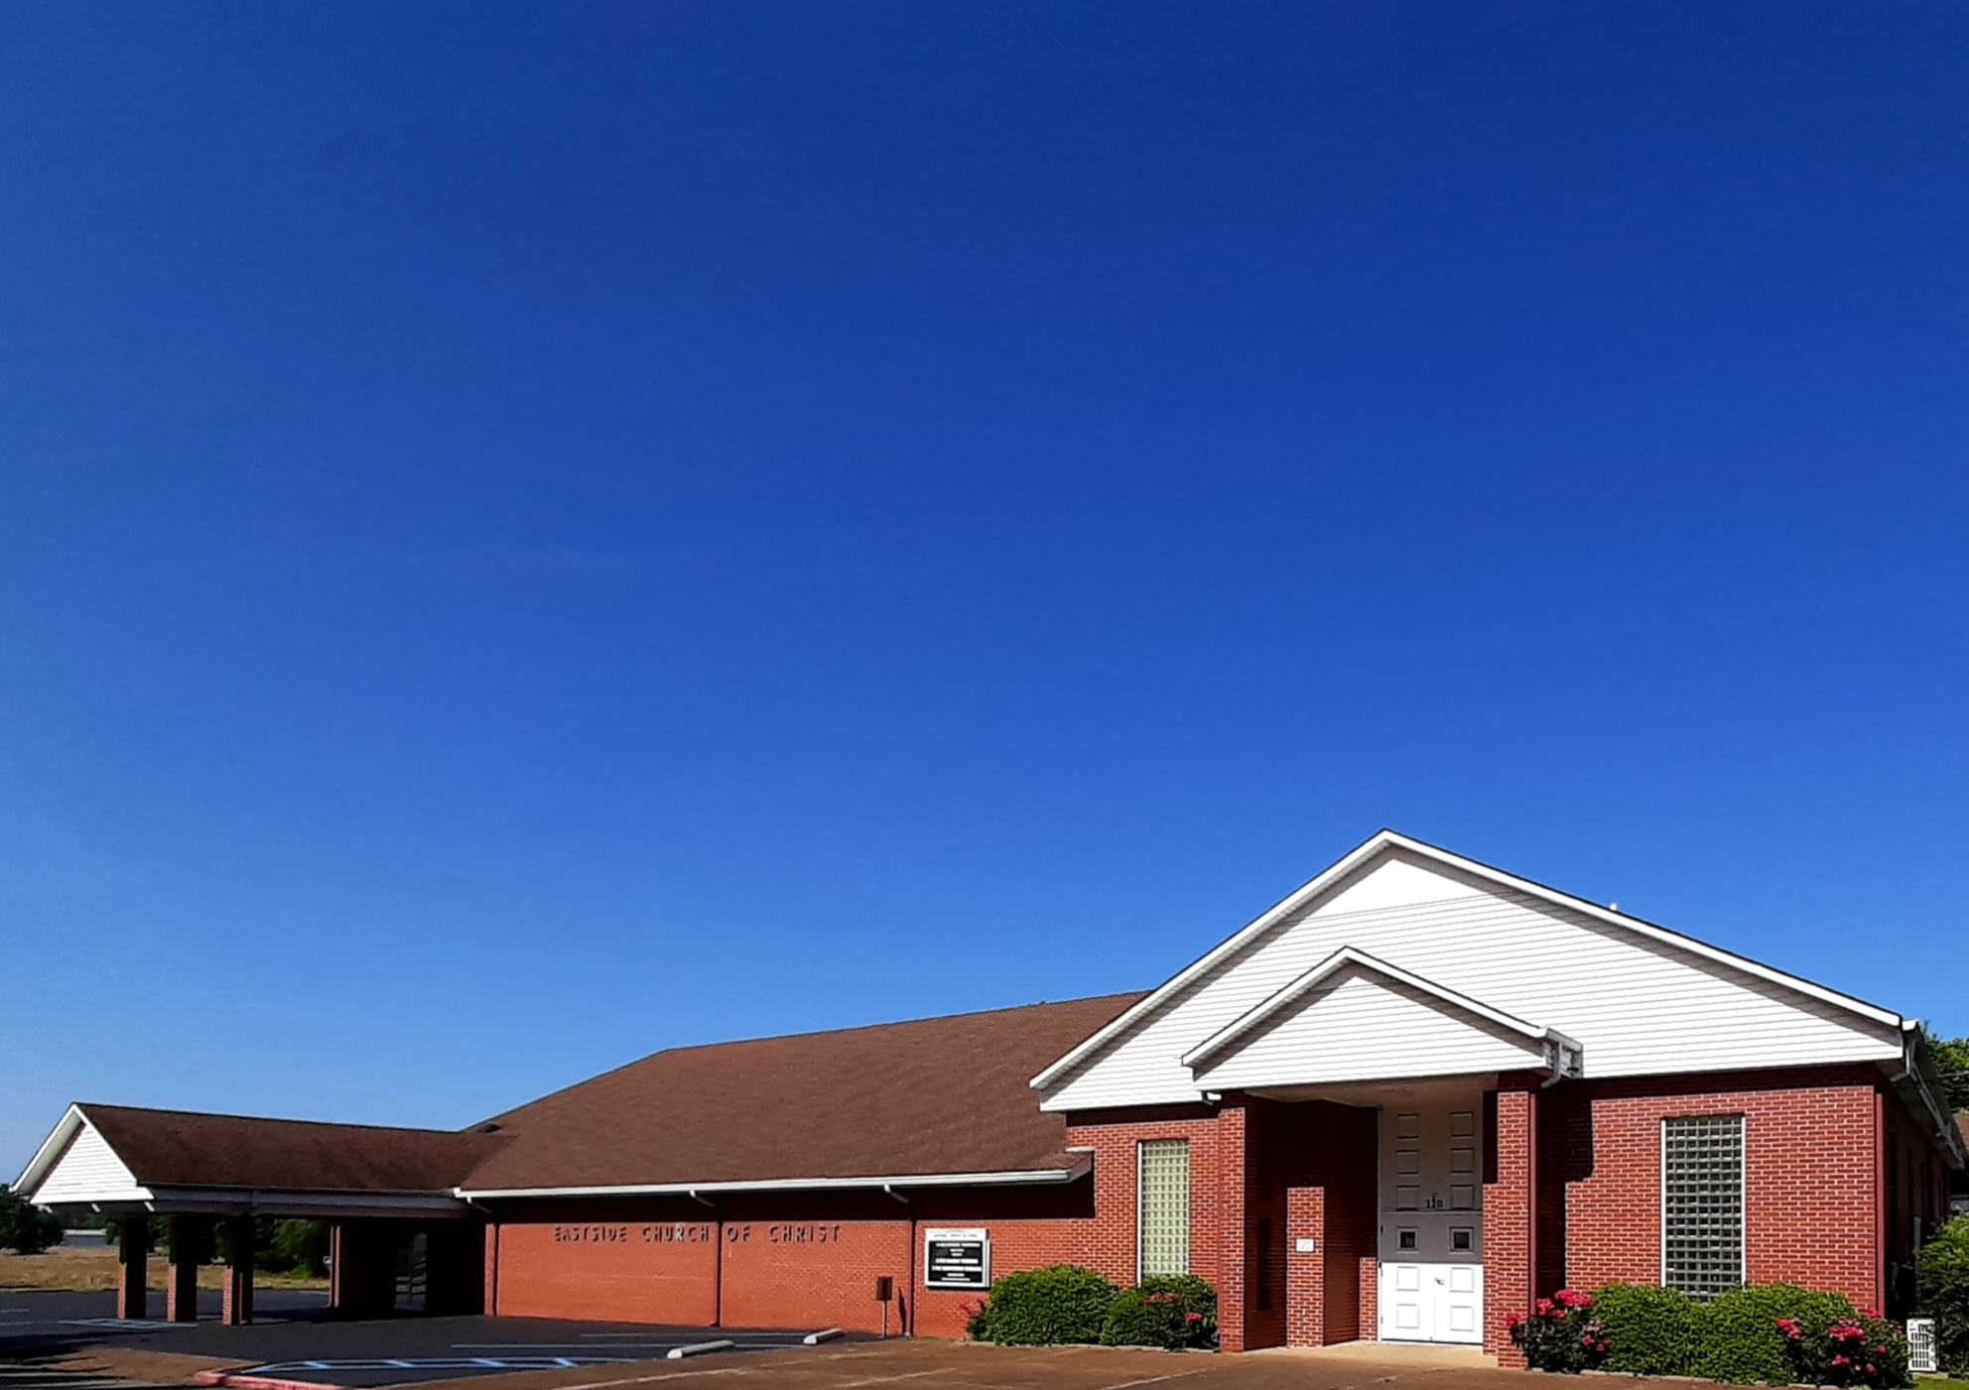
Eastside Church of Christ
Eastside-church.org

