Slide 1

The Epistle of FIRST PETER
Guidance for the Pilgrim

Slide 2
The Epistle of FIRST PETER
Guidance for the Pilgrim
1 Peter 1:2-12
The Pilgrim’s Hope of Salvation – Assurance and Motivation in Hard Times

Slide 3
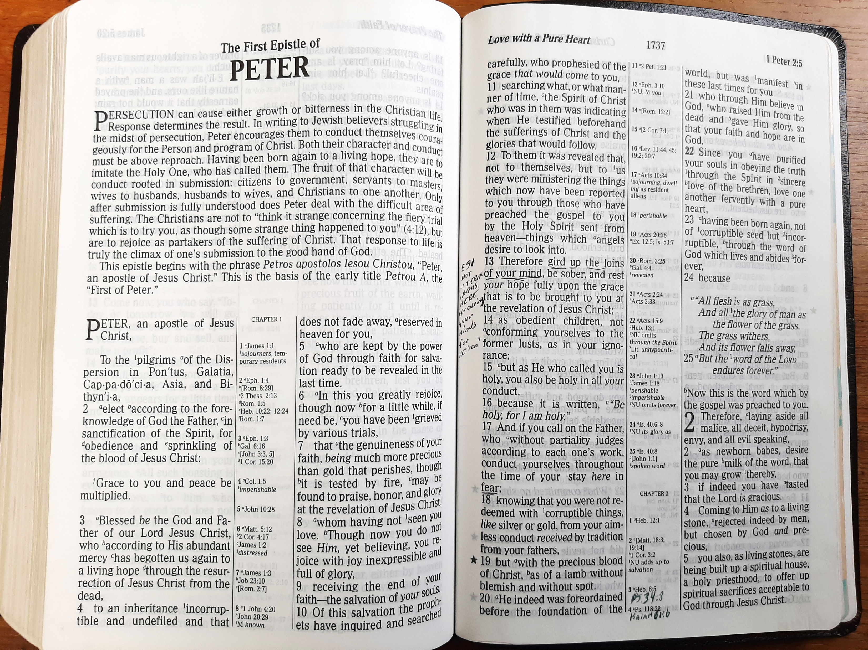
The Spiritual Position of Peter’s Pilgrims (1 Peter 1:2)
They are “elect according to the foreknowledge of God the Father…” (2 Thessalonians 2:13-14; Ephesians 1:4)
“For obedience and sprinkling of the blood of Jesus Christ.”
Their election is with a view to their response to the gospel!
Note that obedience and the application of the blood are joined together in this text!
The blood of Christ is applied to us in the obedience of baptism (Hebrews 9:18-23; 12:24; 1 Peter 1:22a; Rom. 6:3; Acts 22:16)
Notes:
2 Thessalonians 2:13-14 But we are bound to give thanks to God always for you, brethren beloved by the Lord, because God from the beginning chose you for salvation through sanctification by the Spirit and belief in the truth, (14) to which He called you by our gospel, for the obtaining of the glory of our Lord Jesus Christ.
Ephesians 1:4 just as He chose us in Him before the foundation of the world, that we should be holy and without blame before Him in love,
Romans 6:3 Or do you not know that as many of us as were baptized into Christ Jesus were baptized into His death?

Slide 4
Born Again to a Sure Salvation (1 Peter 1:3-5)
The Father is to be blessed – adored and praised (2 Cor. 1:3; Psalm 103:1-2).
His mercy is “abundant” (Eph. 2:4; Psalm 103:17; 118:1-4).
In accordance with His merciful nature, He has begotten us again.
He has given us a new life -- a second chance (John 3:3; 1 Peter 1:23; 2 Corinthians 5:17).
Our new life provides us “a living hope through the resurrection of Jesus Christ from the dead” (1 Cor. 15:12-19).
Notes:
2 Corinthians 1:3 Blessed be the God and Father of our Lord Jesus Christ, the Father of mercies and God of all comfort,
Psalms 103:1-2 A Psalm Of David. Bless the LORD, O my soul; And all that is within me, bless His holy name! (2) Bless the LORD, O my soul, And forget not all His benefits:
Ephesians 2:4 But God, who is rich in mercy, because of His great love with which He loved us,
Psalms 103:17 But the mercy of the LORD is from everlasting to everlasting On those who fear Him, And His righteousness to children's children,
Psalms 118:1 Oh, give thanks to the LORD, for He is good! For His mercy endures forever.
John 3:3 Jesus answered and said to him, "Most assuredly, I say to you, unless one is born again, he cannot see the kingdom of God.“
2 Corinthians 5:17 Therefore, if anyone is in Christ, he is a new creation; old things have passed away; behold, all things have become new.

Slide 5
Born Again to a Sure Salvation (1 Peter 1:3-5)
Our new birth entitles us to an inheritance! (Romans 8:17)
Our inheritance is described in verse 4 as…
Incorruptible: It will not decay (1 Cor. 9:25).
Undefiled: It is unsoiled.
Does not fade away: It retains its original beauty.
Reserved in heaven for you: It is carefully guarded and kept just for you (John 14:2; Colossians 1:5).
Notes:
Romans 8:17 and if children, then heirs—heirs of God and joint heirs with Christ, if indeed we suffer with Him, that we may also be glorified together.
1 Corinthians 9:25 And everyone who competes for the prize is temperate in all things. Now they do it to obtain a perishable crown, but we for an imperishable crown.
John 14:2 In My Father's house are many mansions; if it were not so, I would have told you. I go to prepare a place for you.
Colossians 1:5 because of the hope which is laid up for you in heaven, of which you heard before in the word of the truth of the gospel,

Slide 6
Born Again to a Sure Salvation (1 Peter 1:3-5)
We are safely kept for our final salvation by the power of God through faith! (1:5)
God’s power is unassailable. No one can take the saved out of His hand (John 10:28-29).
Yet we can “depart from the faith”, “cast off” the faith, or stray from the faith (1 Timothy 4:1; 5:12; 6:10; 2 Timothy 2:18).
Once a person is saved by the power of God, his salvation is as secure as his faith!
Notes:
John 10:28-29 And I give them eternal life, and they shall never perish; neither shall anyone snatch them out of My hand. (29) My Father, who has given them to Me, is greater than all; and no one is able to snatch them out of My Father's hand.
1 Timothy 4:1 Now the Spirit expressly says that in latter times some will depart from the faith, giving heed to deceiving spirits and doctrines of demons,
1 Timothy 5:12 having condemnation because they have cast off their first faith.
1 Timothy 6:10 For the love of money is a root of all kinds of evil, for which some have strayed from the faith in their greediness, and pierced themselves through with many sorrows.
2 Timothy 2:18 [Hymanaeus and Philetus] who have strayed concerning the truth, saying that the resurrection is already past; and they overthrow the faith of some.

Slide 7
Born Again to a Sure Salvation (1 Peter 1:3-5)
Our salvation is ready to be revealed in the last time.
Salvation is reserved in heaven! (cf. 1:4)
It is “ready” (“prepared” – John 14:2)
To be “revealed” or “uncovered” (Gr. apokalupto)
The revelation of our salvation coincides with the revelation or appearing of Jesus Christ (Gr. apokalupsis, 1 Peter 1:7, 13)
This event will occur in the “last time”
Not 70 A.D., but at the final increment of time!
This salvation is the goal of our faith! (1 Peter 1:9)

Slide 8
The Joy of Salvation Makes Trials Bearable (1 Peter 1:6-9)
We may rejoice in our salvation even while being grieved by various trials. (1:6, 8)
What are examples of different trials we face?
How long must we endure such trials?
How does the length of time we must endure afflictions compare to the duration of our salvation? (2 Corinthians 4:17)
How does the severity of our sufferings compare to the splendor of our salvation? (Romans 8:18)
Notes:
2 Corinthians 4:17 For our light affliction, which is but for a moment, is working for us a far more exceeding and eternal weight of glory,
Romans 8:18 For I consider that the sufferings of this present time are not worthy to be compared with the glory which shall be revealed in us.

Slide 9
The Joy of Salvation Makes Trials Bearable (1 Peter 1:6-9)
Trials make our faith pure and strong – they prove the genuineness of faith! (1:7)
Purifying faith is like refining precious metal. (Proverbs 17:3)
The Lord uses affliction to refine us (Isaiah 48:10; Romans 5:3-4).
Note the difference between purified gold and purified faith – gold perishes!
Genuine faith enables us to love Jesus and joyfully anticipate His coming! (1:8; Hebrews 11:1)
Notes:
Proverbs 17:3 The refining pot is for silver and the furnace for gold, But the LORD tests the hearts.
Isaiah 48:10 Behold, I have refined you, but not as silver; I have tested you in the furnace of affliction.
Romans 5:3-4 And not only that, but we also glory in tribulations, knowing that tribulation produces perseverance; (4) and perseverance, character; and character, hope.
Hebrews 11:1 Now faith is the substance of things hoped for, the evidence of things not seen.

Slide 10
Our Salvation is Esteemed by Prophets & Angels (1 Peter 1:10-12)
The Prophets were keenly interested in the glories of our salvation (1:10-11; Matthew 13:17)
They were told that their message was not for them, but for us (1:12; cf. Hebrews 11:40)
This very message was preached in the gospel (Acts 3:18, 24; 10:43; 26:22-23)
Angels also desire “to look into” our salvation.
Notes:
Matthew 13:17 for assuredly, I say to you that many prophets and righteous men desired to see what you see, and did not see it, and to hear what you hear, and did not hear it.
Hebrews 11:40 God having provided something better for us, that they should not be made perfect apart from us.
Acts 3:18 But those things which God foretold by the mouth of all His prophets, that the Christ would suffer, He has thus fulfilled.
Acts 3:24 Yes, and all the prophets, from Samuel and those who follow, as many as have spoken, have also foretold these days.
Acts 10:43 To Him all the prophets witness that, through His name, whoever believes in Him will receive remission of sins.“
Acts 26:22-23 [Paul to Agrippa] Therefore, having obtained help from God, to this day I stand, witnessing both to small and great, saying no other things than those which the prophets and Moses said would come— (23) that the Christ would suffer, that He would be the first to rise from the dead, and would proclaim light to the Jewish people and to the Gentiles."
“To look” is from παρακύψσαι (parakupsai). It is rendered “stooping down,” and “stooped down” in Luke 24:12 and John 20:5,11.

Slide 11
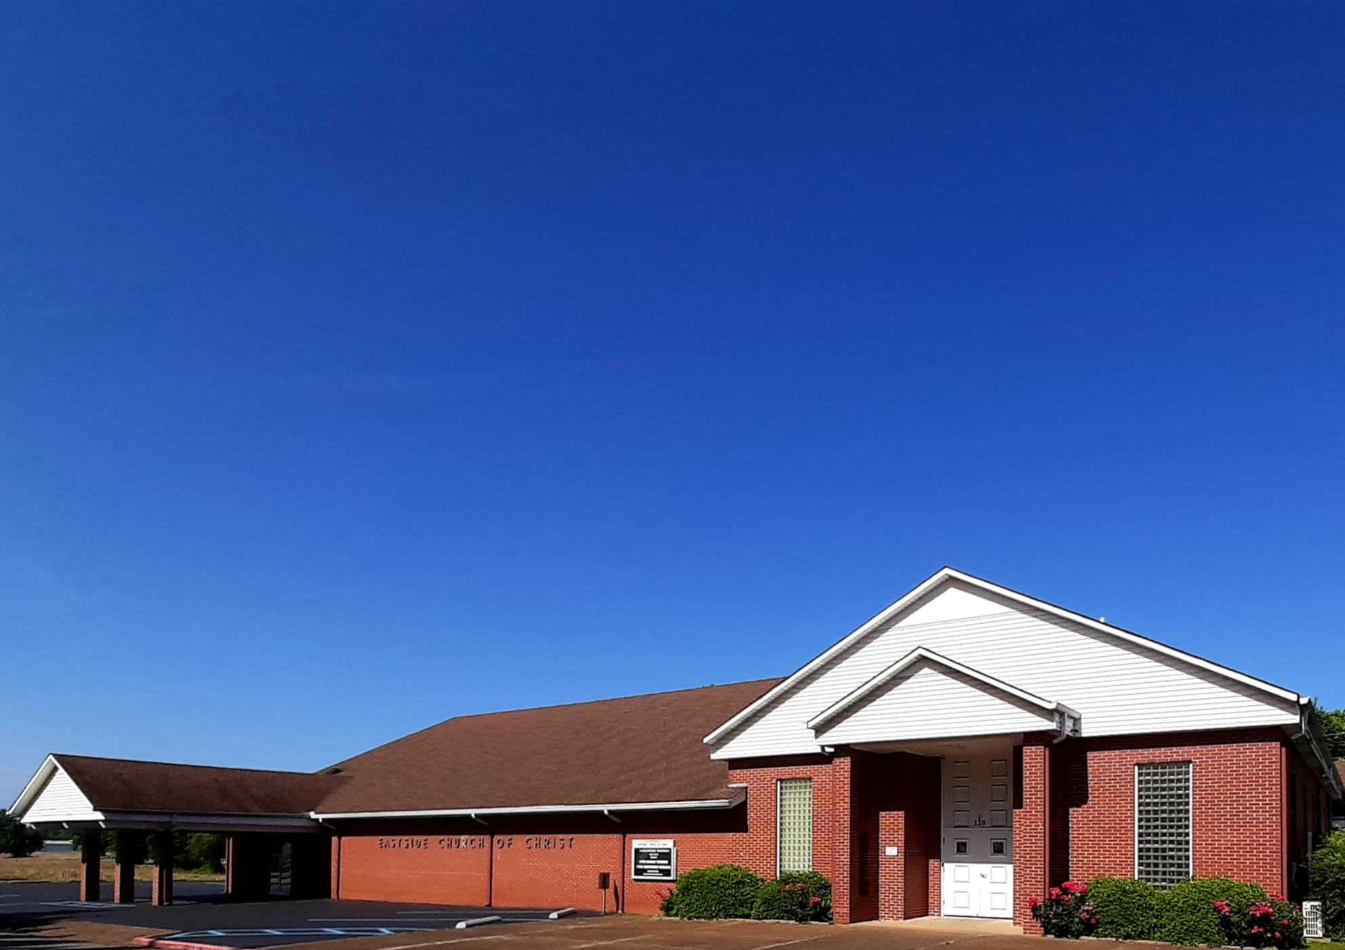
Eastside Church of Christ
Eastside-church.org

