Slide 1


The Gospel of John

Slide 2

The Gospel of John
Early Disciples (John 1:19-40)

Slide 3

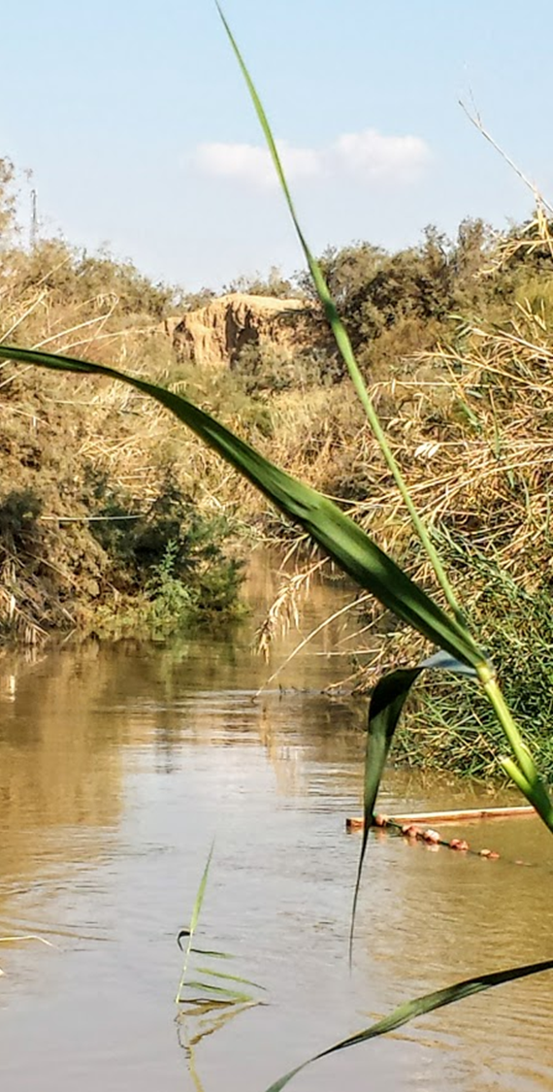
John Points to Jesus (John 1:19-34)
Questions about John’s identity
When asked his identity by Priests and Levites, John declared, “I am not the Christ” (Luke 3:15; Daniel 9:25-26; Psalm 2:2; 132:17).
He said that he was not Elijah (Malachi 4:5-6, cp. 2 Kings 2:11; Lk. 1:17; Matt. 11:13-14; 17:10-13)
He said that he was not “the Prophet” (Deuteronomy 18:18-19; John 6:14; 7:40-41).
John identifies himself with the words of Isaiah 40:3-5, “I am the voice of one crying in the wilderness...’”
Notes:
PICTURE: Jordan River to the north at Qasr al-Yahud. At this point the river is about 405 meters (1330 feet) below sea level.
The Messiah/Christ, the coming “Anointed One” was a subject of OT Prophecy:
Luke 3:15 Now as the people were in expectation, and all reasoned in their hearts about John, whether he was the Christ or not,
Daniel 9:25-26 "Know therefore and understand, That from the going forth of the command To restore and build Jerusalem Until Messiah the Prince, There shall be seven weeks and sixty-two weeks; The street shall be built again, and the wall, Even in troublesome times. 26 "And after the sixty-two weeks Messiah shall be cut off, but not for Himself; And the people of the prince who is to come Shall destroy the city and the sanctuary. The end of it shall be with a flood, And till the end of the war desolations are determined.
Psalms 2:2 The kings of the earth set themselves, And the rulers take counsel together, Against the LORD and against His Anointed, saying,
Psalms 132:17 There I will make the horn of David grow; I will prepare a lamp for My Anointed.
Malachi 4:5-6 Behold, I will send you Elijah [the Tishbite LXX] the prophet Before the coming of the great and dreadful day of the LORD. 6 And he will turn The hearts of the fathers to the children, And the hearts of the children to their fathers, Lest I come and strike the earth with a curse.
The Jews may well have expected literal Elijah to return – he hadn’t died, and he was the anointer of Kings and prophets!!! 2 Kings 2:11 Then it happened, as they continued on and talked, that suddenly a chariot of fire appeared with horses of fire, and separated the two of them; and Elijah went up by a whirlwind into heaven.
Luke 1:17 He will also go before Him in the spirit and power of Elijah, 'TO TURN THE HEARTS OF THE FATHERS TO THE CHILDREN,' and the disobedient to the wisdom of the just, to make ready a people prepared for the Lord.“
Matthew 11:13-14 For all the prophets and the law prophesied until John. 14 And if you are willing to receive it, he is Elijah who is to come.
Matthew 17:10-13 And His disciples asked Him, saying, "Why then do the scribes say that Elijah must come first?" 11 Jesus answered and said to them, "Indeed, Elijah is coming first and will restore all things. 12 But I say to you that Elijah has come already, and they did not know him but did to him whatever they wished. Likewise the Son of Man is also about to suffer at their hands." 13 Then the disciples understood that He spoke to them of John the Baptist.
Deuteronomy 18:18-19 I will raise up for them a Prophet like you from among their brethren, and will put My words in His mouth, and He shall speak to them all that I command Him. 19 And it shall be that whoever will not hear My words, which He speaks in My name, I will require it of him.
Isaiah 40:3-5 The voice of one crying in the wilderness: "Prepare the way of the LORD; Make straight in the desert A highway for our God. 4 Every valley shall be exalted And every mountain and hill brought low; The crooked places shall be made straight And the rough places smooth; 5 The glory of the LORD shall be revealed, And all flesh shall see it together; For the mouth of the LORD has spoken."

Slide 4
John Points to Jesus (John 1:19-34)
The Purpose of John’s baptism:
John’s water baptism would be surpassed by One who would baptize with the Holy Spirit (1:26-27).
This individual is above John because He was before John – Jesus’ preexistence shows His preeminence.
John sees Jesus and identifies Him as the “Lamb of God” and the One who “is preferred before me, for He was before me.” (1:29-30)
John’s purpose in baptizing was to reveal the identity of Jesus (1:31)
John’s baptism prepared the way of the Lord by preparing the hearts of people to receive Him! (Mark 1:1-8; cf. Malachi 3:1; Isaiah 40:3
Notes:
Malachi 3:1 "Behold, I send My messenger, And he will prepare the way before Me. And the Lord, whom you seek, Will suddenly come to His temple, Even the Messenger of the covenant, In whom you delight. Behold, He is coming," Says the LORD of hosts.
Isaiah 40:3 The voice of one crying in the wilderness: "Prepare the way of the LORD; Make straight in the desert A highway for our God.

Slide 5
John Points to Jesus (John 1:19-34)
The Weight of John’s Testimony
John knows the identity of Jesus by revelation (1:32-33).
John and Jesus were kinsmen, and as a babe in the womb, John had “leaped for joy” in the presence of the mother of the Messiah (Luke 1:36-45).
But John’s testimony is based on witnessing events as a fully aware and reasoning adult (Matt. 3:13-17).
John saw and testified: “This is the Son of God!”
John’s testimony would have convinced many people because they “all counted John to have been a prophet indeed” (Mark 11:30-32; cf. Matthew 21:26; Luke 20:6).
John’s testimony was still convincing even years later (Acts 13:22-25).
Notes:
Luke 1:36 Now indeed, Elizabeth your relative has also conceived a son in her old age; and this is now the sixth month for her who was called barren.
Mark 11:30-32 The baptism of John—was it from heaven or from men? Answer Me." 31 And they reasoned among themselves, saying, "If we say, 'From heaven,' He will say, 'Why then did you not believe him?' 32 But if we say, 'From men' "—they feared the people, for all counted John to have been a prophet indeed.

Slide 6
John Points to Jesus (John 1:19-40)
The Weight of John’s Testimony
John’s testimony moves Andrew and another disciple (probably John) to follow Jesus (1:35-40).
Jesus invites them to be witnesses!
He said to them, "Come and see." They came and saw where He was staying, and remained with Him that day (now it was about the tenth hour). -- John 1:39

Slide 7
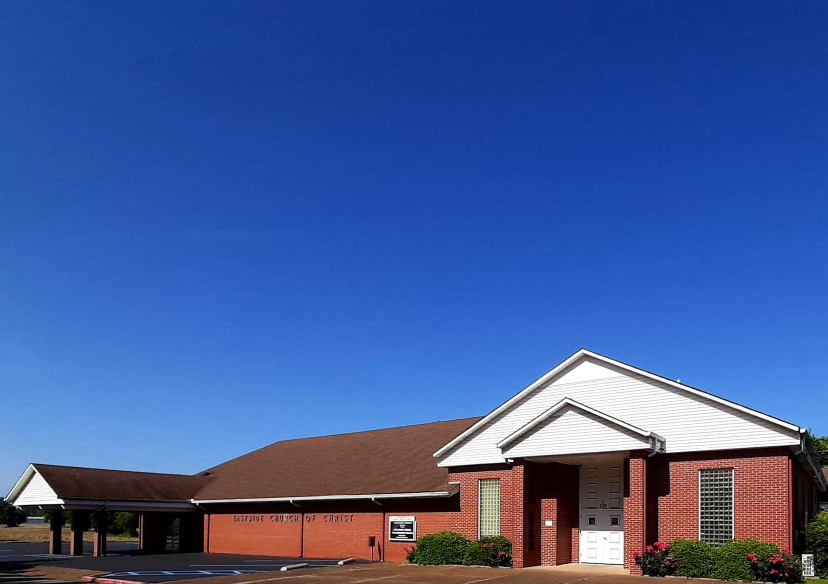
Eastside Church of Christ
Eastside-church.org

