Slide 1
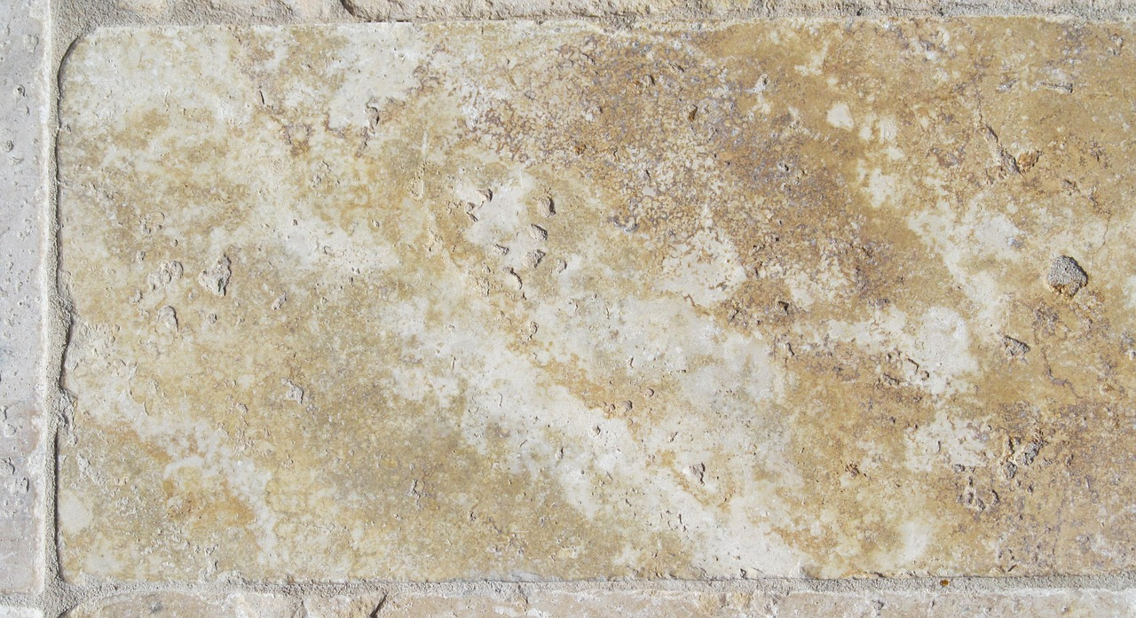

The Gospel of
John

Slide 2

The Gospel of
John
Cleansing Temple / Nicodemus (John 2:12—3:21)
Notes:
The period of consideration continues as the people witness the zeal of Jesus for His Father’s house, and Jesus illuminates a teacher of Israel.

Slide 3
Cleansing the Temple (John 2:12-25)
  Jesus goes to Jerusalem at Passover
  After the wedding in Cana, Jesus “went down to Capernaum, He, His mother, His brothers, and His disciples” but did not stay many days (2:12).
  Jesus goes to Jerusalem at Passover* (2:13-17).
    He finds those selling oxen, sheep, and doves, as well as the money changers; He makes a whip of cords and drives them out, overturning the tables.
      The synoptic gospels place a similar event at a later Passover during which Jesus was crucified (Matthew 21:12-17; Mark 11:15-19; Luke 9:45-48).
    The disciples recall the Psalm of David: “Zeal for Your house has eaten me up” (Ps. 69:9; cf. Romans 15:3).
Notes:
“Passover” commemorated Israel’s deliverance from Egyptian bondage – the Power of God and the blood of a Lamb were significant aspects of that deliverance (Exodus 12)
There are at least three Passovers mentioned in John (cf. 6:4; 11:55)
Psalms 69:7-9 Because for Your sake I have borne reproach (cf. Romans 15:3). Shame has covered my face. 8 I have become a stranger to my brothers, And an alien to my mother's children; 9 Because zeal for Your house has eaten me up, And the reproaches of those who reproach You have fallen on me.
Romans 15:3 For even Christ did not please Himself; but as it is written, "THE REPROACHES OF THOSE WHO REPROACHED YOU FELL ON ME.“

Slide 4
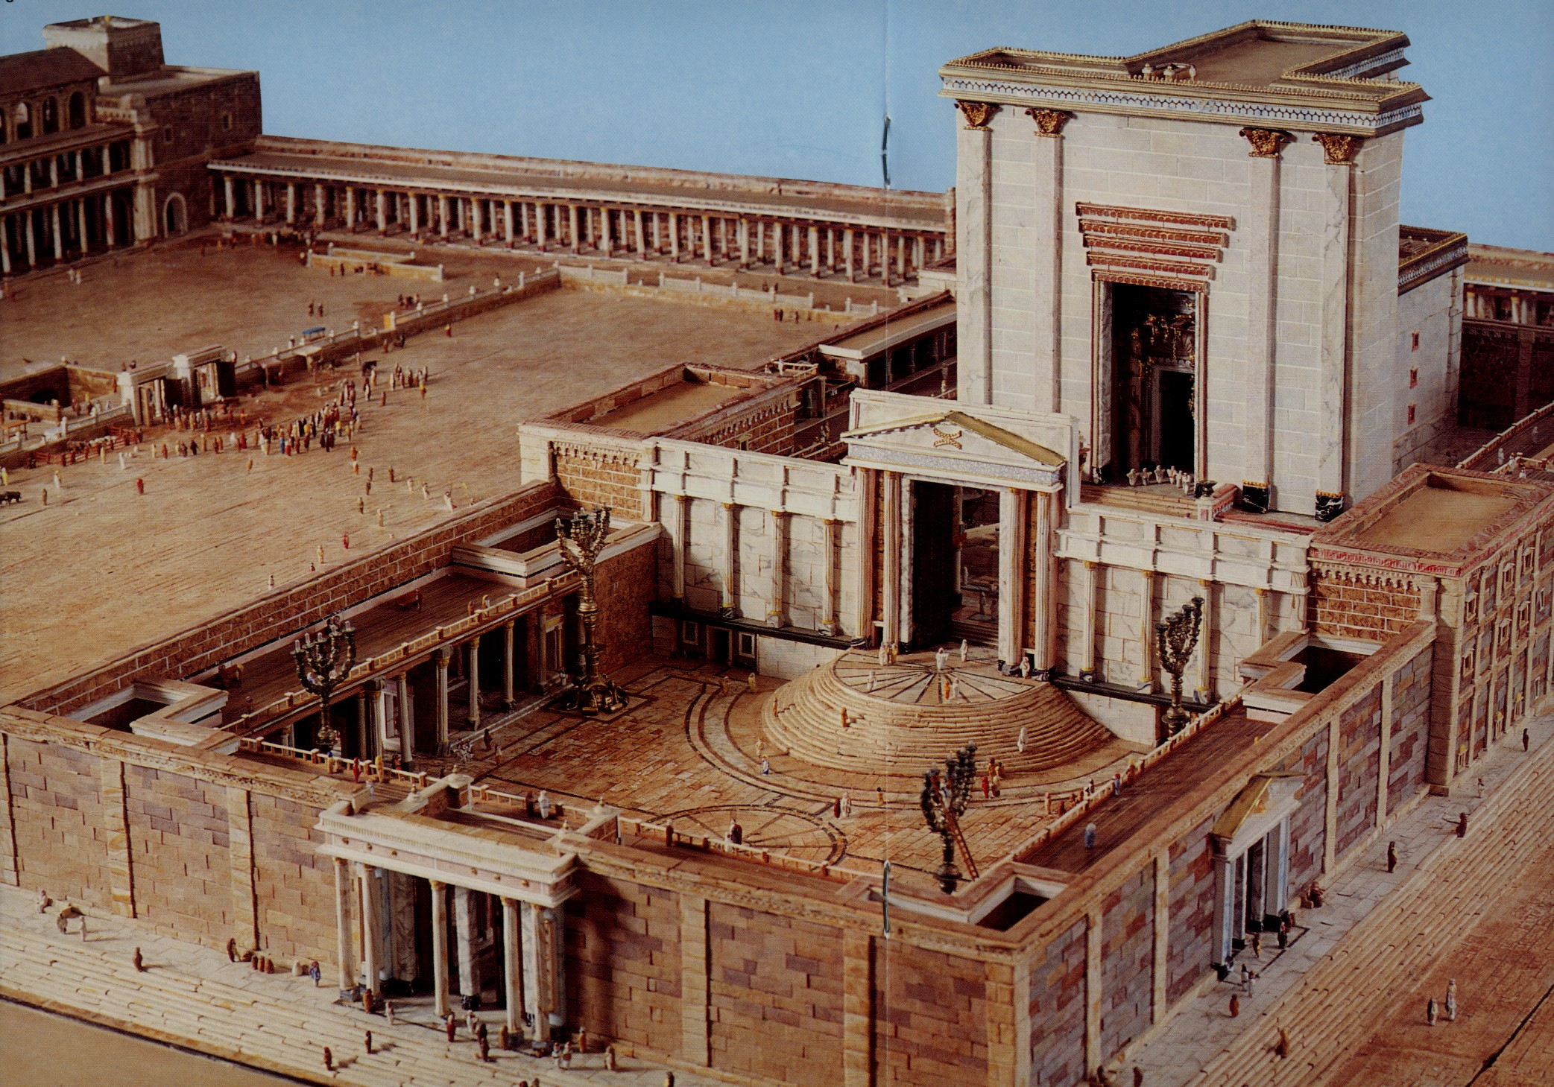

Slide 5
Cleansing the Temple (John 2:12-25)
  Jesus goes to Jerusalem at Passover
  The Jews demand a sign (2:18-22).
    Jesus says, “Destroy this temple, and in three days I will raise it up."
      The literal temple had been under reconstruction for 46 years, but Jesus spoke of the temple of His body.
    After the resurrection, the disciples remembered Jesus’ words and believed the Scripture (cf. Psalm 16:10; Acts 2:27-32; 13:35-37).
  Many “believed in His name when they saw the signs which He did” (2:23-25).
    Jesus performs many signs which John does not record.
    He does not commit or entrust Himself to these believers because He knew what was in them.
Notes:
This temple Herod the Great commenced repairing, or began to rebuild, in the eighteenth year of his reign – [20 BC] that is, sixteen years before the birth of Christ [4 BC] (Jos. ‘Ant.,’ b. xv. Section 1). The main body of the temple he completed in “nine years and a half” (Jos. ‘Ant.,’ xv. 5, 6), yet the temple, with its outbuildings, was not entirely complete in the time of our Saviour… As Herod began to rebuild the temple sixteen years before the birth of Jesus, and as what is here mentioned happened in the thirtieth year of the age of Jesus, so the time which had been occupied in it was “forty-six years.” This circumstance is one of the many in the New Testament which show the accuracy of the evangelists, and which prove that they were well acquainted with what they recorded. It demonstrates that their narration is true. (Albert Barnes).
This also coincides with “the fifteenth year of the reign of Tiberius Caesar” (Luke 3:1) and with the age of Jesus given by Luke as “about thirty years of age” at the beginning of His ministry (Luke 3:23).
Psalms 16:10 For You will not leave my soul in Sheol, Nor will You allow Your Holy One to see corruption.
Acts 13:35-37 Therefore He also says in another Psalm: 'YOU WILL NOT ALLOW YOUR HOLY ONE TO SEE CORRUPTION.' 36 "For David, after he had served his own generation by the will of God, fell asleep, was buried with his fathers, and saw corruption; 37 but He whom God raised up saw no corruption.
Note: Three things that point to Jesus as the Son of God
He was upset that His Fathers house was being misused.
His zeal for His Fathers house fulfilled a prophecy.
He predicts His death and resurrection.
NOTE: This word “commit” or “entrust” is the same as the word “believed” in verse 23. Thayer says it means “to place confidence in.” These believers may have accepted Him as the Christ, but what would they do when He did not turn out to be the type of Christ they were expecting?

Slide 6
Interview with Nicodemus (John 3:1-21)
  Nicodemus comes to Jesus (3:1-2).
  He is a pharisee and a ruler of the Jews (7:50).
  He comes by night (7:50; 19:38-40).
  He believes that Jesus is “a teacher come from God” because of the signs He does.
  Jesus teaches Nicodemus about the new birth (3:3-8).
  One must be born again (of water and Spirit) to enter the kingdom (cf. Romans 6:4).
  This spiritual rebirth is within a person, like the unseen force of the wind.
Notes:
He is referred to as “one of them” in John 7:50 in reference to the chief priests, Pharisees, and rulers who wanted Jesus arrested “Nicodemus (he who came to Jesus by night, being one of them) said to them,
This may indicate that he wanted to keep the meeting secret. He was associated with Joseph of Arimathea:
John 19:38-40 After this, Joseph of Arimathea, being a disciple of Jesus, but secretly, for fear of the Jews, asked Pilate that he might take away the body of Jesus; and Pilate gave him permission. So he came and took the body of Jesus. 39 And Nicodemus, who at first came to Jesus by night, also came, bringing a mixture of myrrh and aloes, about a hundred pounds. 40 Then they took the body of Jesus, and bound it in strips of linen with the spices, as the custom of the Jews is to bury.
Romans 6:4 Therefore we were buried with Him through baptism into death, that just as Christ was raised from the dead by the glory of the Father, even so we also should walk in newness of life.

Slide 7
Interview with Nicodemus (John 3:1-21)
  Nicodemus asks, “How can these things be?” (3:9)
  He seems to have trouble grasping the deeply spiritual nature of the new birth.
  Jesus explains (3:10-21).
  Jesus is testifying to truth as a witness from heaven.
  The Son of man must be lifted up like the serpent in the wilderness (Numbers 21:8-9).
    Being “lifted up” is a euphemism for Jesus’ crucifixion (John 12:32-34; 8:28).
Notes:
John 12:32-34 And I, if I am lifted up from the earth, will draw all peoples to Myself." 33 This He said, signifying by what death He would die. 34 The people answered Him, "We have heard from the law that the Christ remains forever; and how can You say, 'The Son of Man must be lifted up'? Who is this Son of Man?“
John 8:28 Then Jesus said to them, "When you lift up the Son of Man, then you will know that I am He, and that I do nothing of Myself; but as My Father taught Me, I speak these things.

Slide 8
Interview with Nicodemus (John 3:1-21)
  Jesus explains (3:10-21).
  God’s love for the world has made these things possible (3:16-21).
    He gave His only begotten Son “that whoever believes in Him should not perish but have everlasting life” (3:16).
    He sent His son to save, not condemn (3:17-18a).
    But failure to believe will lead to condemnation (3:18b).
    The love of darkness will lead one to choose unbelief (3:19-21).

Slide 9
Further Testimony Of John The Baptist
(John 3:22-36)
  Jesus and His disciples, and John and his disciples, continue baptizing (3:22-24).
  John was baptizing in Aenon near Salim because there was “much water there.”

Slide 10
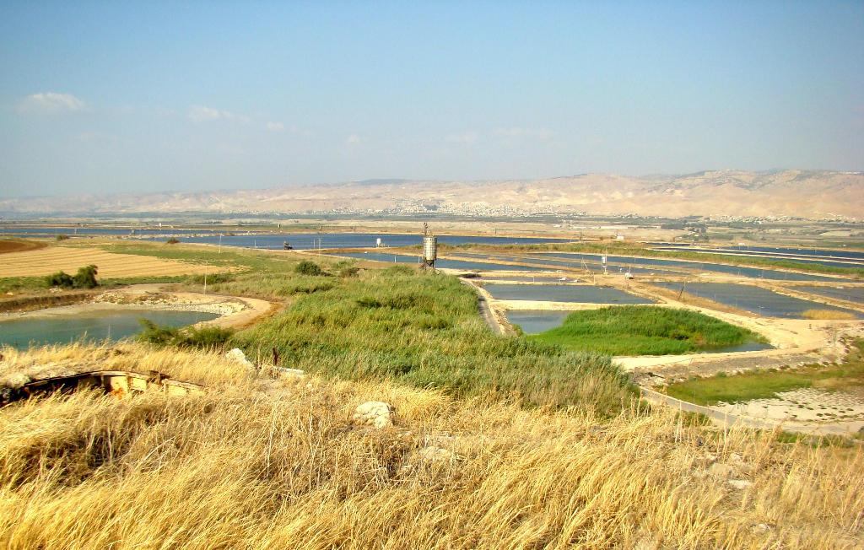
Pools near Salim
Tel Salim in the foreground
The Transjordan in the distance
Photo by Leon Mauldin

Slide 11
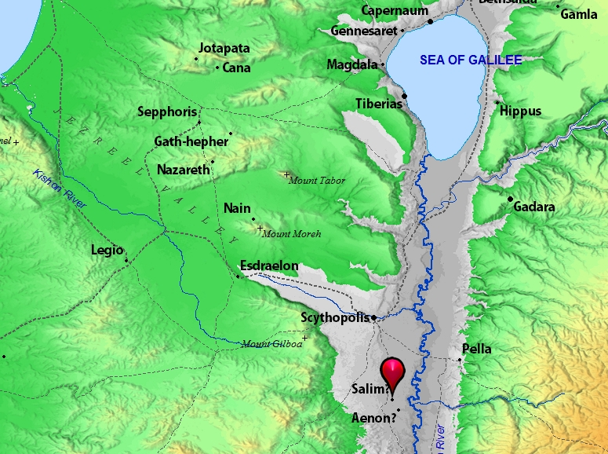

Slide 12
Further Testimony Of John The Baptist
(John 3:22-36)
  Jesus and His disciples, and John and his disciples, continue baptizing (3:22-24)
  John was baptizing in Aenon near Salim because there was “much water there.”
  John’s disciples are troubled that greater numbers are going to Jesus to be baptized (3:25-26).
  John reminds them who Jesus is (3:27-36).
    Jesus has received His authority and work from heaven.
    John had testified the he himself was not the Christ.
    He compares himself to the friend of the groom, rejoicing to hear the groom’s voice as he approaches.
    John declares “He must increase but I must decrease.”
    Jesus is above all – qualified to testify of heavenly things.
Notes:
According to John 3:12-13 & 31-32, why is it that Jesus is the only who is
qualified to offer testimony about heavenly things?

Slide 13
Did the Jews respect John?
Mark 11:32 states that “all counted John to have been a prophet indeed.” This fact is corroborated by other sources:
“Now some of the Jews thought that the destruction of Herod's army came from God, and that very justly, as a punishment of what he did against John, that was called the Baptist: for Herod slew him, who was a good man, and commanded the Jews to exercise virtue, both as to righteousness towards one another, and piety towards God, and so to come to baptism…” (Josephus, Antiquities, 18.5.2)

Slide 14
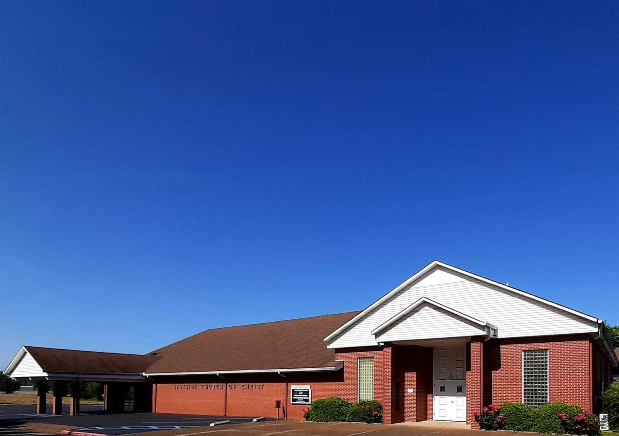
Eastside Church of Christ
Eastside-church.org

