Slide 1
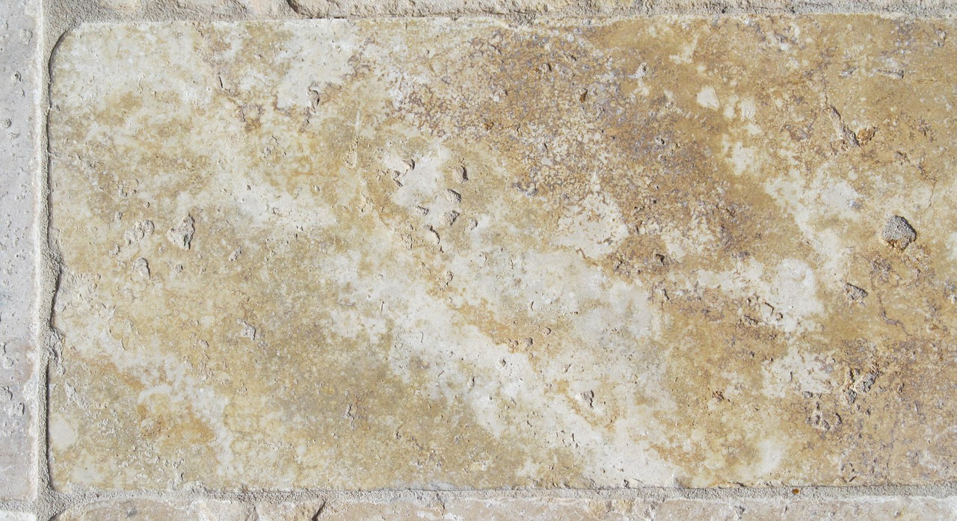

The Gospel of John

Slide 2

The Gospel of John
Samaritan Woman / Nobleman’s Son (John 4:1-54)
Notes:
As the Gospel of John presents its case of evidence that Jesus is the Christ the Son of God, Jesus’ dialogue with the woman at the well and His healing of the Nobleman’s son are offered into evidence. In these accounts, Jesus reaches across racial and gender barriers to share the good news, and He reaches across physical distance to exhibit His compassion and divine power to heal.

Slide 3
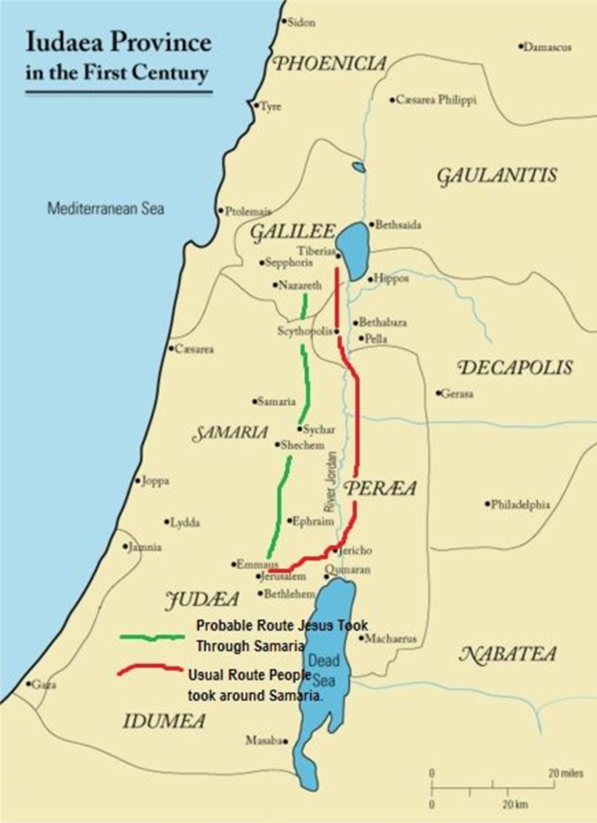
Interview with the Samaritan Woman (John 4:1-42)
Jesus leaves Judea to go to Galilee (4:1-4)
His reason for leaving Judea relates to the attention He had attracted from Jewish leaders.
The reason He “needed to go through Samaria” appears to be His need to evangelize there.

Slide 4
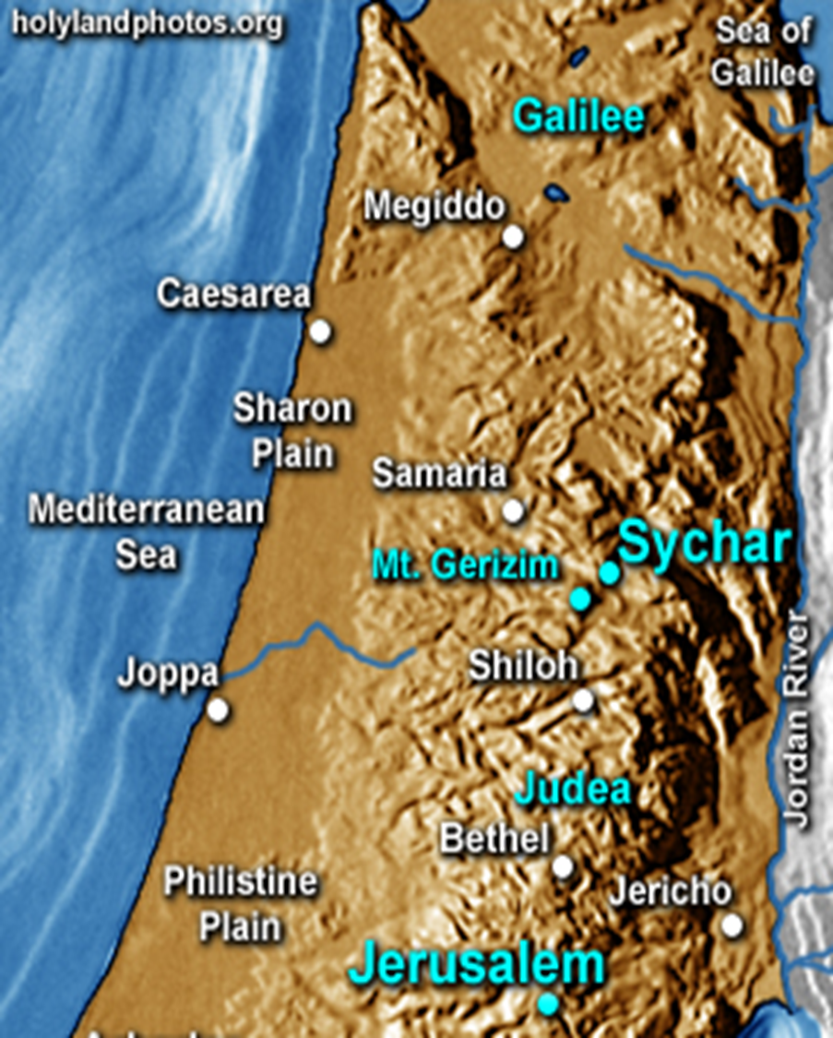
Jesus arrives at Sychar (4:5)
The area near Sychar was important in Old Testament history.
Prior to taking the Land, the tribes were to be divided on Mt. Ebal & Mt. Gerizim; the priests read the blessings & curses to Israel (Deut. 27:12-26).

Slide 5
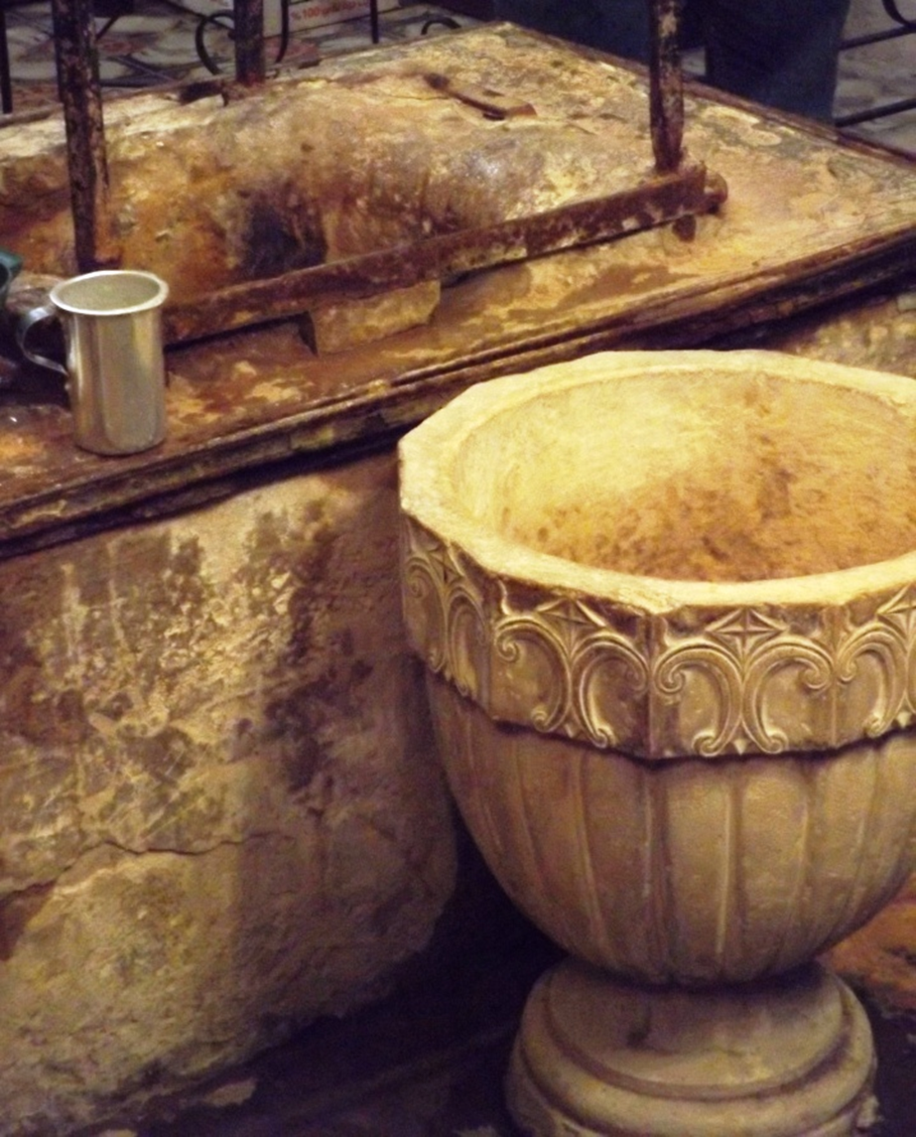
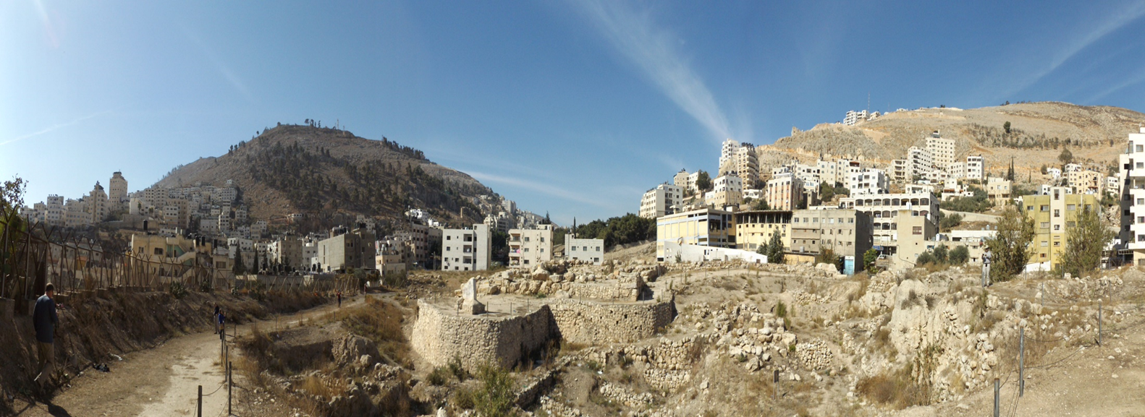
Jesus at Jacob’s well (4:6-8)
About noon, Jesus is weary, and He sits by Jacob’s well.
A woman of Samaria comes to draw water, and Jesus asks her for a drink, since His disciples had gone to town to buy food.

Slide 6
Interview with the Samaritan Woman (John 4:1-42)
Dialogue with the Samaritan Woman (4:9-26)
The woman wonders why a Jew would ask for a drink from a “Samaritan woman” (4:9).
Jesus explains that if she knew who He was, she would ask Him for “living water” (4:10).
The woman is dubious: He has no way to get water from the well. Is He “greater than Jacob?” (4:11-12).
Jesus explains that the water He gives will quench thirst forever and provide everlasting life (4:13-14).
She requests that He give her this water so that “I may not thirst or come here to draw” (4:15).
NOTE: To this point, she is seems only interested in how her earthly lot might be improved.

Slide 7
Interview with the Samaritan Woman (John 4:1-42)
Dialogue with the Samaritan Woman (4:9-26)
Jesus shifts the conversation to her marital status and reveals His intimate knowledge of her life (4:16-18).
The woman perceives that Jesus is a prophet and brings up a topic of major disagreement between Jews and Samaritans: Where to worship? (4:19-20).
Jesus’ response is enlightening (4:21-24).
The time is coming in which neither Jerusalem nor Gerizim will be the place to worship.
At present, Samaritans were worshiping in ignorance; “salvation is of the Jews.”
The hour was soon coming when all true worshipers would worship the Father in Spirit and in truth.

Slide 8
Interview with the Samaritan Woman (John 4:1-42)
Dialogue with the Samaritan Woman (4:9-26)
The woman is certain that the coming Messiah would clear up everything (4:25).
Jesus identifies Himself as the Messiah (4:26).
The reaction of the Samaritan Woman (4:27-30)
The disciples return and are astonished that Jesus is speaking to a woman (4:27).
The woman leaves her waterpot, goes back to town and tells of her experience; as a result, the men of the city come out to see Jesus (4:28-30).

Slide 9
Interview with the Samaritan Woman (John 4:1-42)
Sowing and Reaping (4:31-38)
The disciples urge Jesus to eat, but He says that He has food to eat – to do the work of His Father (4:31-34).
Jesus teaches on “the harvest.”
The time of harvest had arrived! The fields are white! Laborers are needed! (Matthew 9:36-38; Luke 10:1-2).
Sowing and reaping are both vital to bringing “fruit for eternal life.”
Jesus sent the disciples to reap fields in which others had labored (Amos 9:13; 1 Corinthians 3:6).
The Samaritans Believe (4:39-42)
The Samaritans were convinced of Jesus’ identity by the woman’s testimony and by His own words.
Notes:
Matthew 9:36-38 But when He saw the multitudes, He was moved with compassion for them, because they were weary and scattered, like sheep having no shepherd. 37 Then He said to His disciples, "The harvest truly is plentiful, but the laborers are few. 38 Therefore pray the Lord of the harvest to send out laborers into His harvest.“
Luke 10:1-2 After these things the Lord appointed seventy others also, and sent them two by two before His face into every city and place where He Himself was about to go. 2 Then He said to them, "The harvest truly is great, but the laborers are few; therefore pray the Lord of the harvest to send out laborers into His harvest.
Amos 9:13 "Behold, the days are coming," says the LORD, "When the plowman shall overtake the reaper, And the treader of grapes him who sows seed; The mountains shall drip with sweet wine, And all the hills shall flow with it.
1 Corinthians 3:6 I planted, Apollos watered, but God gave the increase.

Slide 10
Healing the Nobleman’s Son (John 4:43-54)
Jesus Journeys to Galilee (4:43-45)
He was received not because it was His home country but because the Galileans had witnessed His works at the feast in Jerusalem (cf. Matt.13:57; Luke 4:28-29).
Healing the Nobleman’s son (4:46-54)
While Jesus is in Cana of Galilee, a nobleman travels from Capernaum to beg Jesus to “come down and heal his son” (4:46-47; cf. Luke 8:3; Acts 13:1).
Jesus notes that people would not believe unless they saw signs and wonders (4:48).
Notes:
Matthew 13:57 So they were offended at Him. But Jesus said to them, "A prophet is not without honor except in his own country and in his own house.“
Luke 4:28-29 So all those in the synagogue, when they heard these things, were filled with wrath, 29 and rose up and thrust Him out of the city; and they led Him to the brow of the hill on which their city was built, that they might throw Him down over the cliff.

Slide 11
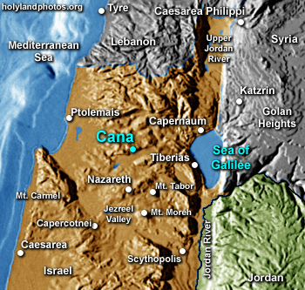

Slide 12
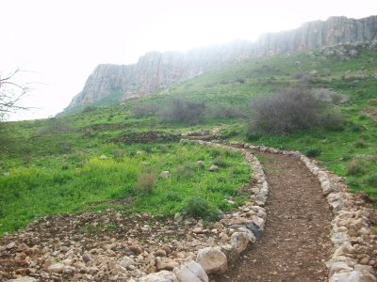
Ancient Roman Road from Cana to Capernaum

Slide 13
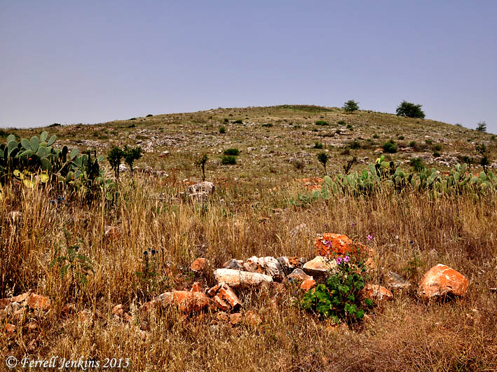
Site of Biblical Cana
Notes:
May 1, 2013, Ferrell’s Travel Blog
This morning we set out from Tiberias to reach Khirbet Kana, the likely site of the Cana of Galilee…Jesus attended a marriage at Cana of Galilee (John 2:1-11), and met the royal official (John 4:46-54).
Here is a view of the rocky hill located on the north side of the Bet Netofa Valley. The ancient road ran in the valley below the city.
This is not the sort of visit one may take lightly. It probably took us 45 minutes in from the main road, and 45 minutes out. (We should have had a Jeep-type vehicle. We spent about an hour walking up one side of the hill and down another. (I hope no one will ask directions!).

Slide 14
Healing the Nobleman’s Son (John 4:43-54)
Healing the Nobleman’s son (4:46-54)
While Jesus is in Cana of Galilee, a nobleman travels from Capernaum to beg Jesus to “come down and heal his son” (4:46-47).
Jesus notes that people would not believe unless they saw signs and wonders (4:48).
Jesus tells the nobleman to return home: “Your son lives!” The man believes and goes home (4:49-50).
When the nobleman learns that his son had been healed at the precise time Jesus said, “He lives,” he “believed and his whole household” (4:51-53).
This is the “second sign” in the Gospel of John (4:54).

Slide 15
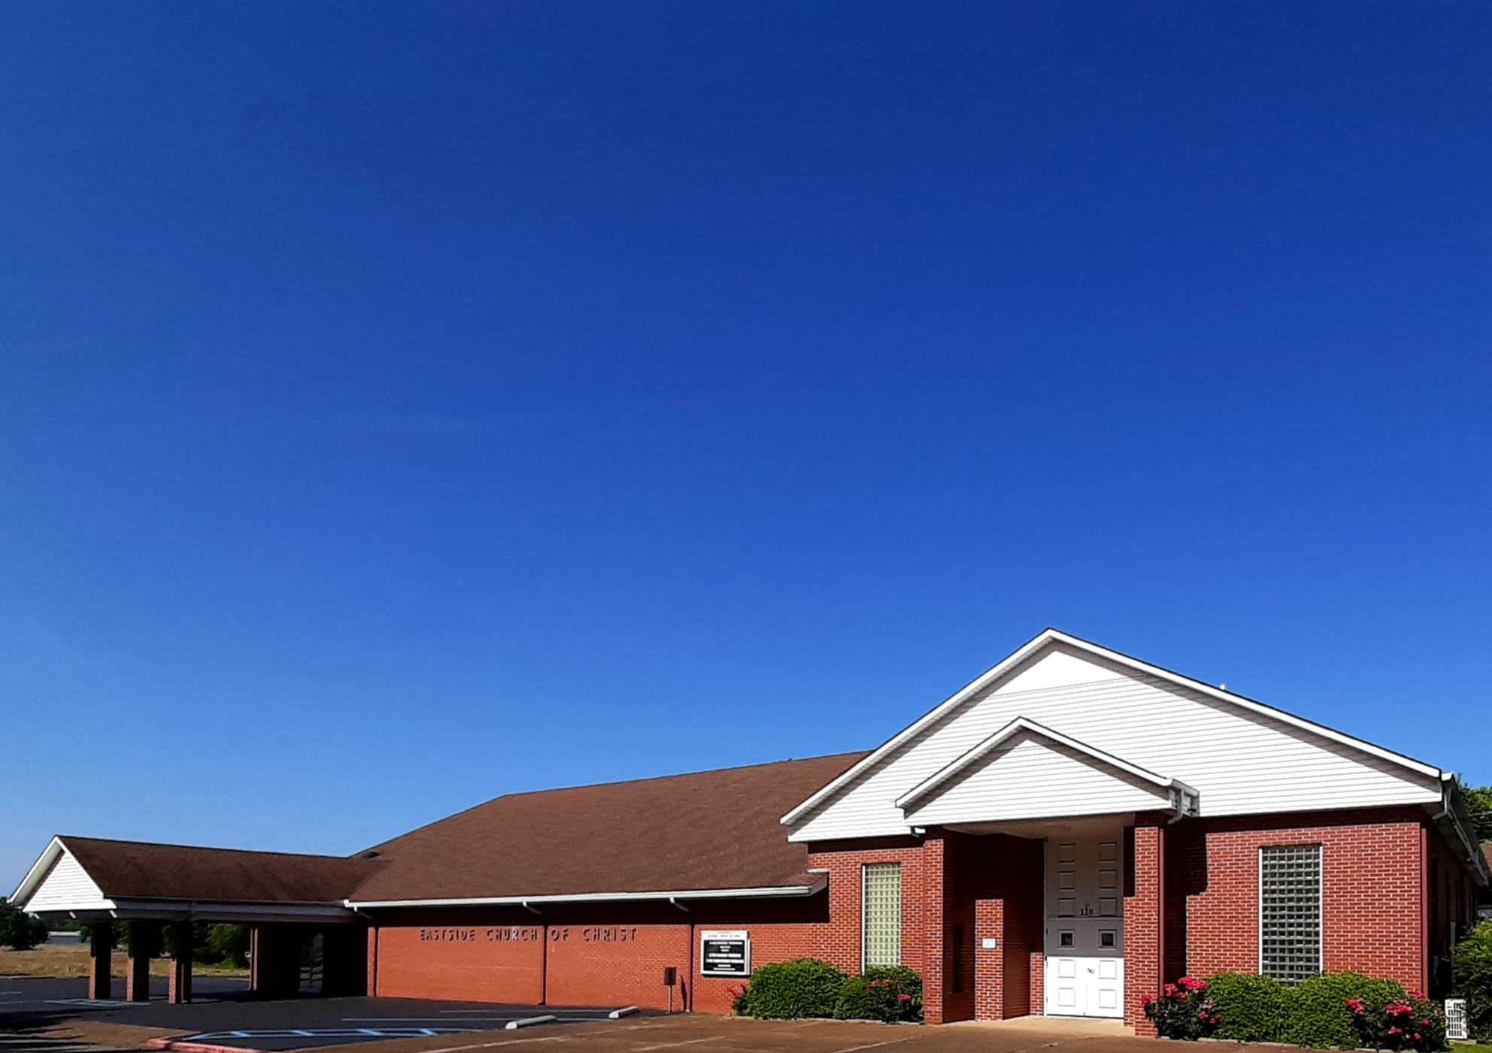
Eastside Church of Christ
Eastside-church.org

