Slide 1

The Epistle of FIRST PETER
Guidance for the Pilgrim

Slide 2
The Epistle of FIRST PETER
Guidance for the Pilgrim
1 Peter 3:13—4:6
Sanctified for Suffering & Suffering for Sanctification
Notes:
Submission and holiness lead to a life blessed by God (1 Peter 3:8-12), and yet righteous people may still suffer. If they do so for doing the will of God, they are blessed.
So, a willingness to suffer for one’s sanctification only leads to a life that is more separate and holy.

Slide 3
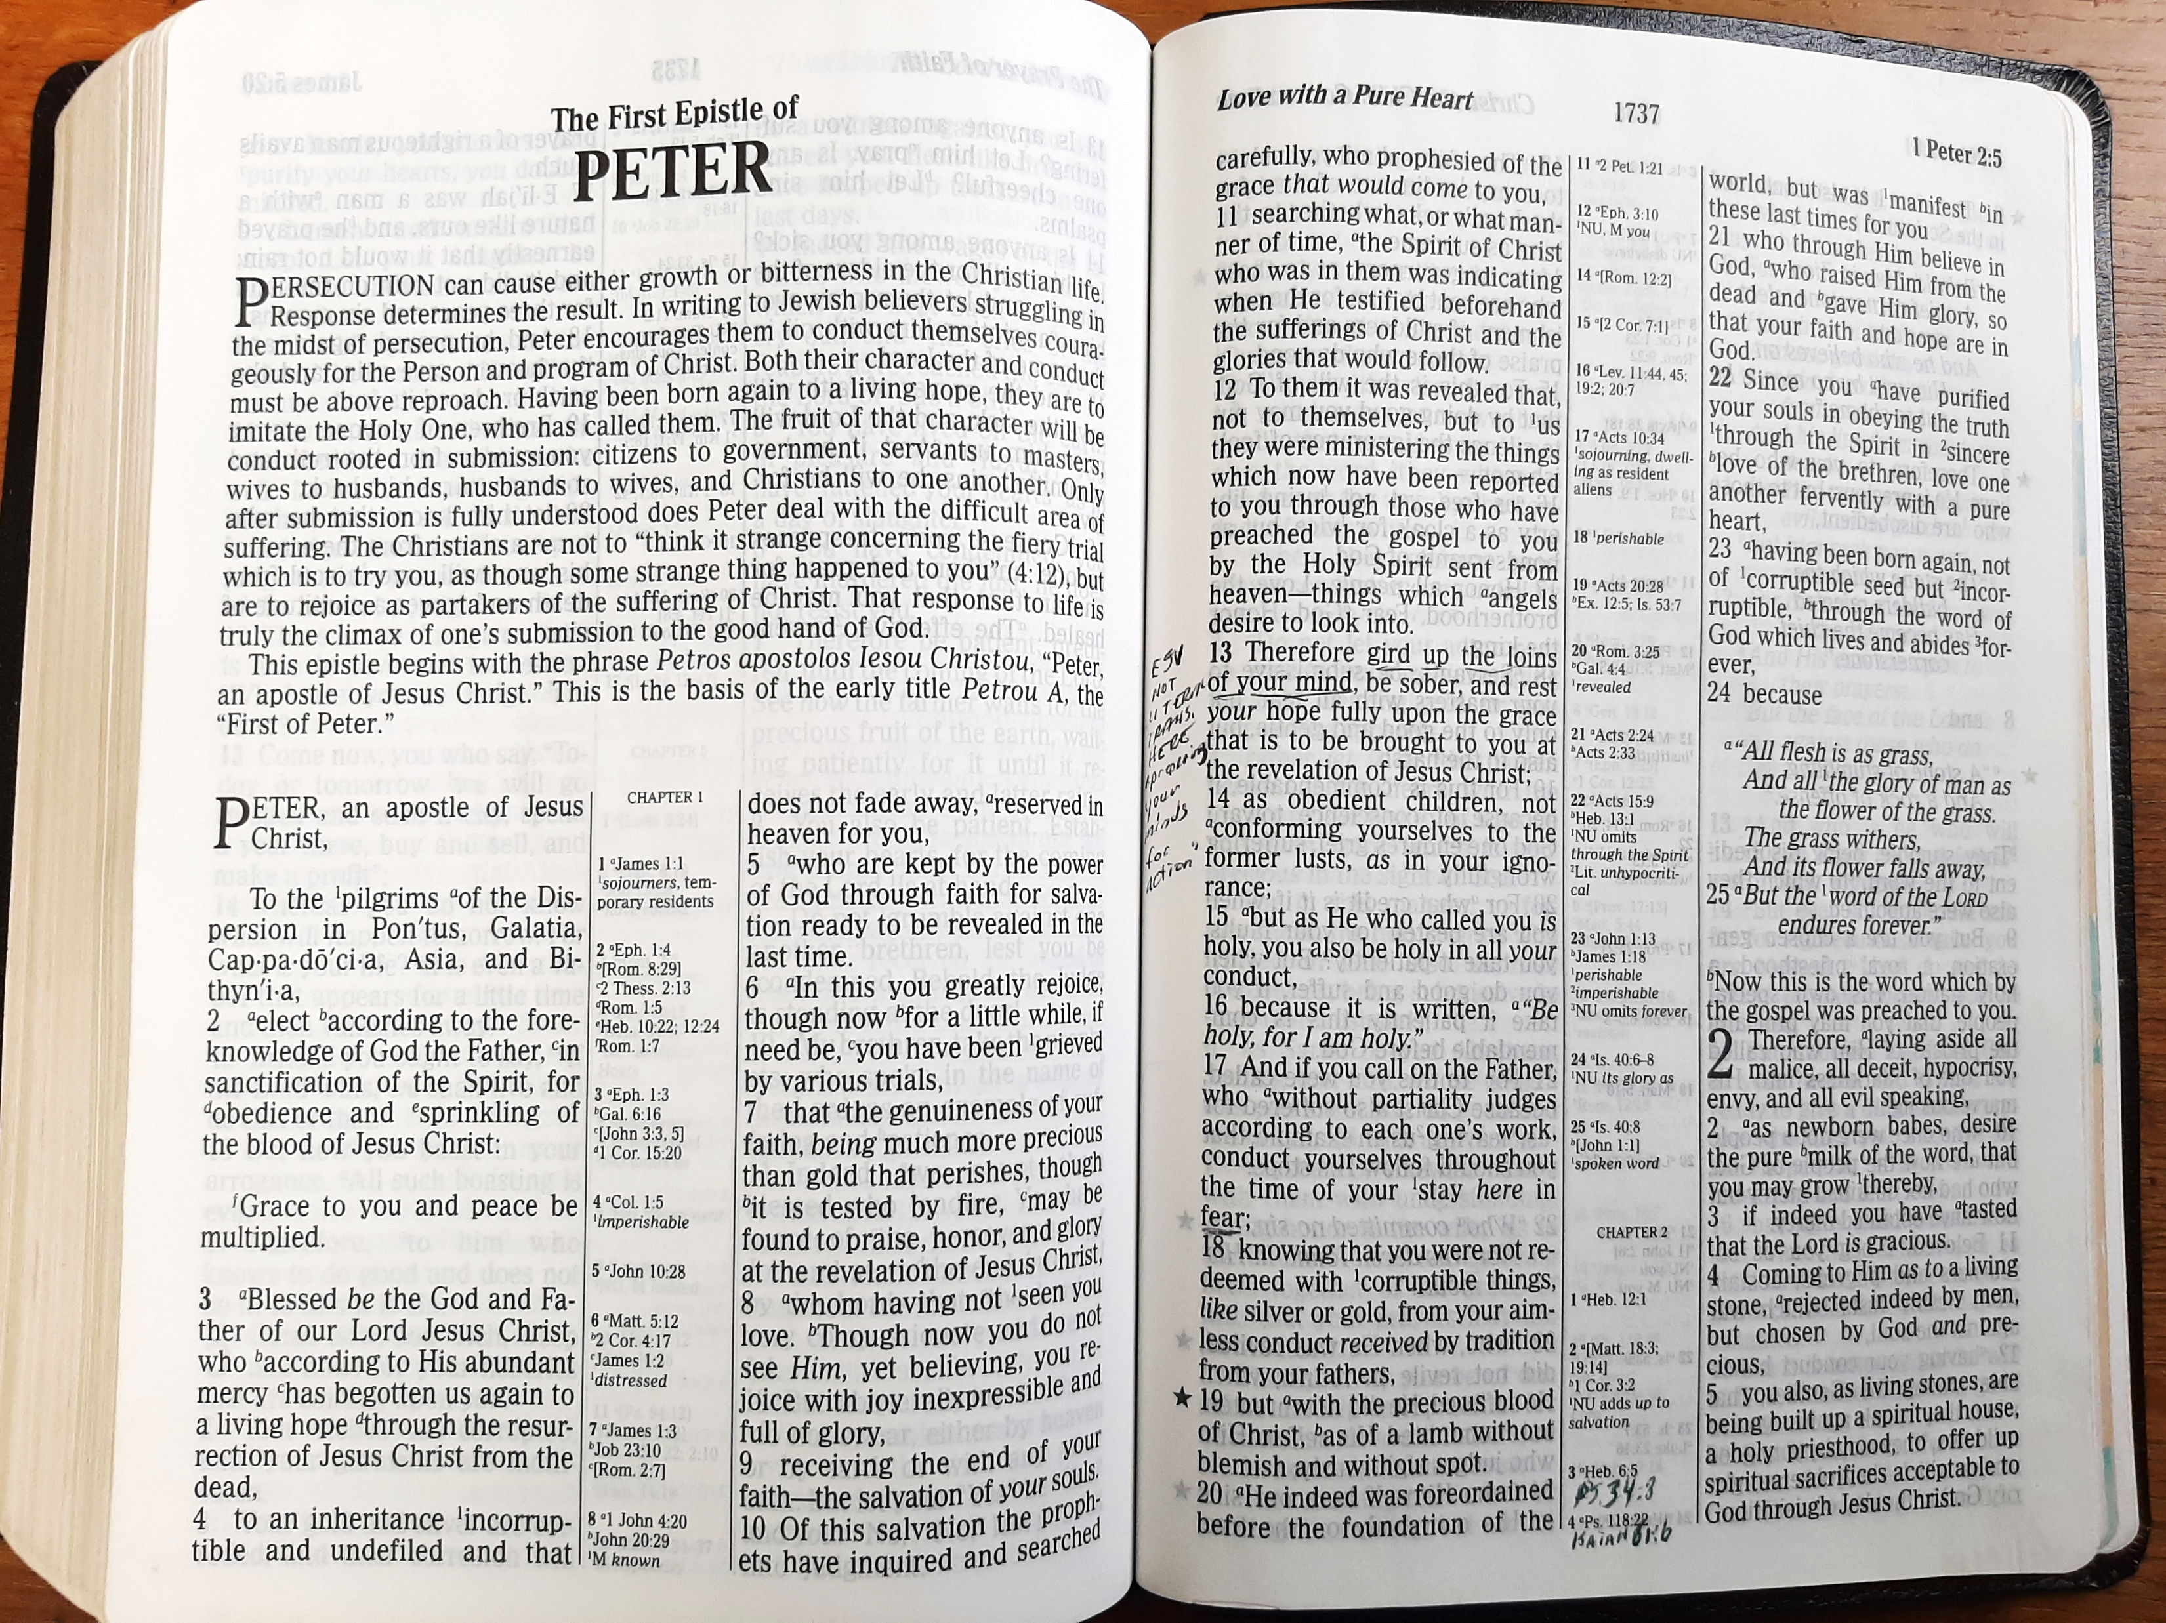
Suffering for Righteousness’ Sake (1 Peter 3:13-17)
Doing good makes it less likely that you will be harmed (3:13).
Fellow citizens and law enforcement have no cause to harm you (Rom. 13:3-4).
If you do suffer for righteousness’ sake, you are blessed. So…
Don’t be afraid.
Take advantage of the opportunity to defend your hope with meekness and fear.
Live true to your conscience, and those who mistreat you will be ashamed.
Remember: It is better to suffer for doing good!
Notes:
Romans 13:3-4 For rulers are not a terror to good works, but to evil. Do you want to be unafraid of the authority? Do what is good, and you will have praise from the same. (4) For he is God's minister to you for good. But if you do evil, be afraid; for he does not bear the sword in vain; for he is God's minister, an avenger to execute wrath on him who practices evil.

Slide 4
Christ’s Example of Suffering (1 Peter 3:18-20a)
Christ also suffered unjustly.
He suffered for our sins, not His (1 Pet. 2:24).
He suffered for the unjust (Romans 5:8).
He suffered to bring us to God.
He was “put to death in the flesh but made alive by the Spirit” (cf. Rom. 8:11).
He preached to “spirits in prison” who had been disobedient in Noah’s day.
These ungodly men are now “reserved under punishment” for the judgment day (2 Peter 2:5, 9).
Jesus’ words to these spirits are not revealed; their mention here serves to introduce Noah’s salvation.
Notes:
Romans 5:8 But God demonstrates His own love toward us, in that while we were still sinners, Christ died for us.
Romans 8:11 But if the Spirit of Him who raised Jesus from the dead dwells in you, He who raised Christ from the dead will also give life to your mortal bodies through His Spirit who dwells in you.
2 Peter 2:5 and did not spare the ancient world, but saved Noah, one of eight people, a preacher of righteousness, bringing in the flood on the world of the ungodly;
2 Peter 2:9 then the Lord knows how to deliver the godly out of temptations and to reserve the unjust under punishment for the day of judgment,

Slide 5
Noah’s Salvation Symbolizes Our Salvation (1 Peter 3:20b-22)
God showed His divine longsuffering in Noah’s day while the ark was being prepared.
Noah was a “preacher of righteousness.”
God’s longsuffering gives men the chance to repent (Romans 2:4).
But only eight souls were saved in the ark through water.
Noah’s salvation is a type or symbol of how we are saved. Baptism now saves us:
An antitype is “something that is represented by a symbol” (Oxford Languages Dictionary).
Noah’s salvation is symbolic of our salvation, not the other way around!
Notes:
Romans 2:4 Or do you despise the riches of His goodness, forbearance, and longsuffering, not knowing that the goodness of God leads you to repentance?
An antitype is a real or actual thing, represented by a type or symbol

Slide 6
Noah’s Salvation Symbolizes Our Salvation (1 Peter 3:20b-22)
Baptism effectively saves us…
As the answer of a good conscience toward God, not by removing the dirt from our bodies.
Because of the power of the resurrection of Christ (Romans 6:4; Colossians 2:12).
The resurrection of Christ also facilitated His exaltation at God’s right hand (cf. Ephesians 1:19-21).
Notes:
Romans 6:4 Therefore we were buried with Him through baptism into death, that just as Christ was raised from the dead by the glory of the Father, even so we also should walk in newness of life.
Colossians 2:12 buried with Him in baptism, in which you also were raised with Him through faith in the working of God, who raised Him from the dead.

Slide 7
Suffering Leads to Sanctification Which Leads to More Suffering (1 Peter 4:1-6)
As pilgrims, we must arm ourselves with the Christ-like mind of self-sacrificial suffering (4:1; Philippians 2:5-8).
Remember that Christ suffered for our sins (3:18).
His example motivates us to strive against sin (Hebrews 12:3-4).
Those who have suffered and died with Christ will not readily choose to do wrong (2 Tim. 2:11; Galatians 2:20; Romans 6:6-7).
They will no longer live for the lusts of men, but for the will of God.
Notes:
The Cycle of Suffering and Sanctification (1 Peter 4:1-6)
Philippians 2:5-8 Let this mind be in you which was also in Christ Jesus, (6) who, being in the form of God, did not consider it robbery to be equal with God, (7) but made Himself of no reputation, taking the form of a bondservant, and coming in the likeness of men. (8) And being found in appearance as a man, He humbled Himself and became obedient to the point of death, even the death of the cross.
Hebrews 12:3-4 For consider Him who endured such hostility from sinners against Himself, lest you become weary and discouraged in your souls. (4) You have not yet resisted to bloodshed, striving against sin.
2 Timothy 2:11 This is a faithful saying: For if we died with Him, We shall also live with Him.
Romans 6:6-7 knowing this, that our old man was crucified with Him, that the body of sin might be done away with, that we should no longer be slaves of sin. (7) For he who has died has been freed from sin.

Slide 8
Suffering Leads to Sanctification (1 Peter 4:1-6)
The Christ-like sufferer will no longer engage in…
LEWDNESS: “lasciviousness” [KJV], “sensuality” [ESV], “unbridled lust” [Thayer]
LUSTS: “Desire for what is forbidden” [Thayer] (Eph. 2:3; Gal. 5:24)
DRUNKENNESS: “excess of wine” [KJV]
REVELRIES: “revellings” KJV, “orgies” NIV. “Drinking parties that are protracted till late at night and indulge in revelry” (Thayer)
DRINKING PARTIES: “banquetings” [KJV] Occasions of social drinking* (Est. 6:14; 1:5-8).
IDOLATRIES: Note the plural. Idolatry can be committed in multiple ways (Col. 3:5; Eph. 5:5).
Notes:
Ephesians 2:3 among whom also we all once conducted ourselves in the lusts of our flesh, fulfilling the desires of the flesh and of the mind, and were by nature children of wrath, just as the others.
Galatians 5:24 And those who are Christ's have crucified the flesh with its passions and desires.
RC Trench defines “potos” as “the banquet, the symposium, not of necessity excessive” he gives Genesis 19:3; 2 Samuel 3:20 and Esther 6:4 as occurrences in the LXX. Potos is found 30 times in the LXX (Greek translation of O.T. Scripture)
Genesis 19:3 But he insisted strongly; so they turned in to him and entered his house. Then he made them a feast, and baked unleavened bread, and they ate. (Translated “feast”)
2 Samuel 3:20 So Abner and twenty men with him came to David at Hebron. And David made a feast for Abner and the men who were with him.
Esther 6:14 While they were still talking with him, the king's eunuchs came, and hastened to bring Haman to the banquet which Esther had prepared.
Esther 1:5 And when these days were completed, the king made a feast lasting seven days for all the people who were present in Shushan the citadel, from great to small, in the court of the garden of the king's palace.
Esther 1:7-8 And they served drinks in golden vessels, each vessel being different from the other, with royal wine in abundance, according to the generosity of the king. (8) In accordance with the law, the drinking was not compulsory; for so the king had ordered all the officers of his household, that they should do according to each man's pleasure.
Colossians 3:5 Therefore put to death your members which are on the earth: fornication, uncleanness, passion, evil desire, and covetousness, which is idolatry.
Ephesians 5:5 For this you know, that no fornicator, unclean person, nor covetous man, who is an idolater, has any inheritance in the kingdom of Christ and God.

Slide 9
Suffering Leads to Sanctification (1 Peter 4:3-6)
Because the Christian lives a sanctified life, he will continue to suffer:
The world will “think it strange” that you do not join them in their worldly pleasures.
They will “speak evil” of you.
They may accuse you of thinking that you are better than everyone else, or they may mock your faith.
They will give an account for this behavior to the Judge of the living and the dead (Acts 10:42; 2 Timothy 4:1).
This is all the more reason the gospel was preached to such individuals!
Notes:
Acts 10:42 And He commanded us to preach to the people, and to testify that it is He who was ordained by God to be Judge of the living and the dead.
2 Timothy 4:1 I charge you therefore before God and the Lord Jesus Christ, who will judge the living and the dead at His appearing and His kingdom:

Slide 10
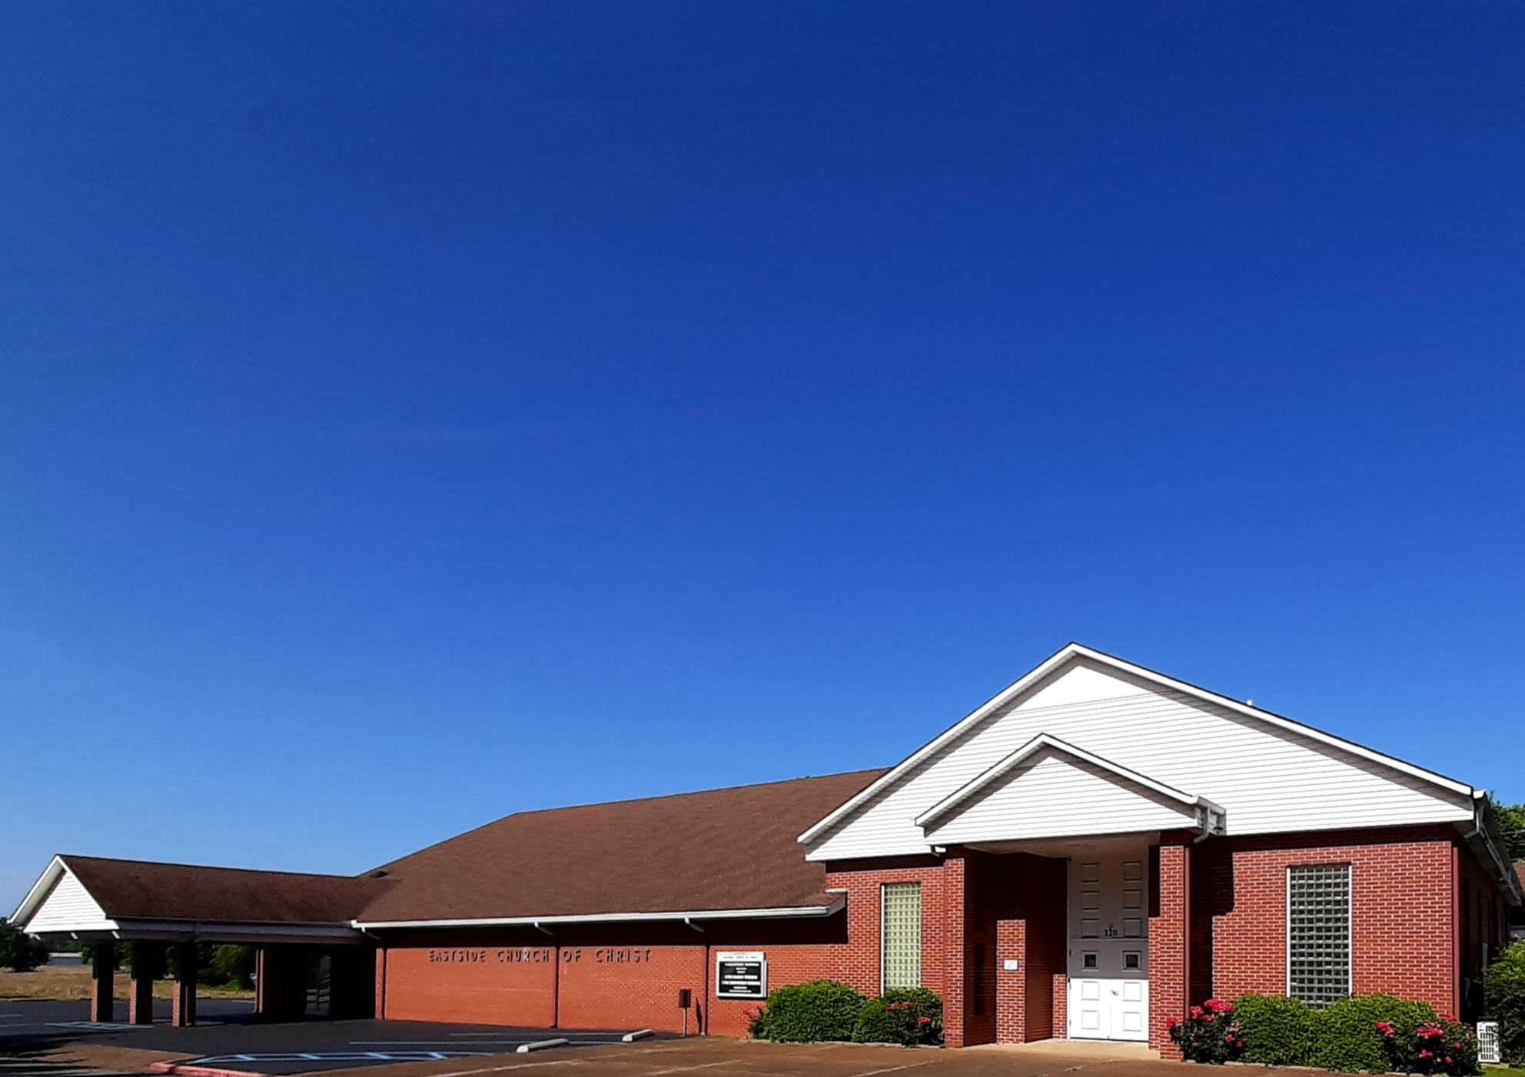
Eastside Church of Christ
Eastside-church.org

