Slide 1
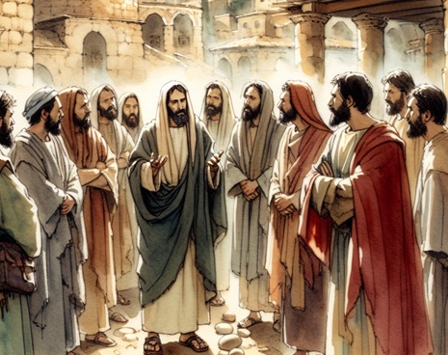
The Life of Christ Part 2
Periods Of Retirement

Slide 2

Seven Periods of Jesus’ Life
Years of Preparation
Beginning of Ministry
Great Galilean Ministry
Periods of Retirement
Close of Ministry
Last Week
Resurrection and Exaltation

Slide 3
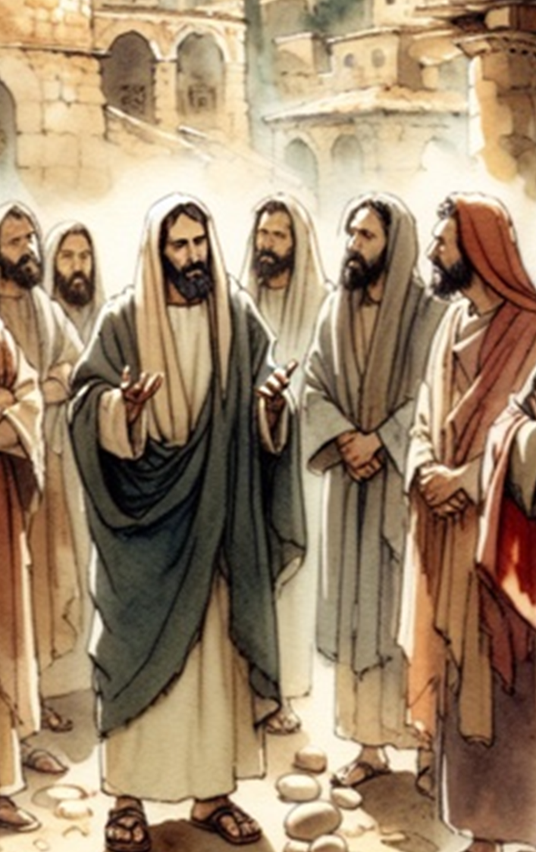
Life of Christ (2) Lesson 4 -- Overview
Healing the Sick in Gennesaret
Jesus is the Bread of Life
Jesus VS. the Traditions of the Pharisees
Jesus heals the daughter of a Gentile
Jesus heals a deaf man
Matthew 14:34-36, 15:1-28
Mark 6:53-56, 7:1-23
John 6:22-71

Slide 4
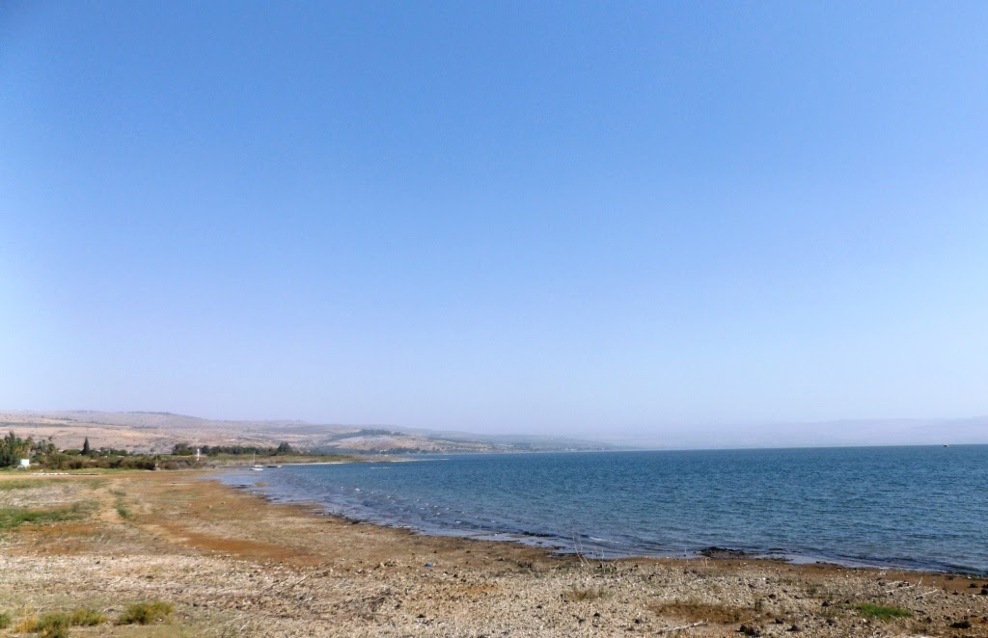
Healing the Sick in Gennesaret (Mark 6:53-56)
Jesus and His disciples anchor the boat at Gennesaret.
They are recognized immediately, and people go throughout the region bringing their sick to Jesus’ location.
People begged to touch the hem of His garment to be made well.
Notes:
4

Slide 5
Seeking Jesus, but desiring more food John 6:22-34
Some of the “5000” realize Jesus is no longer there; only His disciples had gotten in a boat. They go to Capernaum seeking Him.
Jesus says that they are not seeking Him for the signs (spiritual) but for the loaves they ate (physical) (6:26).
Jesus tells them not to labor for the food that perishes but for the food that endures to everlasting life (6:27).
When they ask what to do to work of God, Jesus says, “This is the work of God, that you believe in Him whom He sent” (6:28-29).
Then they ask for a sign so they can believe, and they refer to Moses giving their fathers ‘bread from heaven’ (6:31-32).

Slide 6
A Different Food – the Bread of Life John 6:32-40
Jesus tells them that Moses did not give them this bread but, “My Father gives you the true bread from heaven” which gives life to the world (6:32-33).
They want this bread (6:34)!
Jesus says, "I am the bread of life. He who comes to Me shall never hunger, and he who believes in Me shall never thirst” (6:35).
Many had seen Him and not believed. But those the Father would give to Jesus, He would receive (6:36-37).
Jesus came to do the will of His Father (6:38).
Those who believe in Him will have everlasting life, and He will raise them up at the last day (6:39-40).
Notes:
Coffman on v 33— The true bread was far greater than the manna in these particulars: (1) it gives and sustains spiritual life, a far greater thing than merely sustaining physical life; (2) it is for all the world, not merely for Israel alone; (3) it creates spiritual life leading to eternal life, which no manna could have done.

Slide 7
The Jews Complain John 6:41-52
The Jews complain. How could Jesus claim He came down from heaven when they knew His father and mother (6:41-42)?
Jesus tells them to stop murmuring (6:43). He explains…
The Father would draw people to Jesus through teaching and the hope of eternal life (6:44-47; cf. John 12:32).
Jesus is the Bread of Life. Those who ate the manna are dead! (6:48-49).
Jesus is giving His flesh for the life of the world (6:50-51).
The Jews do not understand how Jesus could give them His flesh to eat (6:52).
Notes:
.
Joh 12:32 "And I, if I am lifted up from the earth, will draw all peoples to Myself."
33 This He said, signifying by what death He would die.

Slide 8
“Whoever eats My flesh and drinks My blood…” John 6:53-59
“Unless you eat the flesh of the Son of Man and drink His blood, you have no life in you” (6:53-55).
The bread is His flesh, and His blood is the drink.
Literally drinking blood would be startling to the Jews (Genesis 9:4; Leviticus 17:10-14).
But they could have understood eating a sacrifice as participation in its benefits; we can understand it too (cf. Hebrews 13:10).
How do we eat His flesh and drink His blood (6:56-58)?
He abides in us and we in Him!
Jesus wants us to absorb His very life into ours (cf. Galatians 2:20).
Notes:
Gen 9:3 "Every moving thing that lives shall be food for you. I have given you all things, even as the green herbs. 4 "But you shall not eat flesh with its life, that is, its blood. 5 "Surely for your lifeblood I will demand a reckoning
Le 17:10-14 'And whatever man of the house of Israel, or of the strangers who dwell among you, who eats any blood, I will set My face against that person who eats blood, and will cut him off from among his people. 11 'For the life of the flesh is in the blood, and I have given it to you upon the altar to make atonement for your souls; for it is the blood that makes atonement for the soul.' 12 "Therefore I said to the children of Israel, 'No one among you shall eat blood, nor shall any stranger who dwells among you eat blood.' 13 "Whatever man of the children of Israel, or of the strangers who dwell among you, who hunts and catches any animal or bird that may be eaten, he shall pour out its blood and cover it with dust; 14 "for it is the life of all flesh. Its blood sustains its life. Therefore I said to the children of Israel, 'You shall not eat the blood of any flesh, for the life of all flesh is its blood. Whoever eats it shall be cut off.’
Hebrews 13:10 We have an altar from which those who serve the tabernacle have no right to eat.
My view is that it does not tie in directly with the Lord's supper (although I had an interesting conversation with a Catholic last week who thought Jesus is speaking LITERALLY in direct reference to the Lord's supper -- i.e. transubstantiation).
Jesus is speaking metaphorically in the context; He is the bread of life, the bread from heaven, etc. -- we take Him into us as we take in food and drink...what we eat and drink sustains our lives eternally...we are made of what we eat...we become Him and He transforms us. This is not a reference to the Lord's supper but to the spiritual reality that the Lord's supper represents -- communion with Christ.

Slide 9
The Choice: Focus on the Spiritual or Reject Jesus John 6:60-69
Many disciples found Jesus’ teaching to be “hard” (6:60).
Would they still be offended if they saw Him ascend back to heaven? (6:61-62)
The Spirit gives life! The flesh profits nothing! The WORDS Jesus speaks ARE SPIRIT and they ARE LIFE!!! (6:63).
Many chose not to believe; they walk with Him no more (6:64-66).
Jesus asks the twelve, “Do you also want to go away?”
Peter responds, “Lord, to whom shall we go? You have the words of eternal life. Also we have come to believe and know that You are the Christ, the Son of the living God” (6:68-69).
Notes:
Coffman on vs 60— Hard saying ... was a correct designation. It was so judged by them that first heard it; and therein appears ample justification for setting aside all interpretations that would make an easy thing out of this, such as declaring that it means "Whoever believes shall be saved"! The right interpretation must take into account the difficulty.

Slide 10
Jesus VS. Traditions (Mark 7:1-13)
Pharisees and scribes from Jerusalem come to Galilee; they find fault when they observe Jesus’ disciples eat with unwashed hands (7:1-2).
They held to the tradition of the Jewish elders concerning ceremonial washing and purification (7:3-4).
They ask Jesus, “Why do Your disciples not walk according to the tradition of the elders, but eat bread with unwashed hands” (7:5)?

Slide 11
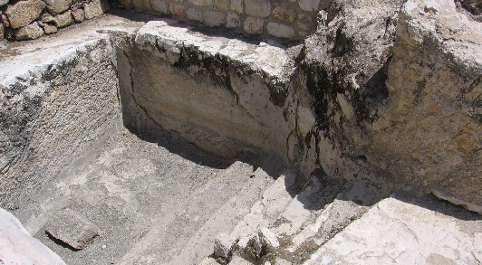
A Mikveh for Ceremonial Washing Near the Temple Site in Jerusalem

Slide 12
Jesus VS. Traditions (Mark 7:1-13)
Jesus responds…
Isaiah had foretold of their hypocrisy (7:6-7; Isa. 29:13).
They teach the commandments and traditions of men while laying aside the commandment of God (7:8-9).
As an example, Jesus refers to their practice of vowing to dedicate funds to God that should have been used to honor indigent parents (7:10-13).

Slide 13
Emphasis on the Heart (Mark 7:14-23)
Jesus explains the true source of uncleanness (7:14-16).
Defilement does not originate from the outside in, but from the inside out.
All need to hear and understand this teaching.
Jesus’ disciples ask Him privately about the teaching and He further clarifies (7:17-23).
Food is processed by the digestive system and does not enter the heart or spiritual center of man; it cannot defile.
The condition of the heart and what comes from it determines whether a man is pure or defiled (cf. Proverbs 4:23).
Notes:
Proverbs 4:23 Keep your heart with all diligence, For out of it spring the issues of life.

Slide 14
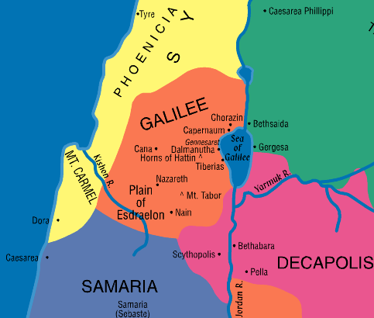
Jesus Heals a Gentile Woman’s Daughter (Mark 7:24-30)
Jesus withdrew from Galilee to the region of Tyre seeking seclusion, “but He could not be hidden” (7:24)
Notes:
14

Slide 15
Jesus Heals a Gentile Woman’s Daughter (Mark 7:24-30)
A woman whose daughter is demon possessed begs Jesus to heal her daughter (7:25-26).
The woman was Greek (of non-Jewish culture) and of Syrophoenician ancestry.
Jesus responds, “Let the children be filled first, for it is not good to take the children's bread and throw it to the little dogs” (7:27).
The woman says, “even the little dogs under the table eat from the children's crumbs” (7:28).
Jesus tells her that “for this saying” the demon was out of her daughter (7:29).
The woman went home and found her daughter healed (7:30).
Notes:
15

Slide 16
Jesus Heals a Deaf Man (Mark 7:31-37)
Jesus travels through the middle of the Decapolis. and then returns to the Sea of Galilee (7:31).
They brought a deaf man to Him to be healed (7:32).
Jesus took him aside, put His fingers in his ears, spat and touched his tongue and said, “Be opened.”
Immediately the man’s ears were opened and his tongue was loosed; he spoke plainly.
Jesus commanded that they tell no one, “but the more He commanded them the more widely they proclaimed it” (7:36).
They were “astonished beyond measure” (7:37)
Witnessing the thoroughness of this miracle, they observe, “He has done all things well.”
Notes:
16

