Slide 1
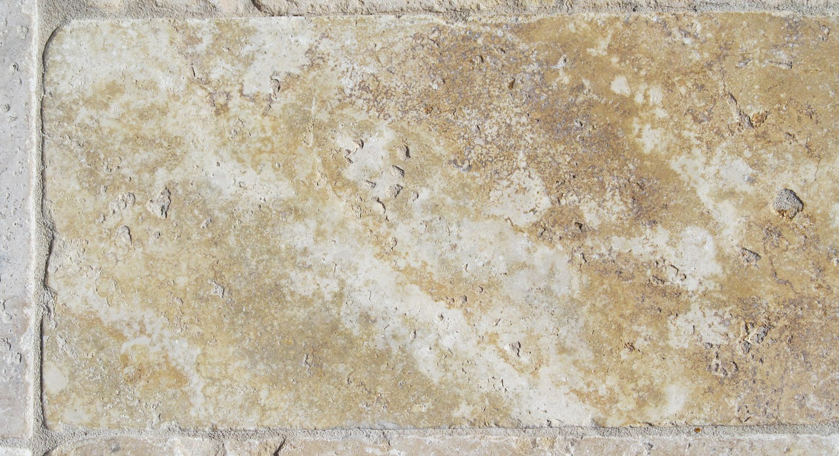

The Gospel of John

Slide 2

The Gospel of John
Healing an Invalid / Jesus calls Witnesses (John 5:1-47)
Notes:
This section of the Gospel of John begins the Period of Controversy. John the Baptist and Jesus have both identified Jesus as the Son of God and the coming Messiah. Jesus has presented evidence in the form of signs and shown His ability to know what was inside of people. Now, as the ramifications of Jesus’ claims become evident to the Jews and their leaders, there will be considerable push back against the claims of Jesus.

Slide 3
Jesus Heals the Invalid at the Pool (John 5:1-18)
Background to the Miracle (5:1-4)
It occurred at a “feast of the Jews” (5:1; cp. 2:13; 6:4; 7:2; 10:22; 13:1).
It occurred “in Jerusalem by the sheep gate” (5:2).
It occurred at a pool with five porches known as Bethesda (5:2).
In this porch lay a great many sick people waiting for the moving of the water (5:3).
An explanation for this is given in John 5:4, but the text may not be in the original.
John 5:7 indicates that the man expected to be healed if he could get in when the water was stirred.
Notes:
Until the 19th century, there was no archaeological evidence for the Pool of Bethesda. Today, there’s really no question that archaeologists have uncovered the actual Pool of Bethesda where Jesus healed the invalid (John 5:1-15).

Slide 4
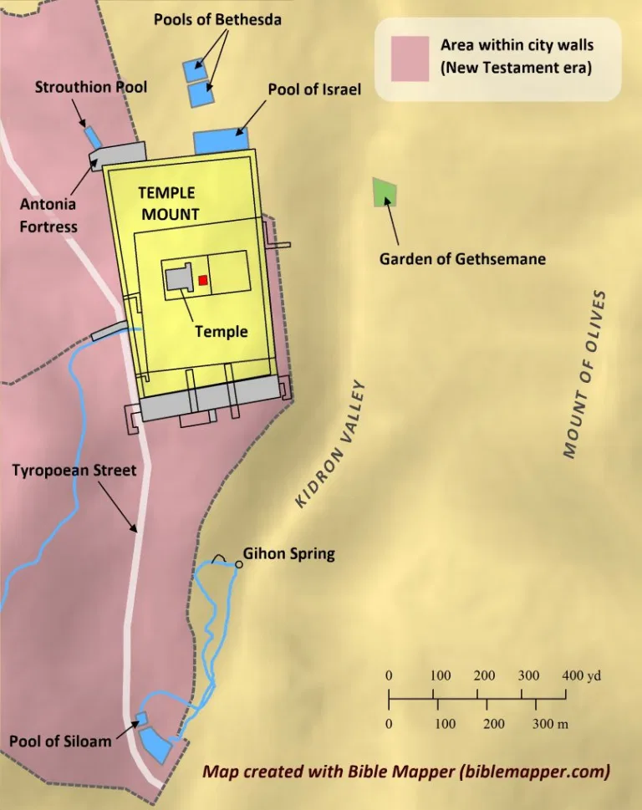

Slide 5
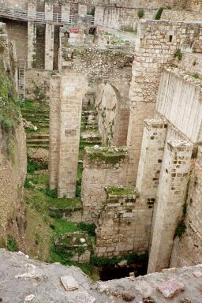
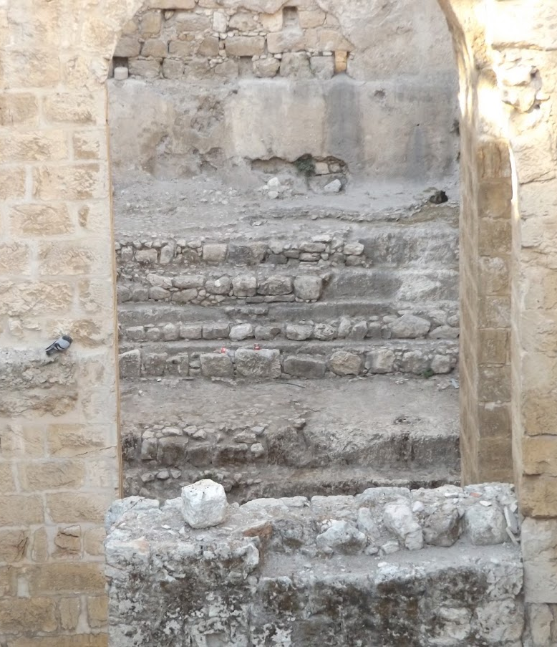
Site of the Pool of Bethesda
Closeup of ancient steps
Notes:
So why a pool with two basins? The archaeological evidence shows that the southern basin had broad steps with landings, indicating that it was indeed a mikveh. The northern basin provided a reservoir, or otzer, to continually replenish and repurify the mikveh with fresh water flowing south through the dam between them. Jerusalem’s pilgrims would flock to the Bethesda Pool and Siloam Pool to purify themselves in these public mikva’ot and, at times, to seek healing. (The Bethesda Pool, Site of One of Jesus’ Miracles
Where Jesus heals the paralytic
(“Bible History Daily,” Biblical Archaeology Society Staff October 03, 2020)

Slide 6
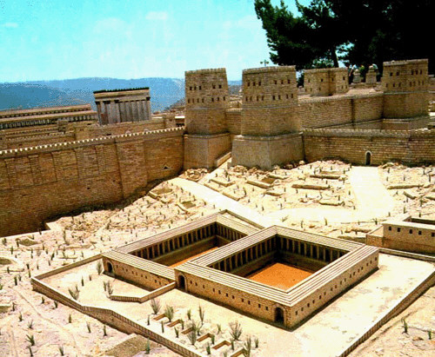
Model of the Pool of Bethesda with the Temple in the background

Slide 7
Jesus Heals the Invalid at the Pool (John 5:1-18)
Jesus heals the invalid (5:5-9).
The man had an infirmity for thirty-eight years.
When Jesus asks if he wants to be made well, he explains that he has no one to put him in the water when it is stirred, and others get in before him.
Jesus said to him, "Rise, take up your bed and walk."
Immediately the man was made well, took up his bed, and walked.
That day was the Sabbath.

Slide 8
Jesus Heals the Invalid at the Pool (John 5:1-18)
Controversy with the Jews (5:10-18).
The Jews tell the man it is not lawful to carry his bed on the Sabbath.
Later, when the man finds Jesus in the temple, Jesus tells him, “See, you have been made well. Sin no more, lest a worse thing come upon you.”
The Jews persecute Jesus because…
He had done these things on the Sabbath.
He claimed to be the Son of God – He indicated that He had the right to continuously do His divine work with His Father (cf. 1:1-2; Hebrews 1:2-3).
Notes:
Hebrews 1:2-3 has in these last days spoken to us by His Son, whom He has appointed heir of all things, through whom also He made the worlds; 3 who being the brightness of His glory and the express image of His person, and upholding all things by the word of His power, when He had by Himself purged our sins, sat down at the right hand of the Majesty on high,

Slide 9
The Claims of Jesus (John 5:19-29)
Jesus is the Son, the Life-giver, and the Judge
As the perfect image of God, Jesus does exactly what the Father shows Him (5:19).
Because the Father loves the Son, Jesus will do even greater works (raising the dead and judging mankind) so that all would honor the Son as they honor the Father (5:20-23; Ps. 2:6-12; Acts 17:31; 2 Cor. 5:10).
The Son will give spiritual life to those who hear and believe Him (5:24-27; cf. 1:4; 1 John 5:11-12).
Even more amazing, the Son will raise all the dead to eternal judgment (5:28-29).
Notes:
Psalms 2:6-12 "Yet I have set My King On My holy hill of Zion." 7 "I will declare the decree: The LORD has said to Me, 'You are My Son, Today I have begotten You. 8 Ask of Me, and I will give You The nations for Your inheritance, And the ends of the earth for Your possession. 9 You shall break them with a rod of iron; You shall dash them to pieces like a potter's vessel.' " 10 Now therefore, be wise, O kings; Be instructed, you judges of the earth. 11 Serve the LORD with fear, And rejoice with trembling. 12 Kiss the Son, lest He be angry, And you perish in the way, When His wrath is kindled but a little. Blessed are all those who put their trust in Him.
Acts 17:31 because He has appointed a day on which He will judge the world in righteousness by the Man whom He has ordained. He has given assurance of this to all by raising Him from the dead.“
1 John 5:11-12 And this is the testimony: that God has given us eternal life, and this life is in His Son. 12 He who has the Son has life; he who does not have the Son of God does not have life.
2 Corinthians 5:10 For we must all appear before the judgment seat of Christ, that each one may receive the things done in the body, according to what he has done, whether good or bad.

Slide 10
Witnesses Attest to Jesus’ Claims (John 5:1-18)
Witnesses back the Claims of Jesus (5:30-47)
Jesus does not bear witness alone (5:30-31; 8:12-20)
John the Baptist (5:32-35)
Jesus’ works (5:36)
The Father (5:37-38)
The Scriptures (5:39-44)
Yet the Jews did not love God, and so they did not receive His word. They preferred the honor of one another over the honor of God
Moses (5:45-47; cf. Gen. 22:18; 49:10; Deut. 18:18-19)
Notes:
Genesis 22:18 In your seed all the nations of the earth shall be blessed, because you have obeyed My voice.“
Genesis 49:10 The scepter shall not depart from Judah, Nor a lawgiver from between his feet, Until Shiloh comes; And to Him shall be the obedience of the people.
Deuteronomy 18:18-19 I will raise up for them a Prophet like you from among their brethren, and will put My words in His mouth, and He shall speak to them all that I command Him. 19 And it shall be that whoever will not hear My words, which He speaks in My name, I will require it of him.

Slide 11
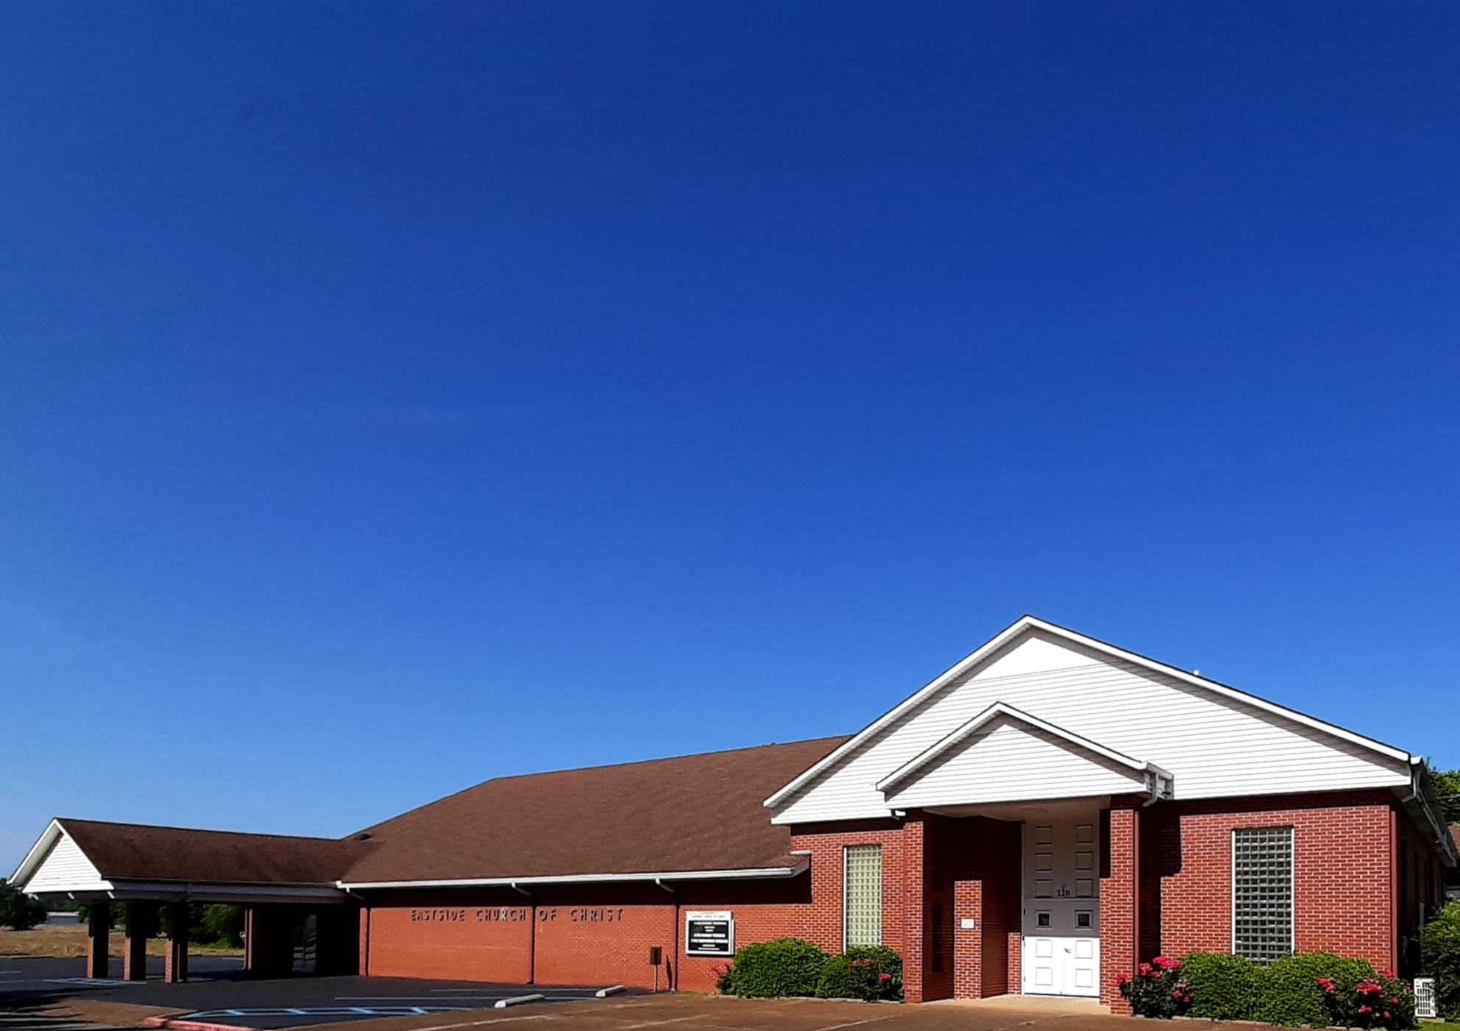
Eastside Church of Christ
Eastside-church.org

