Slide 1
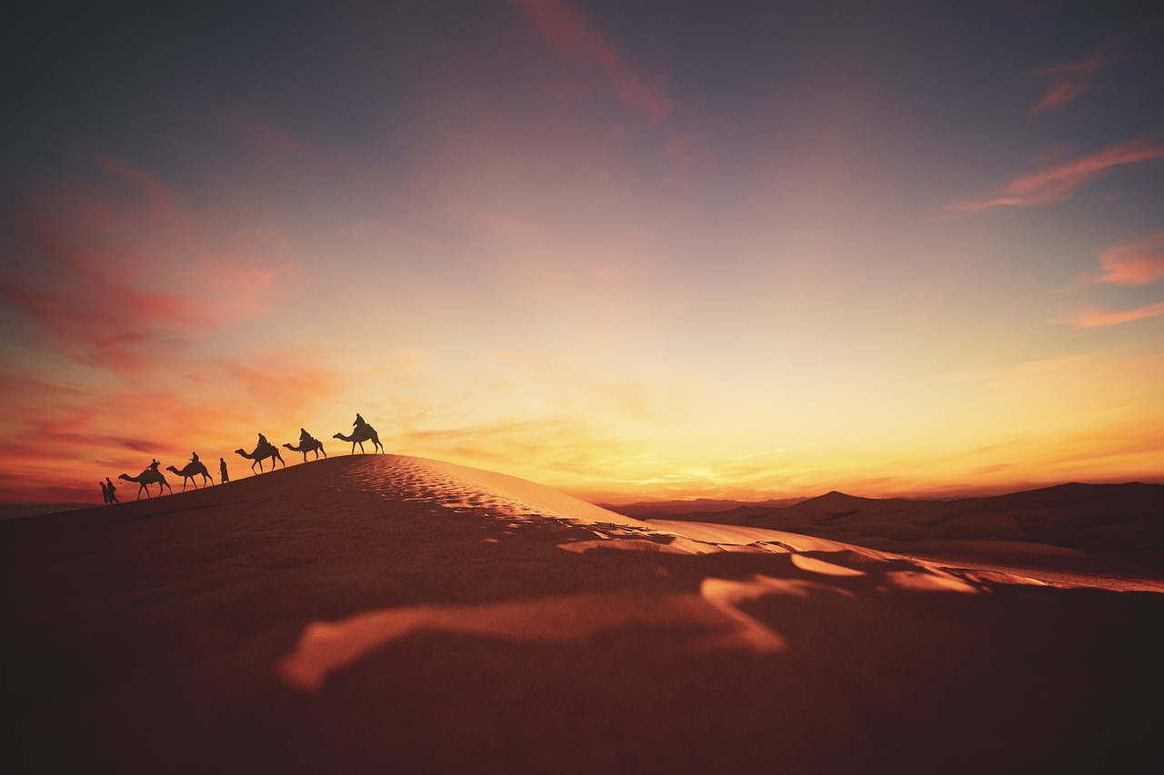
The Epistle of FIRST PETER
Guidance for the Pilgrim

Slide 2
The Epistle of FIRST PETER
Guidance for the Pilgrim
1 Peter 5:1-14
Shepherds and Submission
Notes:
Peter has compared the Christian’s life to a pilgrim’s journey, but it is also like a flock of sheep passing through a wild land. Sheep need shepherds! Sheep need to submit!

Slide 3
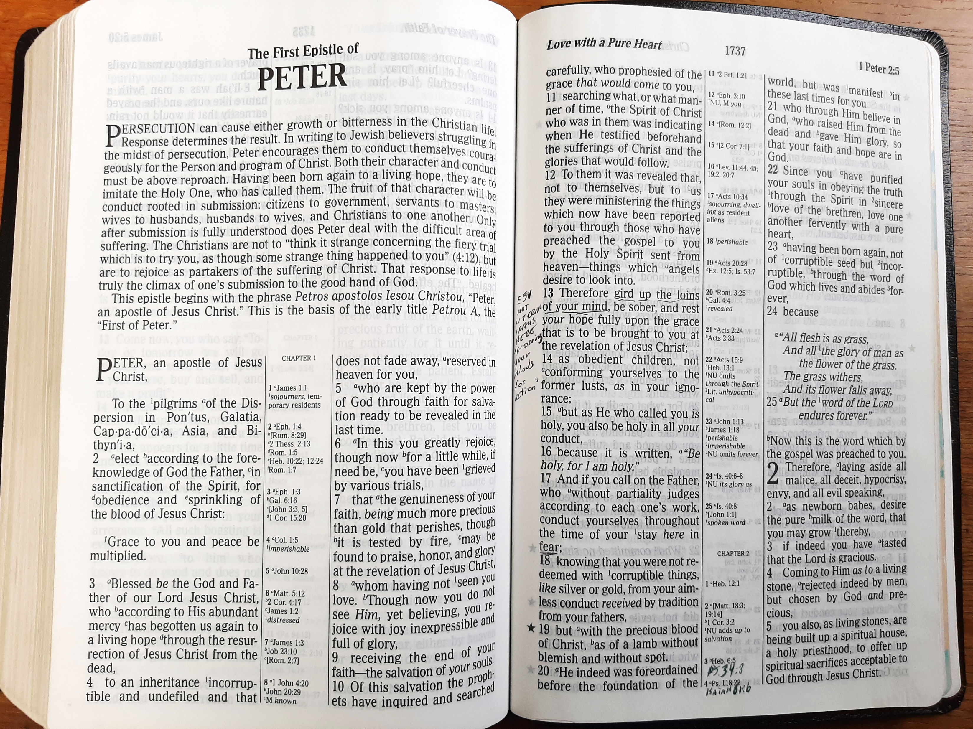
Shepherds of the Flock
(1 Peter 5:1-5)
Peter has compared the Christian’s life to a pilgrim’s journey, but it is also like a flock of sheep passing through a wild land. Sheep need shepherds!
Peter exhorts elders as…
  A fellow elder
  A witness of the sufferings of Christ
    He knows whereof he speaks! (1:11; 2:21; 4:13; Matthew 16:21-22)
  A partaker of the glory that will be revealed (1:7).

Slide 4
Shepherds of the Flock
(1 Peter 5:1-4)
Duties and motivations of shepherds:
  SHEPHERD the flock which is AMONG YOU.
  Serving as OVERSEERS.
  Not by compulsion but willingly.
  Not for dishonest gain but eagerly.
    “Not greedy for money” (1 Tim. 3:3; Titus 1:7).
    Yet worthy of being supported, especially if they labor in the word (1 Tim. 5:17-18).
  Not as “LORDS OVER” but as “EXAMPLES” to the flock.*
  If they do their duties well, the “Chief Shepherd” will give them a crown of glory.*
Notes:
“Serving as overseers,” ἐπισκοπέω is the verb, the noun is “episkopos,” literally an overseer, sometimes translated “bishop”
It is used of Christ’s position as our Shepherd (2:25)
And of shepherds of churches (Acts 20:28 Therefore take heed to yourselves and to all the flock, among which the Holy Spirit has made you overseers, to shepherd the church of God which He purchased with His own blood.” (cf. Phil. 1:1, 1 Tim. 3:2)
1 Timothy 5:17-18 Let the elders who rule well be counted worthy of double honor, especially those who labor in the word and doctrine. (18) For the Scripture says, "YOU SHALL NOT MUZZLE AN OX WHILE IT TREADS OUT THE GRAIN," and, "THE LABORER IS WORTHY OF HIS WAGES.“ (Paul makes the SAME argument regarding the support of preachers, cf. 1 Cor. 9:9, 14)
NOTE: Elders are commended if they “rule well.” Rule is from proistēmi to stand before, that is, (in rank) to preside, or (by implication) to practise: - maintain, be over, rule.
But they are not to serve as “Lords over” (“domineering” ESV, “bossy” CEV, “lording it over” RV)
NOTE: The “crown of glory” “does not fade away” – which is the same thing said of our inheritance in 1 Peter 1:4

Slide 5
Sheep must be Submissive
(1 Peter 5:5-7)
Be submissive to one another
  The younger submit to their elders.
  Everyone submits to everyone (1 Timothy 5:1-2; Eph. 5:21; Phil. 2:3-4).
Be clothed with humility,
  It takes HUMILITY to submit to elders and to one another!
  It takes HUMILITY to receive God’s grace!
The proud cannot access God’s grace,
but it is freely given to the humble!
Notes:
1 Timothy 5:1-2 Do not rebuke an older man, but exhort him as a father, younger men as brothers, (2) older women as mothers, younger women as sisters, with all purity.
Ephesians 5:21 submitting to one another in the fear of God.
Philippians 2:3-4 Let nothing be done through selfish ambition or conceit, but in lowliness of mind let each esteem others better than himself. (4) Let each of you look out not only for his own interests, but also for the interests of others.

Slide 6
Sheep must be Submissive
(1 Peter 5:5-7)
They must humble themselves under the mighty hand of God, that they may be exalted in due time.
  Jesus repeatedly taught this truth, applying it to our attitudes in prayer, public gatherings, and positions of authority (Matthew 23:12; Luke 14:11; 18:14).
It takes HUMILITY to cast all your cares upon the Lord – to realize that you cannot handle them on your own! (Psalm 55:22; 73:25; Philippians 4:6-7)
Notes:
Matthew 23:12 And whoever exalts himself will be humbled, and he who humbles himself will be exalted.
Psalms 55:22 Cast your burden on the LORD, And He shall sustain you; He shall never permit the righteous to be moved.
Psalms 73:25 Whom have I in heaven but You? And there is none upon earth that I desire besides You.
Philippians 4:6-7 Be anxious for nothing, but in everything by prayer and supplication, with thanksgiving, let your requests be made known to God; (7) and the peace of God, which surpasses all understanding, will guard your hearts and minds through Christ Jesus.

Slide 7
Sheep & Shepherds Must Be Vigilant
(1 Peter 5:8-9)
The nature of Satan’s threat demands sobriety and vigilance by both sheep and shepherds (Acts 20:29-31).
Satan is our adversary. He is like…
  A lion
  Walking about (Job 1:7; 2:2)
  Roaring (Psalm 104:21; Amos 3:4)
    Lions roar to mark their territory, to announce a kill, and possibly to paralyze their prey with fear.
  Seeking to devour. He craves the souls of men! (Luke 22:31; 8:12; Ephesians 6:11-18; 2 Timothy 2:26)
Notes:
Lion is mentioned 147 times in Scripture, often as a metaphor for destructive power
Psalms 104:21 The young lions roar after their prey, And seek their food from God.
Amos 3:4 Will a lion roar in the forest, when he has no prey? Will a young lion cry out of his den, if he has caught nothing?
Luke 22:31 And the Lord said, "Simon, Simon! Indeed, Satan has asked for you, that he may sift you as wheat.
Luke 8:12 Those by the wayside are the ones who hear; then the devil comes and takes away the word out of their hearts, lest they should believe and be saved.
2 Timothy 2:26 and that they may come to their senses and escape the snare of the devil, having been taken captive by him to do his will.

Slide 8
Sheep & Shepherds Must Be Vigilant
(1 Peter 5:8-9)
Satan must be resisted!
  Resist him and he will flee! (James 4:7)
    The word translated “resist” in James 4:7 and 1 Peter 5:9 is the same word that translated “withstand” in Ephesians 6:13.
    The willingness to stand and fight comes from steadfast faith.
  We must fight courageously, as a band of brothers, knowing that the same battle is fought by “your brotherhood in the world.” (cf. 1 Corinthians 10:13; 16:13)
Notes:
James 4:7 Therefore submit to God. Resist the devil and he will flee from you.
Ephesians 6:13 Therefore take up the whole armor of God, that you may be able to withstand in the evil day, and having done all, to stand.
1 Corinthians 10:13 No temptation has overtaken you except such as is common to man; but God is faithful, who will not allow you to be tempted beyond what you are able, but with the temptation will also make the way of escape, that you may be able to bear it.
1 Corinthians 16:13 Watch, stand fast in the faith, be brave, be strong.

Slide 9
God’s Grace for Pilgrims
(1 Peter 5:10-11)
God is the God of all grace who has called us to His eternal glory.
God allows us to suffer in order to…
  Perfect us – thoroughly mend, complete, fix, or repair (Matt. 4:21; Gal. 6:1).
  Establish, strengthen & settle us – enabling us to thrive where we are, like a plant with deep roots and healthy foliage!
We acknowledge and praise His eternal glory and dominion.
As suffering, sanctified, and submissive pilgrims we stand in God’s TRUE GRACE!
Notes:
Matthew 4:21 Going on from there, He saw two other brothers, James the son of Zebedee, and John his brother, in the boat with Zebedee their father, mending their nets. He called them,
Galatians 6:1 Brethren, if a man is overtaken in any trespass, you who are spiritual restore such a one in a spirit of gentleness, considering yourself lest you also be tempted.

Slide 10
Salutations and Observations
(1 Peter 5:12-14)
Silvanus is a faithful brother.
  Referred to as Silas in Acts 15:22ff. & 16:25. He is called Silvanus in 2 Corinthians 1:19; 1 Thess. 1:1, and 2 Thess. 1:1.
  Silas apparently served as Peter’s scribe for this epistle.
She who is in Babylon greets you.
  “She” may be a person or a church, and “Babylon” is possibly symbolic of Rome (see Revelation 14:8; 17:5-10)
Notes:
Acts 15:22 Then it pleased the apostles and elders, with the whole church, to send chosen men of their own company to Antioch with Paul and Barnabas, namely, Judas who was also named Barsabas, and Silas, leading men among the brethren.
Acts 15:32 Now Judas and Silas, themselves being prophets also, exhorted and strengthened the brethren with many words.
(“have written” is “epistolary aorist” cf. Hebrews 13:22)
Revelation 14:8 And another angel followed, saying, "Babylon is fallen, is fallen, that great city, because she has made all nations drink of the wine of the wrath of her fornication."

Slide 11
Salutations and Observations
(1 Peter 5:12-14)
Mark also sends his greetings.
  He was the son of Mary (Acts 12:12), cousin of Barnabas (Col. 4:10), and helper of both Paul & Peter (Acts 12:25; 2 Timothy 4:11; Philemon 24)
  Peter regards Mark as a son, just as Paul regarded Timothy & Titus (1 Tim. 1:2; Titus 1:4)
“Greet one another with a kiss of love”
  Christians should greet one another with a holy expression of love (agape).
  This command is repeated in Romans 16:16; 1 Cor. 16:20; 1 Thess. 5:26 & 2 Cor. 13:12.
Notes:
Acts 12:25 And Barnabas and Saul returned from Jerusalem when they had completed their service, bringing with them John, whose other name was Mark.
2 Timothy 4:11 Luke alone is with me. Get Mark and bring him with you, for he is very useful to me for ministry.
Philemon 1:24 and so do Mark, Aristarchus, Demas, and Luke, my fellow workers.
Romans 16:16 Greet one another with a holy kiss. All the churches of Christ greet you.
1 Corinthians 16:20 All the brothers send you greetings. Greet one another with a holy kiss.
1 Thessalonians 5:26 Greet all the brothers with a holy kiss.
2 Corinthians 13:12 Greet one another with a holy kiss.

Slide 12
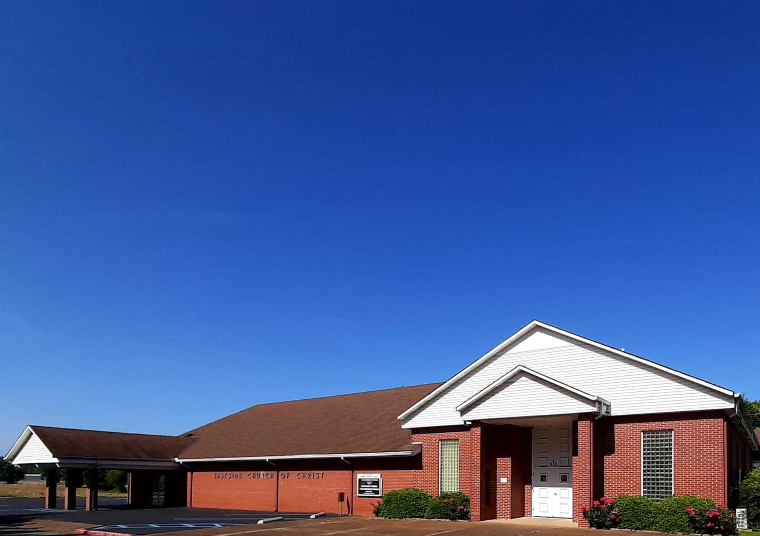
Eastside Church of Christ
Eastside-church.org

