Slide 1



1 John
C o n f i d e n c e I n C h r i s t
Notes:
Confidence in Christ

Slide 2
1 John
C o n f i d e n c e I n C h r i s t
Confidence Comes From Testing What We Hear (1 John 4:1-6)
Notes:
In chapter 3 we’ve learned that Confidence in Christ increases as we live righteously, not sinfully, and as we love our brethren in deed and in truth.

Slide 3
Confidence in our Relationship with God gives us Confidence in Prayer
Keeping God’s commandments gives us confidence that our prayers are granted (3:22).
Commandment keeping assures us that we truly know God (1 John 2:3, 5).
God hears those who hear Him! (1 Peter 3:12; Pro. 28:9).
Additional conditions for effective prayer include praying in faith (Matt. 21:22; James 1:5-6) and praying in accordance with God’s will (1 John 5:14-15).
The key commandments under consideration are believing in Christ and loving one another (3:23).*
Fellowship with God is assured because we keep His commandments and because He has given us the Holy Spirit (3:24; Eph. 1:13-14; 2 Cor. 5:5).
Notes:
1 Peter 3:12 For the eyes of the LORD are on the righteous, and His ears are open to their prayers; but the face of the Lord is against those who do evil.“
Proverbs 28:9 One who turns away his ear from hearing the law, Even his prayer is an abomination.
Matthew 21:22 And whatever things you ask in prayer, believing, you will receive.“
James 1:5-6 If any of you lacks wisdom, let him ask of God, who gives to all liberally and without reproach, and it will be given to him. (6) But let him ask in faith, with no doubting, for he who doubts is like a wave of the sea driven and tossed by the wind.
KEY COMMANDMENTS UNDER CONSIDERATION: Are we keeping a commandment when we show brotherly love? Are we keeping a commandment when we believe?. Is it right to teach and believe that commandment keeping is separate from love and belief?
Ephesians 1:13-14 In Him you also trusted, after you heard the word of truth, the gospel of your salvation; in whom also, having believed, you were sealed with the Holy Spirit of promise, (14) who is the guarantee of our inheritance until the redemption of the purchased possession, to the praise of His glory.
2 Corinthians 5:5 “God…has given us the Spirit as a guarantee.”

Slide 4
Confidence Comes from Testing What We Hear
We must test the spirits (4:1).
What we BELIEVE impacts our fellowship with God as much as what we do! (2 Thess. 2:12).
There are many false teachers (2 Peter 2:1).
We must work to identify them (Matthew 7:15; 2 Cor. 11:13-14; Gal. 2:4; Rev. 2:2; 1 Thess. 5:21).
We can know if a “spirit” is “of God” by whether it acknowledges that Jesus has come in the flesh (4:2-3).
The message and influence of false teachers must be identified, exposed, and noted to keep it from spreading (Titus 1:10-13; 2 Timothy 2:16-18; Romans 16:17-18; 2 John 10).
Notes:
2 Thessalonians 2:12 that they all may be condemned who did not believe the truth but had pleasure in unrighteousness.
2 Peter 2:1 But there were also false prophets among the people, even as there will be false teachers among you, who will secretly bring in destructive heresies, even denying the Lord who bought them, and bring on themselves swift destruction.
Matthew 7:15-16 "Beware of false prophets, who come to you in sheep's clothing, but inwardly they are ravenous wolves. (16) You will know them by their fruits.
2 Corinthians 11:13-14 For such are false apostles, deceitful workers, transforming themselves into apostles of Christ. (14) And no wonder! For Satan himself transforms himself into an angel of light.
Galatians 2:4 And this occurred because of false brethren secretly brought in (who came in by stealth to spy out our liberty which we have in Christ Jesus, that they might bring us into bondage),
1 Thessalonians 5:21 Test all things; hold fast what is good.
Titus 1:10-13 For there are many insubordinate, both idle talkers and deceivers, especially those of the circumcision, (11) whose mouths must be stopped, who subvert whole households, teaching things which they ought not, for the sake of dishonest gain. (12) One of them, a prophet of their own, said, "Cretans are always liars, evil beasts, lazy gluttons." (13) This testimony is true. Therefore rebuke them sharply, that they may be sound in the faith,
2 Timothy 2:16-18 But shun profane and idle babblings, for they will increase to more ungodliness. (17) And their message will spread like cancer. Hymenaeus and Philetus are of this sort, (18) who have strayed concerning the truth, saying that the resurrection is already past; and they overthrow the faith of some.
Romans 16:17-18 Now I urge you, brethren, note those who cause divisions and offenses, contrary to the doctrine which you learned, and avoid them. (18) For those who are such do not serve our Lord Jesus Christ, but their own belly, and by smooth words and flattering speech deceive the hearts of the simple.
2 John 1:10 If anyone comes to you and does not bring this doctrine, do not receive him into your house nor greet him;

Slide 5
Confidence Comes from Testing What We Hear
Overcoming the “Antichrist” (4:4-5).
Children of God are able to overcome the influence of error because “He who is in us is greater than he who is in the world.”
The false teachers are “of the world,” so their message resonates with those in the world (John 3:31; 10:5).
The ultimate test of truth and error (and of whether we know God) is whether or not we listen to God’s inspired messengers (4:6).
He who is of God hears God’s words (John 8:47).
The apostles and prophets of Jesus spoke and wrote God’s words (John 16:13-15; Mark 13:11; 1 Corinthians 2:9-13; 14:37; Ephesians 3:3-5; 2:19-20).
Notes:
John 3:31 He who comes from above is above all; he who is of the earth is earthly and speaks of the earth. He who comes from heaven is above all.
John 10:5 Yet they will by no means follow a stranger, but will flee from him, for they do not know the voice of strangers.“
The following would apply to the “knowing ones” of today who have changed the very fabric of the gospel to accommodate the world – justifying and supporting abortion, violence for social causes, and same sex marriage.
F.F. Bruce writes in his commentary (and Dan King quotes in his) the following: “But why should the leaders of the other party, with their followers, be said to be ‘of the world’? Because the philosophy to which they endeavor to accommodate the gospel, depriving it of what makes it the gospel in the process, is current secular philosophy, the prevalent climate of opinion. We have already seen that there is no form of worldliness so inimical to Christianity as this kind of ‘re-statement’. Such a re-statement is congenial to the world because it is inline with contemporary fashion; nevertheless, it is doomed to pass away because with a change in fashion it loses its appeal, which the gospel never does.”
John 8:47 He who is of God hears God's words; therefore you do not hear, because you are not of God.“
John 16:13-15 However, when He, the Spirit of truth, has come, He will guide you into all truth; for He will not speak on His own authority, but whatever He hears He will speak; and He will tell you things to come. (14) He will glorify Me, for He will take of what is Mine and declare it to you. (15) All things that the Father has are Mine. Therefore I said that He will take of Mine and declare it to you.
Mark 13:11 But when they arrest you and deliver you up, do not worry beforehand, or premeditate what you will speak. But whatever is given you in that hour, speak that; for it is not you who speak, but the Holy Spirit.
1 Corinthians 2:9-13 But as it is written: "EYE HAS NOT SEEN, NOR EAR HEARD, NOR HAVE ENTERED INTO THE HEART OF MAN THE THINGS WHICH GOD HAS PREPARED FOR THOSE WHO LOVE HIM." (10) But God has revealed them to us through His Spirit. For the Spirit searches all things, yes, the deep things of God. (11) For what man knows the things of a man except the spirit of the man which is in him? Even so no one knows the things of God except the Spirit of God. (12) Now we have received, not the spirit of the world, but the Spirit who is from God, that we might know the things that have been freely given to us by God. (13) These things we also speak, not in words which man's wisdom teaches but which the Holy Spirit teaches, comparing spiritual things with spiritual.
Ephesians 3:3-5 how that by revelation He made known to me the mystery (as I have briefly written already, (4) by which, when you read, you may understand my knowledge in the mystery of Christ), (5) which in other ages was not made known to the sons of men, as it has now been revealed by the Spirit to His holy apostles and prophets:
Ephesians 2:19-20 Now, therefore, you are no longer strangers and foreigners, but fellow citizens with the saints and members of the household of God, (20) having been built on the foundation of the apostles and prophets, Jesus Christ Himself being the chief cornerstone,
1 Corinthians 14:37 If anyone thinks himself to be a prophet or spiritual, let him acknowledge that the things which I write to you are the commandments of the Lord.

Slide 6
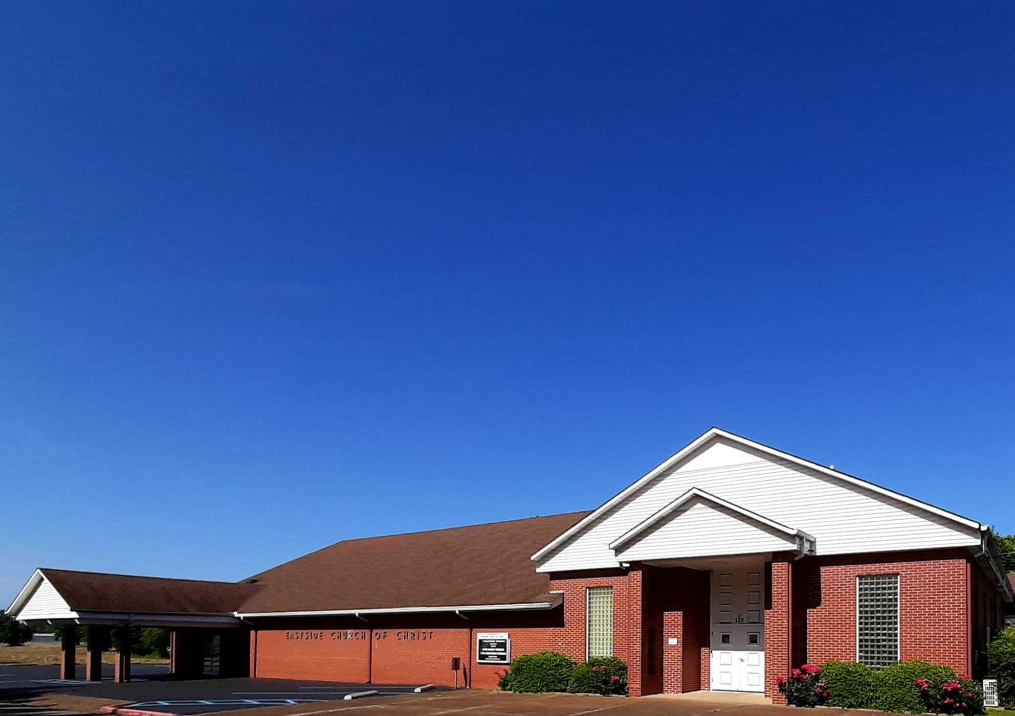
Eastside Church of Christ
Eastside-church.org

